Slide 1
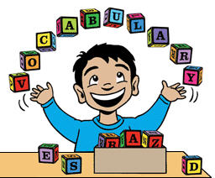
A Balinese Folk Tale – Vocabulary

Slide 2

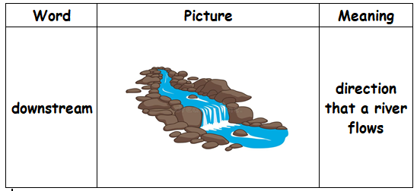
Examples
We were running downstream when we saw the men digging the hole.
We paddled downstream for about three miles to reach the river.

Slide 3

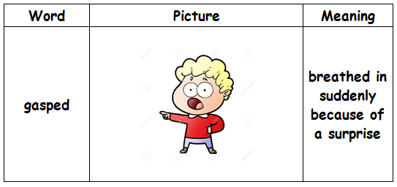
Examples
She gasped when she realised that she has forgotten her passport at home.
Omar gasped as he opened the mysterious box and found it filled with games.

Slide 4
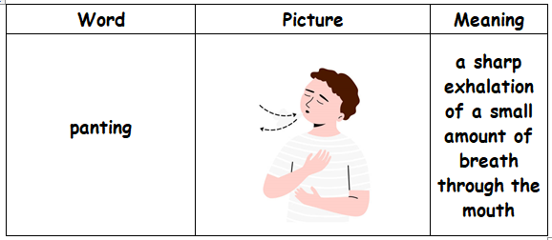

Quick
Breathing
1- The dog was panting heavily after chasing the ball around the yard.
2- She arrived at the top of the hill, panting and sweating but the breathtaking view made the climb worthwhile.

Slide 5
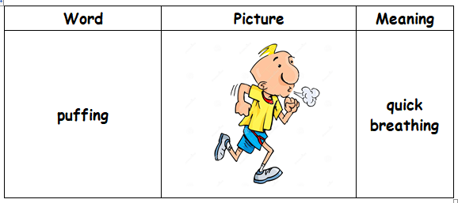
Sharp exhalation of a small amount of breath through the mouth
1- The little girl was puffing when she ran to catch the ice cream truck, but she managed to reach it before it drove away and she happily enjoyed her treat.
2- The train was puffing loudly and the sound whistle echoed through the valley.

Slide 6
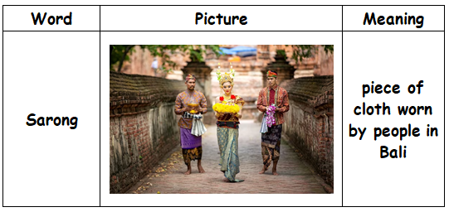
Examples
He wore homemade sandals and a sarong that fell from his waist to his knees.
She was wearing a sarong and a colorful headband.

Slide 7
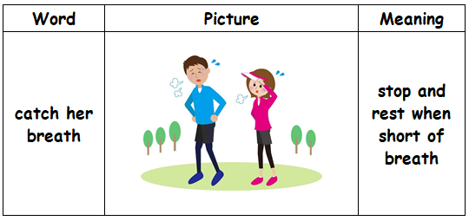

It is a magical place to catch your breath and admire the views.
2) Suzy caught her breath and sat up sharply after running for about a mile.

Slide 8
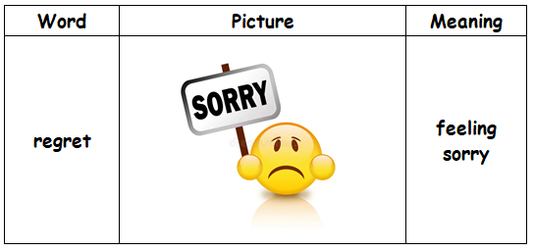

1) I regret not studying for the test and now I wish I had been prepared.
2) My regret is not studying for the test and now I wish I had been prepared for it.

Slide 9
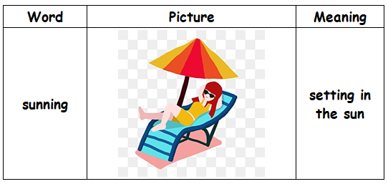

sitting in
the sun
Would you rather go sunning by the beach or would you rather go to the cinema?
I wanted to sun by the beach but I forgot my sun cream.

Slide 10
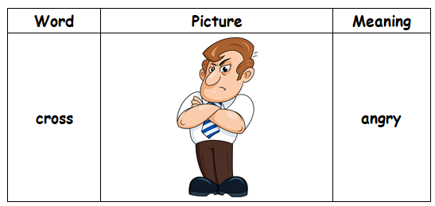

She was quite cross with him because he was late.
Although she was very cross , she kept on smiling.

Slide 11
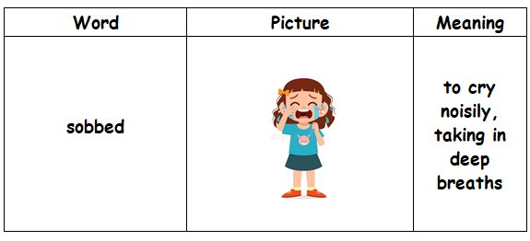

1- The little girl sobbed quietly in the corner and her friends rushed to comfort her.
2- After receiving the bad news, the man sobbed for a while and decided to confront the problem and find out smart solutions to solve it.

