Slide 1

MS Access 2010
Click Start
INTERNATIONAL EDITION

Slide 2
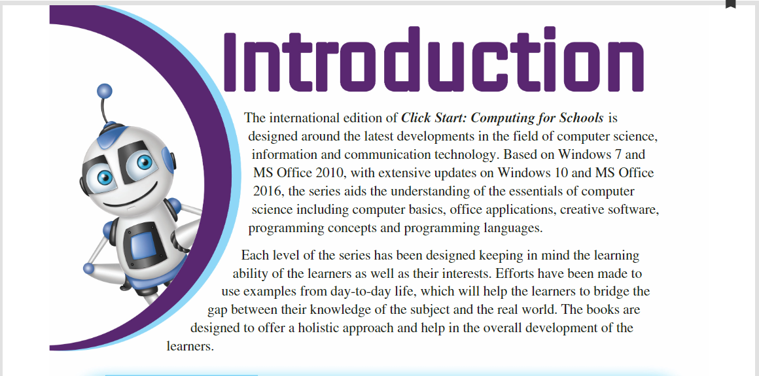

Slide 3
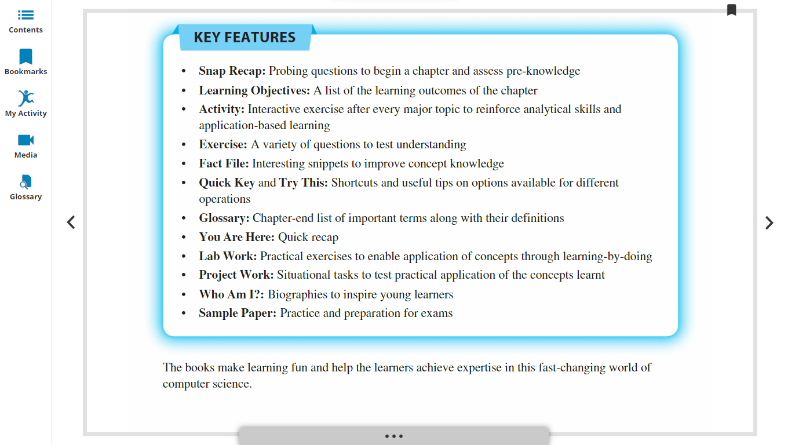

Slide 4
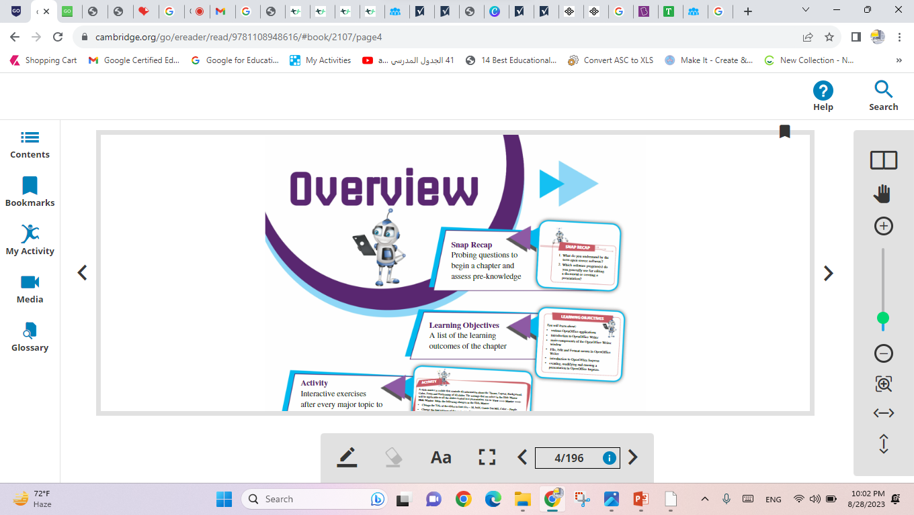

Slide 5
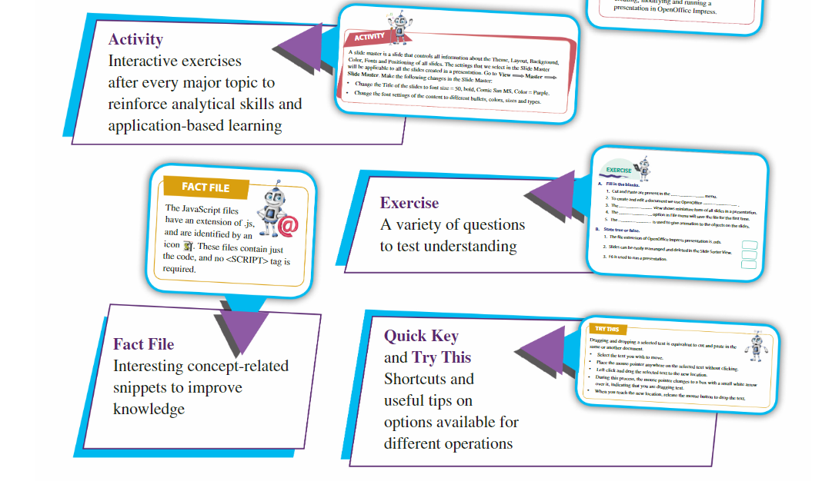

Slide 6
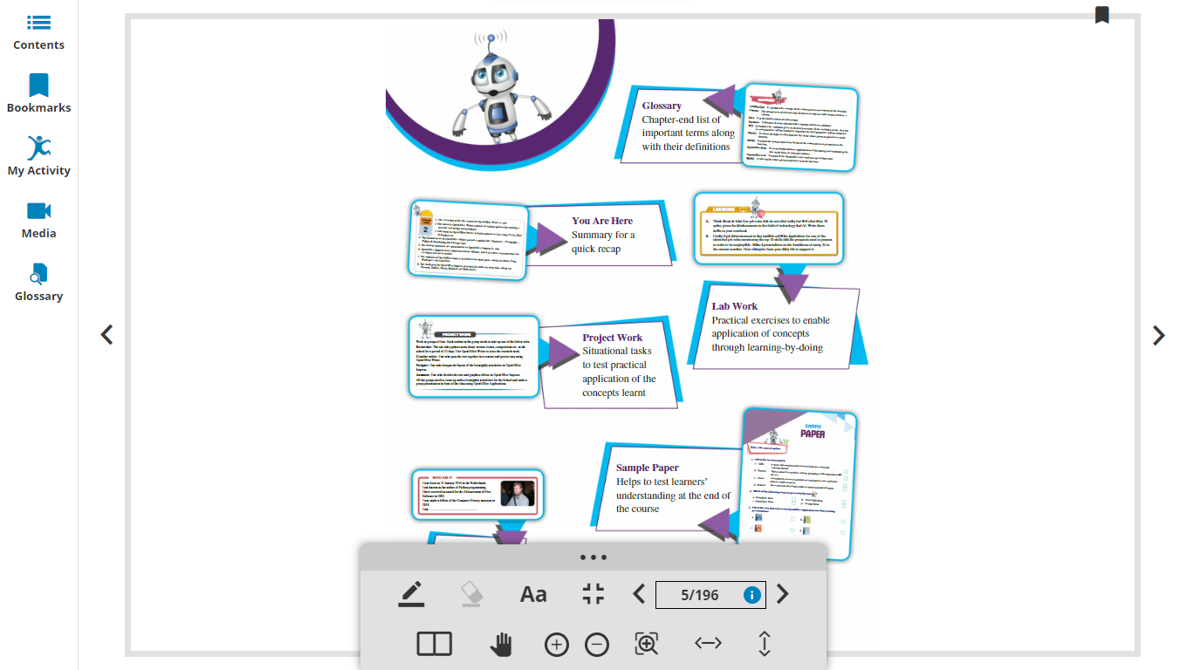

Slide 7
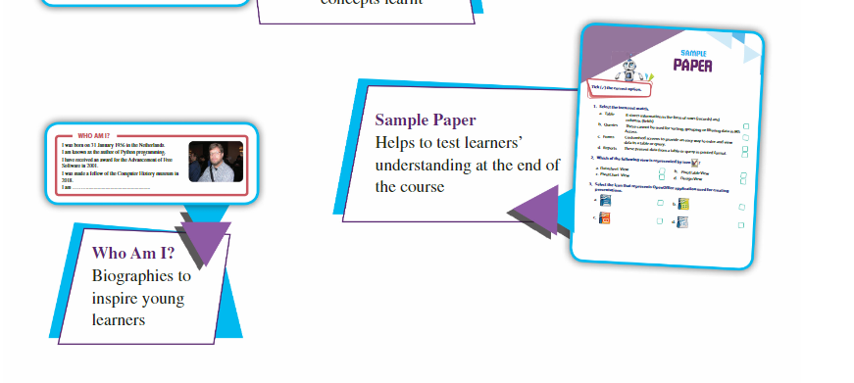

Slide 8
Learning Objectives
The student should be able to:
Understand why we need to store data in tables
Name some of the applications used to store tabular data.
Define the Important terms related to databases such as :
Database(DB)
Database Management System(DBMS)
Record, Field.
Table ,Queries ,Forms and Reports.
Functions of DBMS and database objects

Slide 9
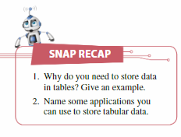
Why do you need to store data in tables?
We can store or present large amounts of information in different ways.
One way of presenting or storing information to make it to clearer and easier to understand ,is to put it in a table .
A table means that Data can be grouped together and given a title to allow the audience to see the information clearly .
Storing data in tables is a great way to organize the information, as the information becomes clearer than put the data as apart of a text paragraph, so that people can understand ,retrieve it later and also update it as needed.

Slide 10



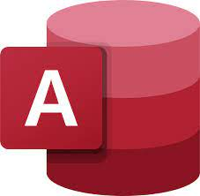

Name some applications you can use to store tabular data.
Google Sheets
Microsoft Excel
Xara online table maker
Microsoft Access
Fox Pro
Fox Base……..

Slide 11
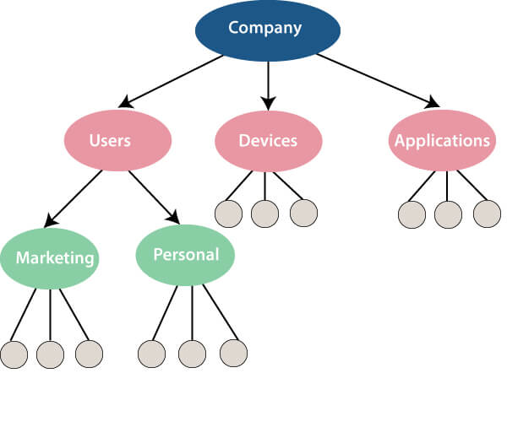
What is a database?
A database is an organized collection of structured information, or data, typically stored in a computer system. A database is usually controlled by a database management system (DBMS).

Slide 12
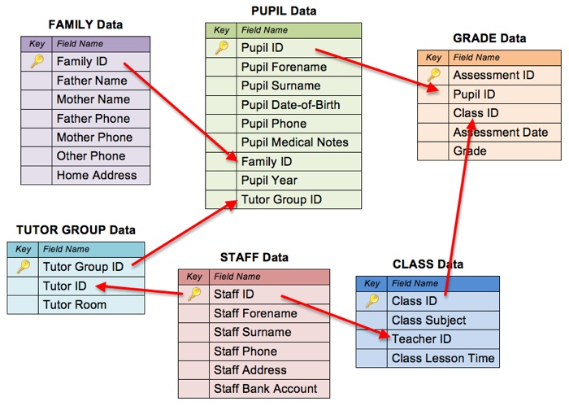
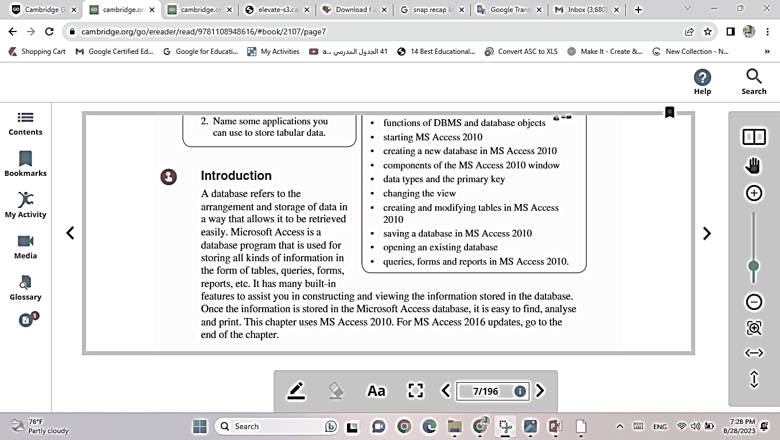

Slide 13
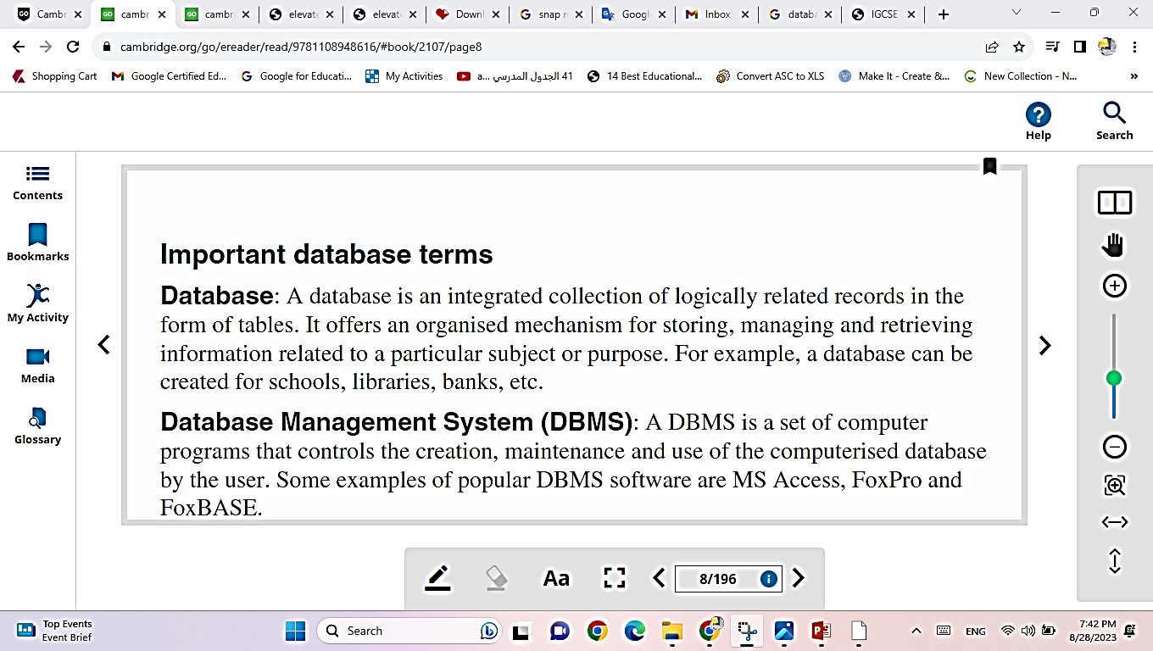

Slide 14
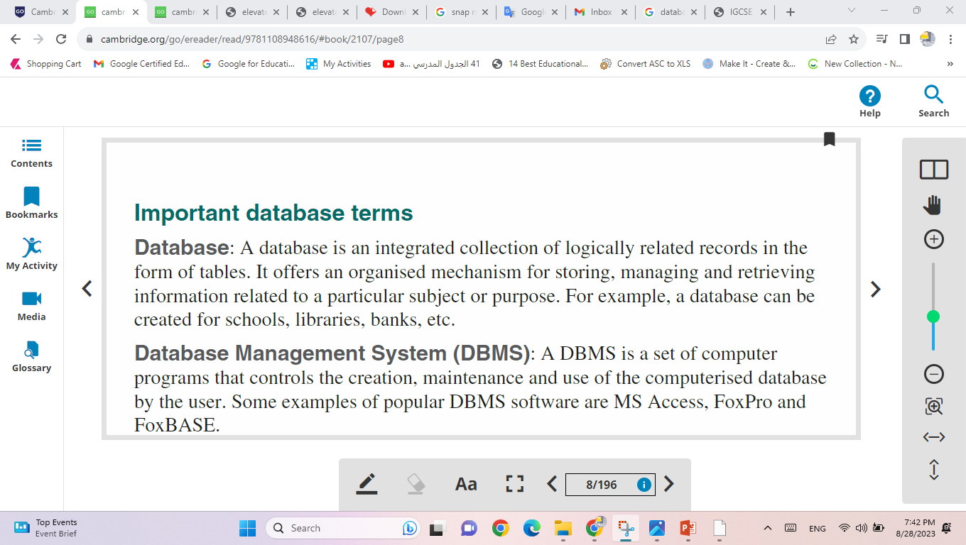
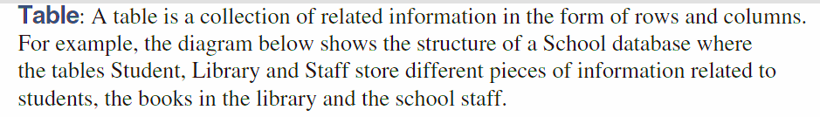
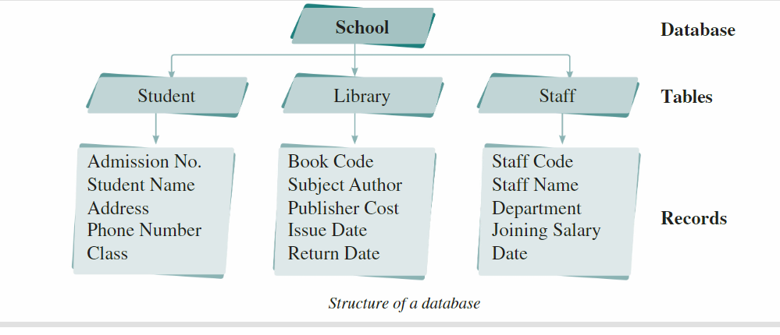

Slide 15
Database Diagram
Database
Tables
Fields
Records

Slide 16
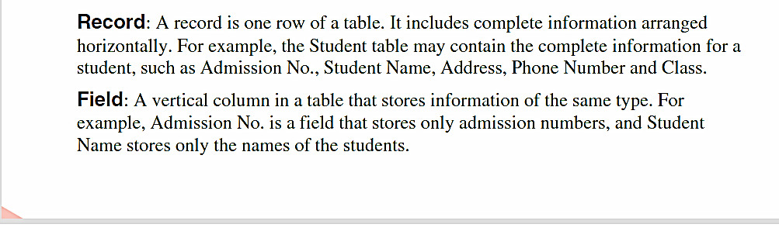

Slide 17
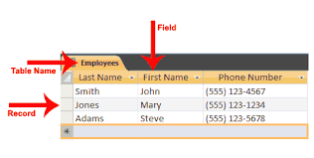
A table has records (rows) and fields (columns). Fields have different types of data, such as text, numbers, dates, and hyperlinks. A record: Contains specific data, like information about a particular employee or a product.

Slide 18
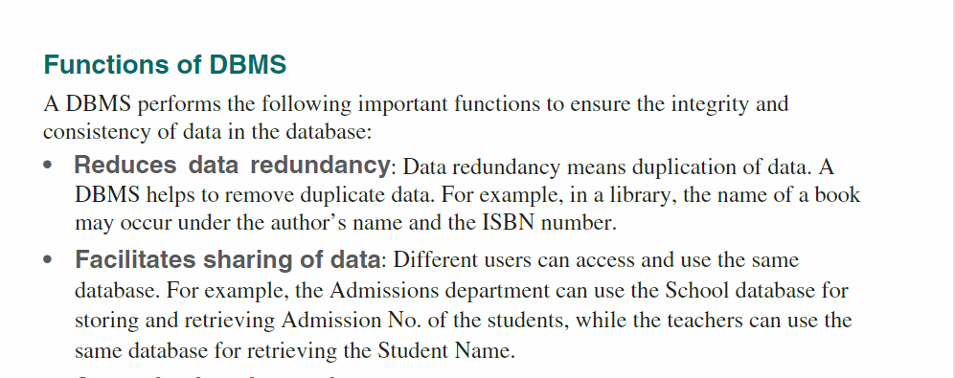
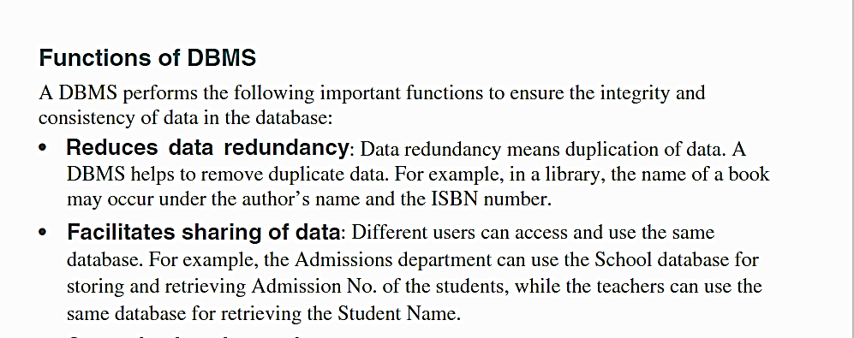

Slide 19

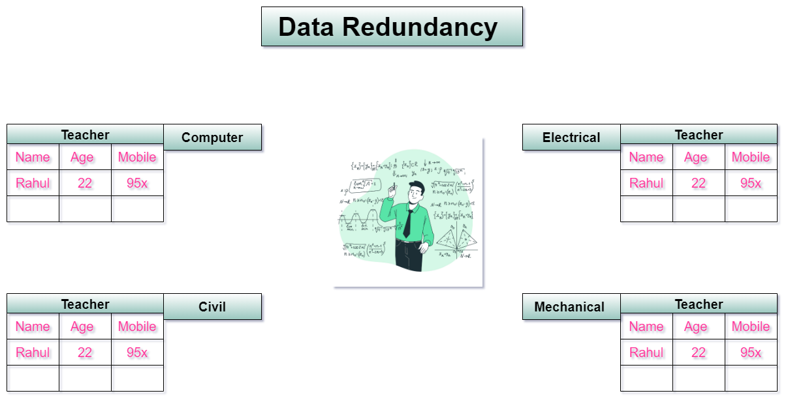
Data redundancy occurs when the same piece of data is stored in two or more separate places and is a common occurrence in many businesses.

Slide 20
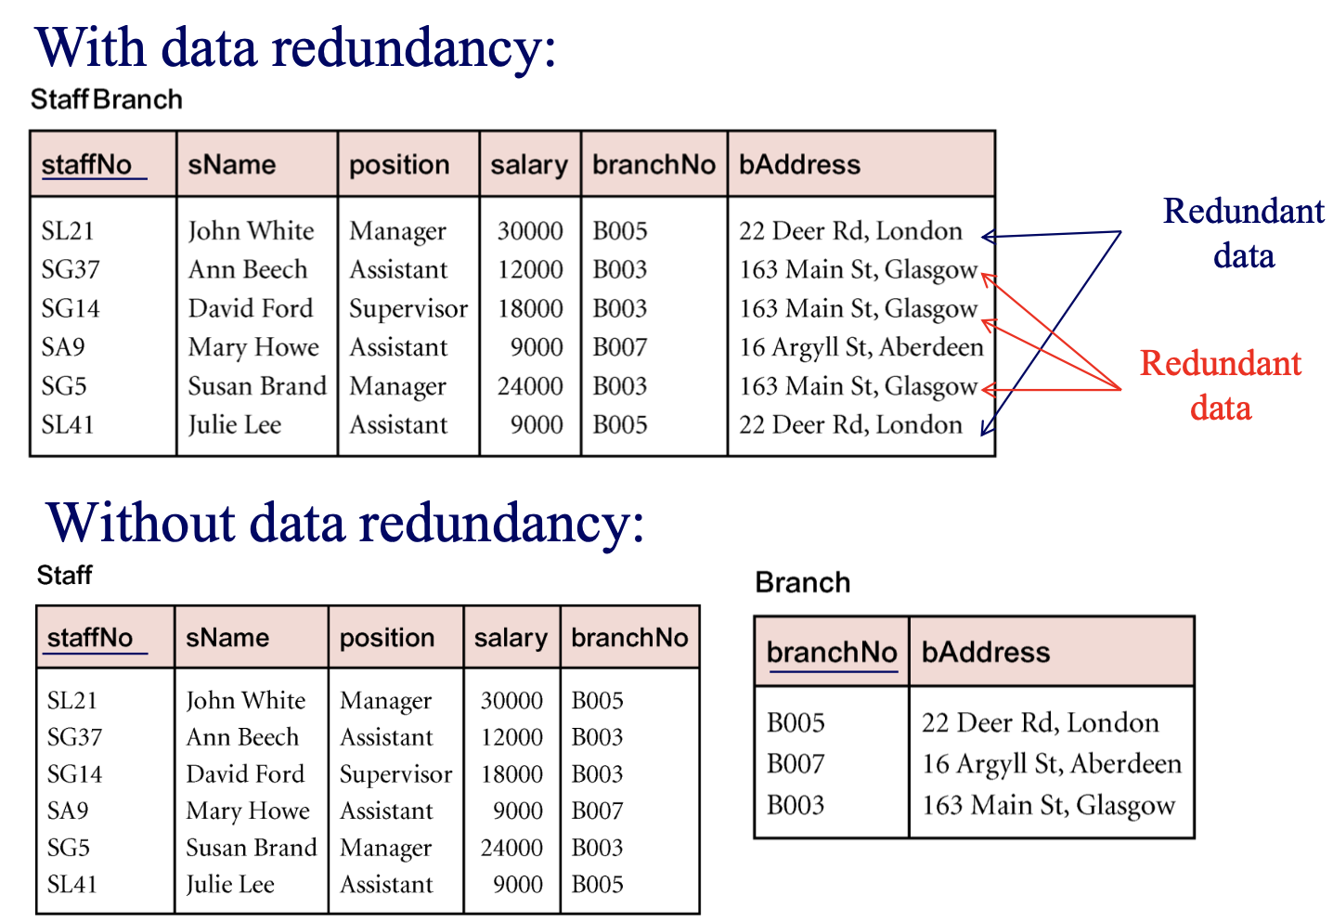

Slide 21
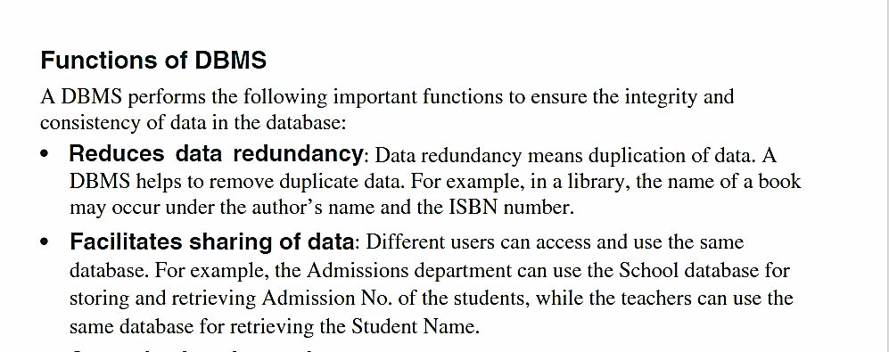

Slide 22
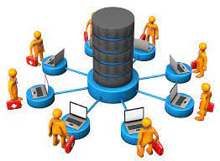
Sharing Data

Slide 23
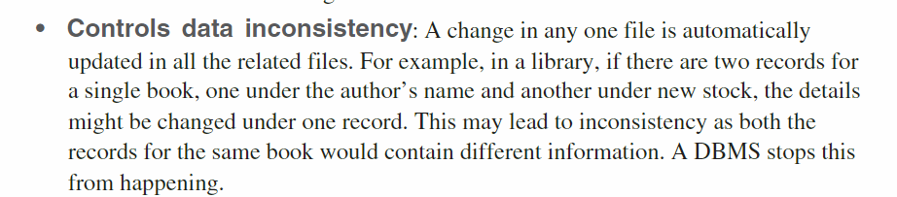

Slide 24
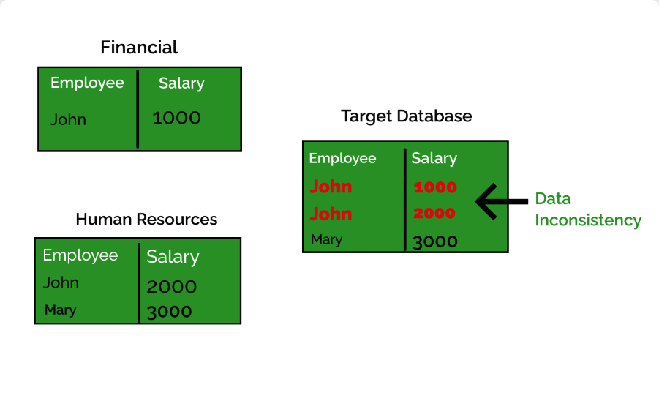

The DBMS stops data inconsistency

Slide 25
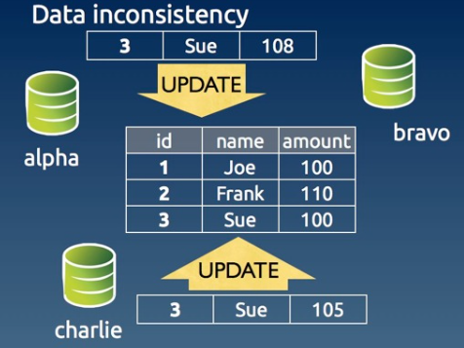

Slide 26
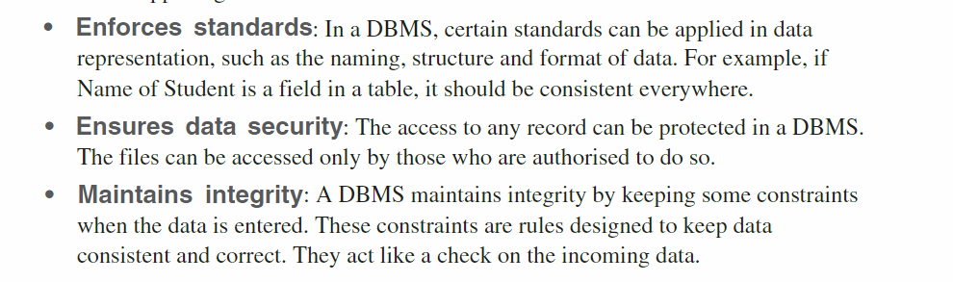


Slide 27
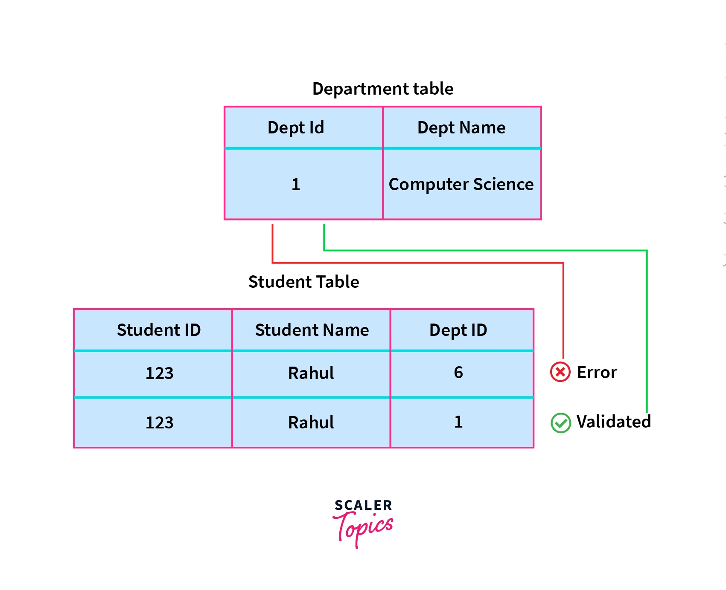
Maintains Integrity
Adding
Deleting
Modifying

Slide 28
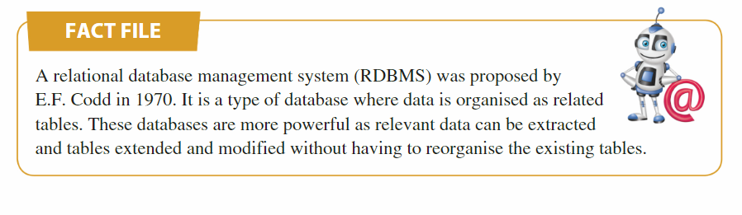

Slide 29
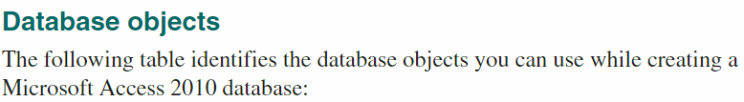
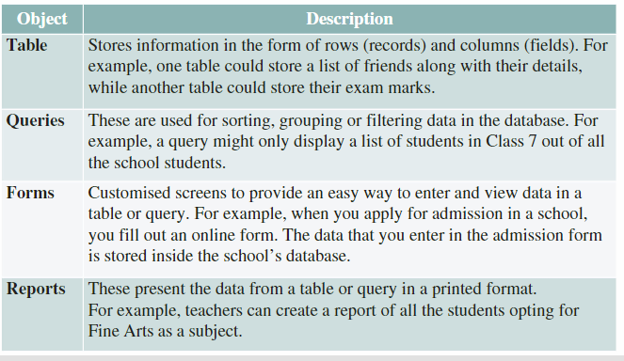

Slide 30
