Slide 1

Learning Objectives
The student should be able to:
Understand the commonly used option in the Design Grid pane.
Create Query from single table or two_ table Query
Add criteria to a query using arithmetic and logical operators ,wildcards in a query
Edit a query: add, remove, move, hide, and unhide fields.
Delete and Run a Query

Slide 2
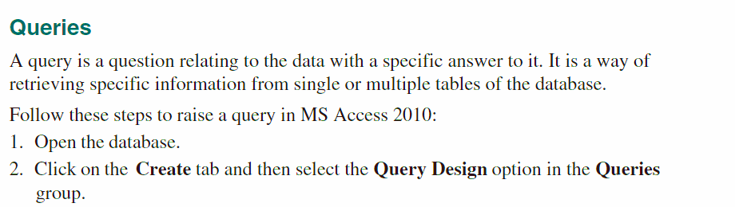
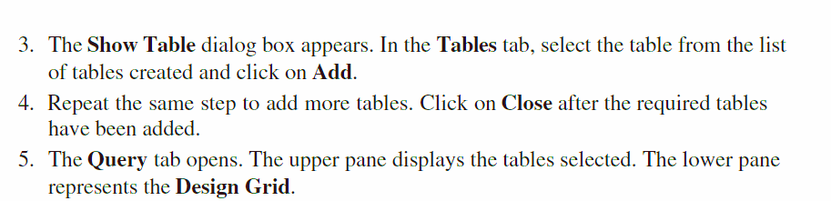

Slide 3
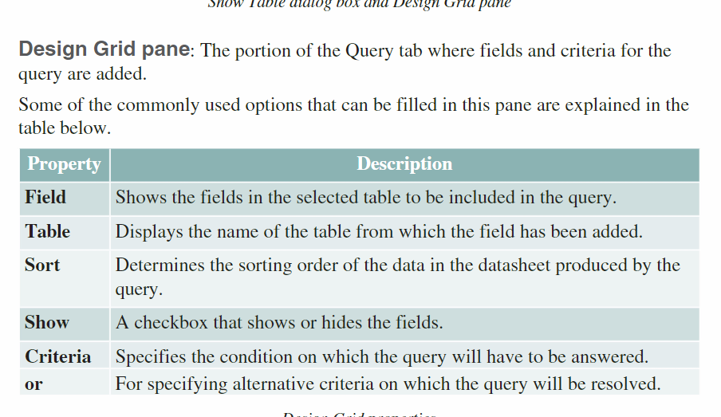

Slide 4
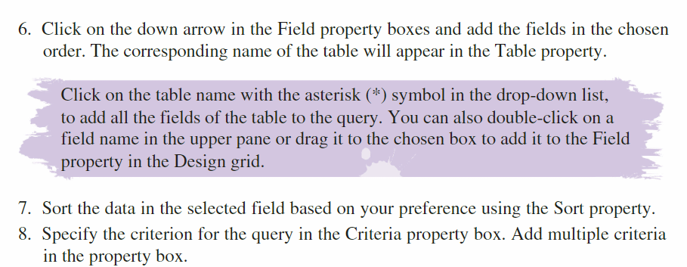
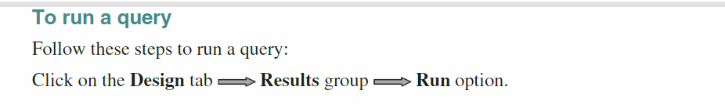

Slide 5

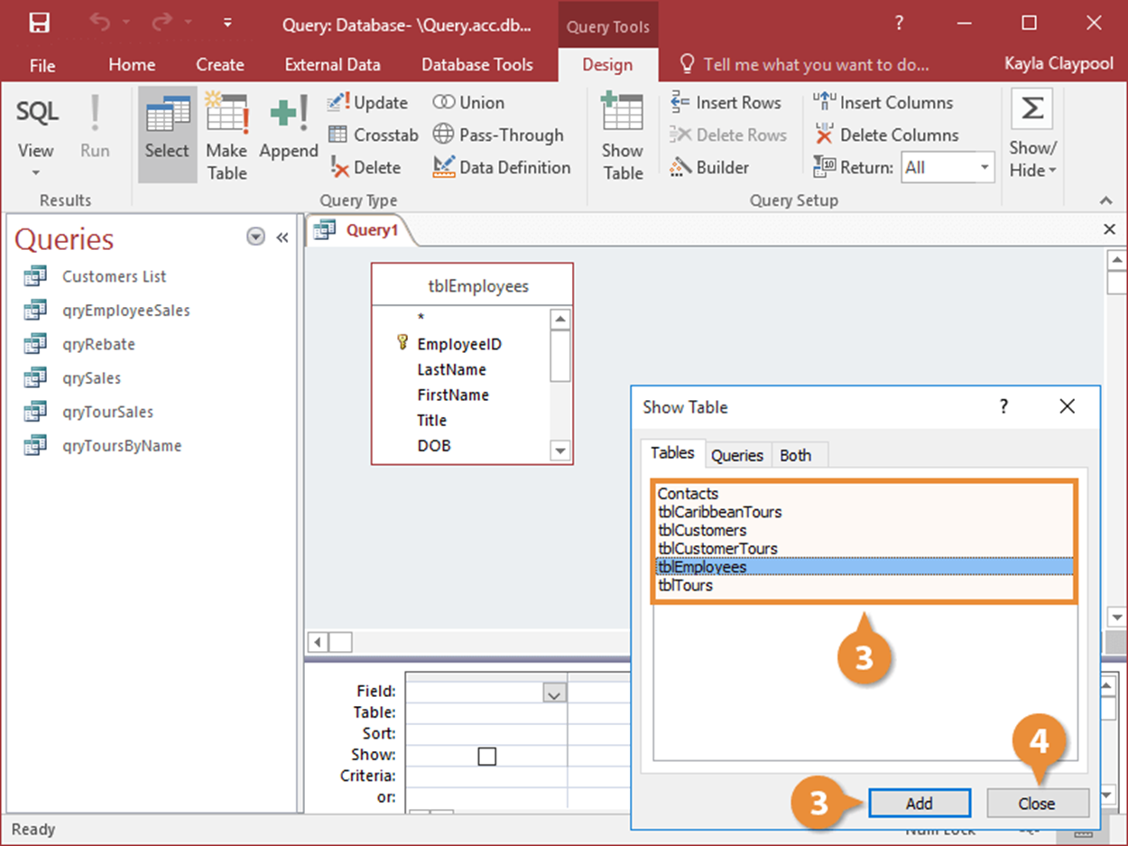
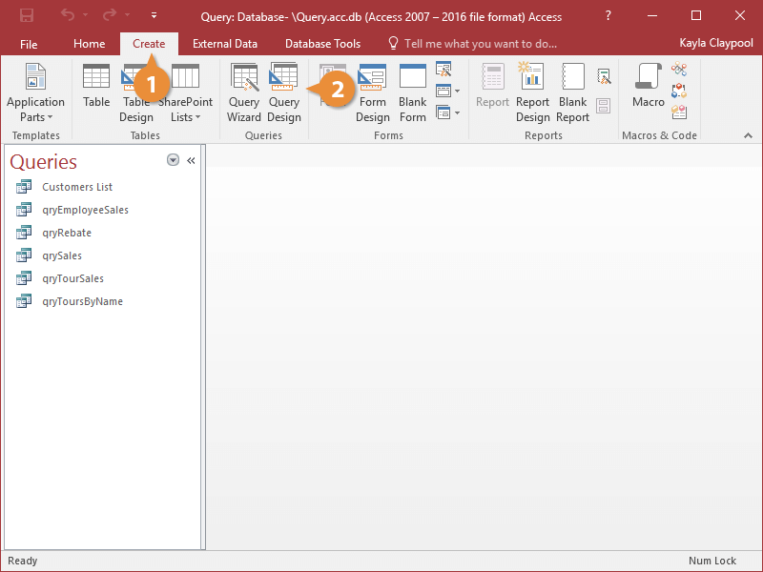
To create a Query from one table using form Query Design do the following:

Slide 6
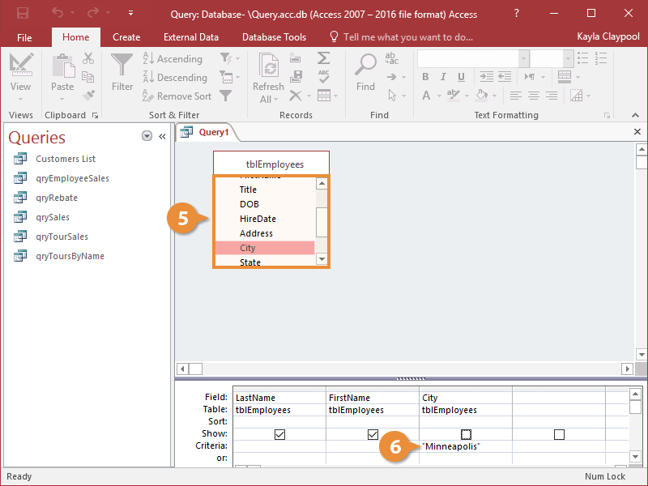
To create a Query from one table using form Query Design do the following:
Note : You can also add tables to a query by dragging them from the Navigation Pane to the top half of the Query window.

Slide 7
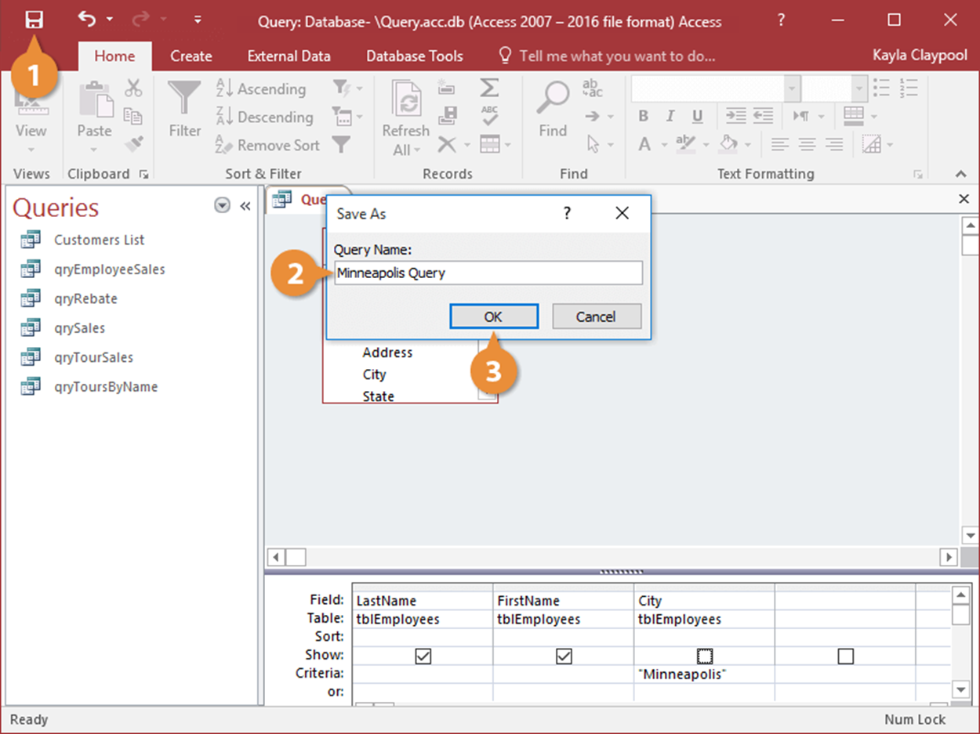
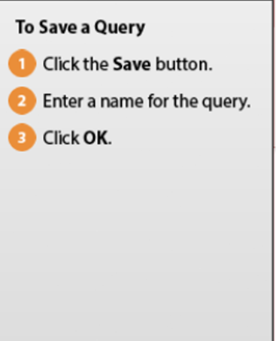
To Save a Query do the following:

Slide 8
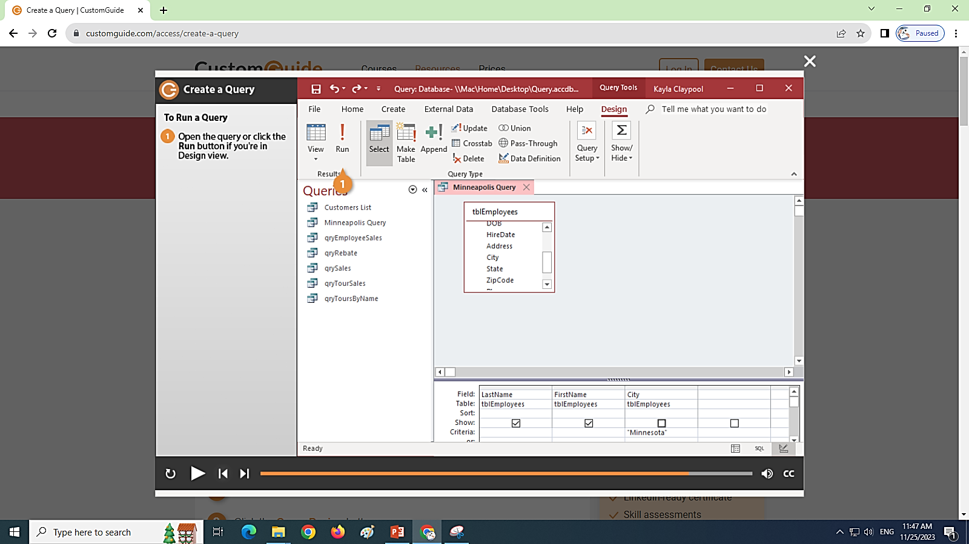
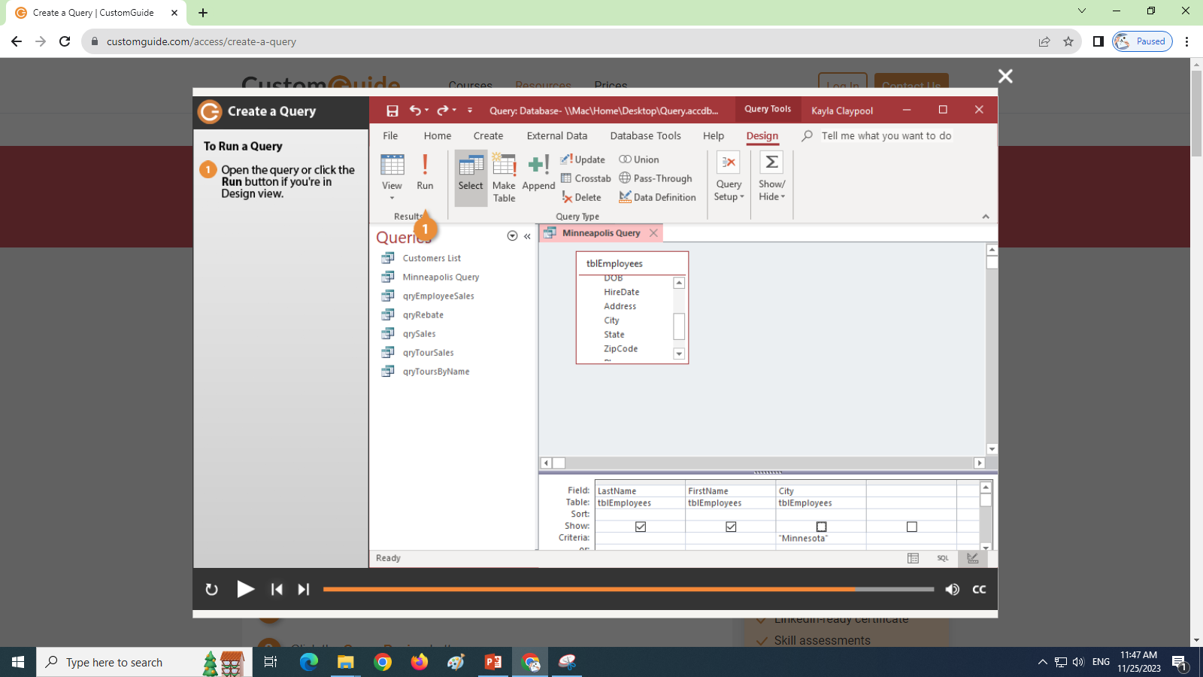
To Run a Query do the following:

Slide 9
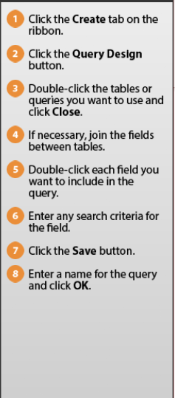
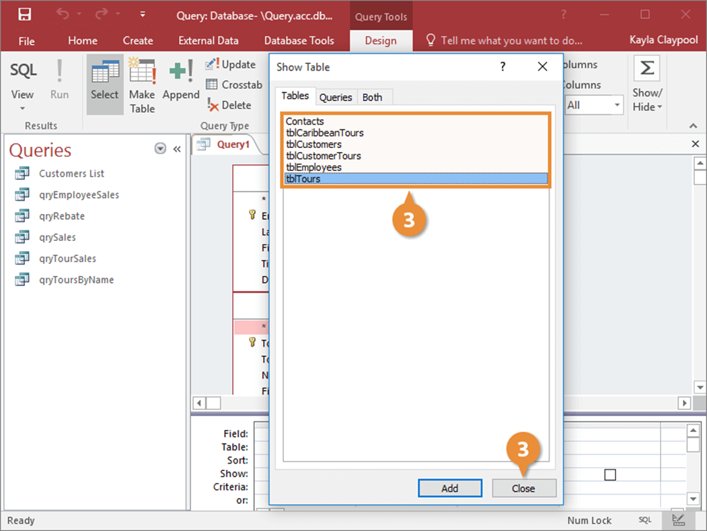
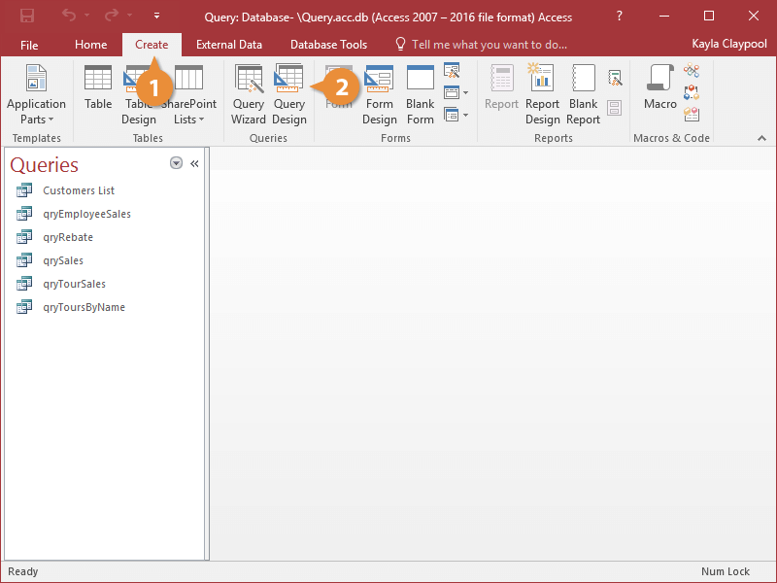
To create a Query from two- table using form Query Design do the following:
(Choose two tables)

Slide 10
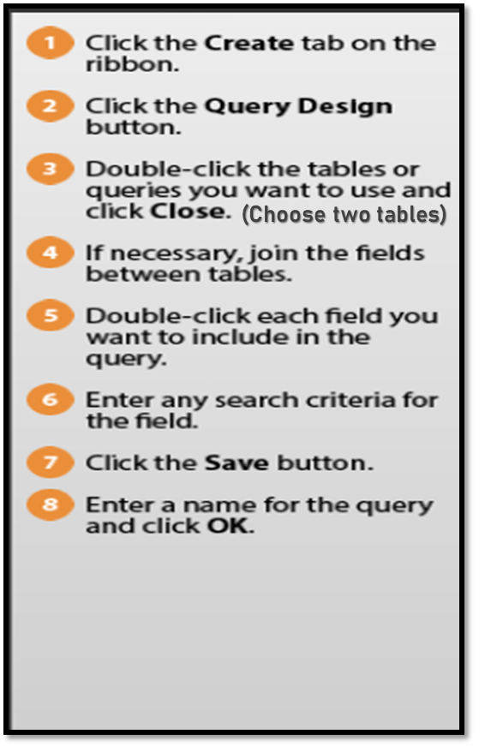
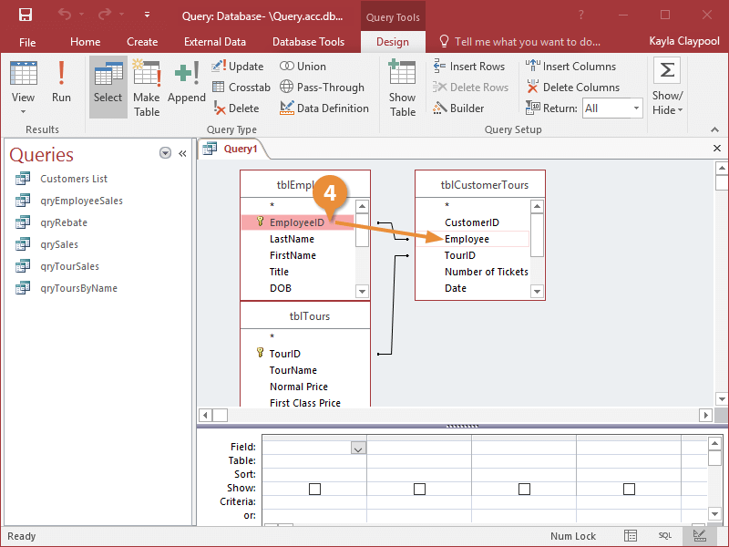
To create a Query from two- table using form Query Design do the following:
Note: No need to do the step4 is not included .

Slide 11
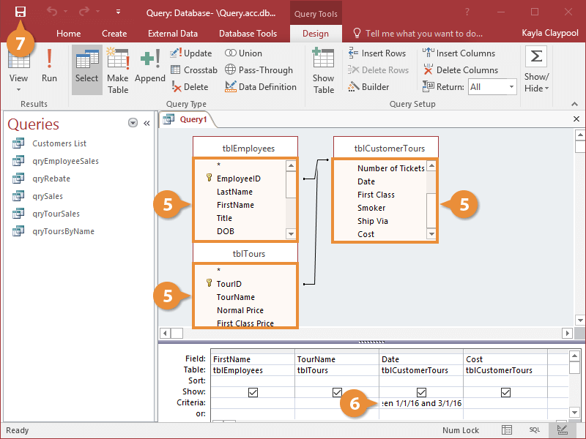

To create a Query from two- table using form Query Design do the following:
(Choose two tables)

Slide 12
TO enter the Criteria in Design view Numbers:
Less than to 45:
<45
Less than or equal to 45:
<=45
Greater than or equal to 45:
>=45
Equal to (is) 45:
=45
Does not equal to (Excludes) 45:
<>45
Number must be between 10 and 100 :
Between 10 and 100
Criteria | <45
Criteria | <=45
Criteria | >=45
Criteria | =45
Criteria | <>45
Criteria | Between 10 and 100

Slide 14
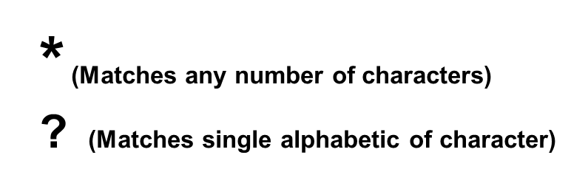
TO enter the Criteria in Design view: Text Data type Wild cards(*,?):
The Data must contain (include) “er” : *er*
The Data must start (begin) with “me” : me*
The Data must end with “ly” : *ly
The Data must start with “be” and it only consists of four letters:
be??
The Data must end with “er” and it only consists of five letters:
???er
After Pressing the Enter Key it will Change to Like “ me* “
Criteria | “*er*”
Criteria | “me*”
Criteria | “*ly”
Criteria | “Be??”
Criteria | like”???er*”

Slide 15
TO enter the Criteria in Design view: Date and time Data type:
Today’s date : =Date()
Today’s date or later : >=Date()
Today’s date or earlier: <=Date()
After 2/3/2020: > 2/3/2020
Before 2/3/2020: < 2/3/2020
On or After 2/3/2020: >= 2/3/2020
After Pressing the Enter Key it will Change to >#2/3/2020#
Criteria | =Date()
Criteria | >=Date()
Criteria | <=Date()
Criteria | > 2/3/2020
Criteria | < 2/3/2020
Criteria | < #2/3/2020#

Slide 16
Add criteria to a query using one or more of the following logical operators:
or
And
Notes:
Not Equal: Type NOT or <>
Yes/No: Type Yes or No or type True or False
Text: Type text or =text
wildcards Symbols :
  * (Matches any number of characters)
  ? (Matches single alphabetic of character)
Criteria |  | >=Date()
Or | <=45
Criteria | <=45 | >=Date()
Or

Slide 17
Apply these skills:
Create a new query using all the fields from supplier table , to show records with supplier ID greater than or equal 2. Save it with the name rosary_Query. Save and close your database. [2Minutes]
Create a new query from two tables using the following:
The productID and Amount fields from the Deliveries table and
the Company and ContactPerson field from the Suppliers table.
To show all companies whose name contains word “Fruit “then save it with name Company_Query.Save and close your database . [2 Minutes]

Slide 18
Apply these skills:
Open the Delivery2014 Query. Add criteria to show all Company that have a ProductID between 4 and 7. Then save .
Move the SupplierID field from the Delivery2014 Query, so that it appears immediately after the amount field, then Save . [1Minute]
Open the Delivery2014 Query. Add criteria to show records where the Suppliers number is not equal to 3 or the DeliveryDate is after 1/1/2014 ,Then save. [1Minutes]
Remove the NewSupplier field from the Delivery2014 query. Then save and close.
[1Minute]

