Slide 1


Reported Speech
Grammar Book
Pages: 100, 101 and 102.

Slide 2

Learning Objectives
1. Differentiate between direct speech and reported speech by identifying their key features, structure, and usage in context.
2. Convert sentences from direct speech into reported speech accurately, applying correct grammar rules.
3. Recognize and apply the grammatical changes needed when reporting speech, including:
Backshifting tenses (e.g., is eating → was eating, ate → had eaten).
Changing pronouns appropriately (e.g., I → he/she).
Adjusting time expressions (e.g., today → that day, tomorrow → the next day).
Using “that” to connect the reporting verb with the reported clause.

Slide 3
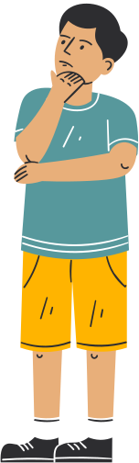
What Is Reported Speech?
In Direct Speech we give the exact words somebody said and use quotation marks.
In Reported Speech is used when we tell someone what another person said without quoting their exact words.
We do not use quotation marks, and we often change the tense, pronouns and time expressions to fit the situation.

Slide 4
Introduction to reported speech:
Direct speech and reported speech are two ways of conveying what someone else has said, but they differ in structure and style. Here's a clear breakdown:
Direct Speech:
Definition: In direct speech, we quote the exact words spoken by someone. The speaker’s words are presented directly, usually with quotation marks.
Structure:
  The speaker's exact words are given.
  Quotation marks are used.
  The punctuation is preserved (e.g., question mark, exclamation point).
Example:
  John said, "I am going to the store."

Slide 5
Reported Speech:
Definition: In reported speech (or indirect speech), we report what someone said without using their exact words. The message is paraphrased, and there is often a change in the tense, pronouns, and time expressions.
Structure:
  No quotation marks are used.
  The verb "say" (or its variations like "tell," "ask," etc.) is followed by the reported message.
  The sentence is usually made into a statement, not a question or exclamation.
Example:
  John said (that) he was going to the store.
  (Note: The word “that” is often optional, especially in informal speech.)

Slide 6

Key Differences Between Direct and Reported Speech:
Quotation Marks:
  Direct Speech: Uses quotation marks to show exact words.
  Reported Speech: No quotation marks; words are paraphrased.
Tense Changes:
  Direct Speech: The tense remains the same as the original.
  Reported Speech: The tense usually shifts one step back in time (e.g., present becomes past, future becomes conditional).
    Example:
      Direct: "I will help you." → Reported: She said she would help me.
Pronouns:
  Direct Speech: Pronouns remain the same.
  Reported Speech: Pronouns may change based on the perspective of the speaker.
    Example:
      Direct: "I am leaving now." → Reported: He said he was leaving then.
Punctuation:
  Direct Speech: Includes the exact punctuation from the original statement (e.g., question mark, exclamation mark).
  Reported Speech: Punctuation changes to fit the structure of a statement.
    Example:
      Direct: "Are you coming?" → Reported: He asked if I was coming.
Time Expressions:
  Direct Speech: Time references remain as they are.
  Reported Speech: Time expressions may need to be adjusted.
    Example:
      Direct: "I will call you tomorrow." → Reported: She said she would call me the next day.

Slide 7


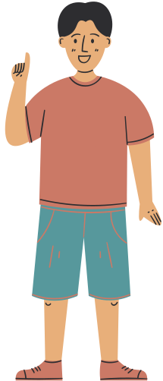

Direct Speech
Jimmy Said, “Parrots can talk!”
This is direct speech.

Slide 8

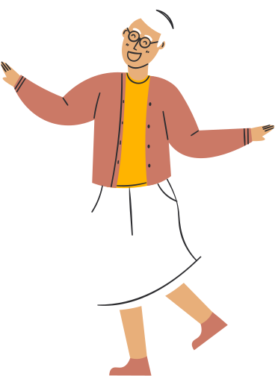



Reported Speech
Correct!!
Jimmy said that you could talk.
This is reported speech.
can
could
Can changes to could.

Slide 9

We usually introduce Reported Speech with the verbs:
tell (when there is a person/pronoun as an object)
Direct speech: "I'm leaving, Tina," she said.
Reported Speech → She told Tina (that) she was leaving.
and say (when there is no person/pronoun as an object).
Direct speech: "I'm leaving," she said.
Reported Speech → She said (that) she was leaving.
Note: “That” is often optional.

Slide 10
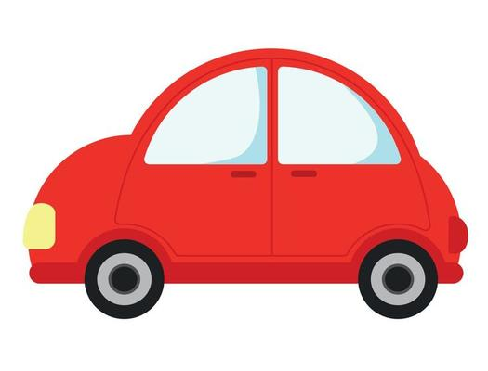
How Is It Formed?
The verb shifts to its past tense form.
Direct Speech
Reported Speech
He said, ”I want to buy a new car.”
He said (that) he wanted to buy a new car.
Simple present
Simple past

Slide 11
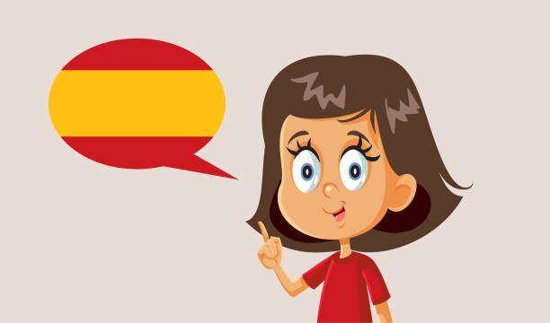
How Is It Formed?
The verb shifts to its past tense form.
Direct Speech
Reported Speech
She said, ”I am learning Spanish.”
She said (that) she was learning Spanish.
Present Progressive
Past Progressive

Slide 12
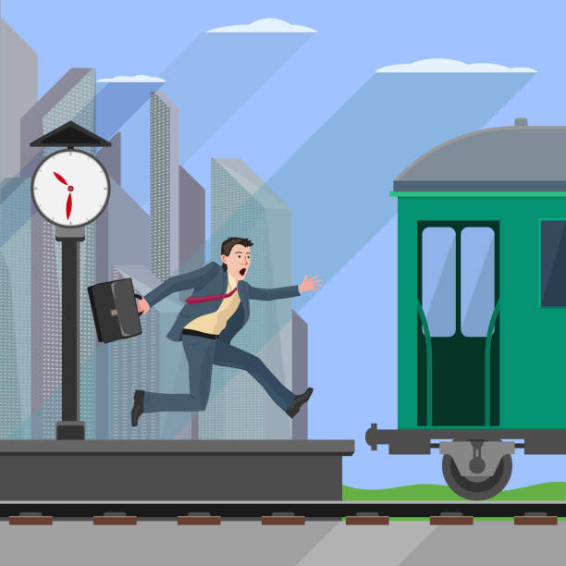
How Is It Formed?
The verb shifts to its past tense form.
Direct Speech
Reported Speech
”I missed the train.” he said.
He said (that) he had missed the train.
”I have missed the train.” he said.
Simple Past
Past Perfect Simple
Present Perfect

Slide 13

How Is It Formed?
The verb shifts to its past tense form.
Direct Speech
Reported speech
She said, ”I was studying with a friend”.
She said (that) she had been studying with a friend.
Past Progressive
She said, ”I have been studying with a friend”.
Past Perfect Progressive
Present Perfect Progressive

Slide 14

Change the following sentences from direct to reported speech:
Direct Speech:
He said, "I play football every weekend."
She said, "I visited my grandmother last week."
John said, "I am studying for my exams."
Tom said, "I was watching a movie last night."
She said, "I have finished my homework."
He said, "I have seen that movie before."
Jake said, "I have been working all day."
Ben said, "I am reading a new book."
Emma said, "I walked to school this morning."
Paul said, "I have been waiting for you."

Slide 15

Change the following sentences from direct to reported speech:
He said that he played football every weekend.
She said that she had visited her grandmother the previous week.
John said that he was studying for his exams.
Tom said that he had been watching a movie the previous night.
She said that she had finished her homework.
He said that he had seen that movie before.
Jake said that he had been working all day.
Ben said that he was reading a new book.
Emma said that she had walked to school that morning.
Paul said that he had been waiting for me.

Slide 16

How Is It Formed?
The verb shifts to its past tense form.
Direct Speech
Reported Speech
She said, ”I will call you”.
She said (that) she would call me.
will
would
He said, ”I can run very fast”.
He said (that) she could run very fast.
can
could
They said, ”We may go on a holiday”.
They said (that) they might go on a holiday.
may
might

Slide 17
How Is It Formed?
The verb shifts to its past tense form.
Direct Speech
Reported Speech
She said, ”She must get up early everyday”.
She said (that) she had to get up early everyday.
must
Had to (obligation/commitment)
He said, ”You must be tired”.
He said (that) I must be tired .
must
Must (deduction/assumption/conclusion)
She said, ”You must not shout”.
She said (that) we mustn't shout .
Must not
Mustn’t (Prohibited)

Slide 18
How Is It Formed?
The verb shifts to its past tense form.
Direct speech
Reported Speech
She said, ”I need to go shopping”.
She said (that) she needed/ had to go shopping.
need
Needed/ had to
He said, ”I needn’t hurry ”.
He said (that) he didn’t have to hurry.
Needn’t
didn’t have to (present)
She said, ”You needn’t pick me up tomorrow”.
She told me (that) I wouldn’t have to pick her up the following day .
Needn’t
Wouldn't have to ( Future)

Slide 19
The use of "must" in reported speech can be a bit tricky because sometimes it changes to "had to", while in other cases, it stays as "must". Here's how it works:
1. When "must" changes to "had to":
"Must" usually changes to "had to" when it's referring to a necessity or obligation in the past.
This happens because we are reporting something that was necessary at that time.
Direct Speech: “I must finish my homework tonight,” said Lina.
Reported Speech: Lina said she had to finish her homework that night.
2. When "must" stays as "must":
Present or future necessity (something that is still true now or in the future).
Strong advice or instruction (that still applies).
Direct: “You must study hard for the exam,” said the teacher.
Reported: The teacher said we must study hard for the exam.
(The advice is still true — it’s about the present/future.)
Direct: “You must wear a helmet when you ride a bike,” said Dad.
Reported: Dad said I must wear a helmet when I ride a bike.
(This is a rule that’s always true.)
Direct: “We must be careful on the road,” said the driver.
Reported: The driver said we must be careful on the road.
(The necessity still applies.)

Slide 20


Note!
Would, could, might, should, ought to
do not change in Reported Speech !

Slide 21
Change the following sentences from direct to reported speech:
Direct Speech:
She said, "I can swim very fast."
Tom said, "I should study harder."
John said, "I may go to the party later."
Anna said, "I must leave early tomorrow."
Mark said, "I will help you with your homework."
She said, "I could hear the music from my room."
He said, "I might visit my cousin this weekend."
Sarah said, "I would like to have some ice cream."
James said, "I can play the guitar."
Paul said, "I might go to the gym tomorrow."

Slide 22
Change the following sentences from direct to reported speech:
Reported Speech:
She said that she could swim very fast.
Tom said that he should study harder.
John said that he might go to the party later.
Anna said that she had to leave early the next day.
Mark said that he would help me with my homework.
She said that she could hear the music from her room.
He said that he might visit his cousin that weekend.
Sarah said that she would like to have some ice cream.
James said that he could play the guitar.
Paul said that he might go to the gym the next day.

Slide 23


How to change Time
Expressions
from
Direct speech to Reported speech.

Slide 24
 | Direct Speech | Reported Speech
Time Expression | Now Today/ tonight Yesterday Tomorrow Last week (month, etc) Next week (month, etc) Ago | Then That day/ that night The day before / the previous day The next/ following day The previous week (month, etc), the week (month, etc) before The following week Before
Other Changes | This / these Here Pronouns / possessive adjectives | That/ those There They change according to the content.

Slide 25
Rewrite the sentences in Reported Speech, changing the time words correctly.
“I’m studying English now,” said Huda.
→ ________________________________________________
“We are going to the mall today,” said my friends.
→ ________________________________________________
“I called you yesterday,” said Lina.
→ ________________________________________________
“I will see you tomorrow,” said my teacher.
→ ________________________________________________
“We finished our project last week,” said the students.
→ ________________________________________________
“We are travelling next month,” said my parents.
→ ________________________________________________
“I met her three days ago,” said Ali.
→ ________________________________________________

Slide 26
Change the following from Direct to Reported Speech:
“I bought this dress here at the mall,” said Rania.
→ ________________________________________________
“We like these books,” said the students.
→ ________________________________________________
“I’ll bring this bag to you here tomorrow,” said Sami.
→ ________________________________________________

Slide 27
Rewrite the sentences in Reported Speech, changing the time words correctly.
“I’m studying English now,” said Huda.
→ Huda said that she was studying English then.
“We are going to the mall today,” said my friends.
→ My friends said that they were going to the mall that day.
“I called you yesterday,” said Lina.
→ Lina said that she had called me the day before.
“I will see you tomorrow,” said my teacher.
→ My teacher said that she would see me the next day / the following day.
“We finished our project last week,” said the students.
→ The students said that they had finished their project the previous week.
“We are travelling next month,” said my parents.
→ My parents said that they were travelling the following month.
“I met her three days ago,” said Ali.
→ Ali said that he had met her three days before.

Slide 28
Change the following from Direct to Reported Speech:
8. “I bought this dress here at the mall,” said Rania.
→ Rania said that she had bought that dress there at the mall.
9. “We like these books,” said the students.
→ The students said that they liked those books.
10. “I’ll bring this bag to you here tomorrow,” said Sami.
→ Sami said that he would bring that bag there the next day.

Slide 29

NO Changes
are made in the following cases.
When the reporting verb is in the Present, Future or Present Perfect tense.
Direct speech: He says, "I will be a lawyer when I grow up."
Reported speech: → He says (that) he will be a lawyer when he grows up.

Slide 30

NO Changes
are made in the following cases.
• When the sentence expresses a general truth or something that is unlikely to change.
Direct speech: She said, "The days are longer in the summer."
Reported speech → She said (that) the days are longer in the summer.

Slide 31
NO Changes
are made in the following cases.
The Past Perfect (Simple and Progressive) does not change when we report speech.
Past Perfect Simple:
🔹 had + past participle
Example:
Direct Speech → She said, “I had prepared dinner in advance.”
Reported Speech → She said (that) she had prepared dinner in advance.
Past Perfect Progressive:
🔹 had been + verb-ing
Example:
Direct Speech → She said, “I had been studying all night.”
Reported Speech → She said (that) she had been studying all night.

Slide 32

NO Changes
are made in the following cases.
• The Past Progressive does not usually change; Past tenses in time clauses do not change.
Direct speech: "I was speaking on the phone when the doorbell rang," she said.
Reported speech → She said (that) she was speaking on the phone when the doorbell rang.

Slide 33

NO Changes
are made in the following cases.
When something is reported immediately after it is said.
Direct speech: "This shirt looks awful," Mary said.
Reported speech → Mary said (that) this shirt looks awful.

Slide 34

NO Changes
are made in the following cases.
The Past Simple in colloquial speech can either change or remain the same.
Direct speech: "I got my school report yesterday," said Jim.
Reported speech→ Jim said (that) he got/had got his school report the day before.

Slide 35

NO Changes
are made in the following cases.
• When something, although said earlier, will take place in the future.
Direct speech: John said, "I'm flying to Rome tomorrow."
Reported speech→ John said (that) he is flying to Rome tomorrow. (It is still today.)

Slide 36

NO Changes
are made in the following cases.
• When there is a Conditional (Type 2 or type 3) or a sentence with wish/If only.
Peter said, "If I were rich, I would travel a lot." (Conditional type 2)
→ Peter said (that) if he were rich, he would travel a lot.
Karen said, "If I hadn't woken up late, I wouldn't have missed the bus." (Conditional type 3)
→ Karen said (that) if she hadn't woken up late, she wouldn't have missed the bus.
Susan said, "I wish I knew her name." → Susan said (that) she wished she knew her name.

Slide 37
Rewrite the following sentences in reported speech.
1. She said, “The Earth orbits the Sun.”
→ _____________________________________________
2. He says, “I will travel to Japan when I retire.”
→ _____________________________________________
3. She said, “I had been waiting for two hours before the bus arrived.”
→ _____________________________________________
4. “I was reading when the phone rang,” she said.
→ _____________________________________________
5. John said, “I’m flying to Rome tomorrow.” (It was still the same day.)
→ _____________________________________________
6. Peter said, “If I were rich, I would buy a private island.”
→ _____________________________________________
7. Susan said, “I wish I hadn’t forgotten her birthday.”
→ _____________________________________________

Slide 38
1. She said (that) the Earth orbits the Sun.
(General truth — no tense change.)
2. He says (that) he will travel to Japan when he retires.
(Reporting verb in present tense — no change.)
3. She said (that) she had been waiting for two hours before the bus arrived.
(Past Perfect Progressive — no change.)
4. She said (that) she was reading when the phone rang.
(Past tense in time clauses).
5. John said (that) he is flying to Rome tomorrow.
(Still true at the time of reporting — no change.)
6. Peter said (that) if he were rich, he would buy a private island.
(Conditionals type 2 — no change.)
7. Susan said (that) she wished she hadn’t forgotten her birthday.
*(Wish clause — no tense change.)

Slide 39


YES/NO Question Forms:
In yes/no questions, use IF.
Do you speak German?
She wondered if I spoke German!
Rule:
ask/wonder + if/whether + subject+ verb.

Slide 40
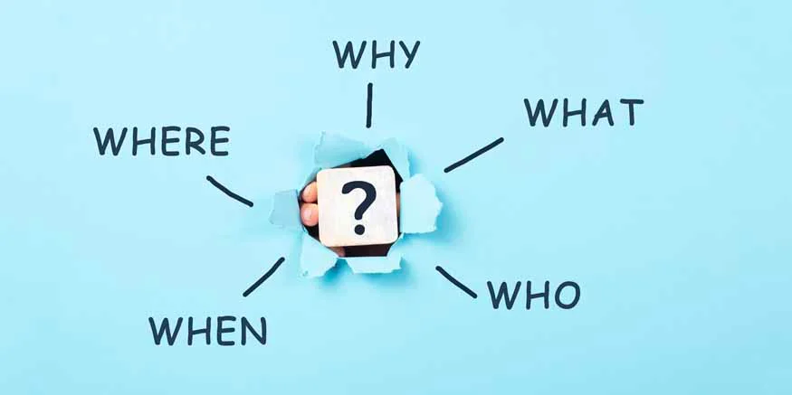

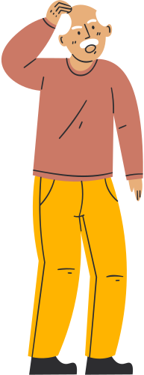
WH- Question Forms
In WH- Questions, the subject and auxiliary verb switch places.
Where do you live?
She wanted to know where I lived .
Rule:
ask/wonder + question word + subject+ verb.

Slide 41
Change the following into reported speech, using if, whether, or appropriate wh- words. Be careful with tense and word order.
1. The teacher asked, “Have you completed your project yet?”
→ _____________________________________________
2. He asked, “What were you doing when I called you last night?”
→ _____________________________________________
3. She wondered, “Will they accept my apology or not?”
→ _____________________________________________
4. The officer said, “Did you see the accident happen?”
→ _____________________________________________
5. “Where have you been hiding all this time?” she asked.
→ _____________________________________________

Slide 42
1. The teacher asked if/whether we had completed our project yet.
2. He asked what I had been doing when he called me the previous night.
3. She wondered if/whether they would accept her apology or not.
4. The officer asked if/whether I had seen the accident happen.
5. She asked where I had been hiding all that time.

Slide 43

Whether
often indicates uncertainty or doubt. It is used when there is a choice between two alternatives.
He wondered whether I had posted the letter or not.
Question Tag
In direct speech, a question tag repeats the auxiliary verb and matches the subject.
In reported speech, question tags are omitted.
The sentence becomes a reported yes/no question introduced by if or whether.
Question Tags are omitted in Reported Speech.
"They haven't arrived yet, have they?" he said.
→ He asked if/whether they had arrived yet.

Slide 44
Question Tag
Direct: He said, “You are coming to the meeting, aren’t you?”
Reported: He asked if/whether I was coming to the meeting.
Direct: She said, “You finished your homework, didn’t you?”
Reported:She asked if/whether I had finished my homework.
Direct: They said, “You can swim, can’t you?”
Reported: They asked if/whether I could swim.

Slide 45
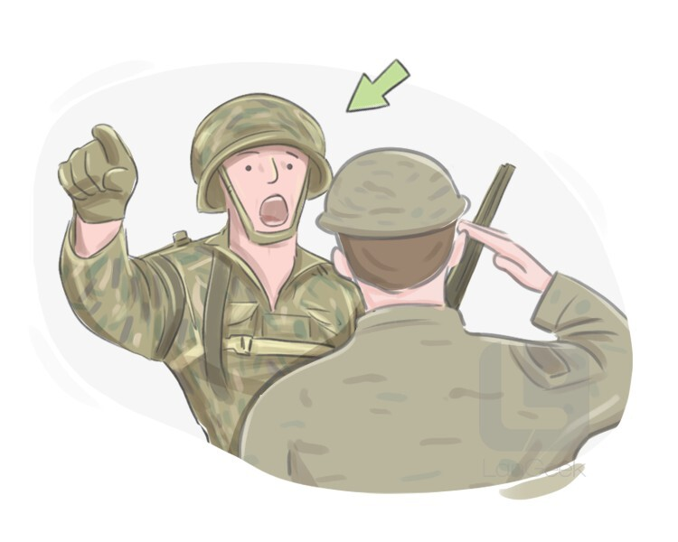

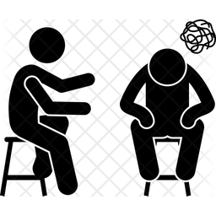
Command- Request- Advice
To report commands, requests, advice, warnings or suggestions, we use the verbs tell, ask, beg, order, command, advise, forbid, warn, encourage, etc. + (object) + full infinitive.
The flight attendant said, "Please return to your seats and fasten your seat belts.“
→ The flight attendant asked (us) to return to our seats and fasten our seat belts.
Direct speech: “ Don’t talk so fast,” he said.
Reported speech → He advised me not to talk so fast.

Slide 46
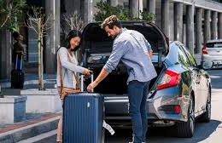
Other Reporting Verbs
refuse/offer/promise (+ object)/threaten (+ object)/claim/agree, etc. + full infinitive
Direct speech: "I'll pick you up from the airport," he said.
Reported speech → He offered to pick me up from the airport.
Direct speech: He said, "I will be there on time."
Reported speech→ He promised to be there on time.
Direct speech:She said, "I will call the police if you don't leave."
Reported speech→ She threatened to call the police if they didn't leave.

Slide 47

Other Reporting Verbs
• accuse sb of/complain to sb about/insist on/admit (to)/deny/apologise for + -ing form
Susan said, "He stole the old woman's handbag."
Reported speech → Susan accused him of stealing the old woman's handbag.
"I didn't write anything on the desk," he said.
Reported speech → He denied writing/having written anything on the desk.

Slide 48

Other Reporting Verbs
• complain/explain/agree/claim/deny
promise/threaten/warn + (object)
"My coffee is too cold," she said.
→ She complained that her coffee was too cold.
+ that-clause

Slide 49
Note!
"Let's go for a swim," Peter said.
→ Peter suggested
going for a swim.
that they should go for a swim.
that they go/went for a swim.

Slide 50
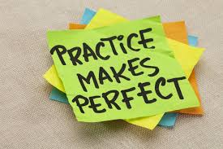
Let’s Practice!
Get ready!
Grammar book exercises, pages: 103-104-105.

Slide 51
Quiz
https://wordwall.net/resource/54820859/repoted-speech-necessary-changes
https://wordwall.net/resource/12088603/reported-speech-match-up
Get ready!

Slide 52

What Did She Say?!
I have a question.
Can you speak Parrot?
Where are the crackers?
You’re so pretty.
Let me out.
What is your password?

Slide 53
Answers
I have a question.
She said she had a question.
Where are the crackers?
She asked me where the crackers were.
Let me out.
She told me to let her out.
Can you speak Parrot?
She asked if I could speak Parrot.
You’re so pretty.
She told me I was pretty.
What is your password?
She asked me what my password was!

Slide 54
Thank You!
Any questions?

