Slide 1

Homes Sweet Homes
Done and Presented By :
Faris Alamat

Slide 2
The moral of the Poem “Homes Sweet Homes” is every animal loves it home.

Slide 3
The key events:
A girl and a boy were in a pond and they put there hand in the pond and they saw a tadpole .

Slide 4
Main Characters:
A Boy And
A Girl
Animals and Plants

Slide 5
REATELING THE POEM:
The boy and the girl saw the animals then they went to the pond the boy and girl put there hand in the pond they saw a tadpole in there hands.

Slide 6
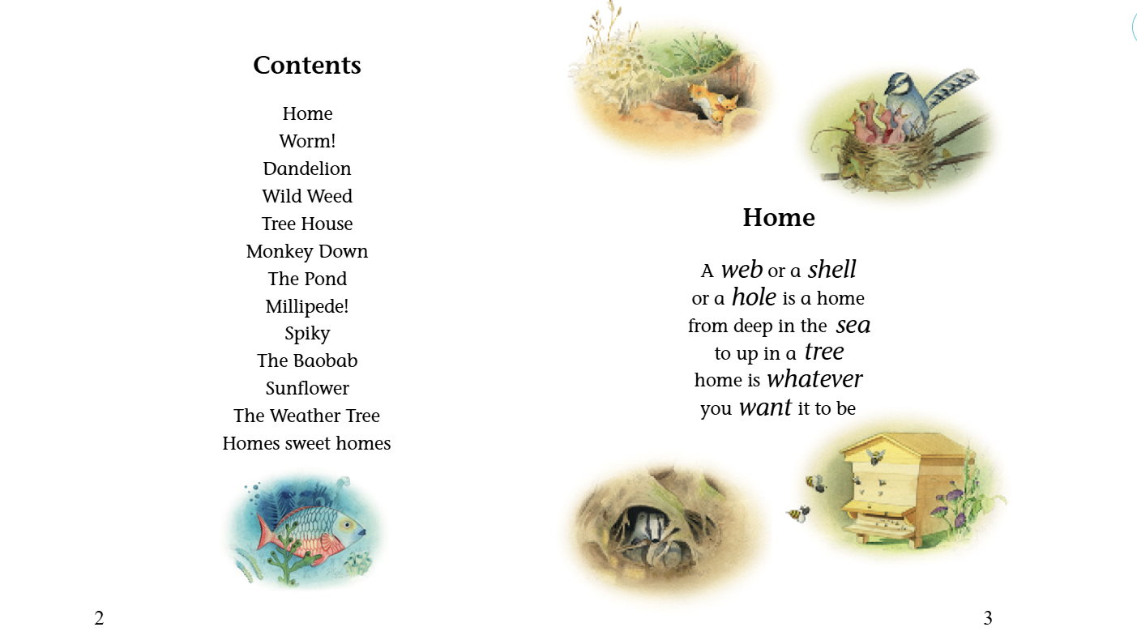

Slide 7
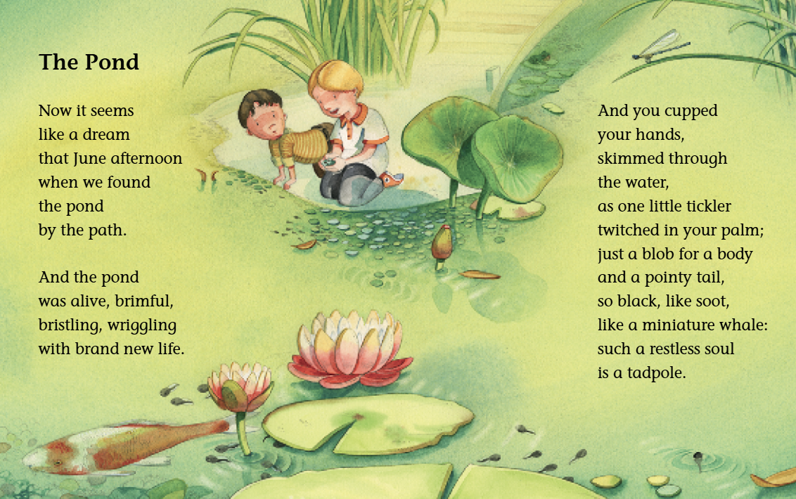

Slide 8
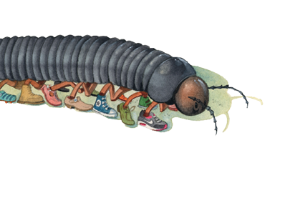
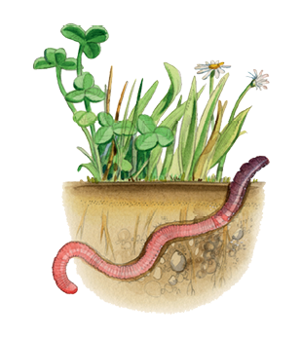
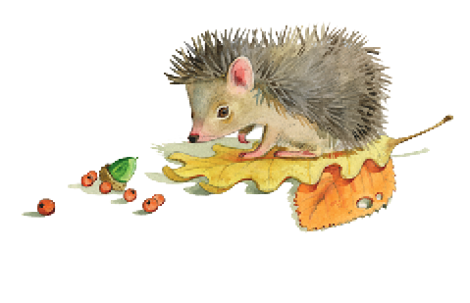
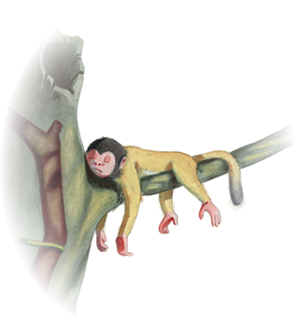

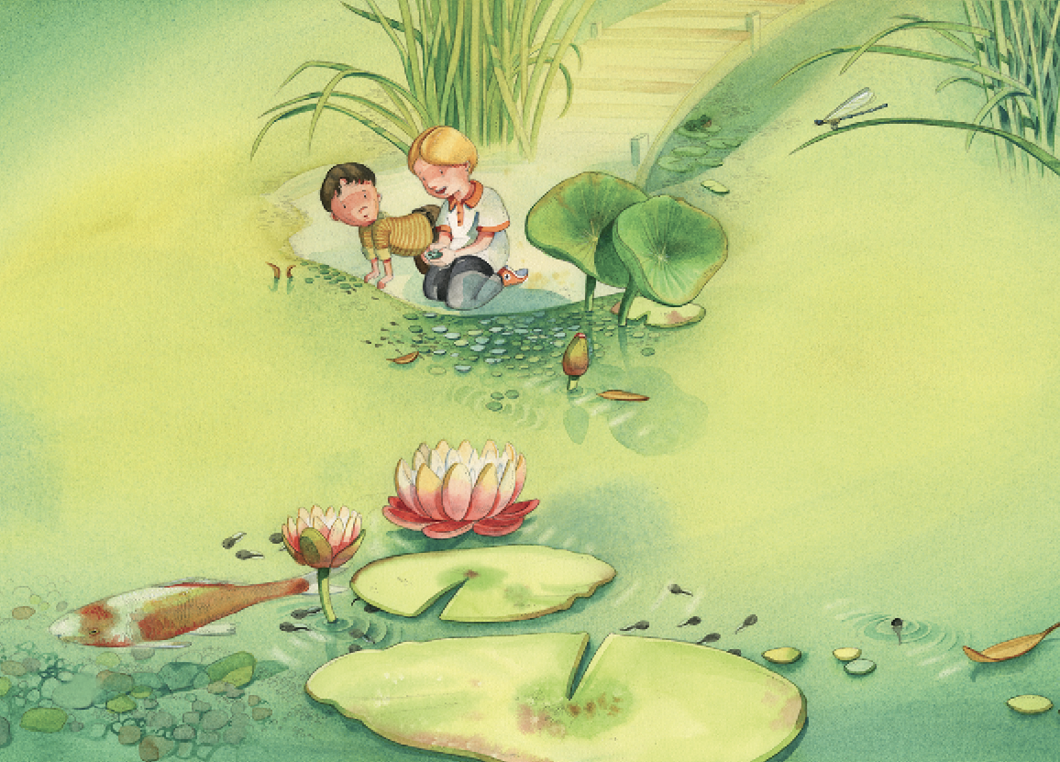



Slide 9
Try to read the Poem!
Thank you!

