Slide 1
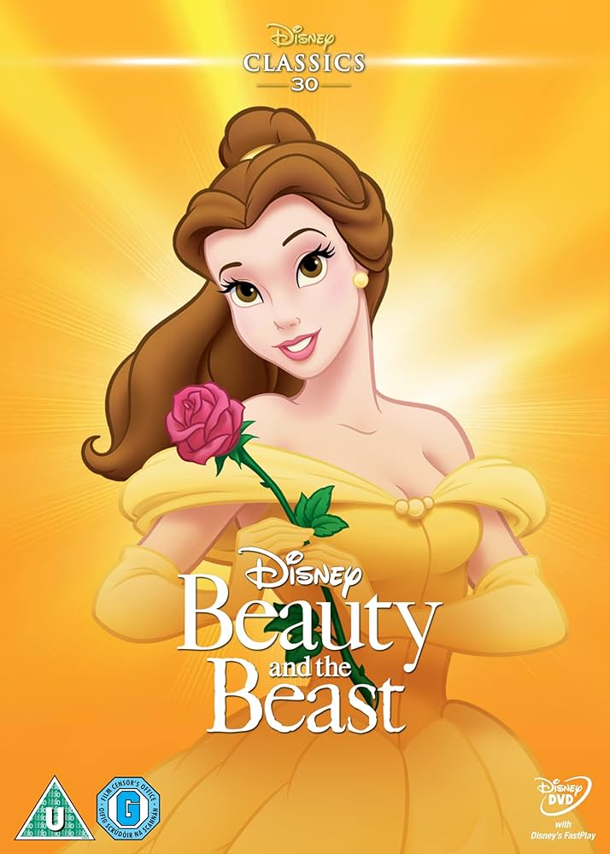
Beauty & The beast
Made by: Naya Shawareb 3(A)

Slide 2
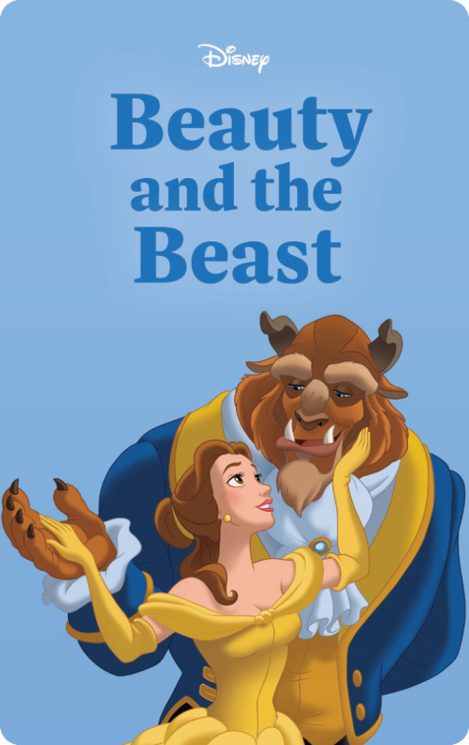
Beauty & the beast
My favorite traditional tale is Beauty and the Beast!
It’s more than just a fairy tale—it’s a magical story that shows how true beauty comes from the heart.
It’s full of mystery, enchantment, and a love that grows stronger than any curse.

Slide 3
Where does the story come from?
Beauty and the Beast comes from France, a country known for its fairy tales and castles!
It was first written down in the 1700s—over 300 years ago!
It’s a tale that people have loved for centuries!
It has been translated to almost all the languages in the world!

Slide 4
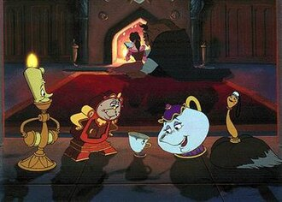
Who are the main characters?
Belle – Brave, kind, and curious. She’s not afraid of the Beast and sees the good in others.
The Beast – A prince under a powerful curse. He learns how to love and be kind again.
The Enchantress – A mysterious fairy who teaches an important lesson through the curse.

Slide 5
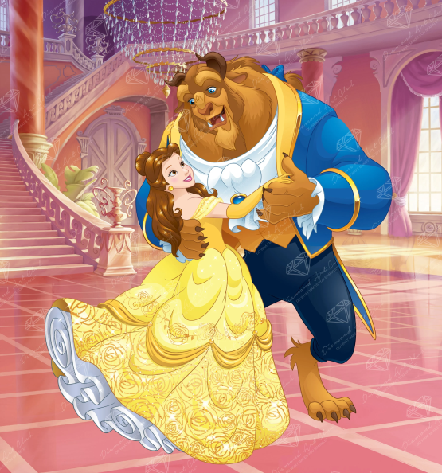
What is the moral of the story?
Never judge a book by its cover.
Beauty and the Beast teaches us that kindness, courage, and love are what truly matter.
Even someone who seems scary or different might have a heart full of gold.

Slide 6
Modernized beauty & the beast
Belle could be a music-loving teenager who stands up for what’s right.
The Beast could live in a hidden skyscraper with enchanted gadgets instead of a castle!
They could connect through social media and slowly become friends.
The curse might be linked to how the Beast treats others online.

Slide 7
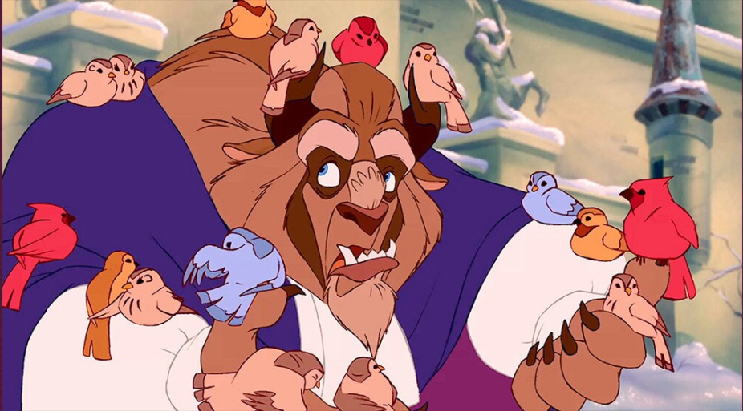
Would you recommend this story?
Absolutely, yes!
It’s magical, exciting, and filled with emotions that we can all understand.
It helps us believe in second chances, inner beauty, and the magic of being true to yourself.
Everyone should experience this story at least once!

Slide 8

THE END

