Slide 1

How to make popcorn
Presenter: Jude Alnuman
Notes:
Hi everyone! Today I’ll show you how to make yummy popcorn! It's super quick, delicious, and fun for movies, parties, or just relaxing!

Slide 2
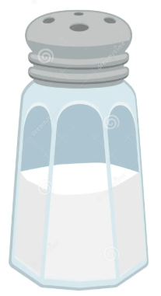
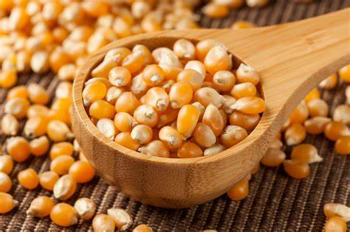
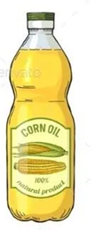
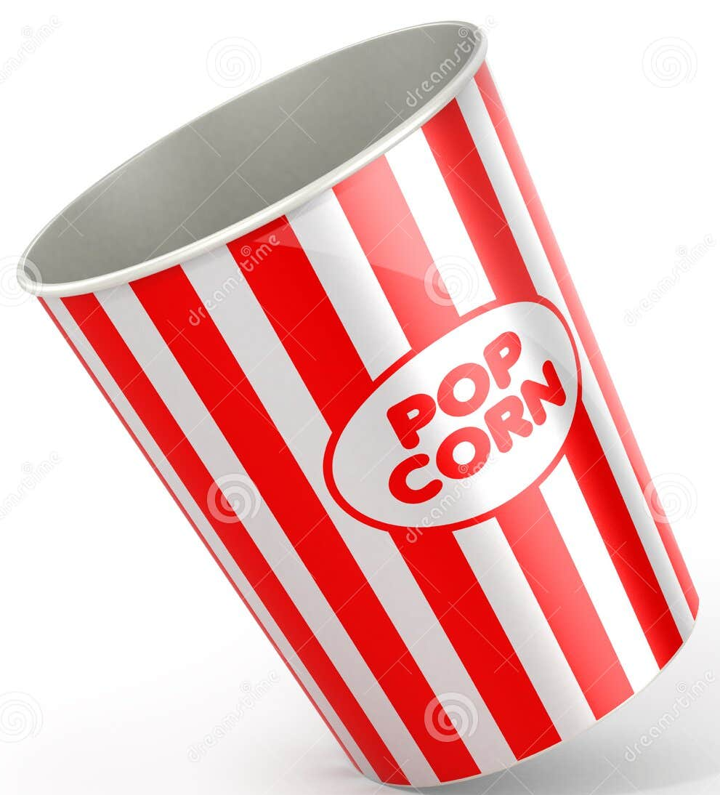
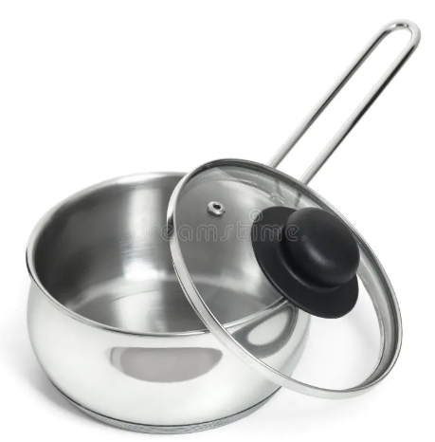
Ingredients and tools
Salt
Popcorn kernels
Oil
Popcorn Bucket
Pot
Notes:
What you need:

Slide 3
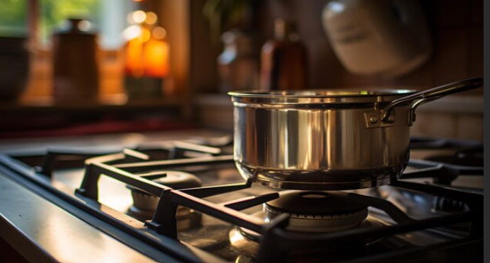
Step 1
First, put a pot on the stove.

Slide 4
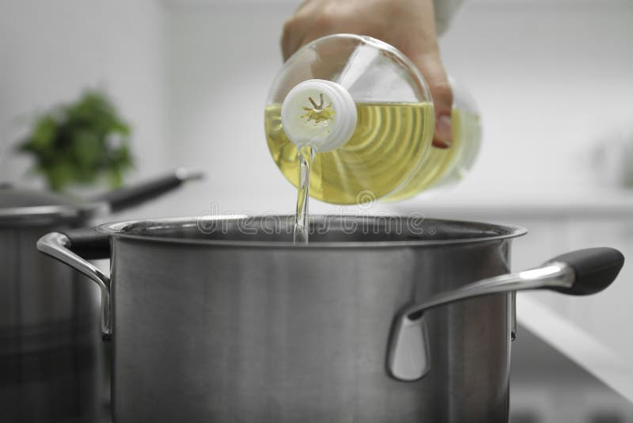
Step 2
Second, pour a little oil into the pot.

Slide 5
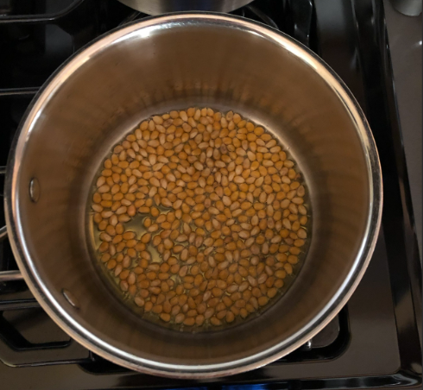
Step 3
Next, add the popcorn kernels and some salt.

Slide 6
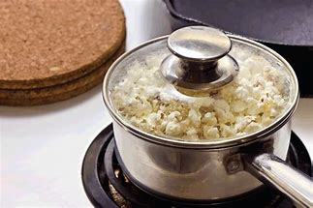

Step 4
Then, place the lid on the pot and listen for the popcorn kernels popping!

Slide 7
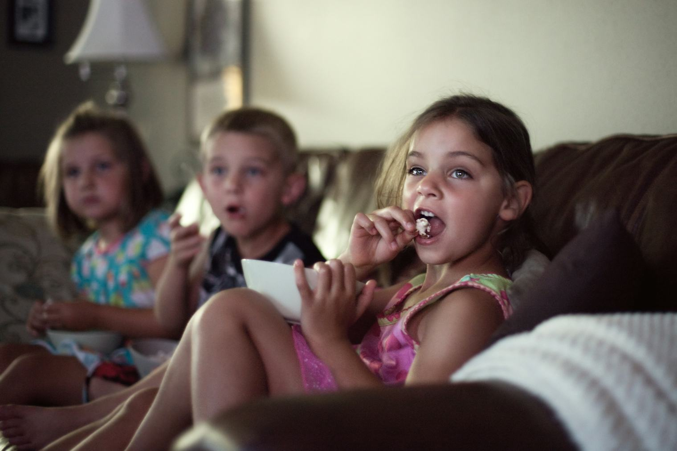
Step 5
Finally, enjoy your delicious homemade popcorn while watching a nice movie.
Notes:
Now you know how easy it is to make popcorn. I hope you try it at home and have fun eating it!

