Slide 1
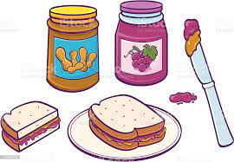

How to make a jam sandwich
What to do:
1.First pick up the spreading knife
2.Spread the peanut butter over the first slice of bread
what you will need: 3.Next,Spread the jam across the peanut butter.
Two slices of bread 4.Put the second slice of bread on top of the jam.
Peanut Butter 5.After that, Cut the sandwich in half.
Jam 6.After cutting the sandwich , Place the sandwich on a plate.
Spreading knife 7.finally serve and enjoy.
Knife
plate
Careful, the knife is sharp , ask an adult to help you

