Slide 1
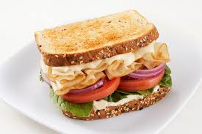
Turkey Sandwich Recipe

Slide 2
Introduction
Hi everyone!
Today, I’m going to show you how to make a super yummy turkey sandwich. It’s easy to make, fun to eat, and perfect for lunch! Let’s get started

Slide 3
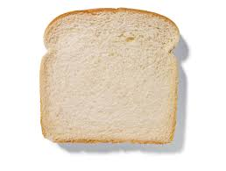
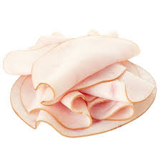


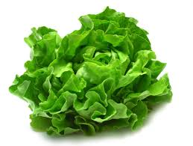
Igredients
• 2 slices of bread
. 2 slices of turkey
. 1 slice of cheese (any kind you like!)
• A little bit of mayonnaise
• 1 leaf of lettuce (if you like it!)

Slide 4

Steps
Wash your hands!

Slide 5
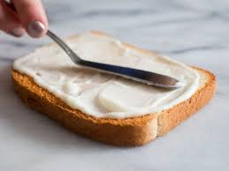
Spread it on!

Slide 6
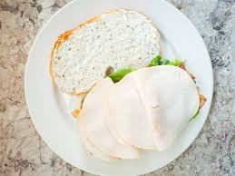
Add the turkey!

Slide 7
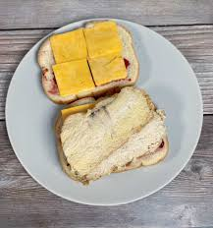
Add the cheese!

Slide 8
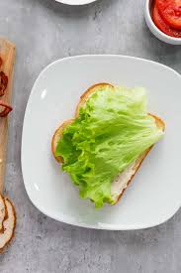
Lettuce time!

Slide 9
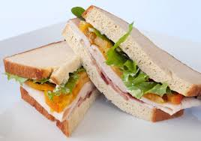
Cut and enjoy!

