Slide 1
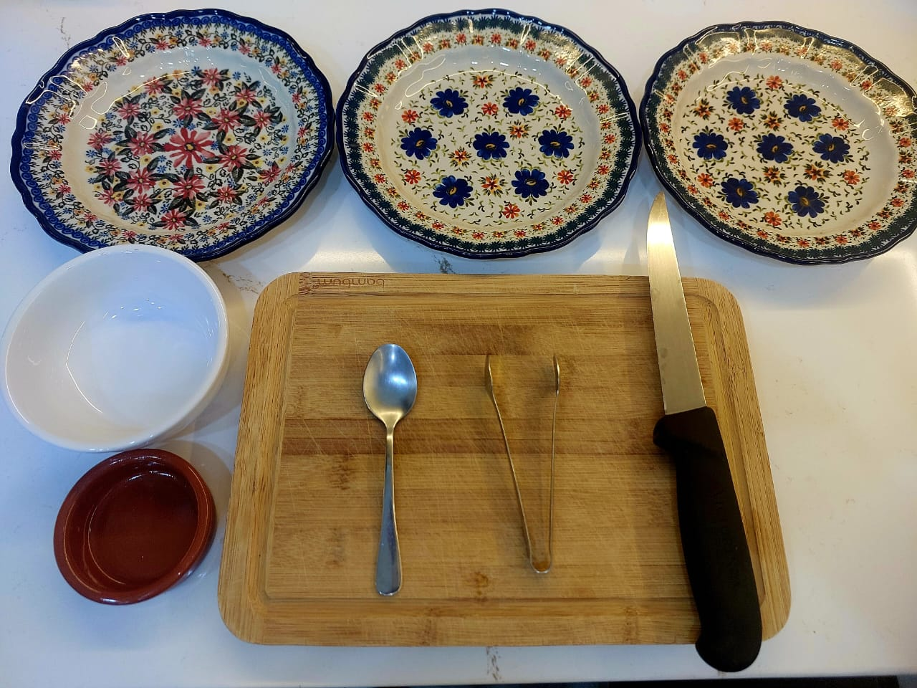
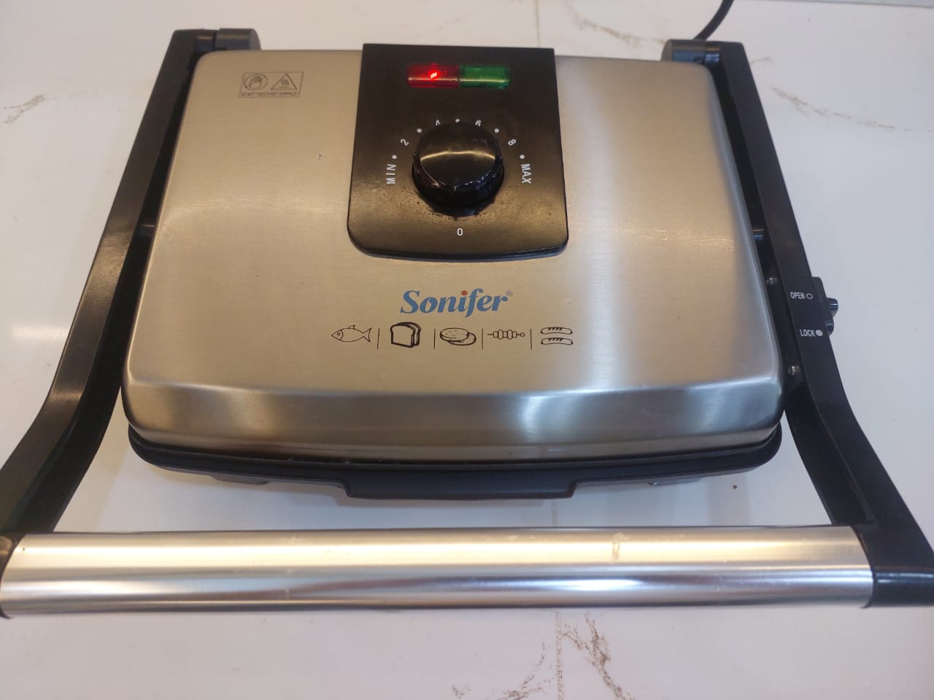
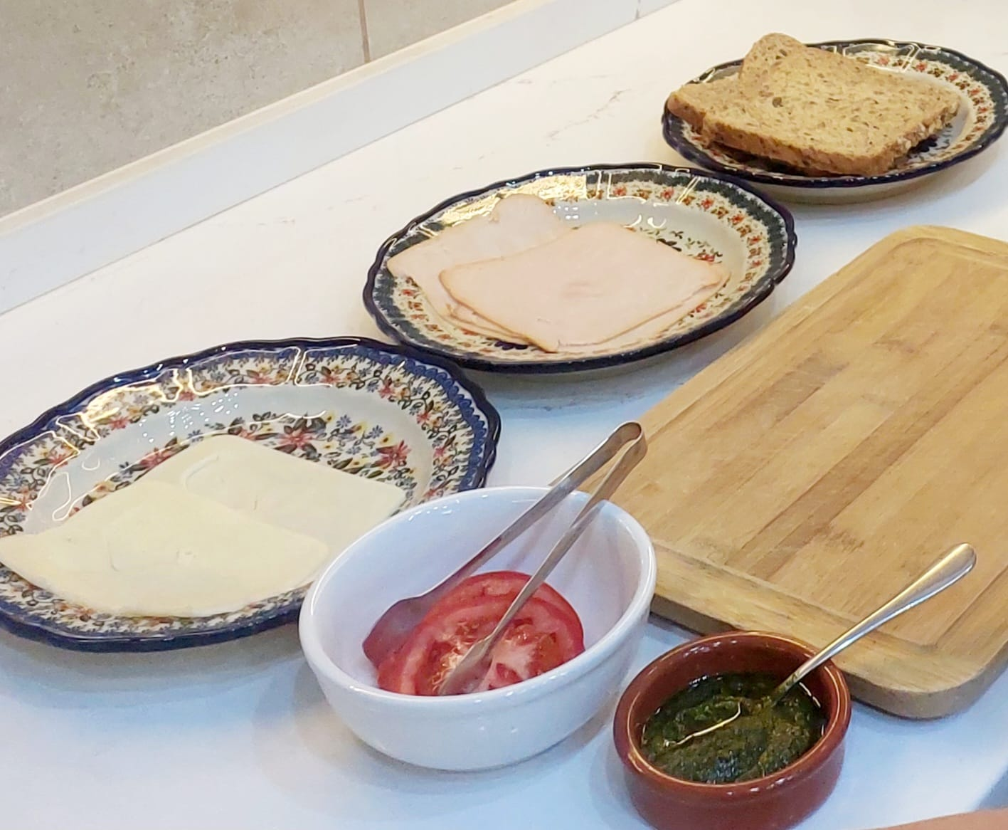
Turkey& Cheese Sandwich Recipe
How To Make Turkey& Cheese Sandwich
Equipment List Ingredients
Plates – Cutting Board – Sauce Bowl Toast Bread Two Pieces
Bowl – Knife – Tong – Small Spoon Smoked Turkey Two Pieces
Mozzarella Cheese Two Pieces
Slice Tomato four pieces
Pesto Two Spoon
Preparation

Slide 2
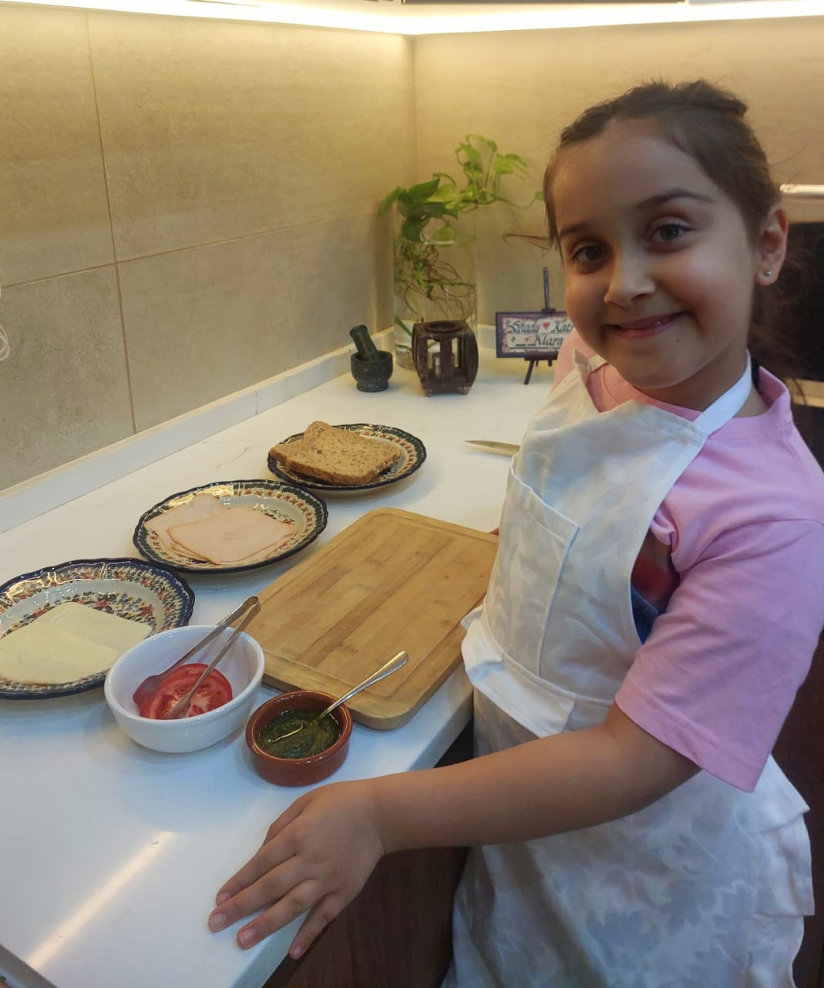
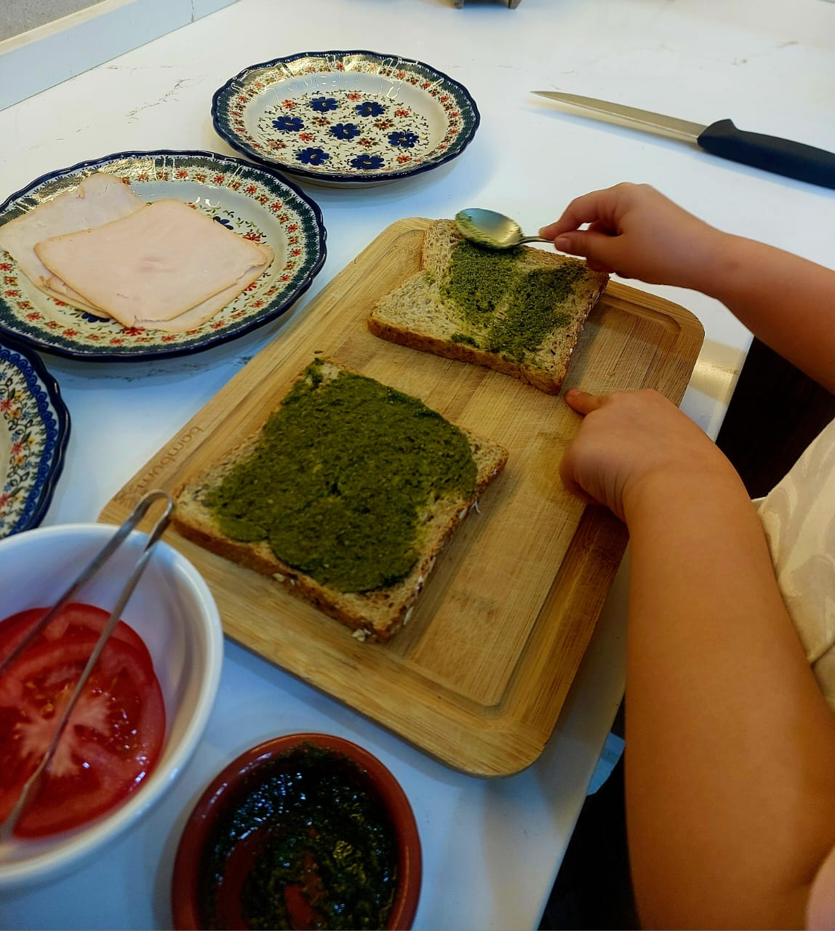
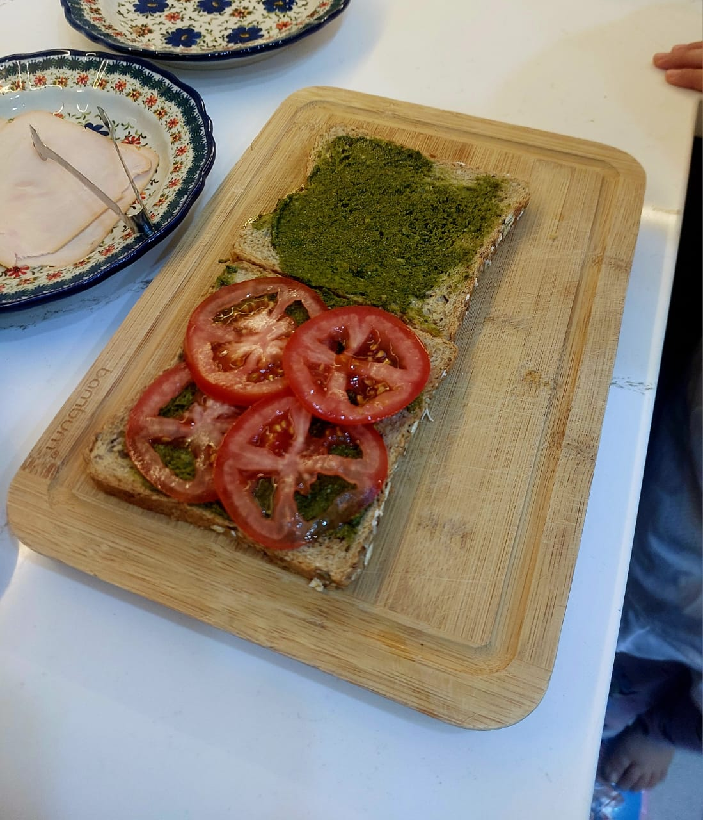
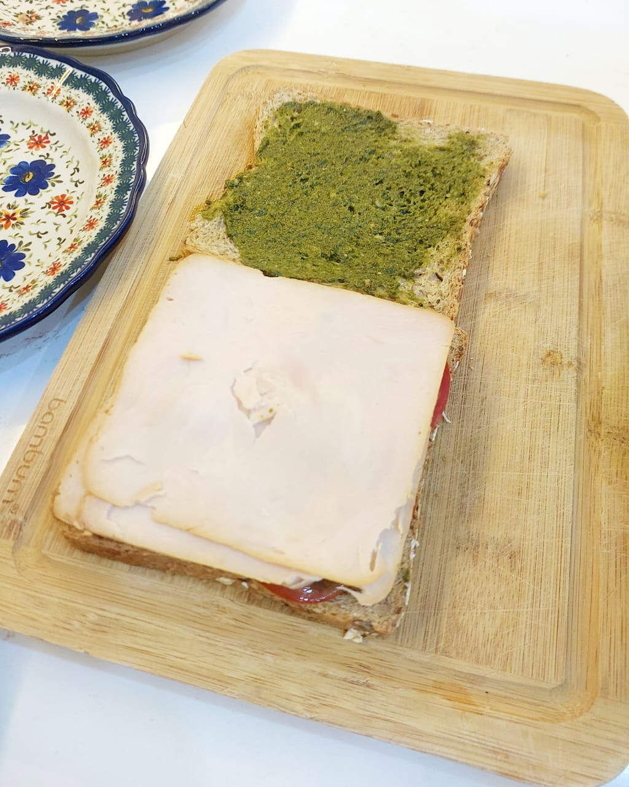
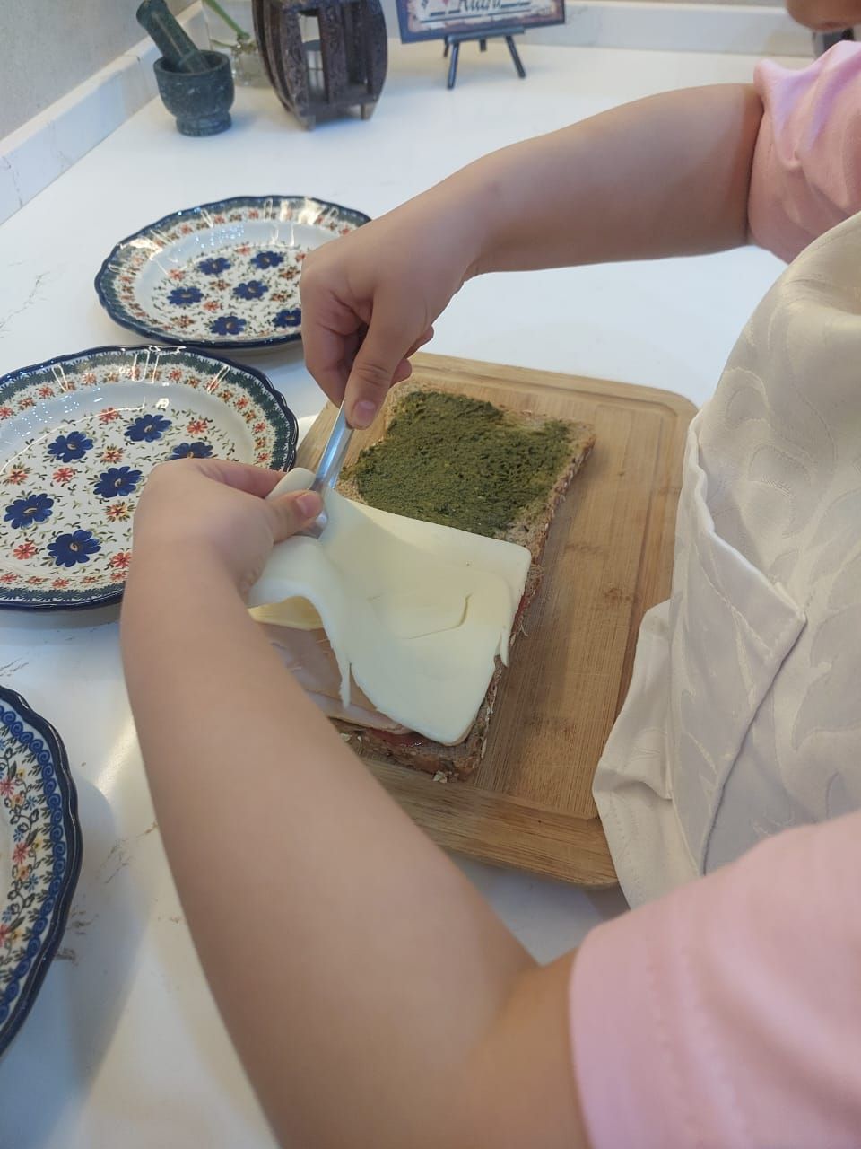
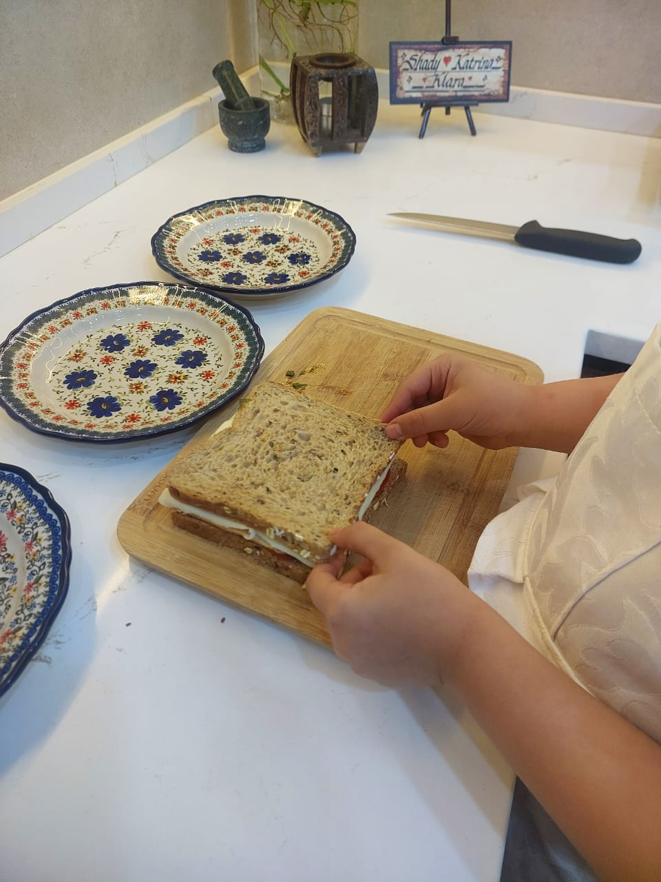
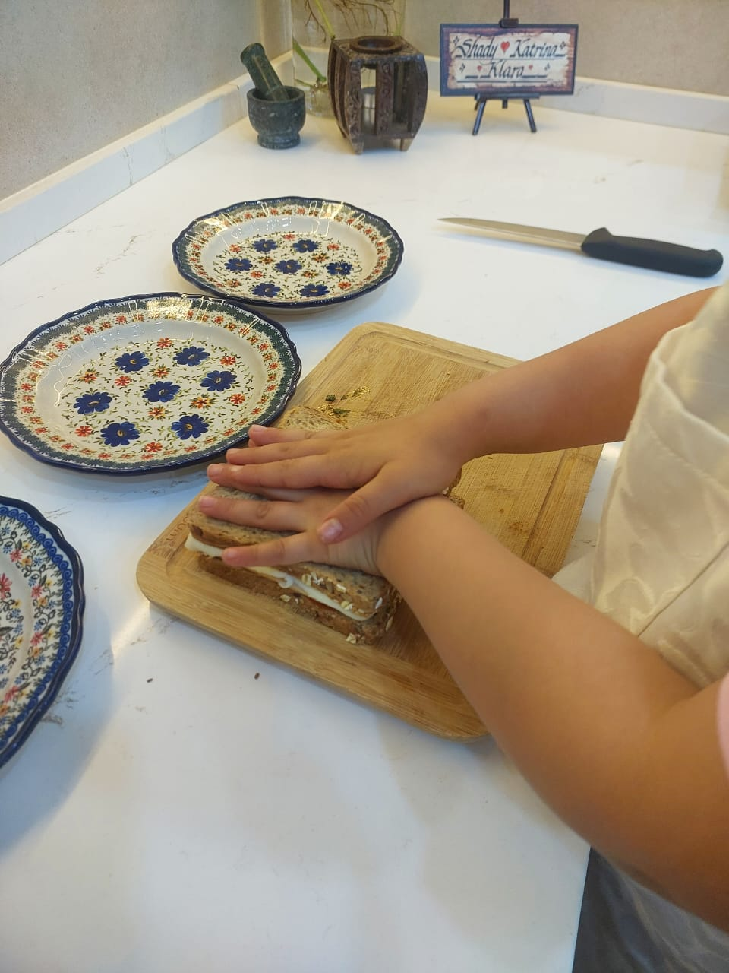
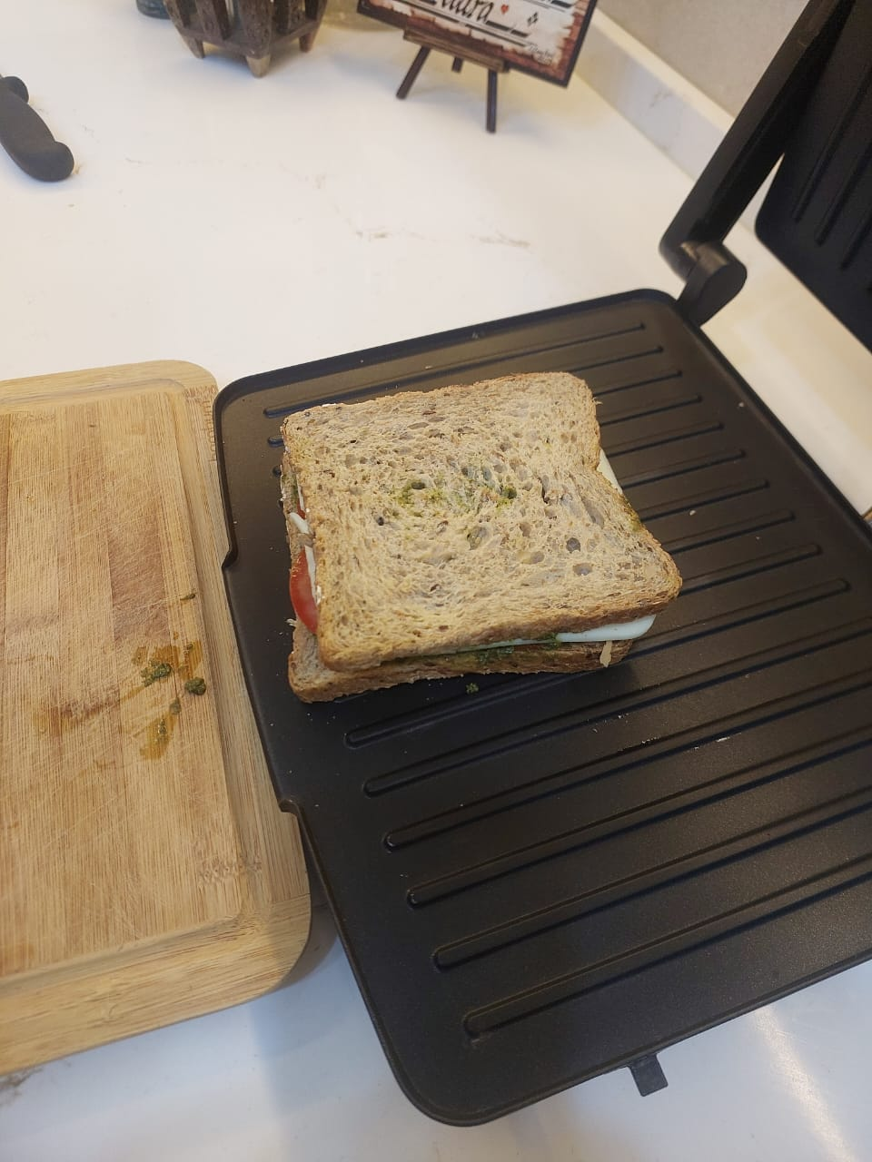
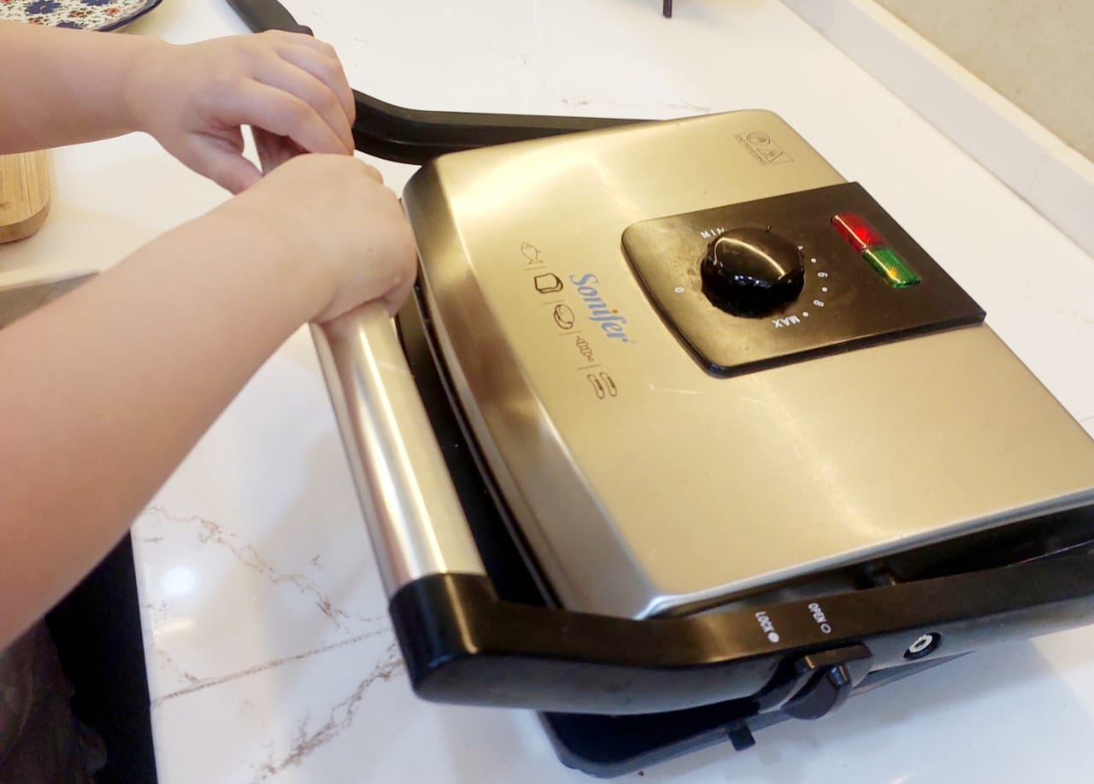
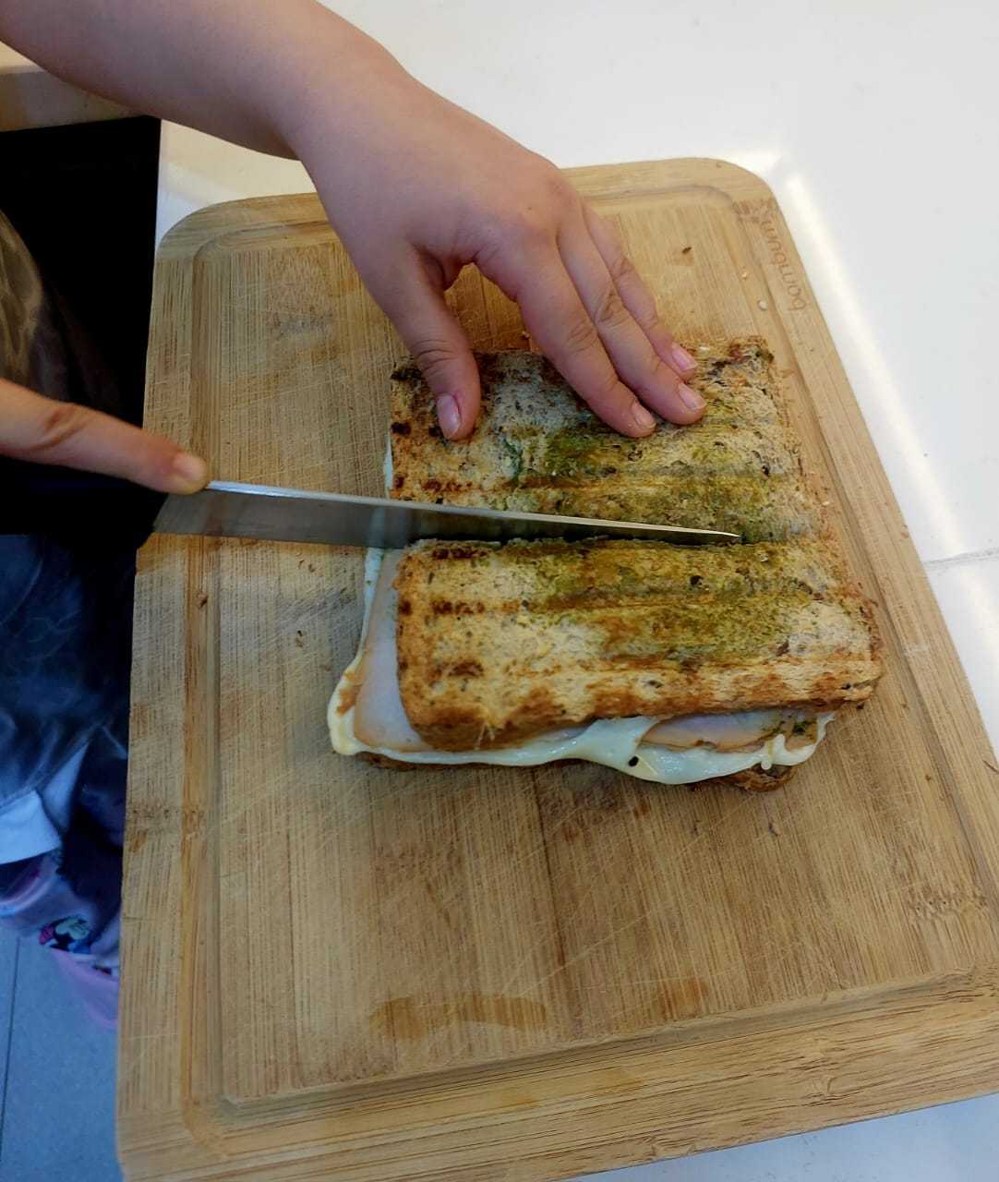
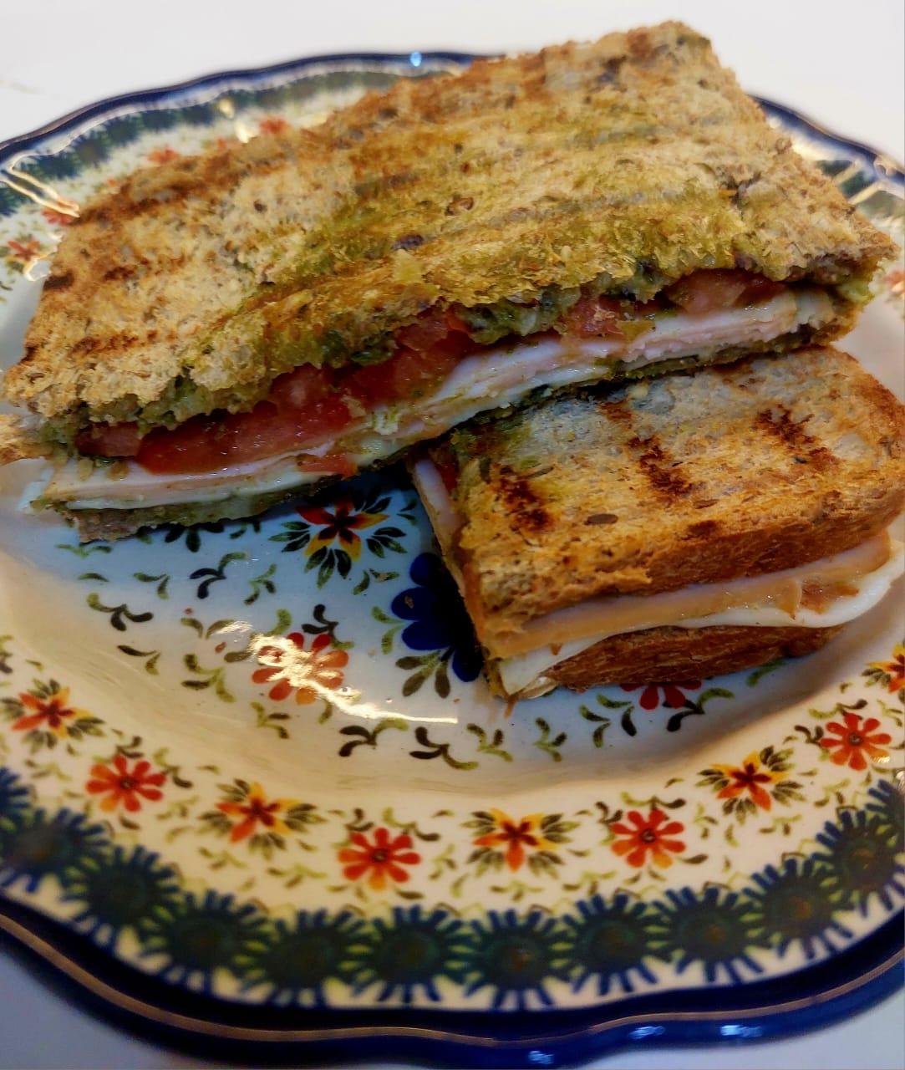
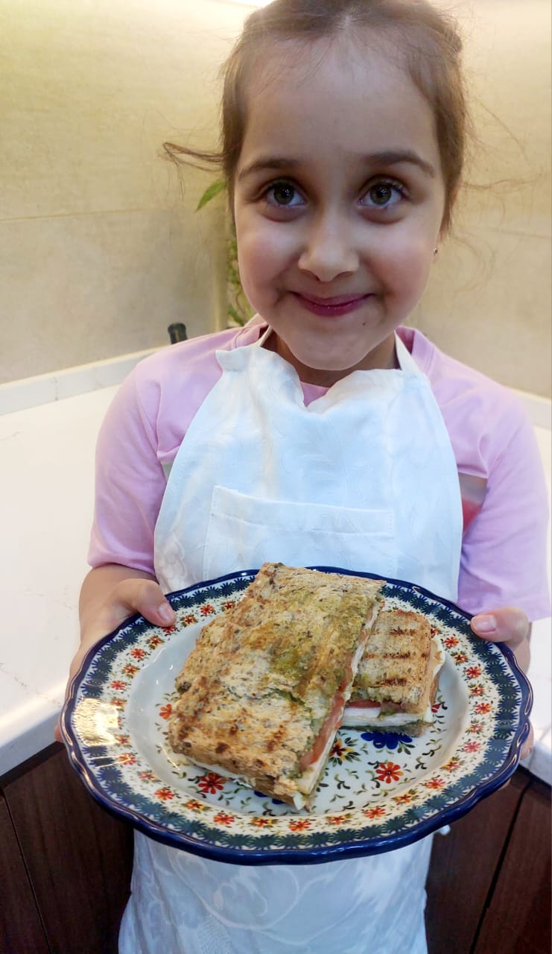
Preparation
Put ingredients on the table Add Pesto Sauce Add Slice Tomato Add Smoked Turkey Add The Cheese Put the bread on The Top
Pres The Sandwich Place it on the Grilled Tosted Well Cut it into Two Serve it on the plate Enjoy

