Slide 1
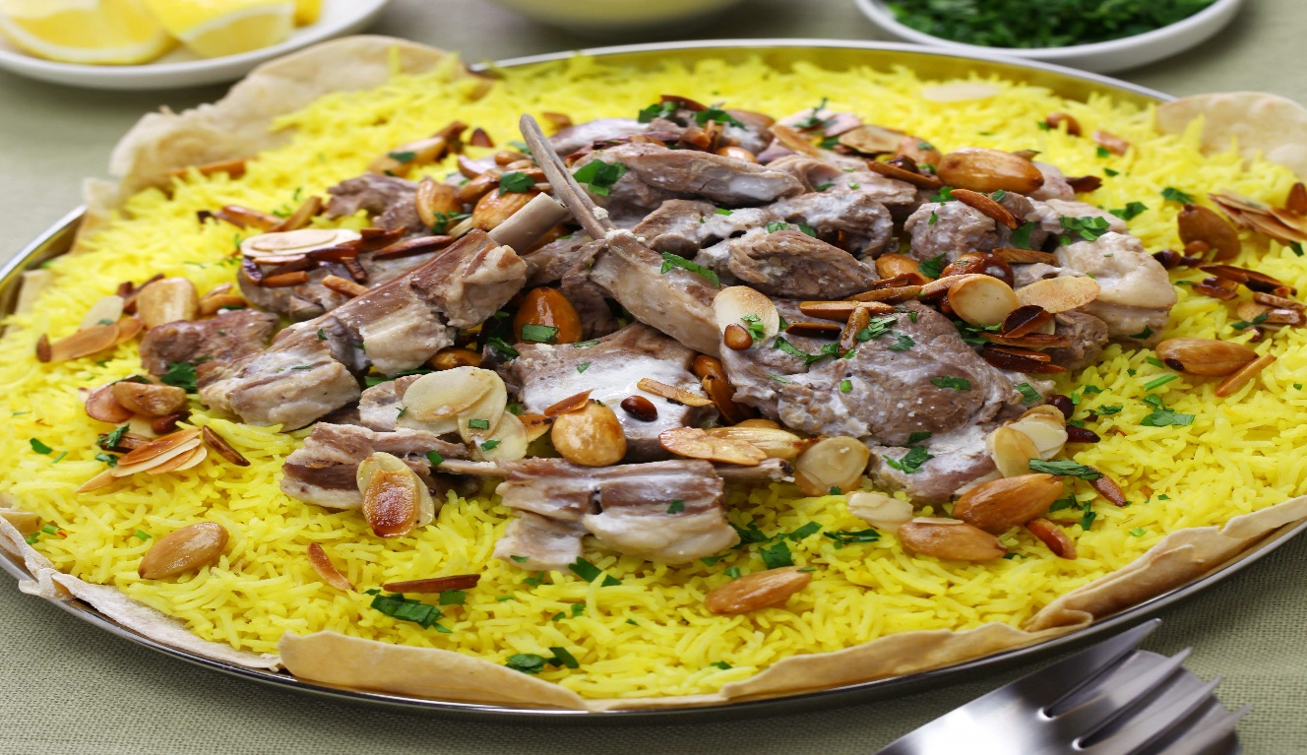
How to make Mansaf

Slide 2
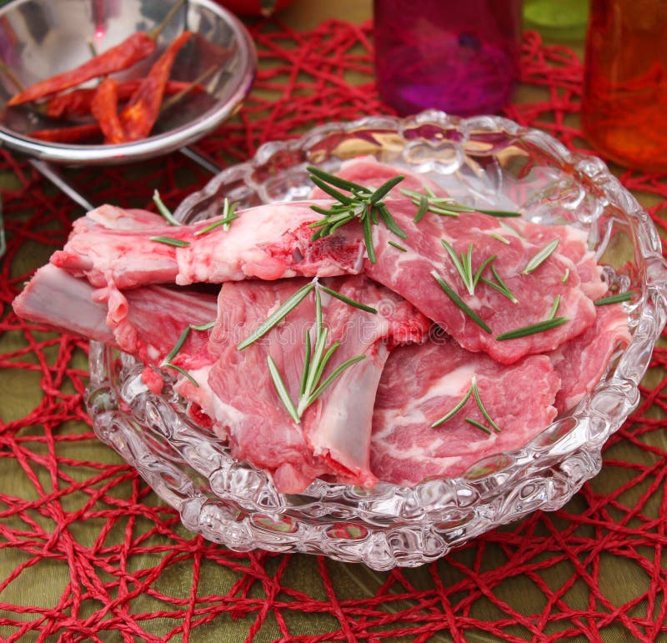
First, 🍖 Cook the meat in water.

Slide 3
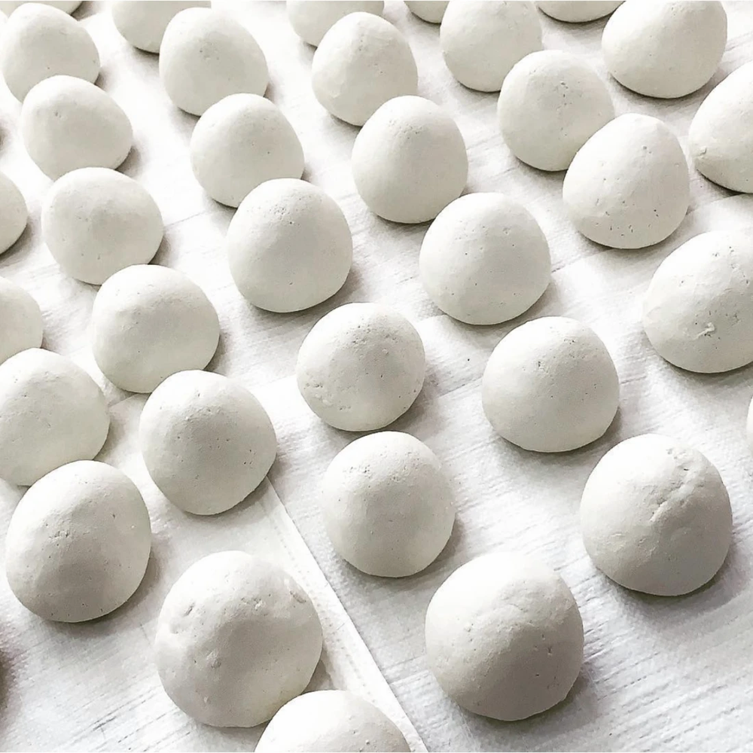
Second, 🔥 Heat the jameed until it bubbles.

Slide 4
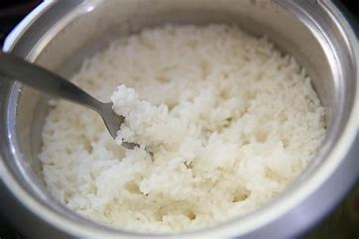
Third, 🍚 Cook the rice.

Slide 5
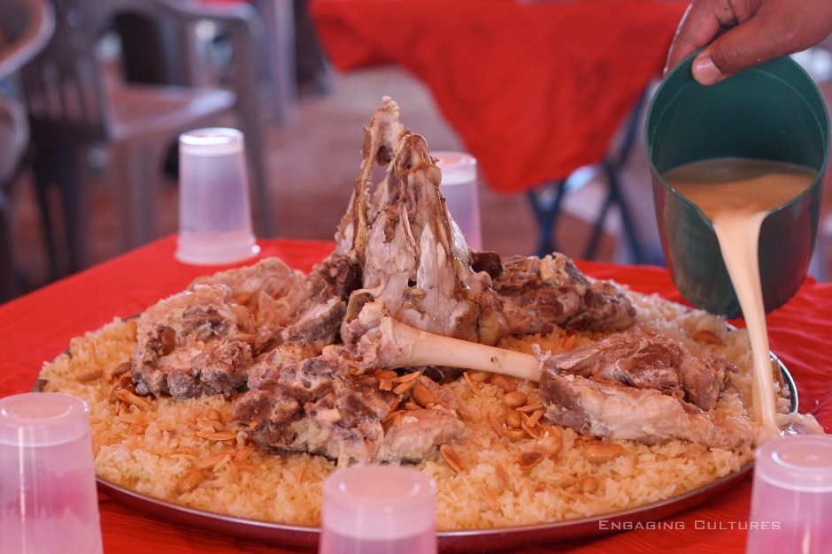
Last, 🍖 Put the meat on top of the rice. put the yogurt on the meat and rice.

Slide 6

Enjoy your Mansaf!

