Slide 1
Pinocchio
By : Mira Shatara 7B

Slide 2
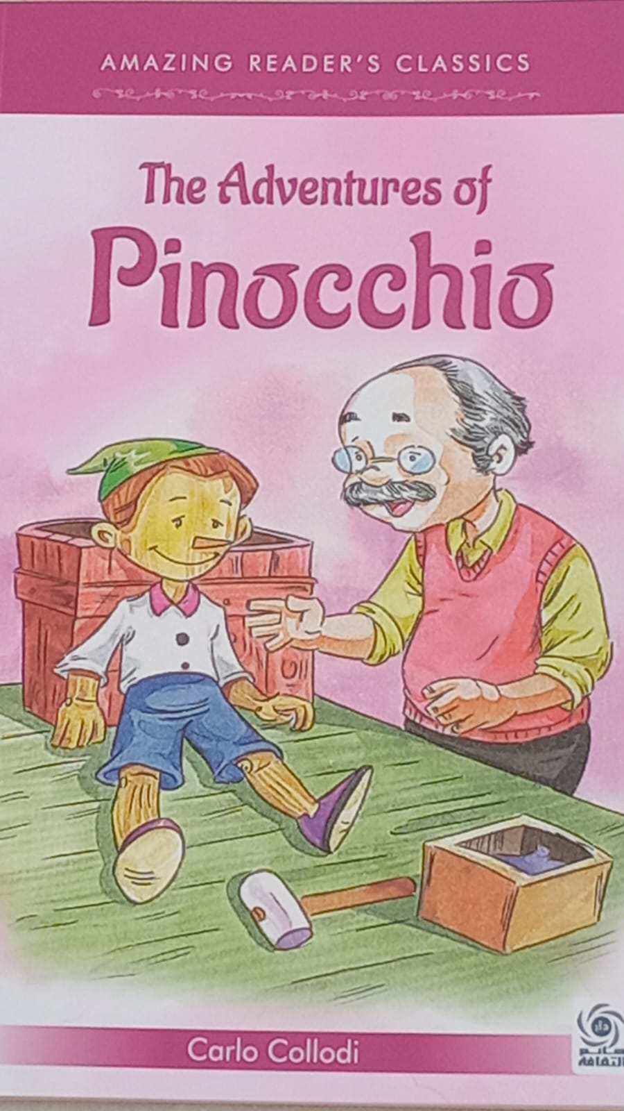
Good morning everyone , today I am going to be talking about the book I read called Pinocchio.
Before I start, I want to tell that in the summer break I read 3 books : Alice in Wonder Land, Peter Pan and Pinocchio of cores. I chose Pinocchio because it has one of the most repeated mistakes children and adults do which is LYING
Today I am going to talk about :
The characters of the story.
The theme of the story.
The summary of the story.
And lastly the moral of the story.

Slide 3
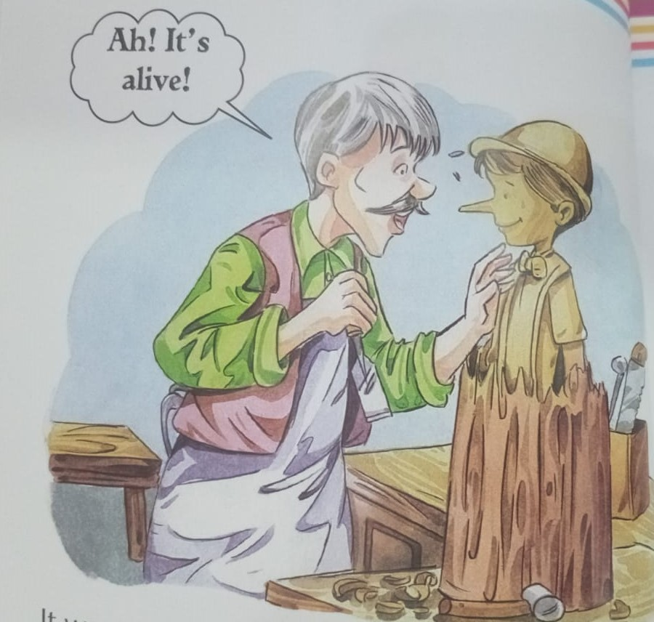
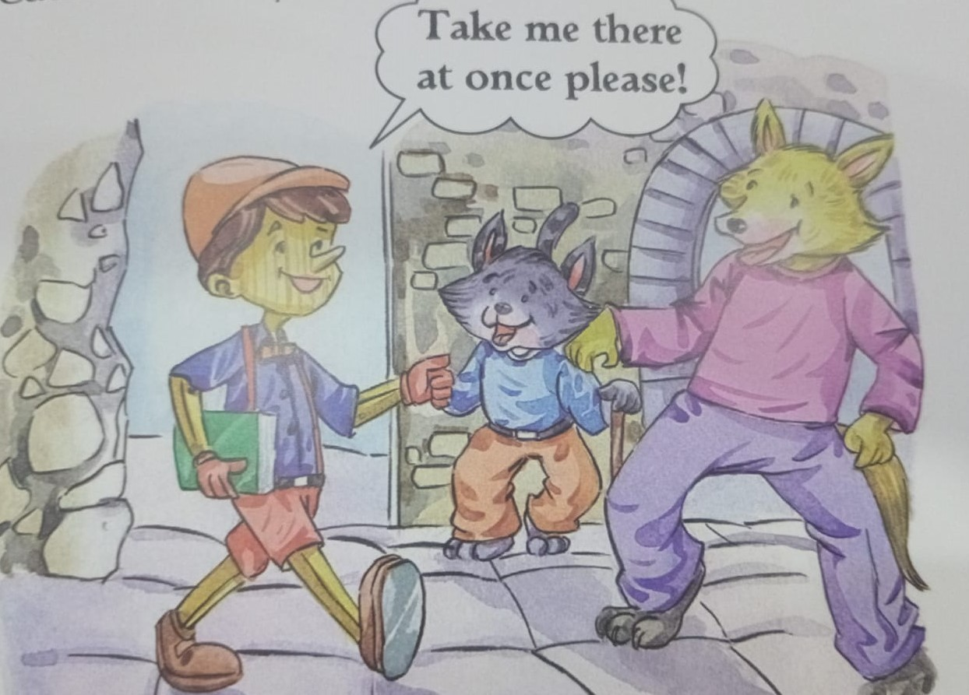
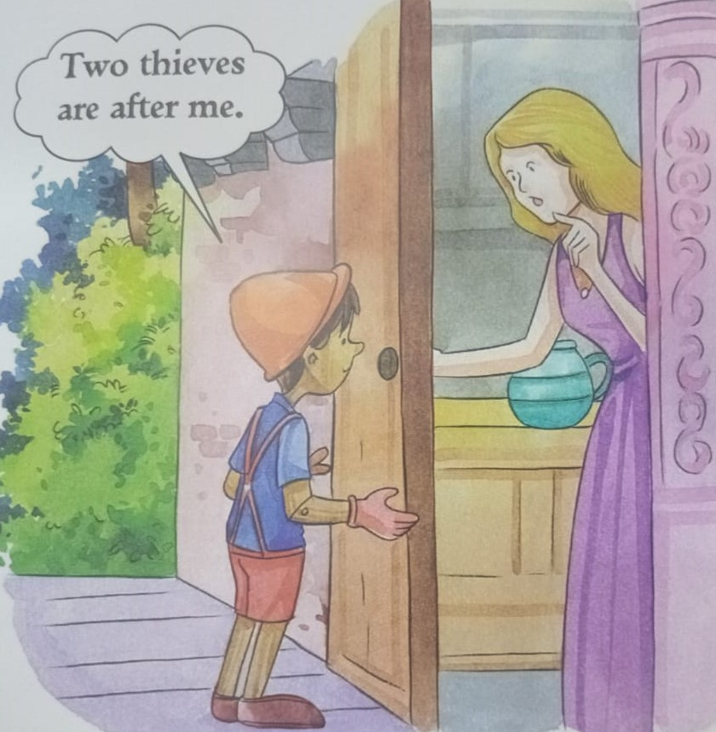
The characters of the story
Geppetto : he is an old man who carved out Pinocchio and made him his son.
Pinocchio : he is a wooden boy whose nose kept growing from lying.
The cat and fox : the were crooks and pretended to be blind to take Pinocchio’s money.
A fairy : she helped Pinocchio from the cat and fox and they lived like siblings.
The farmer : he had a grape tree that Pinocchio tried to eat from so he caught him and trapped him. He tied him and made him guard the chickens. At night he met some foxes and they told him to give them 2 chickens. Pinocchio let them enter the chickens house then locked them in. the farmer was happy and let him free.

Slide 4
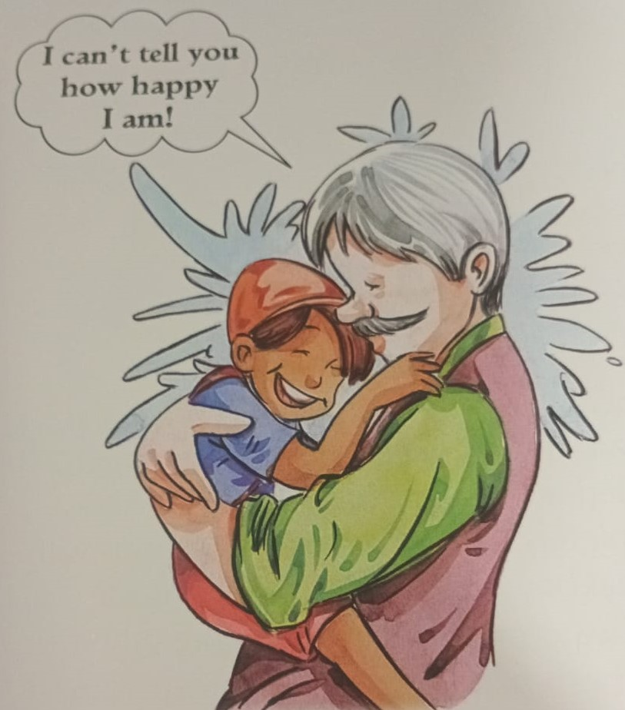
The theme of the story
The theme of this story is transformation and self-discovery , teaching lessons about the importance of honesty, courage and responsibility

Slide 5
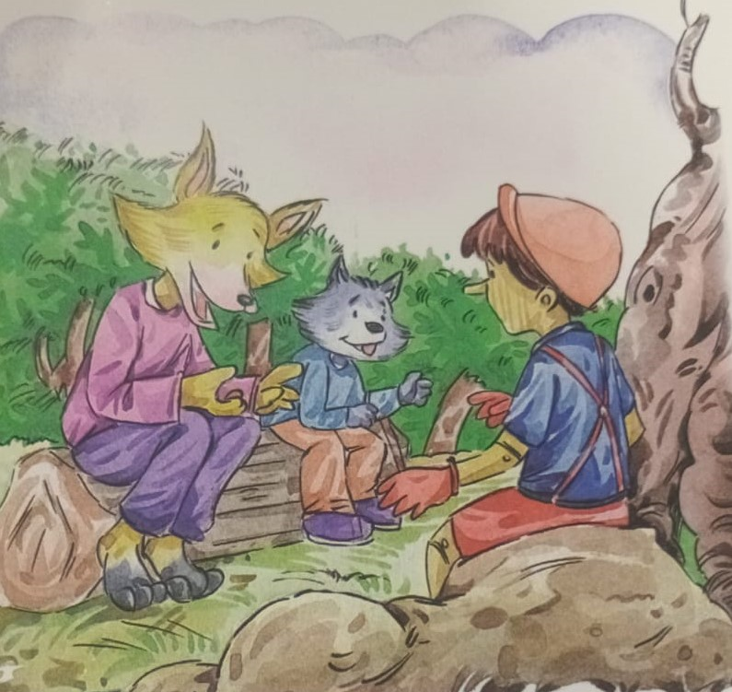
The summary of the story
It describes the story of Pinocchio, an animated puppet, and his poor father , Geppetto , a woodcarver. In the beginning, Pinocchio is mischievous and tends to tell lies, and suffers from a nose growing problem every time he lies!
However, as events in the story proceed , he starts doing nice things and is rewarded by the fairy. The fairy blesses him and he turns into a nice boy in the end.

Slide 6
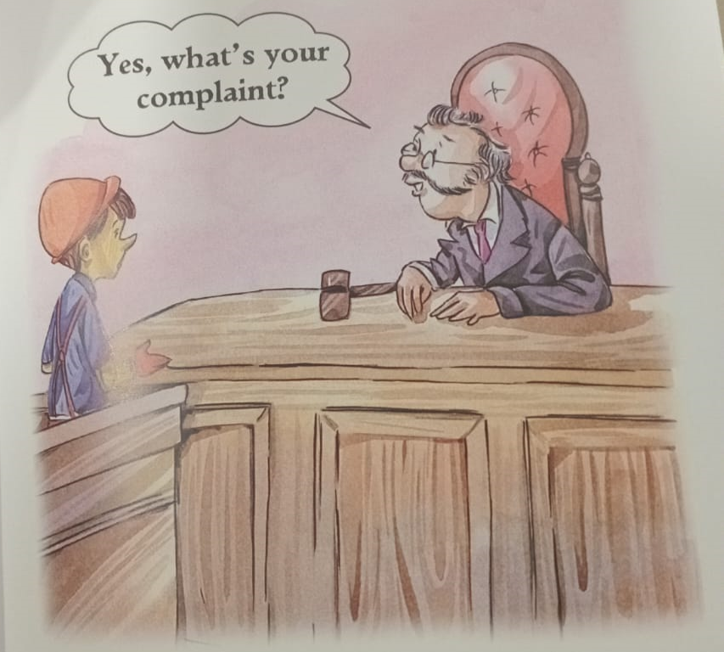
The moral of the story
Be truthful.
Be responsible .
Be obedient.
Be kind and brave.
Learn from your mistakes.
And Never lie.

Slide 7
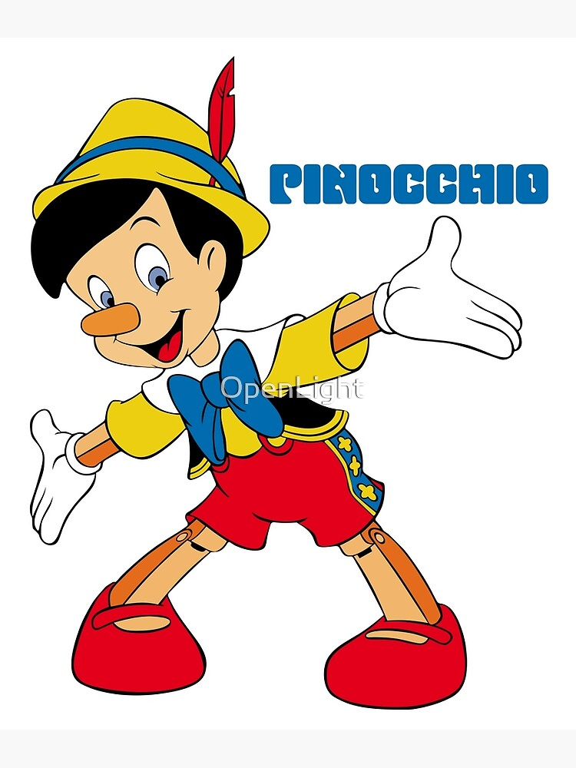
Thank you for listening

