Slide 1

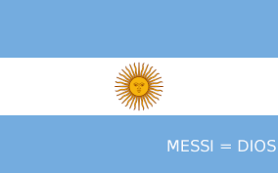
messi life

Slide 2



Early Life
Lionel Andrés Messi was born June 24, 1987, in Rosario, Argentina.
From a young age, Messi showed extraordinary talent. At 11, he was diagnosed with a growth hormone deficiency, and his family struggled to afford treatment. FC Barcelona offered to cover his medical expenses if he joined their youth academy, La Masia. At age 13, he moved to Spain with his family.

Slide 3


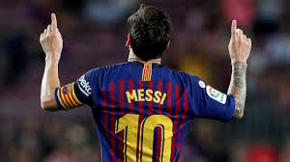
Career at Barcelona (2004–2021):
Messi made his first-team debut in 2004 at just 17. Over 17 years, he became Barcelona’s all-time top scorer and won 10 La Liga titles, 7 Copa del Rey titles, and 4 UEFA Champions League trophies. Individually, he won 6 Ballon d’Or awards during his time there

Slide 4


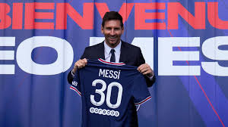
Move to PSG (2021–2023):
Due to Barcelona’s financial crisis, Messi left the club in 2021. He signed with Paris Saint-Germain (PSG), where he played for two seasons, winning Ligue 1 titles.

Slide 5


Inter Miami (2023–present):
In 2023, Messi joined Inter Miami in Major League Soccer (MLS), bringing global attention to U.S. football.

Slide 6

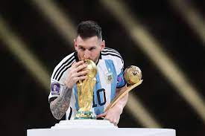
International Career:
Messi initially faced criticism for not replicating his Barcelona success with Argentina. But he silenced critics by winning the Copa América in 2021 (his first major international trophy) and the 2022 FIFA World Cup in Qatar, where he captained Argentina to glory.

Slide 7

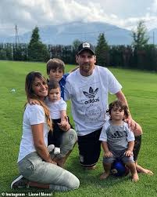
Personal Life:
Messi married his childhood sweetheart, Antonela Roccuzzo, in 2017. They have three children. Beyond football, he is involved in philanthropy through the Leo Messi Foundation.

Slide 8

thank you for listening
shafiq AbuJeris
7A

