Slide 1
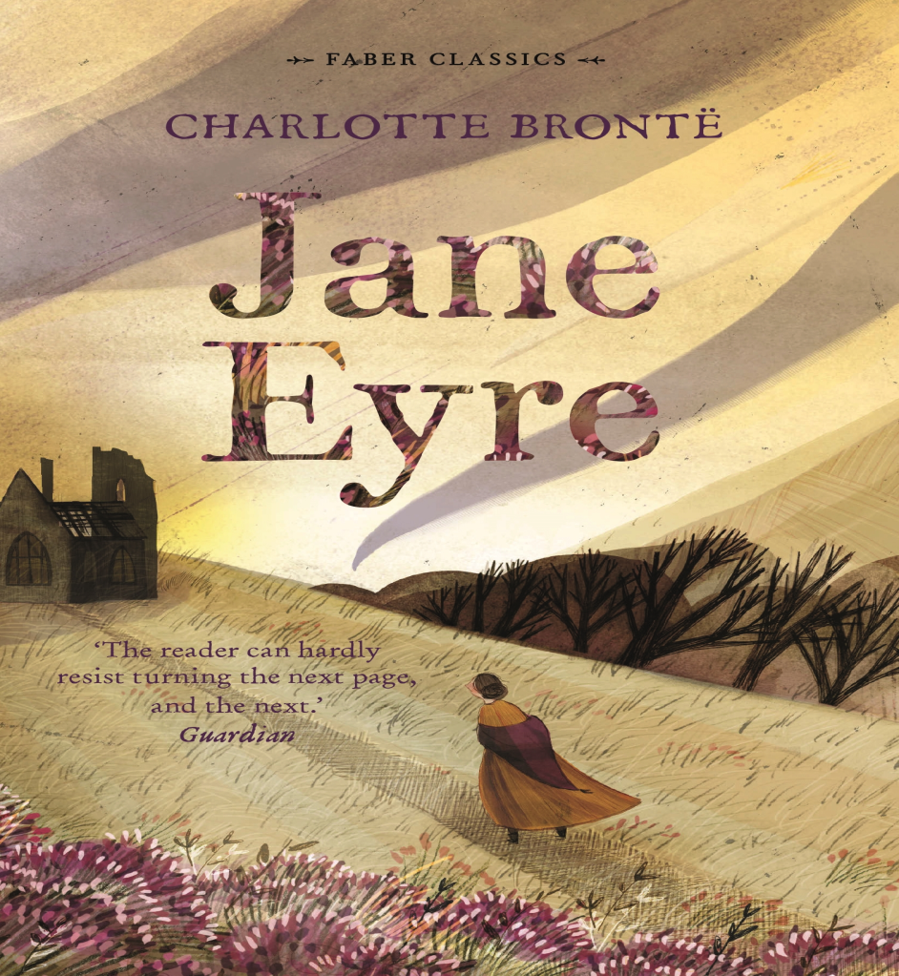
Jane eyre
Done by: Zain al nahar

Slide 2
What the novel contains
It contains pot twists you cant even expect
It creates a lot of suspense
It doesn’t give you the idea directly

Slide 3
Main events in the novel
her harsh childhood at Gateshead Hall and the incident in the Red Room.
Her formative years at Lowood School where she forms key relationships.
her role as a governess at Thornfield Hall where she falls in love with Mr. Rochester and discovers his secret wife, Bertha;
her subsequent flight from Thornfield and the discovery of her inheritance and her cousins, the Rivers family
and finally, her return to the ruined Ferndean estate to be with a blind and disabled Rochester, leading to their marriage

Slide 4
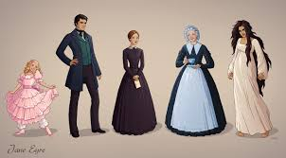
The characters of this story the main characters of this story:
;
;

Slide 5


