Slide 1
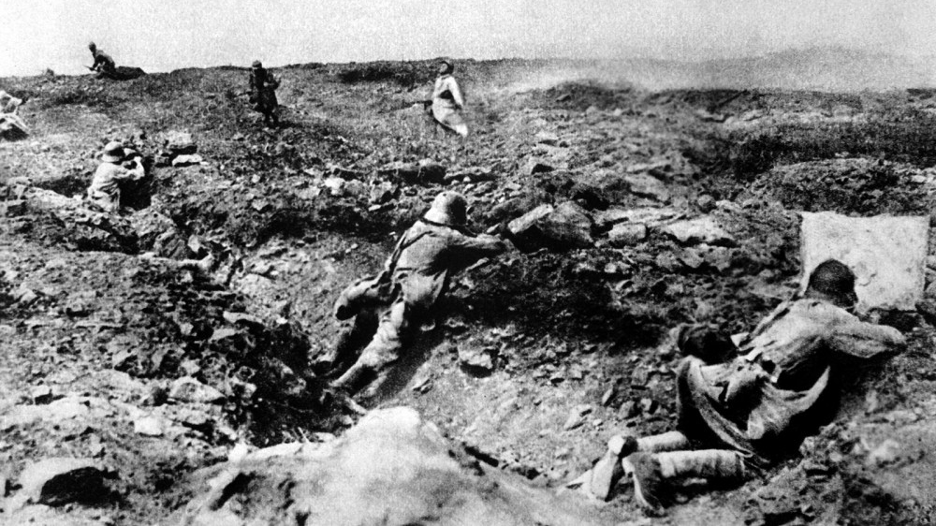
History on world war
(by francis A. March Jr. and Richard J.Beamish,1919)
This Photo by Unknown Author is licensed under CC BY-SA

Slide 2
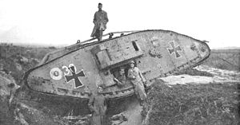

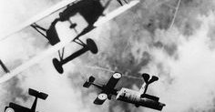
About The Book
The book mainly talks about WW1 and its events and tragedies.
The book was written right after WW1 ended.
The main point of the book was to give a full picture about”The Worlds Greatest War”.
Its completely free to read online.
This Photo by Unknown Author is licensed under CC BY-SA

Slide 3
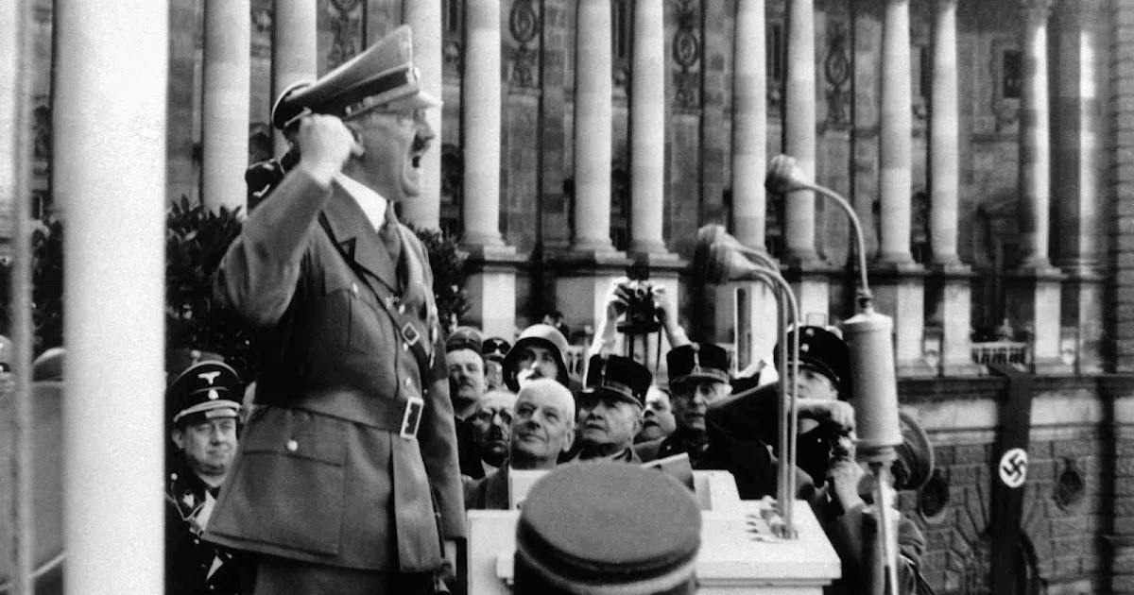
Contents
The main causes of the war are (alliances, rivalries, assassination of Archduke).
The most major battles were at Marne, Verdun, Somme.
During the time the managed to make a lot of weapons.
When the war ended a treaty launched which is called the treaty of Versailles

Slide 4
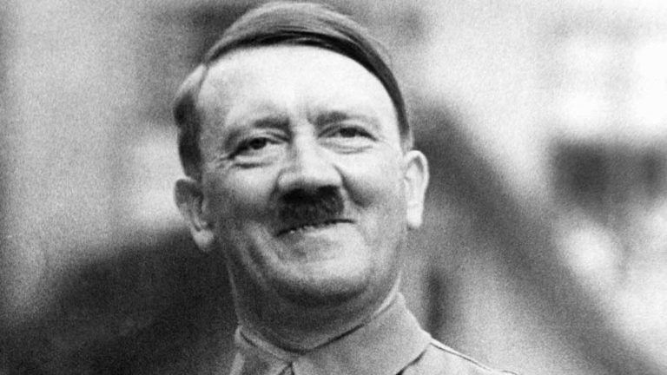
BYE.
This Photo by Unknown Author is licensed under CC BY-NC-ND

