Slide 1
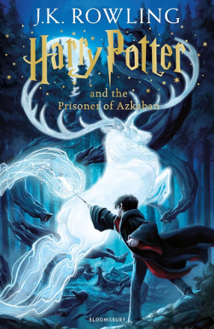
Harry Potter and the Prisoner of Azkaban
AbdelRahman Samara – 7E
Notes:
---

Slide 2
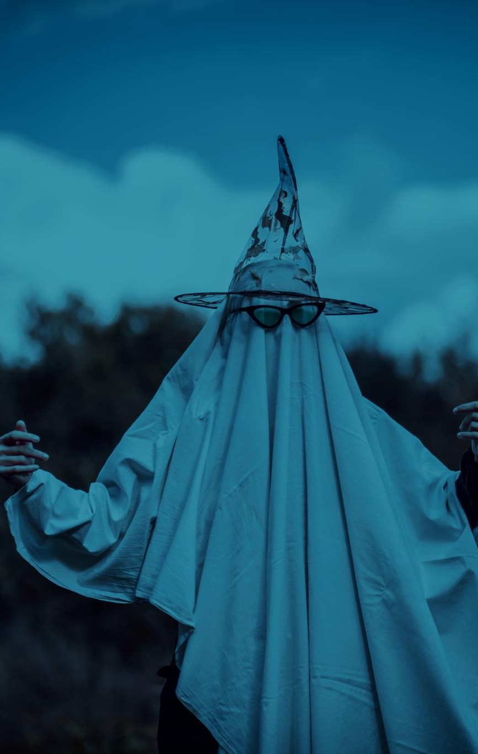
Main Characters
Harry Potter
  Harry is the brave and kind main character growing as a skilled wizard throughout the story.
Hermione Granger
  Hermione is intelligent and resourceful, solving problems with her extensive knowledge.
Ron Weasley
  Ron is loyal and supportive, always standing by Harry’s side through challenges.
Sirius Black and Others
  Sirius is a mysterious escaped prisoner and Harry’s godfather; Lupin teaches defense magic; Buckbeak the Hippogriff plays a key role; Dementors cause fear.
Notes:
The story features several important characters. Harry Potter is the brave and kind main character who continues to grow as a wizard. Hermione Granger is intelligent and resourceful, often helping solve problems with her knowledge. Ron Weasley is loyal and supportive, always standing by Harry’s side. Sirius Black is introduced as a mysterious escaped prisoner, but later revealed to be Harry’s godfather and a wrongly accused man. Professor Lupin is the new Defense Against the Dark Arts teacher who teaches Harry how to defend himself and becomes a trusted adult figure. Buckbeak is a magical creature called a Hippogriff who plays a key role in the story. The Dementors are dark, ghost-like creatures that guard Azkaban and cause fear and sadness. These characters contribute to the story’s excitement and emotional depth.

Slide 3

summary
  Harry Potter and the Prisoner of Azkaban is the third book in the series about a young wizard. Harry finds out that a prisoner named Sirius Black has escaped and people think he wants to hurt him. At school, Harry meets scary creatures called Dementors that feed on fear. With help from his friends Ron and Hermione, Harry learns that Sirius is actually his godfather and was wrongly blamed for betraying his parents. The real traitor is Peter Pettigrew, who was hiding as Ron’s pet rat. Harry bravely helps Sirius escape and learns more about his family.

Slide 4
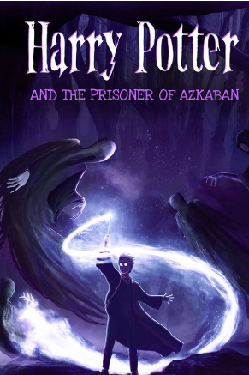
Key Themes
Friendship
  Friendship is central as Harry, Ron, and Hermione collaborate and support each other through challenges.
Bravery
  Bravery is shown by Harry confronting dangers .
  Truth Discovery
  The story emphasizes uncovering truth and understanding that appearances can be deceiving.
  Loyalty and Love
  Loyalty and love are highlighted in key relationships, especially between Harry and Sirius.
Notes:
Harry Potter and the Prisoner of Azkaban explores several important themes. One major theme is friendship, as Harry, Ron, and Hermione work together to solve mysteries and support each other through difficult times. Another theme is bravery, shown by Harry’s courage in facing the Dementors and standing up for what is right. The story also emphasizes the importance of discovering the truth, as Harry learns that things are not always as they seem and that people can be wrongly judged. Loyalty and love are also central themes, especially in the relationship between Harry and Sirius. These themes help readers understand the deeper meaning of the story and relate to the characters’ experiences.

Slide 5
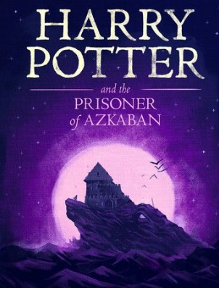
Where the Story Takes Place
Hogwarts Castle
  Hogwarts is a magical castle filled with enchanted rooms, secret passages, and magical creatures.
Forbidden Forest
  The Forbidden Forest is a dark, mysterious place near Hogwarts.
Hogsmeade Village
  Hogsmeade is a quaint village.
  Shrieking Shack
  The Shrieking Shack is an abandoned building holding many secrets.
Notes:
The story is set in several magical locations. The main setting is Hogwarts School of Witchcraft and Wizardry, a castle filled with enchanted rooms, secret passages, and magical creatures. The Forbidden Forest near Hogwarts is a dark and mysterious place where important events occur. Hogsmeade Village is another key location, where students visit shops and enjoy treats. The Shrieking Shack is an abandoned building in Hogsmeade that holds secrets about Sirius Black. These settings create a magical and adventurous atmosphere that draws readers into the story. The mood of the book is often mysterious and suspenseful, with moments of excitement and emotion.

Slide 6
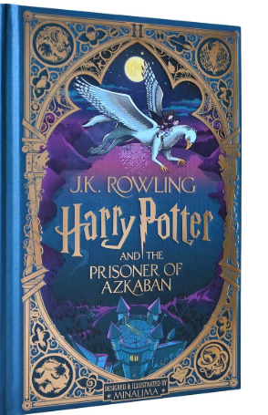
Conflict and Resolution
In Harry Potter and the Prisoner of Azkaban, a man named Sirius Black escapes from prison. People think he wants to hurt Harry. At school, Harry feels scared because of dark creatures called Dementors. Later, Harry finds out Sirius is his godfather and was blamed for something he didn’t do. The real bad guy is Peter Pettigrew, who was hiding as a pet rat. With help from Hermione and magic, Harry saves Sirius and a creature named Buckbeak. Harry is happy to know he has someone who cares about him.

Slide 7
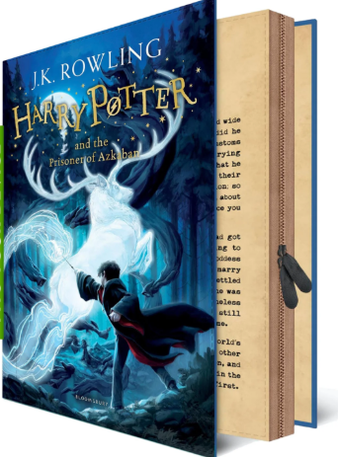
Literary
Genre: Fantasy
  The story belongs to the fantasy genre, featuring magical creatures, spells, and enchanted objects that captivate readers.
Point of View
  The third person point of view reveals thoughts and actions of multiple characters, enriching the narrative.
Notes:
Harry Potter and the Prisoner of Azkaban includes many literary elements that make the story engaging. The genre is fantasy, with magical creatures, spells, and enchanted objects. The point of view is third person, allowing readers to see the thoughts and actions of multiple characters. The mood is mysterious and adventurous, with moments of tension and excitement. Symbols in the story include the Time Turner, which represents second chances and the power of time; the Dementors, which symbolize fear and sadness; and the Patronus, which represents hope and protection. These elements help create a rich and imaginative world that captivates readers and enhances the storytelling.

Slide 8
THE END
Thank you
AbdelRahman Samara

