Slide 1


The Princess and the Foal
By : Yasmina Yaish
7E

Slide 2
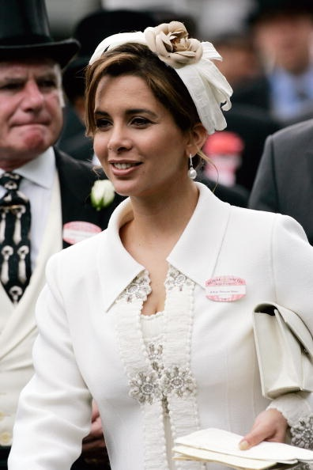
Who Inspired The Story?
The novel is written by Stacy Gregg that tells a fictional story inspired by the real-life childhood of Princess Haya Bint Al Hussein of Jordan.

Slide 3
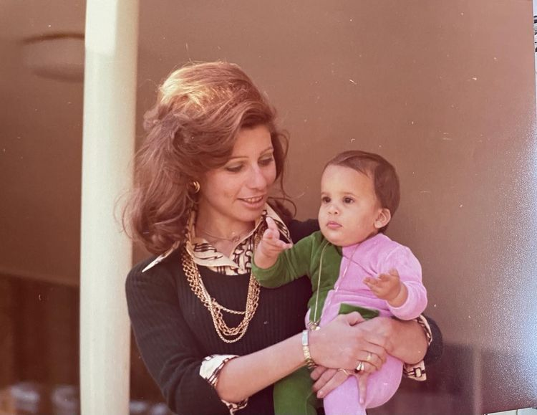
What is the Story about?
The story is about a young girl called Princess Haya after her mother Queen Alia passed away by airplane accident. Before her mother leaves Haya did not want her mother to leave her and she cried so much but queen Alia had to travel for work.

Slide 4
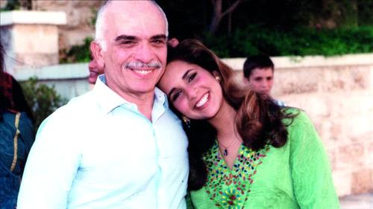
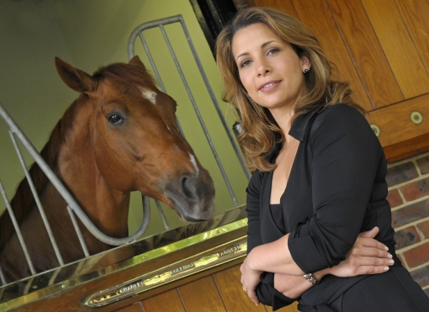
What is the Story about?
She receives a foal for her birthday from her father King Hussein of Jordan, gave her a foal and make a deep friendship with Haya and the Foal. And she named the foal Bint al-Reeh. She became the first female to represent Jordan internationally at showjumping at 13 years old

Slide 5
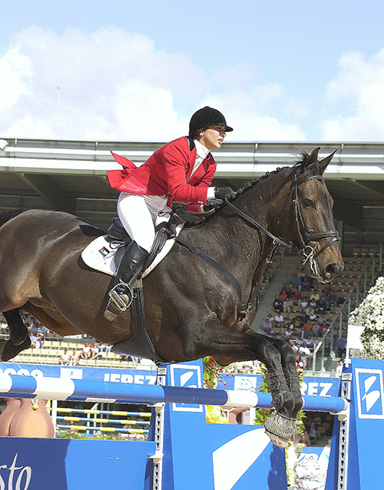
Her dream was
Her dream was to win the king’s cup in Jordan when she was young, when she grew up she won the cup of Jordan.

Slide 6
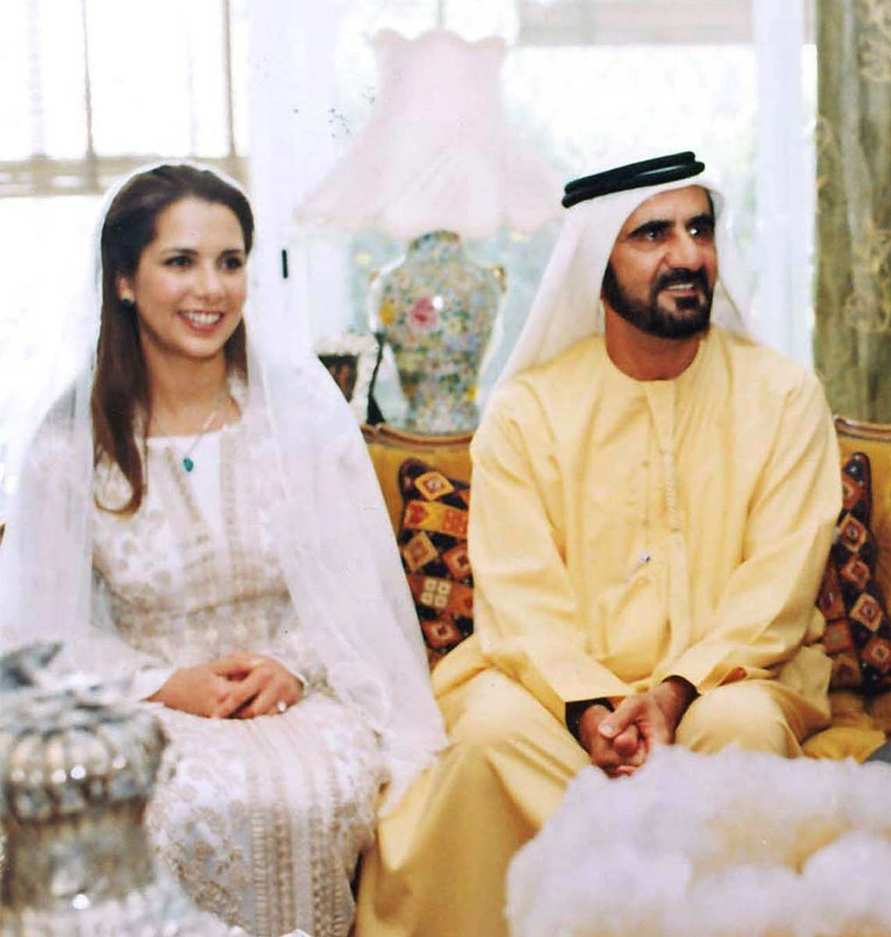
Her marriage
In 2004, Princess Haya married Sheikh Mohammed bin Rashid Al Maktoum, the ruler of Dubai and she bought two children. Then she left him. Haya and her children went to live in London

Slide 7

Thank You For Listening

