Slide 1
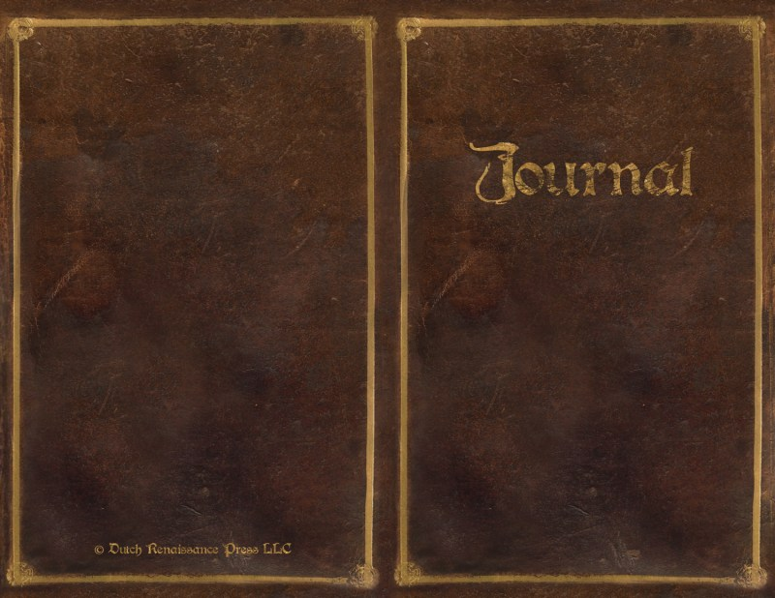
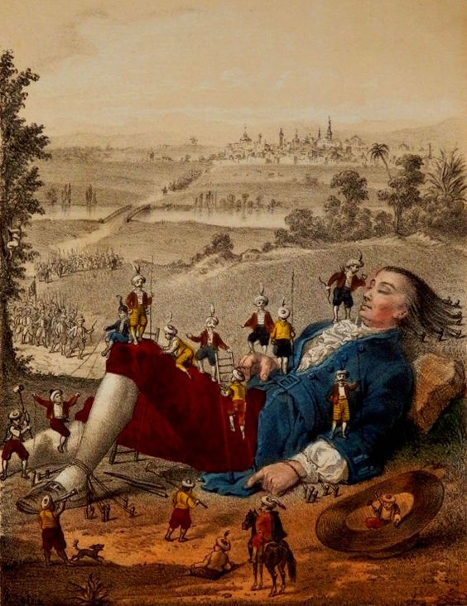
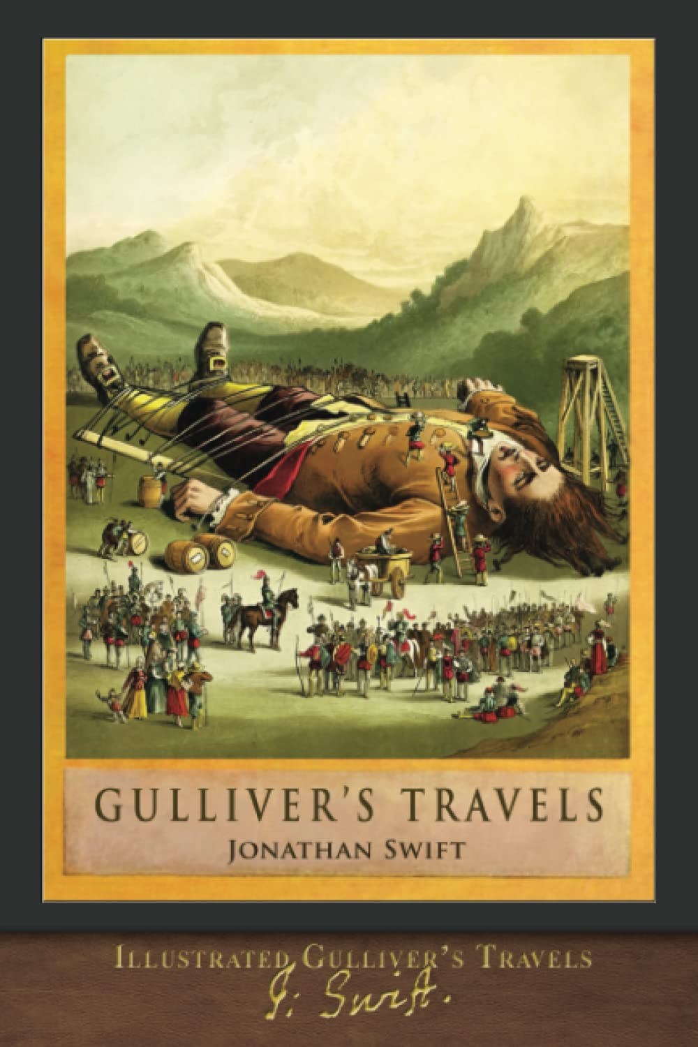
Rayyan Essam Al Hadid 7th grade

Slide 2
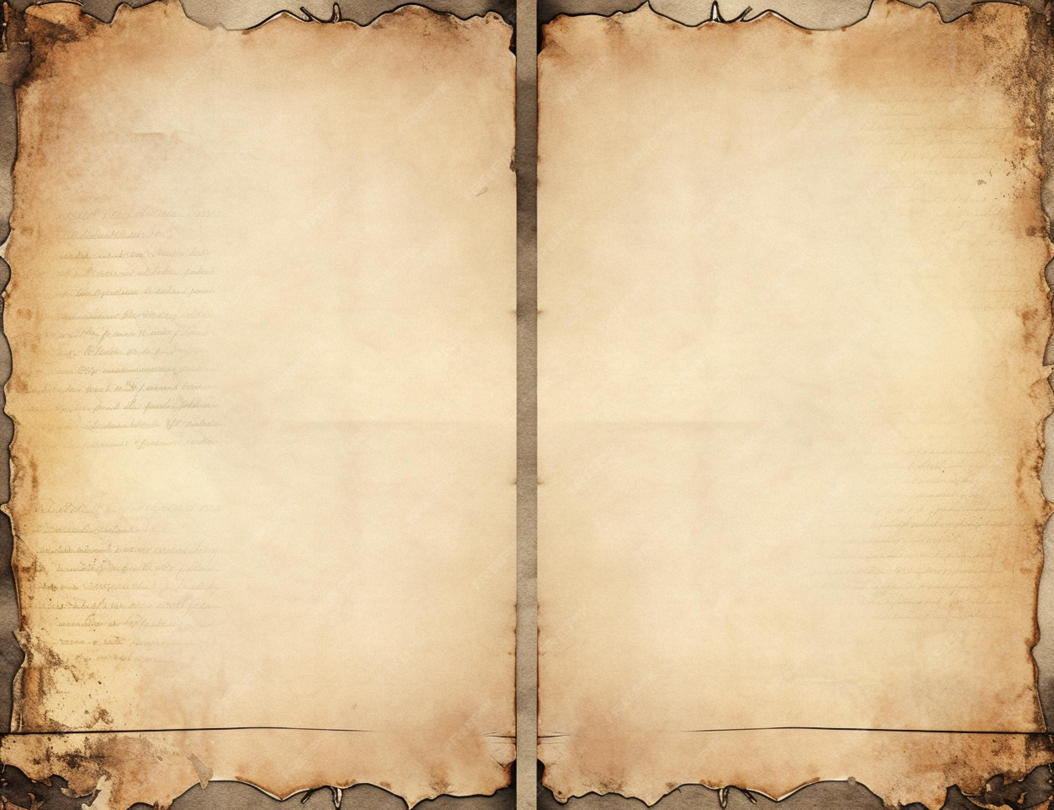
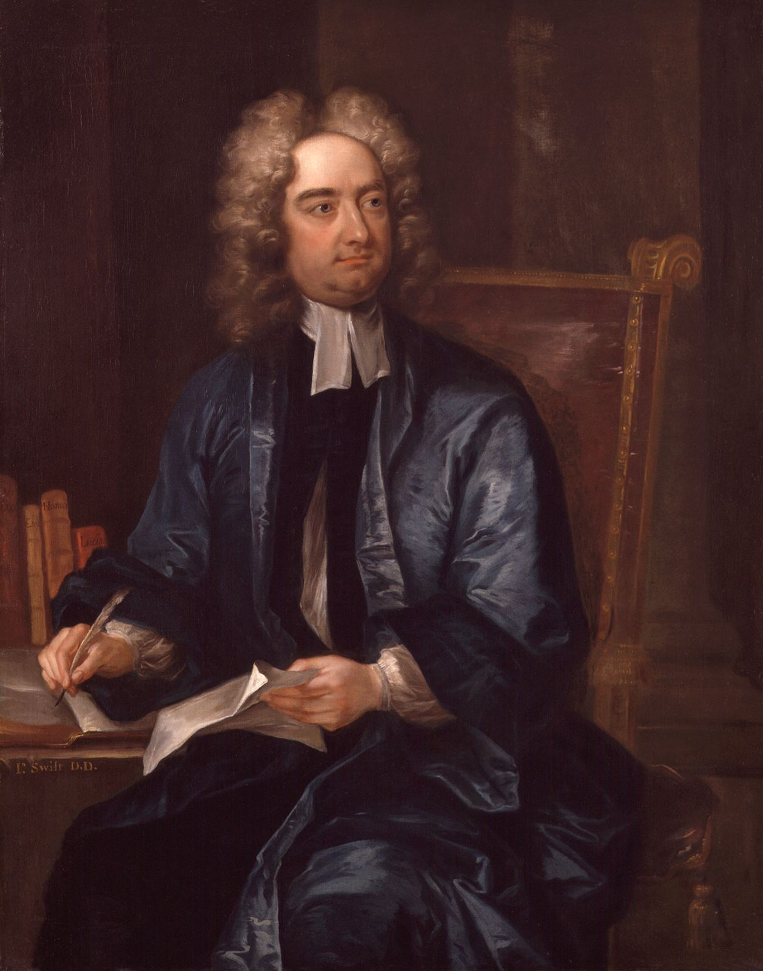
Gulliver's Travels, originally titled Travels into Several Remote Nations of the World. Written by the Anglo-Irish writer Jonathan Swift, who was from Ireland, but his family came from England. It is a 1726 adventure and prose satire novel. Which is an art or literature that uses irony, and sarcasm to talk about evil or bad behavior in humanity. The purpose of this genre is to change or improve the problem highlighted by making it sound funny and ridiculous to make people think they can change something.

Slide 3

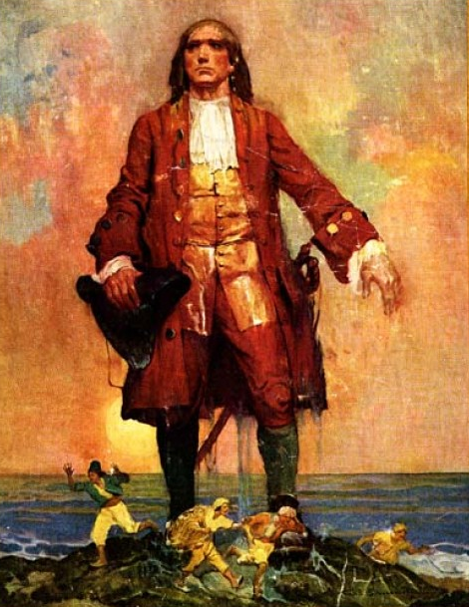
Main Character:
Lemuel Gulliver – A curious and brave Englishman who works as a ship’s doctor. He travels to strange lands and tells the stories of what he sees.

Slide 4
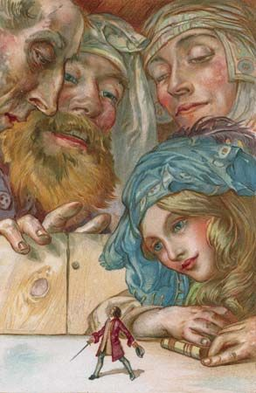
Plot Summary
Gulliver goes on four big sea adventures, and each one takes him to a strange and magical land:
Lilliput – A land of tiny people, only 6 inches tall! Gulliver is a giant here. The people argue about silly things, like which end of an egg to crack. This part makes fun of how governments fight over unimportant things.
2. Brobdingnag – A land of giants. Now Gulliver is the tiny one! The giants think people in Europe (like Gulliver) are foolish and selfish. This part shows how strange human behavior looks from a different view.

Slide 5
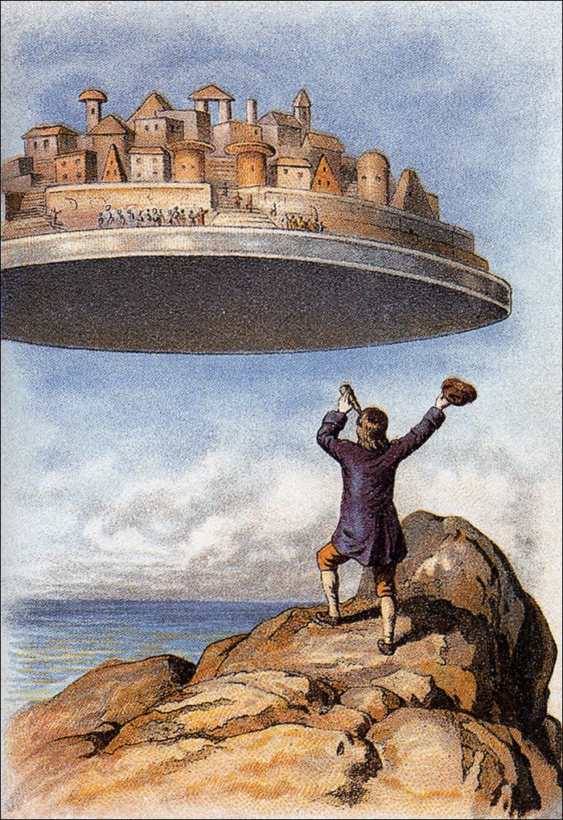
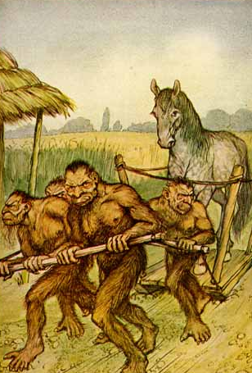
3. Laputa and other islands – A land of scientists and thinkers who are so focused on weird ideas that they forget common sense. This part makes fun of people who care more about looking smart than being practical.
4. Houyhnhnms and Yahoos – A land where horses are the smart, kind rulers, and the humans (called Yahoos) are wild, dirty, and mean. Gulliver starts to think the horses are better than people. This part shows how bad humans can be when they act selfishly.

Slide 6

Even though it’s funny and full of imagination, the book teaches us to:
Think about how we behave as people and as a society
See the world from different points of view

