Slide 1
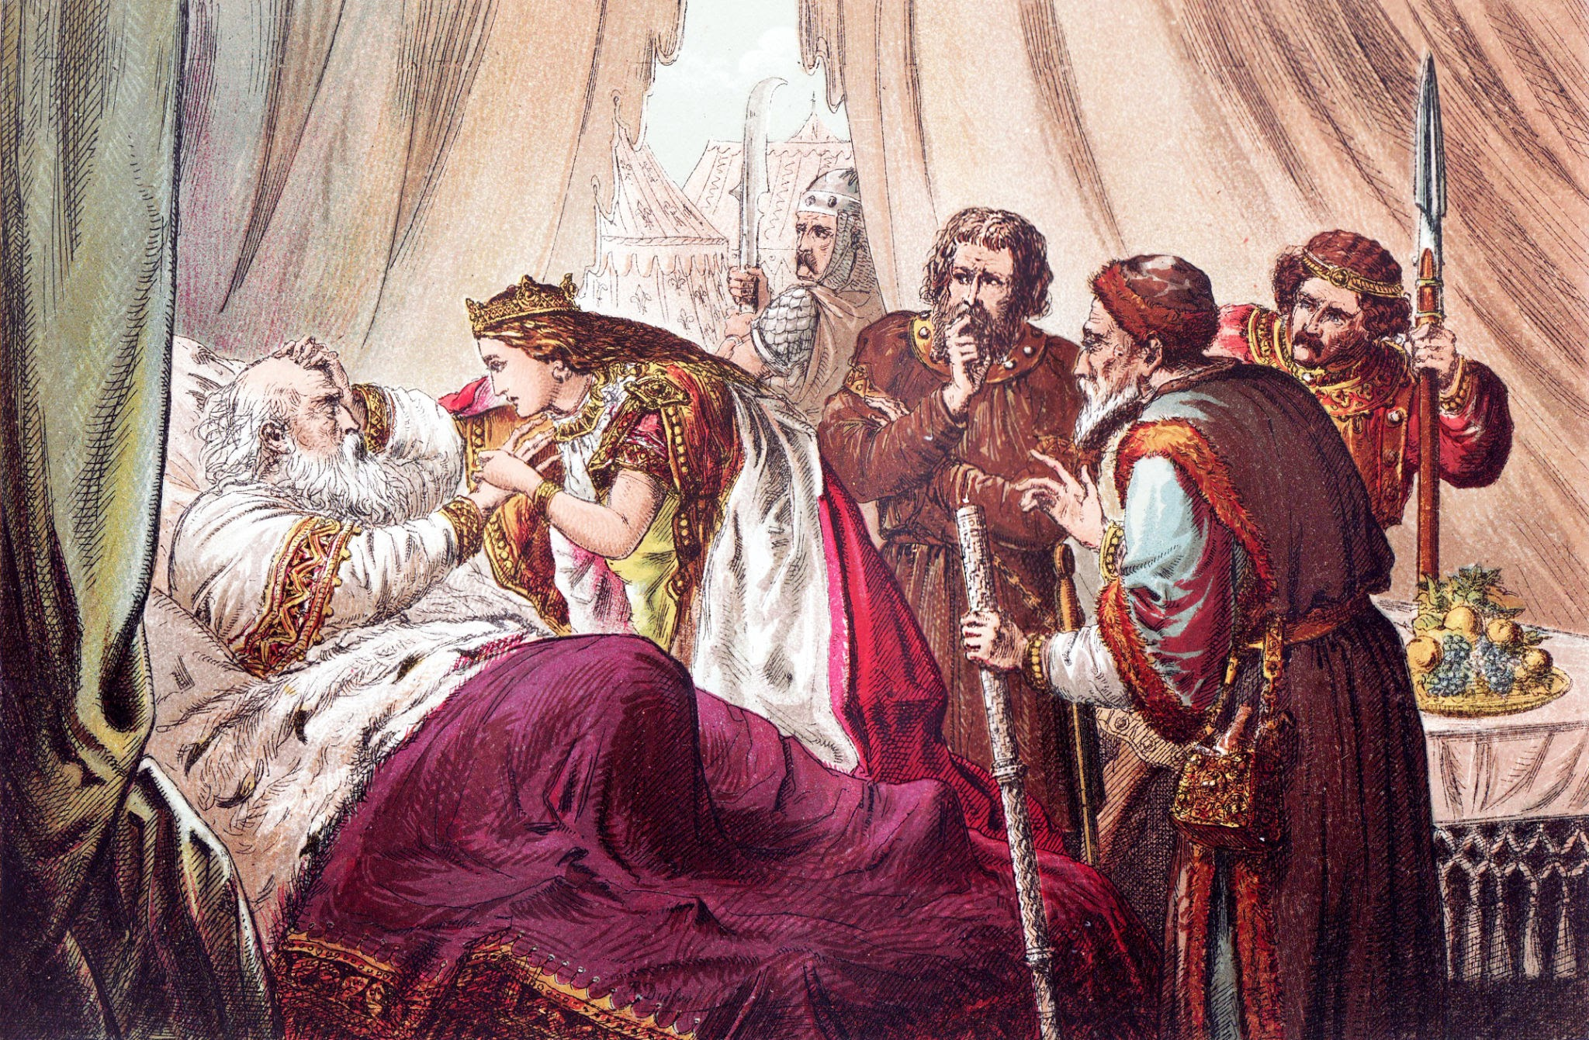

King Lear
Act 1 Scene 1
:
Abdel-Latif Al-Saadi
&
Marc Abdel-Massih

Slide 2
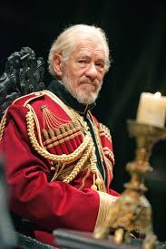
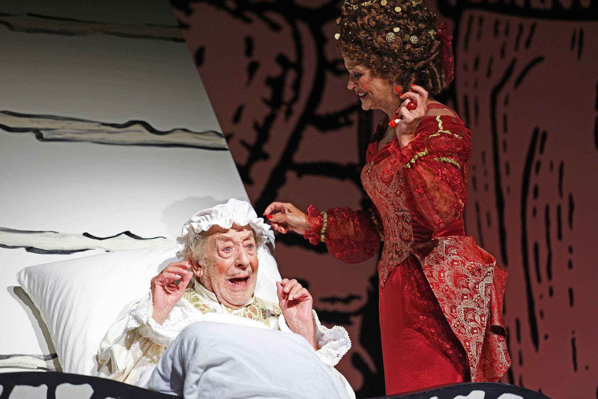
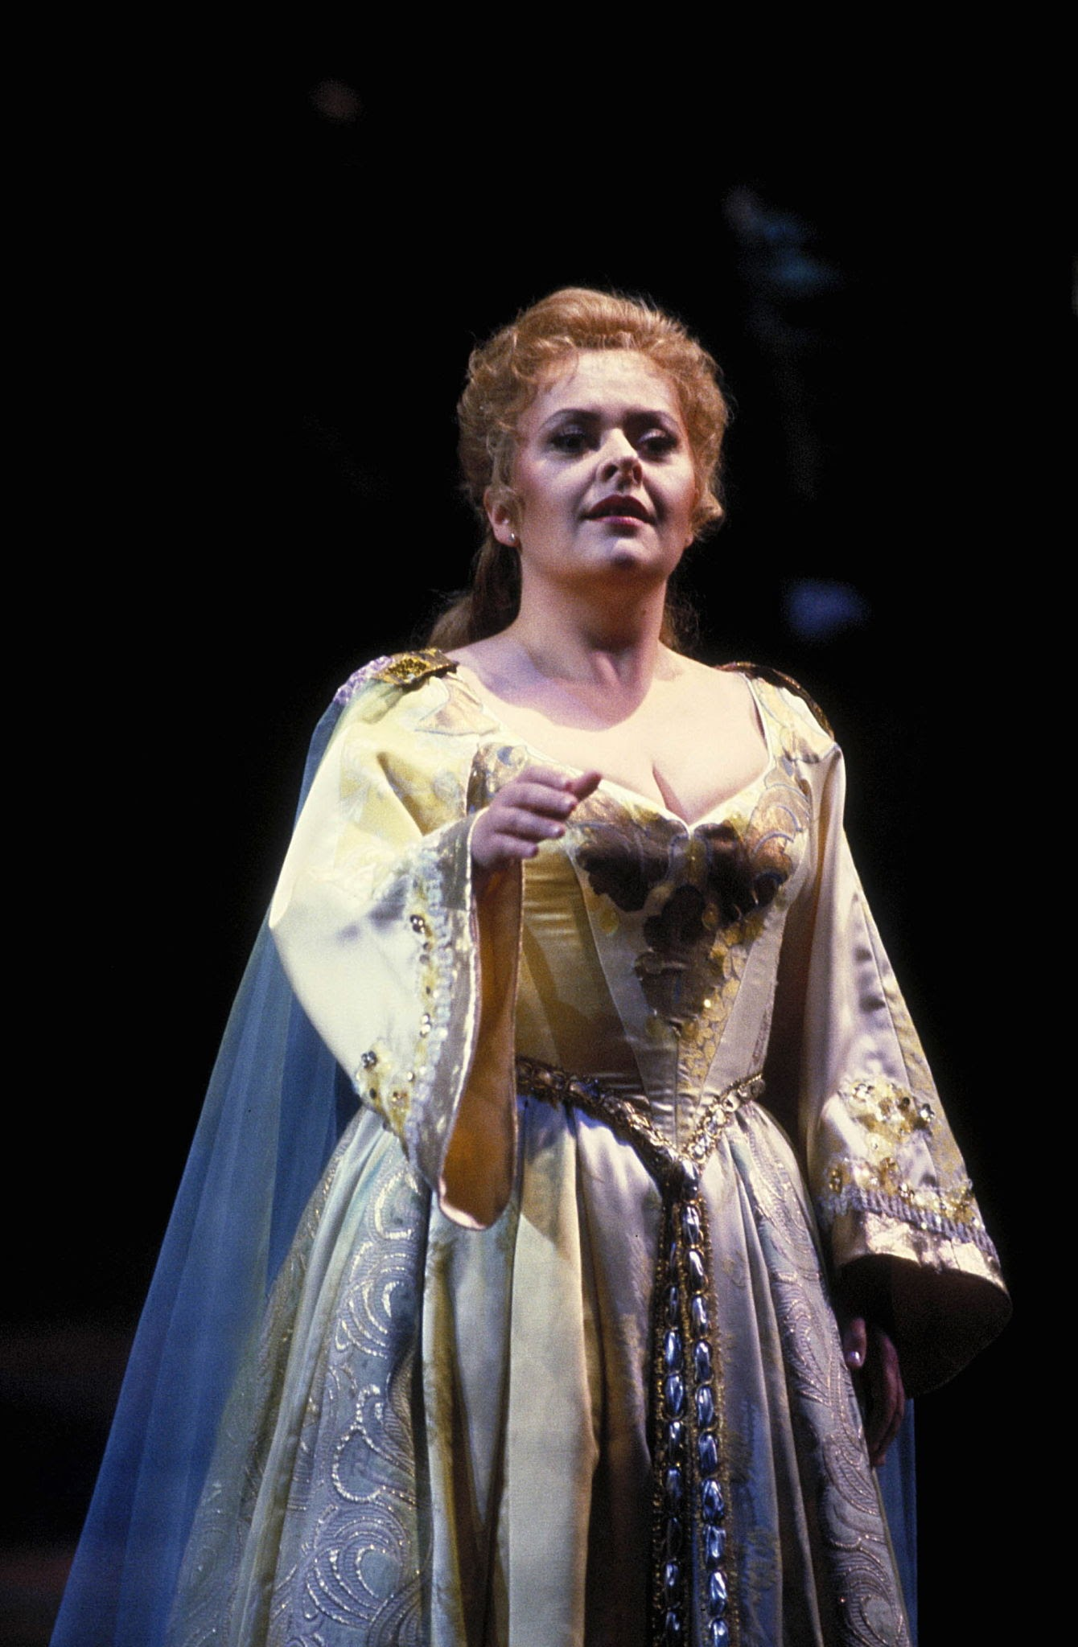
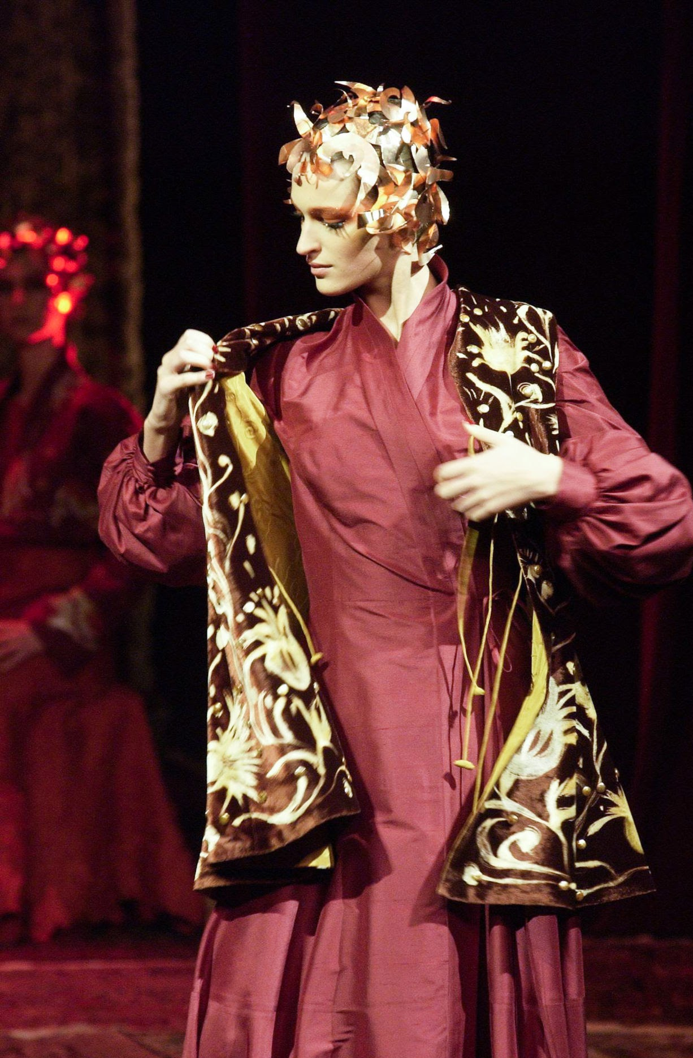
Characters In The Play(Main-Plot)
King Lear: Is a proud old king whose poor judgment leads to betrayal, madness, and tragic wisdom.
Regan: King lear’s Middle Daughter. She is equally deceitful and cruel, often matching or exceeding her sister’s harshness.
Cordelia: King Lear’s youngest daughter. She is honest, loyal, staying true to her father despite his rejection.
Goneril: King lear’s eldest daughter.She is ambitious and ruthless, seeking power at any cost.

Slide 3
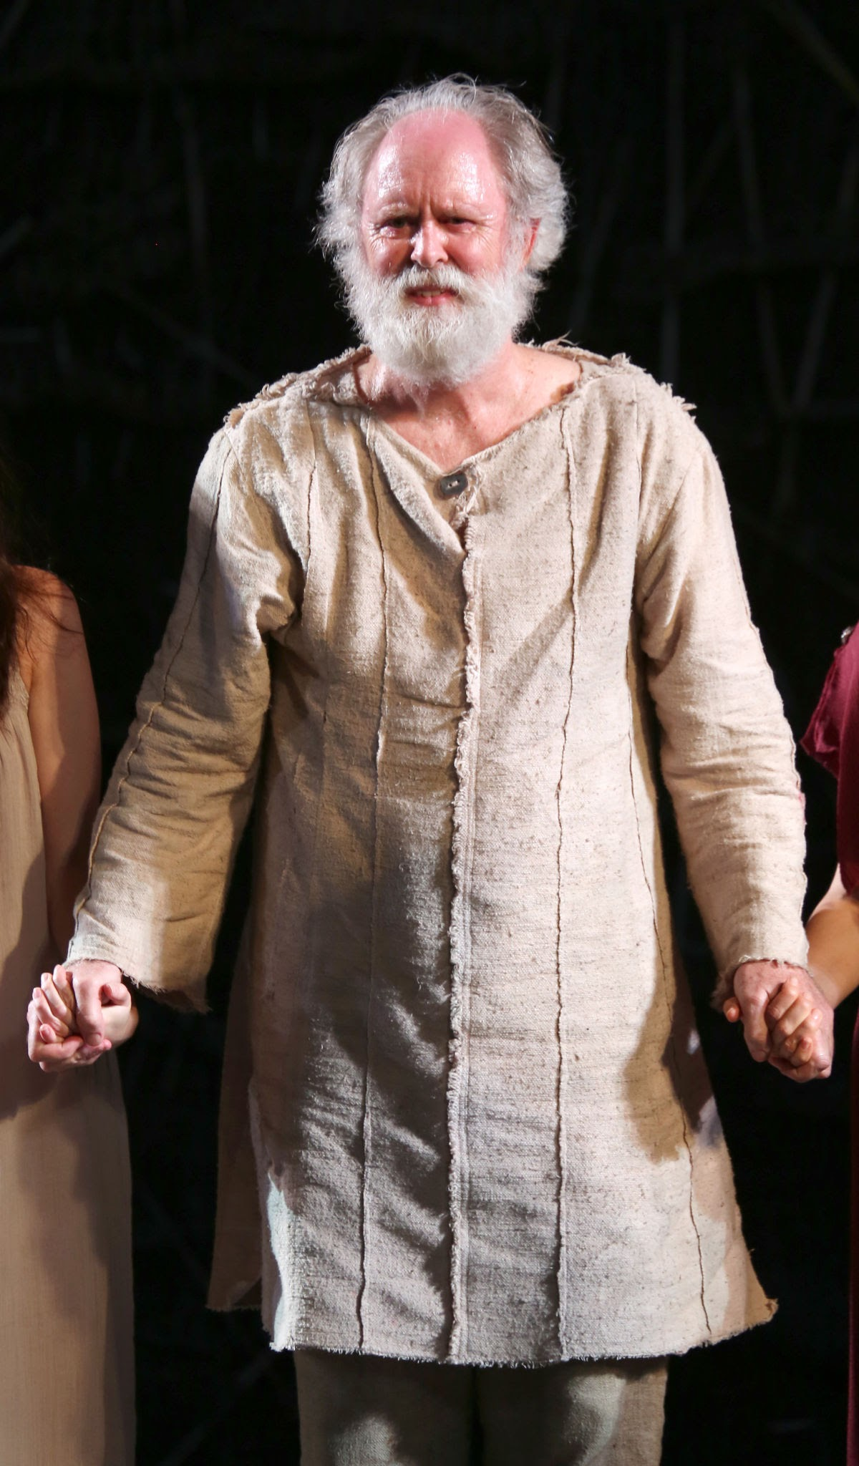
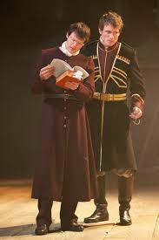
Characters In The Play(Sub-Plot)
Gloucester:
He is a loyal nobleman who is deceived by his illegitimate son Edmund, suffers betrayal and blindness, but eventually finds redemption through his son Edgar.
Edgar & Edmund:
Edmund – cunning, ambitious, and treacherous, he schemes to betray his father and brother for power.
Edgar – honest, loyal, and virtuous, he endures hardship to protect his family and ultimately restores order.

Slide 4
Short Summary
King Lear decides to divide his kingdom among his three daughters:Goneril, Regan, and Cordelia. Based on how much they say they love him. Goneril and Regan flatter him with exaggerated praise, but Cordelia refuses to lie, saying she loves him "according to her bond, no more nor less." Angered by her honesty, Lear disowns and banishes Cordelia, splitting the kingdom between the other two daughters.
The Earl of Kent tries to defend Cordelia, but Lear banishes him too. Meanwhile, the King of France marries Cordelia. After Lear leaves, Goneril and Regan reveal their true feelings, saying their father is foolish and that they will need to take control.

Slide 5
Main Events
King Lear decides to divide his kingdom among his three daughters.
He demands each daughter to declare how much she loves him.
Goneril and Regan flatter him with exaggerated speeches.
Cordelia refuses to flatter and simply says she loves him “according to her bond.“
Lear becomes angry, disowns Cordelia, and divides the kingdom between Goneril and Regan.

Slide 6
Main Themes
Main Themes
Power & Authority – Lear giving up his kingdom.
Appearance vs Reality – Goneril and Regan’s false flattery vs Cordelia’s honesty.
Family & Loyalty – Cordelia’s true but unembellished love, Kent’s loyalty to Lear.
Pride & Foolishness – Lear’s pride blinds him and leads to poor judgment.

Slide 7
Our Impression
This opening scene powerfully sets the stage for tragedy. Lear's decision to divide his kingdom based on his daughters' flattery reveals his vanity and poor judgment. Cordelia’s honesty contrasts sharply with her sisters’ deceit, highlighting the theme of appearance vs. reality. Lear's rash actions — disowning Cordelia and banishing Kent — show the beginning of his downfall. The scene introduces key themes like power, loyalty, and betrayal, making it a dramatic and foreboding start to the play.

Slide 8
The End

