Slide 1
King Lear: Act 1, Scene 1
Presentation by: Yaser Zeineh
Class: 8D

Slide 2
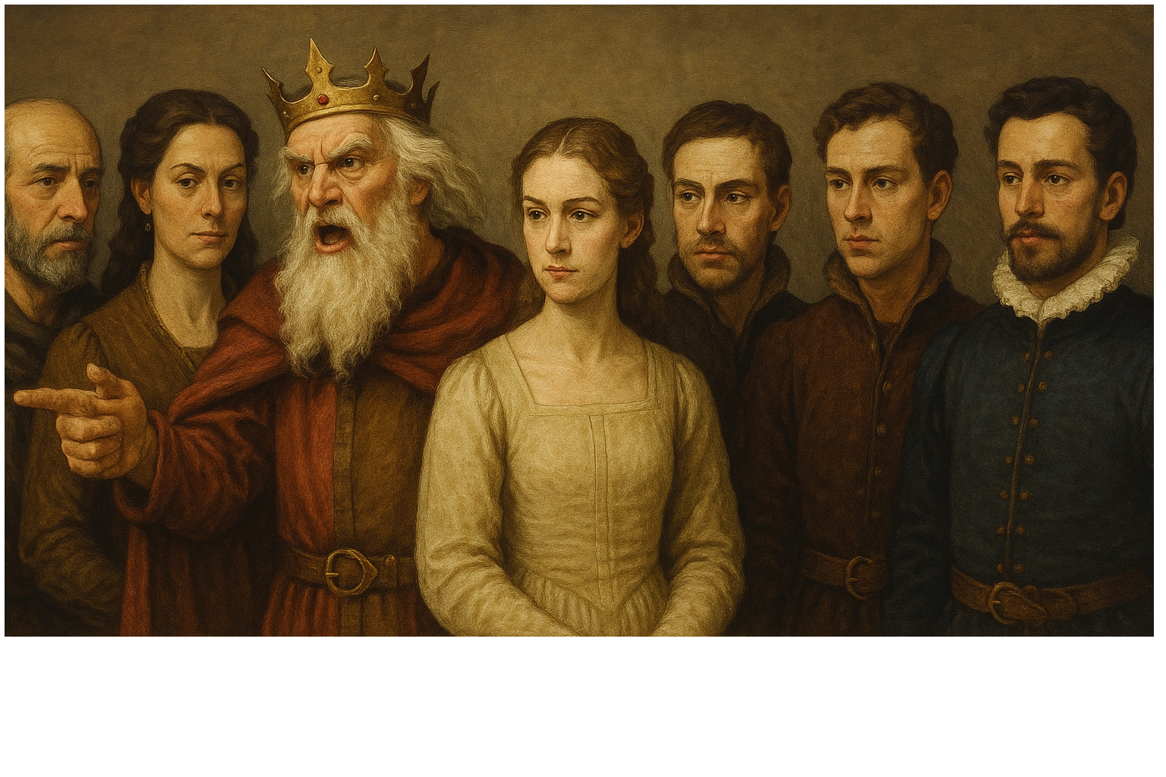

Slide 3
Main events
Lear plans to divide the realm by a love test.
Goneril and Regan flatter and gain large shares.
Cordelia refuses to flatter and is disowned.
Kent defends her and is banished.
Burgundy pulls out; France marries Cordelia.
Lear gives rule to Goneril and Regan and keeps one hundred knights. The sisters plan to control him.

Slide 4
Characters
King Lear: proud, ageing, quick to anger.
Goneril: eldest, smooth, selfish.
Regan: similar to Goneril.
Cordelia: honest, steady.
Kent: loyal counsellor.
Gloucester: senior lord, father of two sons.
Edmund: illegitimate, watchful.
Burgundy: suitor focused on dowry.
France: suitor who values character.

Slide 5
Themes
Words contradicting actions
People can sound kind but not be kind.
Example: the two elder sisters speak nicely in public, then plan in private to control their father.
Pride and poor choices
Wanting praise leads to bad decisions.
Example: Lear pushes away the honest daughter and the loyal adviser because they do not please him.
Order and confusion
Sharing power without clear rules causes trouble.
Example: Lear gives rule to his elder daughters but keeps one hundred knights and moves between their houses, which creates confusion.

Slide 6
Short Summary
At court, a love test decides how the realm is shared.
Flattery wins, honesty loses, and real power shifts to the elder sisters.
The family is divided, and the stage is set for conflict.

Slide 7
My Impression and What I expect next
Impression: Lear wants praise more than truth, which is unwise for a ruler.
Next: the sisters will tighten control, and Edmund will start trouble in Gloucester’s house.

Slide 8
Thank you very much for listening
Any Questions
Yaser Zeineh
8D

