Slide 1

King LEAR
Act1 Scene1
Salma Samara -8B

Slide 2
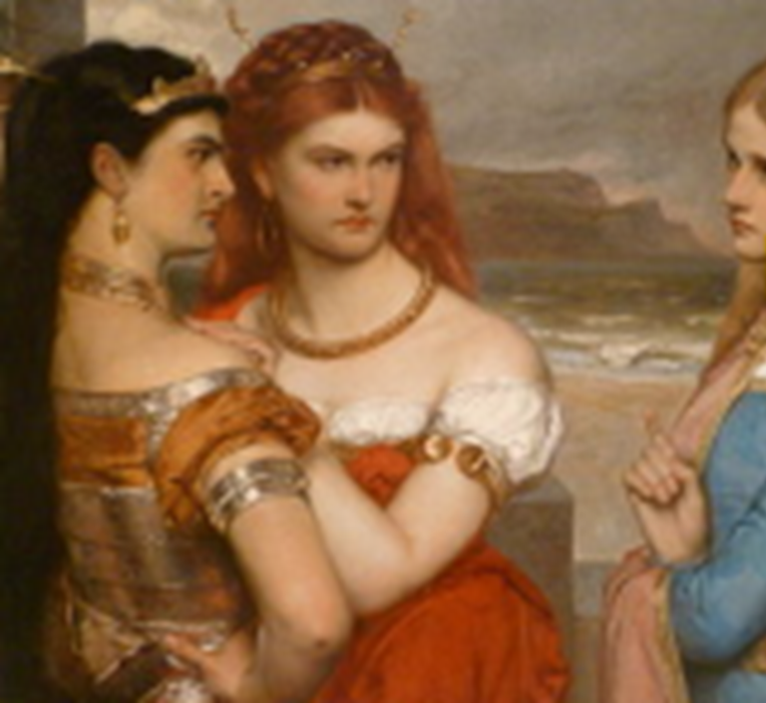
Main events in the Scene:
Kent and Gloucester talked about the “plan” of how he is dividing his kingdom
Goneril and Regan Flatters Lear to get the biggest amount of share
and Lear tells his 3 daughters that he is going to give the biggest amount of share to the daughter that shows him the most love
Cordelia doesn’t want to flatter him and Lear didn’t want anything to do with her so he disowned her

Slide 3
Main Characters
King lear
Gonreil
Regan
Cordelia
Kent
Gloucester
Edmund

Slide 4
Main Themes
Power: Lear hands over his kingdom and still expects care and respect
Betrayal and loyalty: Kent stays loyal and speaks the truth to Lear, but he took it as disrespect
Family: the daughters love is tested but at the end the daughter who cared and loved him got punished but the daughters who just wanted the inhertence (fake love) is reworded
Example
When Cordelia refuses to flatter Lear he disowns her this shows that the theme is about lies and truth.

Slide 5

Summary
King Lear decides to divide his kingdom among his three daughters based on how much they claim to love him Regan and Goneril flatter him with fake love while Cordelia, the youngest refuses to show her love by words Lear becomes angry and disowns her Kent defends Cordelia but is also thrown-out of the kingdom Cordelia loses all her inheritance and the Duke of Burgundy refuses to marry her However, the King of France loved her honesty and care and decides to marry her Meanwhile Regan and Goneril reveal their true feelings calling their father a fool and begin plotting against him.

Slide 6
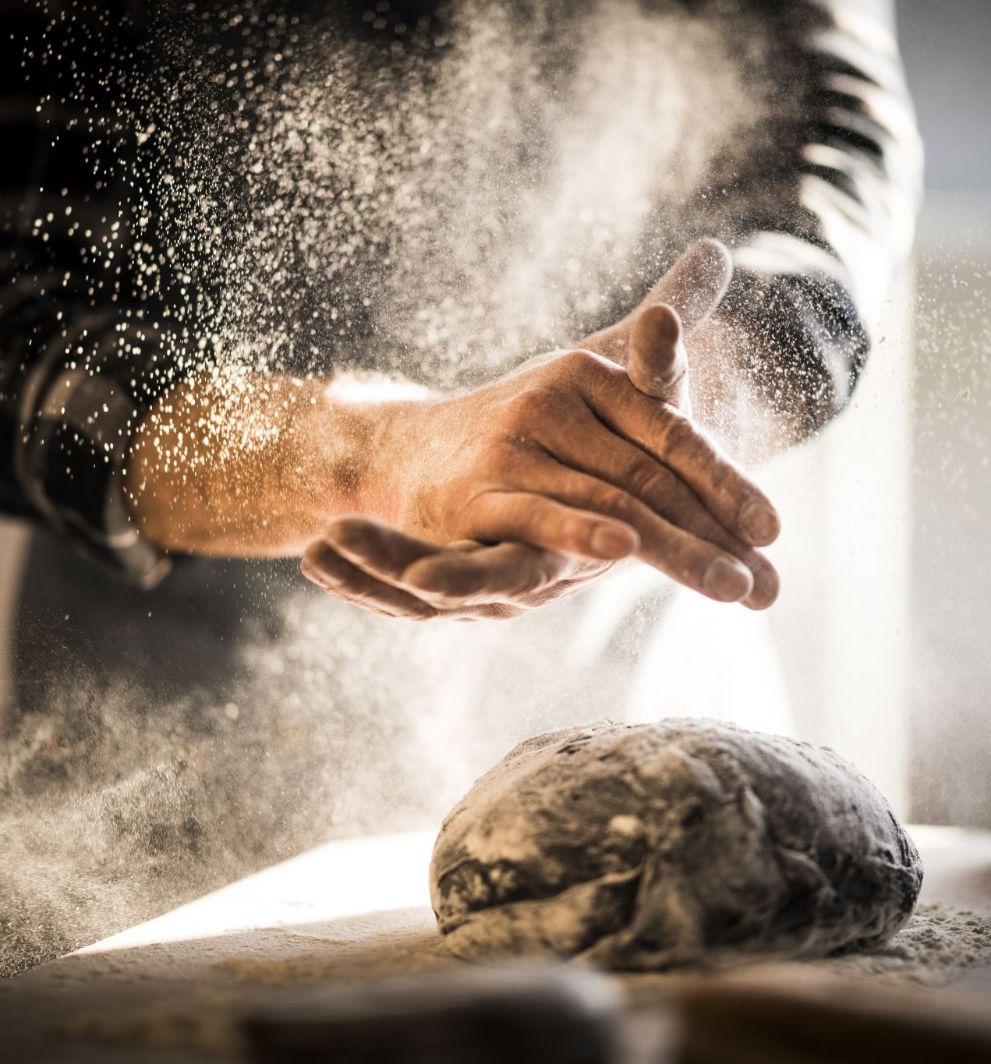
My opinion
I think that lear is VERY wrong of what he did he should split the inhertance by half and gave it to his doughters equely
Lear made a big problem he should not have told his doughters to show him love he should hanve been more realistic and he should have knew by himself wich ofhis doughters is best
His choices had ruined a family he should have been more polit with Cordelia

Slide 7

What do I think is going to happen in the future
I think that more conflicts are likely to arise as mentioned in the text Goneril and Regan plotting on something.

Slide 8

Thank you

