Slide 1
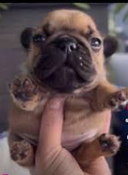

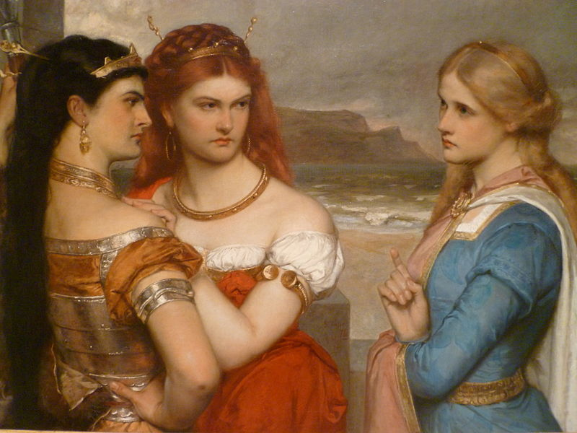
King Lear – By William Shakespeare Act 1 Scenes 2.3.4.5

Slide 2
King Lear –Act 1 Scenes 2.3.4.5 Main Events
Scene 2
• Edmund starts his plan to destroy Edgar.
• He tricks Gloucester with a fake letter.
Scene 3
• Goneril grows tired of Lear and his knights.
• She tells Oswald to treat Lear disrespectfully.
Scene 4
• Lear begins to see the disrespectful behavior in Goneril’s house.
• Goneril orders him to reduce his knights which makes lear feel angry.
• Lear decides to go to Regan instead.
Scene 5
• Lear leaves Goneril with Kent (in secret).
• He begins to understand that giving up power was a massive mistake .

Slide 3
King Lear –Act 1 Scenes 2.3.4.5 Main Characters
• Edmund – Bold, confident, rebellious, dishonest
• Gloucester – easily fooled by Edmund .
• Edgar – not guilty and naive .
• Goneril – disrespectful and neglectful towards her father.
• Lear – shocked, angry, confused and betrayed.
• Kent – loyal and protective.
• Oswald – follows Goneril’s orders and mistreats Lear.

Slide 4
King Lear –Act 1 Scenes 2.3.4.5 Main Themes
Betrayal
• Edmund lies about Edgar.
• Goneril turns against her father.
Power & Authority
• Lear realizes he no longer has real authority after giving away the kingdom.
Appearance versus Reality
• Edmund pretends to be loyal.
• Goneril pretends to love Lear but disrespects him.

Slide 5
King Lear –Act 1 Scene 2.3.4.5 Short Summary
Scenes 2–5 show two big conflicts:
Edmund tricks Gloucester and starts ruining Edgar’s life, and Goneril begins mistreating King Lear.
Lear becomes angry and hurt, leaves Goneril’s house in hopes Regan will treat him better.
Kent stays by his side in disguise.

Slide 6
King Lear –Act 1 Scenes 2.3.4.5 Impression and expectation for the next act
Impression
Expectation for Act 2:
Impression
The scenes show the beginning of chaos and family problems. Lies, disrespect, and ambition start tearing everyone apart.
Expectation for the Next Scene
Regan will probably treat Lear the same way as Goneril.
Edmund’s plan will grow and cause more damage.

Slide 7
Thank you for listening
Fouad Omaish
8A

