Slide 1
King Lear: Act 1, Scene 2-5
Presentation by: Yaser Zeineh
Class: 8D

Slide 2
Main events
Scene 2: Edmund plans to take Edgar’s place. He writes a false letter and fools Gloucester into thinking Edgar is plotting against him.
Scene 3: At Goneril’s home, she grows tired of Lear’s noisy knights. She orders her servants to treat Lear rudely and sends word to Regan.
Scene 4: Lear arrives at Goneril’s. Kent returns in disguise and is hired as a servant. The Fool jokes but tells the truth. Goneril demands fewer knights, and Lear decides to go to Regan.
Scene 5: On the road to Regan, Lear sends Kent ahead with a message. The Fool warns Lear that giving away power was a mistake.

Slide 3
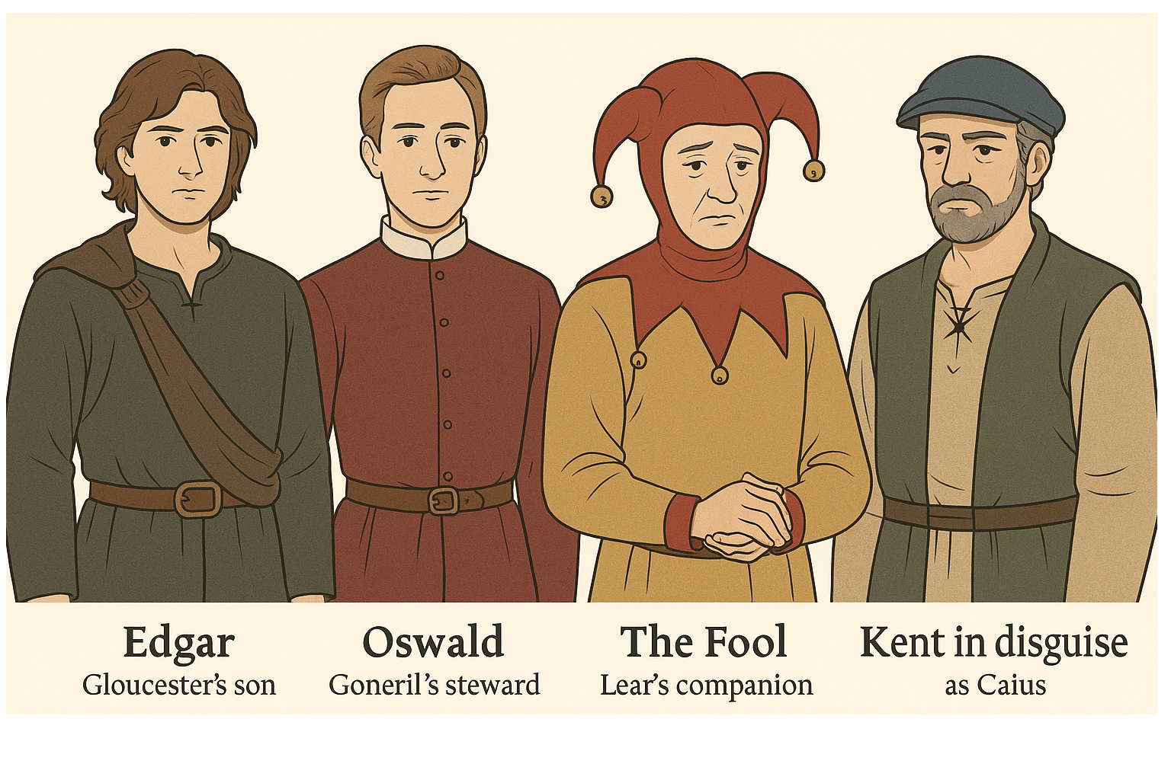

Slide 4
Characters
Edmund: clever and dishonest, wants to steal his brother’s place.
Edgar: kind but too trusting, becomes the victim of Edmund’s trick.
Oswald: Goneril’s steward, rude and loyal only to her.
The Fool: Lear’s companion who uses jokes to tell the truth.
Kent (as Caius): Lear’s loyal adviser, returns in disguise to help him.

Slide 5
Themes
Lies and trickery: Edmund’s false letter and fake story fool both Gloucester and Edgar.
Power and respect: Lear has lost control and finds that Goneril no longer treats him as a king.
Seeing and blindness: Gloucester believes Edmund’s lies without proof, just as Lear cannot see who truly cares for him.

Slide 6
Short Summary
Scene 2: Edmund tricks Gloucester and Edgar with a false letter and turns them against each other.
Scene 3: Goneril is angry with Lear’s men and tells her servants to be rude so that Lear will leave.
Scene 4: Lear arrives and is treated poorly. Kent returns in disguise, and the Fool speaks wisely. Lear leaves for Regan’s after Goneril’s insults.
Scene 5: Lear sends Kent ahead to Regan. The Fool warns that worse will come.

Slide 7
My Impression and What I expect next
Lear is losing power and respect. His older daughters are joining against him.
Edmund is dangerous because he lies easily and is believed.
Edmund will continue to trick his family, and Lear will find more betrayal.

Slide 8
Thank you for listening.
Thank you very much for listening
Any Questions
Yaser Zeineh
8D

