Slide 1
Saint Mary Alphonsine Ghattas
Founder of the Rosary Sisters
1843–1927

Slide 2
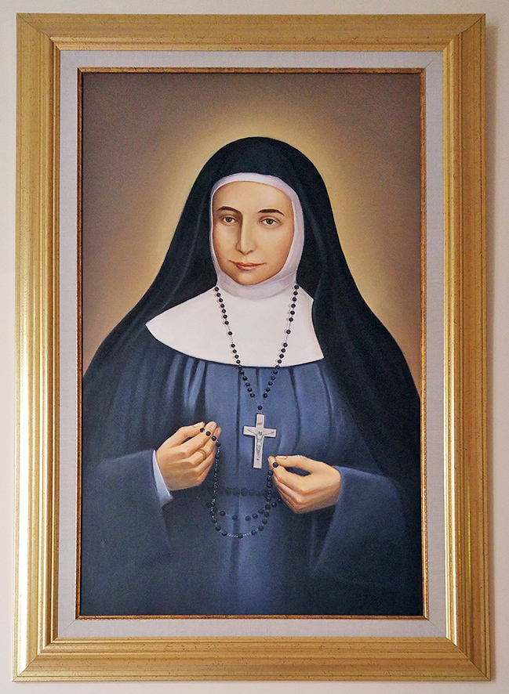
Mary Alphonsine’s life:
She was an Arab Christian nun who was born in Jerusalem in 1843, and her real name was Sultana. She was known for her love, silence, generosity, and kindness.

Slide 3
Her mission:
She helped educate girls and teach the Catholic faith.
Worked with the poor and helped families in need.
She believed strongly in kindness and serving others with love.

Slide 4
The Virgin Mary’s Message:
Mary Alphonsine reported visions of the Virgin Mary.
The Virgin Mary asked her to start a new congregation focused on prayer and service.
This led to the creation of the Rosary Sisters.

Slide 5
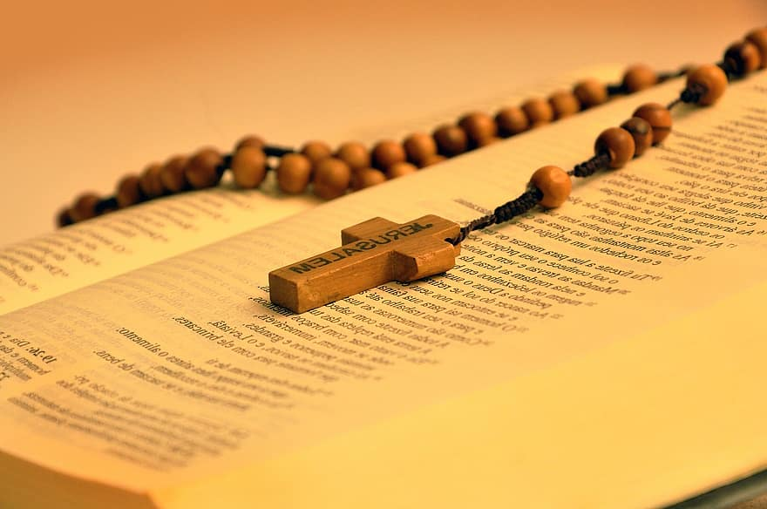
Founding the Rosary Sisters:
In 1880, she founded the Congregation of the Rosary Sisters.
It was the first Catholic congregation
founded in the Middle East.
Today, the Rosary Sisters run schools, hospitals, and service centers in many countries.

Slide 6
Done by : Jack Nersisian 5B

