Slide 1
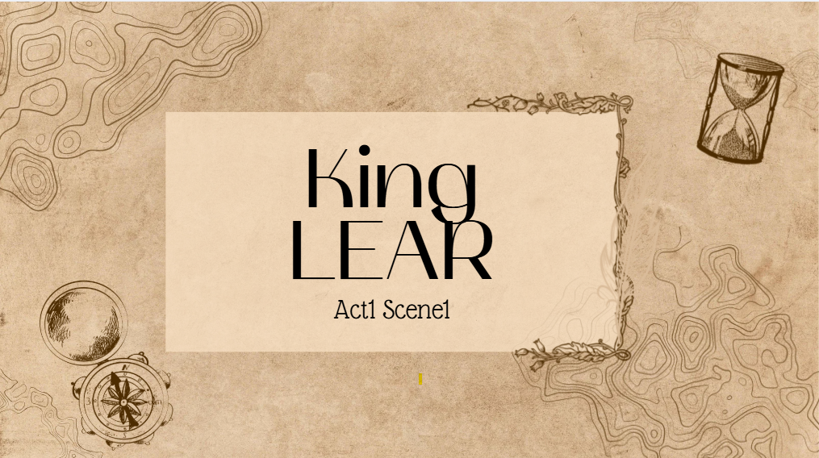

Act 1 scenes( 2,3,4,5)
Salma Samara(8B)

Slide 2
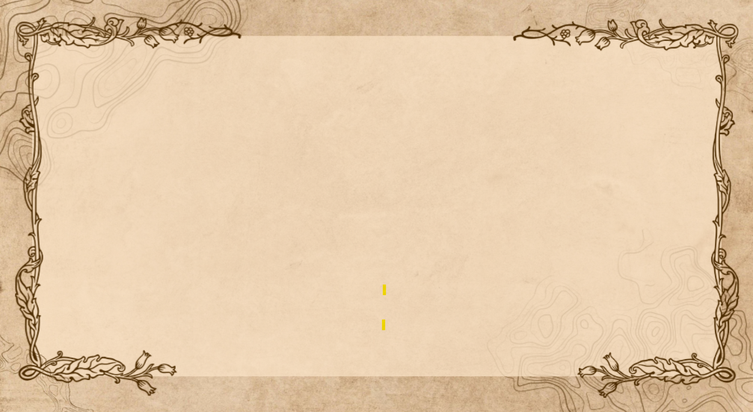
The main event/ events in the scenes
Edmund plans to trick Gloucester and make Edgar look guilty by forging a letter.
Gloucester believes Edmund’s lie, starting a family conflict.
Goneril becomes angry with Lear and his knights and decides to reduce his power.
Goneril orders Oswald to be rude to Lear.
Lear visits Goneril, notices disrespect, and argues with her about his knights.
The Fool mocks Lear for giving away his kingdom and losing authority.
Lear curses Goneril and decides to go to Regan for support.
Lear sends a letter to Regan and begins to feel worried and regretful about his decision.

Slide 3
The main characters that are introduced in the scenes.
Edmund
Gloucester
Goneril Oswald
The Fool
Albany

Slide 4
The main theme/themes with discussion and examples from the scenes.
Betrayal
People turn against their own family. Edmund tricks his dad and brother, and Goneril starts to go against her father, King Lear.
Power and Respect
Lear gave away his kingdom, and now nobody respects him. He learns that without power, people treat him differently.
Family Problems
Lear and his daughters fight instead of helping each other. This shows how families can break apart when people want control.
Foolish Choices
Lear made a bad choice by giving away his power. The Fool keeps reminding him that he was wrong.

Slide 5
A short summary about each scene.
Act 1, Scene 2
Edmund decides to trick his father Gloucester by making him believe that Edgar wants to harm him.
Act 1, Scene 3
Goneril becomes annoyed with Lear and his knights and plans to reduce his power by sending some knights away.
Act 1, Scene 4
Lear visits Goneril, notices disrespect, argues with her about his knights, and curses her before deciding to go to Regan.
Act 1, Scene 5
Lear sends a letter to Regan and starts to feel worried and regretful about giving away his kingdom.

Slide 6
After reading the scene, what is your impression about (act 1, scenes 2,3,4,5) and what do you expect to happen next (act 2, scene 1).
I think these scenes show how bad choices and greed can break families apart. Lear is losing respect because he gave away his power, and Edmund is causing trouble by lying. I feel like things will get worse in the next act. I think Edmund will make Gloucester hate Edgar even more, and Lear will find out that Regan is not as kind as he hopes.

Slide 7

Thank you

