Slide 1
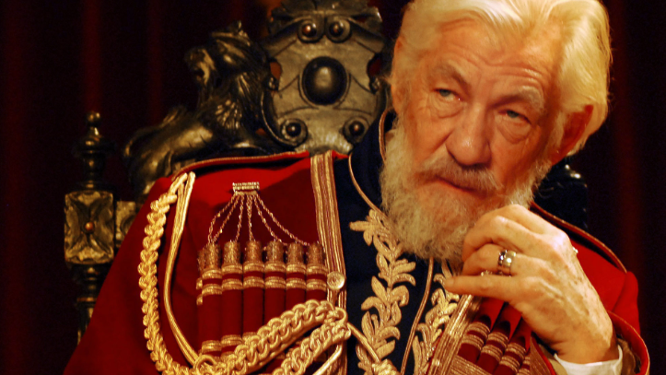
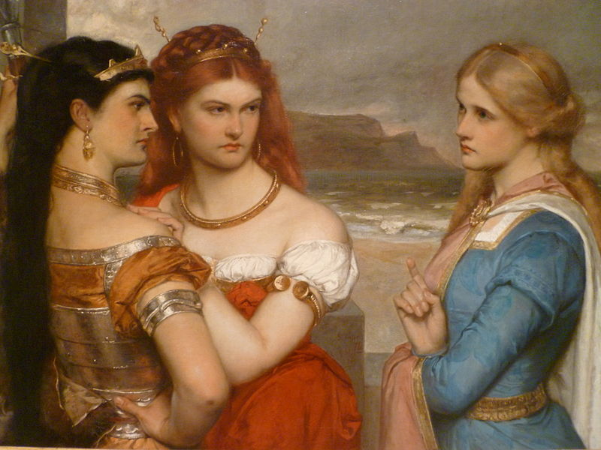
King Lear – By William Shakespeare Act 1 Scenes 2.3.4.5

Slide 2

King Lear –Act 1 Scenes 2.3.4.5 Main Events
Scene 2
Edmund starts his plan to get rid of Edgar.
He tricks Gloucester with a fake letter to make Edgar look bad.
Scene 3
Goneril is fed up with Lear and his noisy knights.
She tells Oswald to treat Lear disrespectfully.
Scene 4
Lear notices people in Goneril’s house are being rude to him.
Goneril tells him to have fewer knights, which makes him angry.
Lear decides to go stay with Regan instead.
Scene 5
Lear leaves Goneril’s home with Kent, who is in disguise.
He starts to realize that giving away his power was a big mistake.

Slide 3

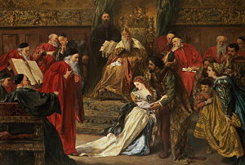
King Lear –Act 1 Scenes 2.3.4.5 Main Characters
Edmund – confident, daring, disloyal, and untrustworthy.
Gloucester – easily misled by Edmund.
Edgar – blameless and overly trusting.
Goneril – disrespectful and uncaring toward her father.
Lear – feels surprised, upset, confused, and betrayed.
Kent – faithful and protective.
Oswald – carries out Goneril’s commands and treats Lear badly.

Slide 4
King Lear –Act 1 Scenes 2.3.4.5 Main Themes
In these scenes, betrayal becomes a major theme as Edmund invents lies about Edgar to destroy him, and Goneril turns against her own father. Lear also begins to understand the consequences of giving away his power, realizing that he no longer has any real authority or respect. The contrast between appearance and reality is shown through Edmund, who pretends to be a loyal son while secretly plotting, and through Goneril, who acts loving toward Lear at first but soon reveals her disrespect and cruelty. These moments highlight how trust, power, and false appearances shape the tragedy in King Lear.

Slide 5
King Lear –Act 1 Scene 2.3.4.5 Short Summary
Scenes 2–5 reveal two main struggles: Edmund fools Gloucester and begins to ruin Edgar’s life, while Goneril starts treating King Lear badly. Feeling upset and betrayed, Lear leaves her home and turns to Regan, hoping she will treat him more fairly. During all of this, Kent remains loyal and continues to support Lear while hiding his true identity.

Slide 6
King Lear –Act 1 Scenes 2.3.4.5 Impression and expectation for the next act
Act 2 gives the sense that disorder and conflict are beginning to take hold within the family. The characters’ lies, selfish ambitions, and lack of respect are starting to create serious tension and fracture relationships. Looking ahead, it seems likely that Regan will behave toward Lear just as harshly as Goneril did, while Edmund’s scheming is expected to intensify, bringing even greater trouble and complications for those around him.

Slide 7


