Slide 1


ADDING DECIMALS!

Slide 2

Hello everyone!
Today we will talk about decimals!
LETS START!

Slide 3
what are decimals?
Decimals are the numbers that are after the decimal point .
V.I.P:
THERE IS THREE DIGHTS IN DECIMAL PART LIKE
TENTH,HUNDRETH,THOUSANDTHS!

Slide 4
EX:
0.9
The 9 here is in the tenth place.
0.09
The 9 here is in the hundreths place.
0.009
The 9 here is in the thousandths place .
ARE U READY FOR A ACTIVTI!

Slide 5

LAST THING!:
NEVER DO THIS 0.10 BUT WE CAN DO THIS 1!

Slide 6



Q1)
Find the sum!
0.794
+0.213
1)
2)
0.641
+0.667
4)
0.765
+0.455
3)
0.234
+0.123

Slide 7
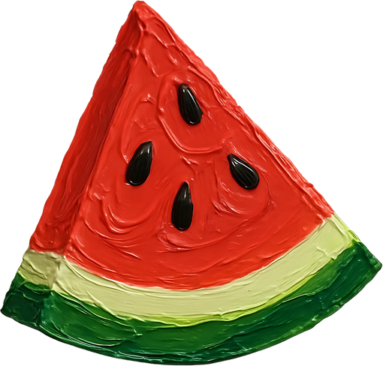


WORLD PROBLEM!:
If a watermelon mass is 2.22
AND A!
A pinapple’s mass is 3.87
What is the total of both?

Slide 8
Answer here!

Slide 9
Done By:
Nai Abu-Dahia
and
Yasmeen Al-Fauri

