Slide 1
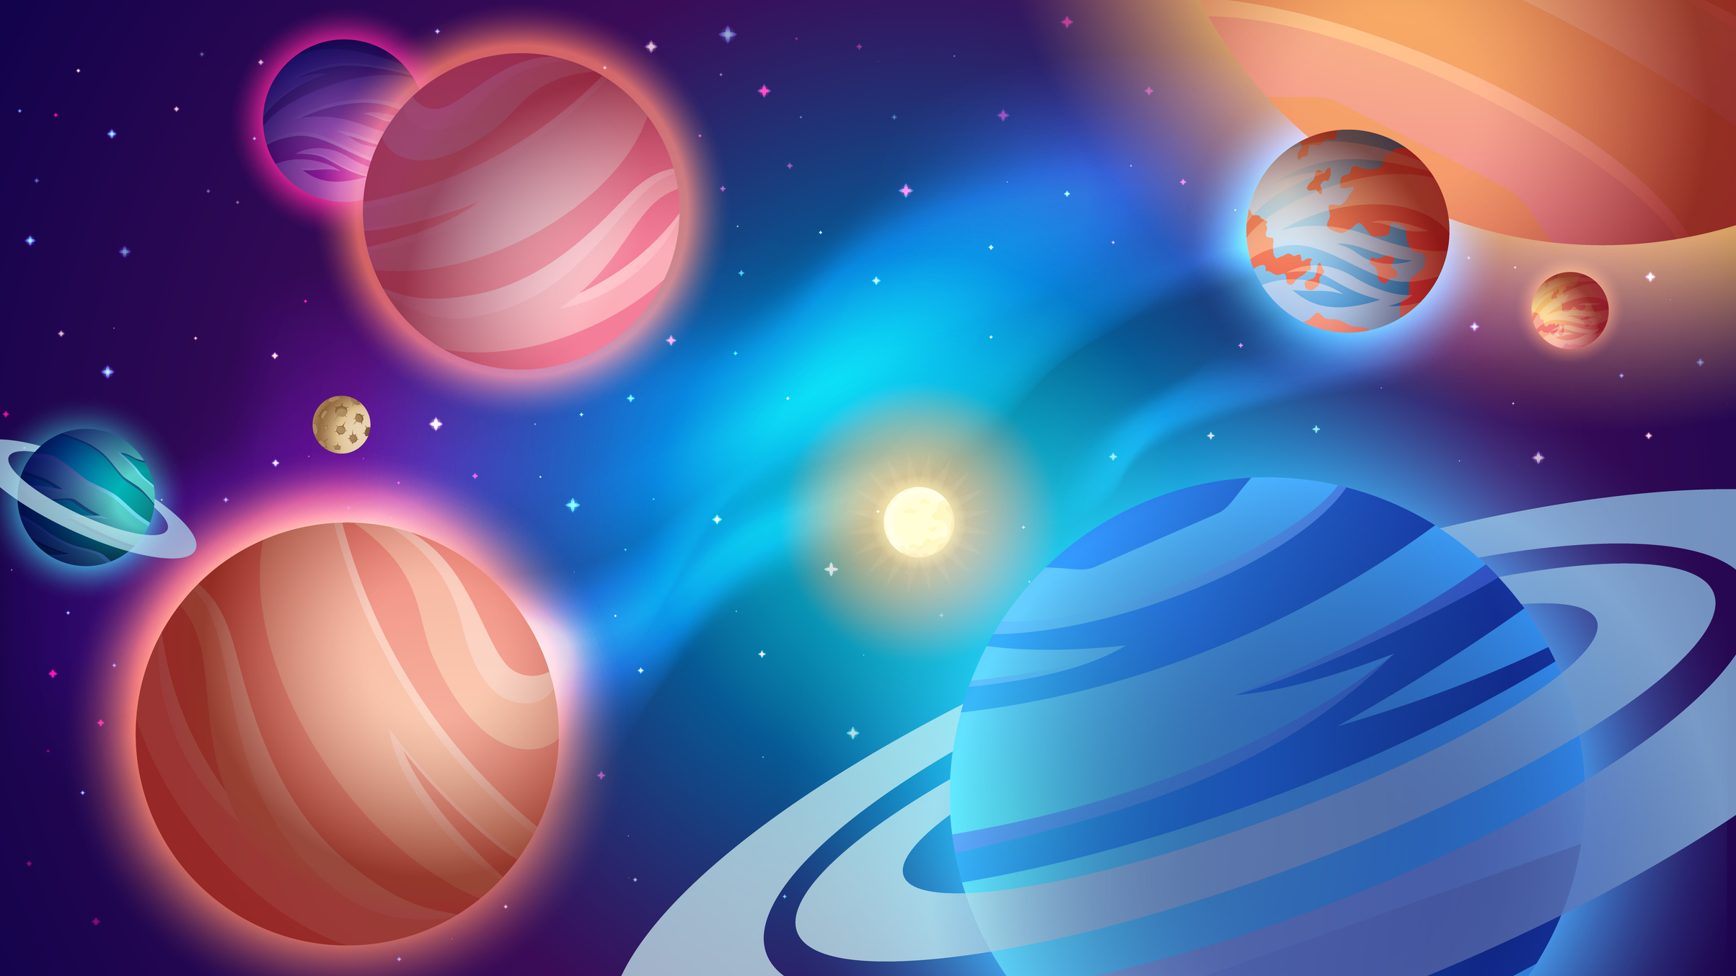
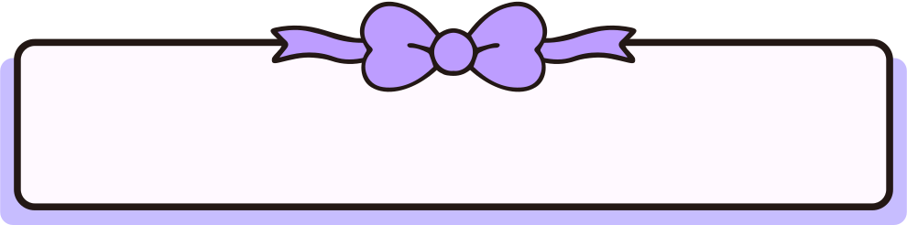
Mass and Weight

Slide 2

What is the difference between Mass and weight?
Mass does not change from one planet to another because it's how much matter in a human
weight changes from one planet to another because it changes depending on the force of gravity

Slide 3


Did you know?
Did you know that when we say our weight is 35 kg,We are wrong we need to say our mass is 35 kg

Slide 4
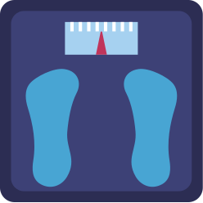


Now questions time
What do we use to measure mass?
What do we use to measure weight?
What is the unit for mass?
What is the unit for weight?

Slide 5
Thank you🩷
Made by:Maya and Carla 5d

