Slide 1
All about dogs

Slide 2
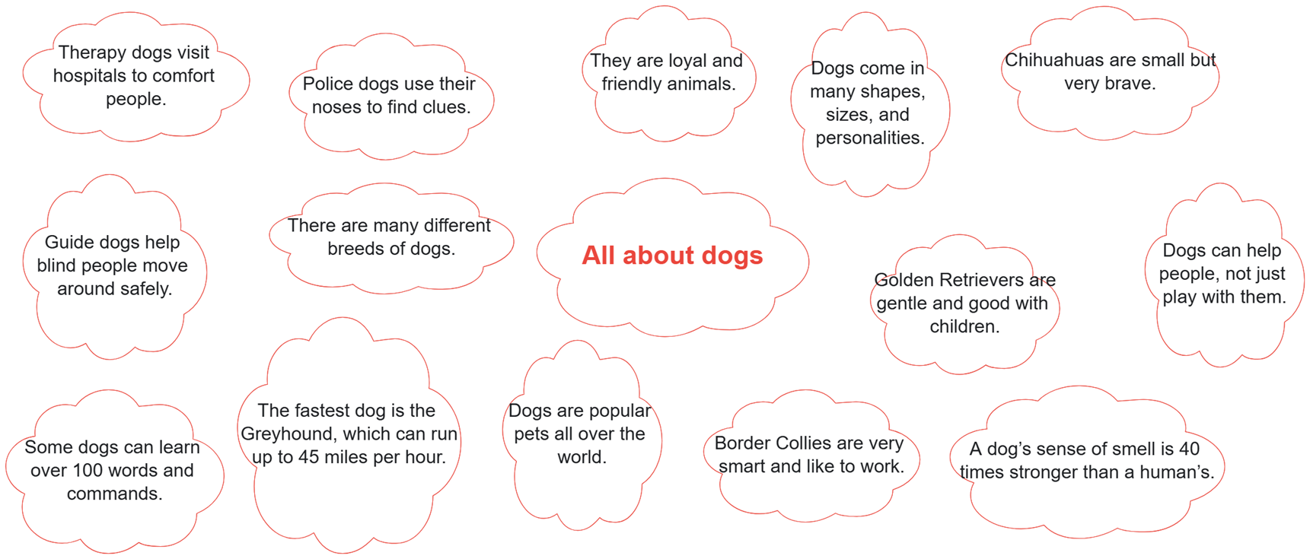
3 min.

Slide 3
Instructions for Writing a Non-Chronological Report About Dogs
Start your report with a title at the top (e.g. All About Dogs).
Write an introduction paragraph that grabs the reader’s attention and explains what your report is about.
Use three subheadings to organize your information (Types of Dogs, How Dogs Help People, Interesting Facts About Dogs).
Under each subheading, write a paragraph with a topic sentence and at least three supporting details.
Use connectives to join your ideas (e.g. for example, in addition, on the other hand).
Remember to write in the present tense and use third person.
Check that your writing is in full sentences and has capital letters and punctuation.

Slide 4
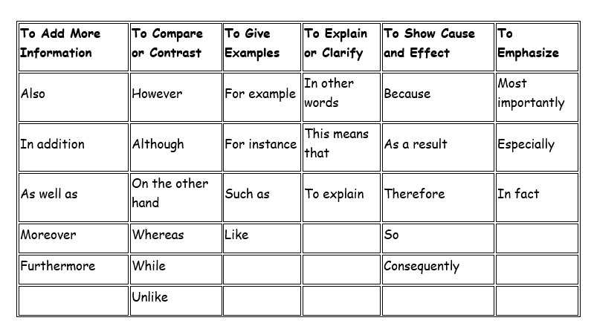

Slide 5
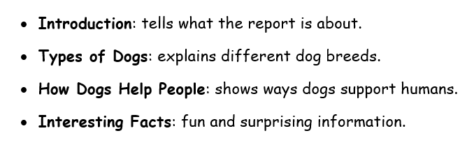
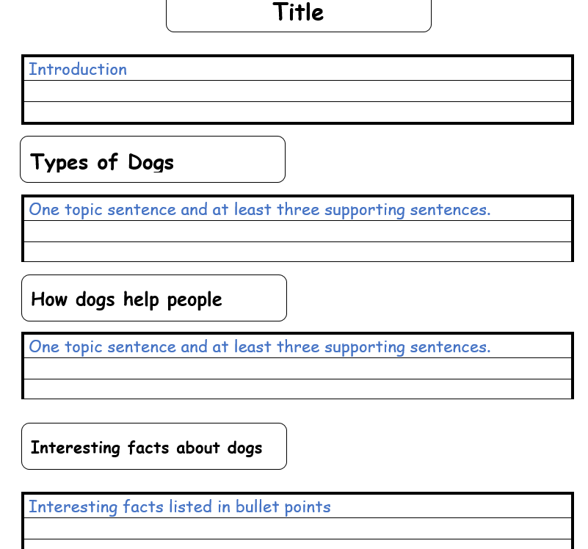

Slide 6

7 min.

Slide 7
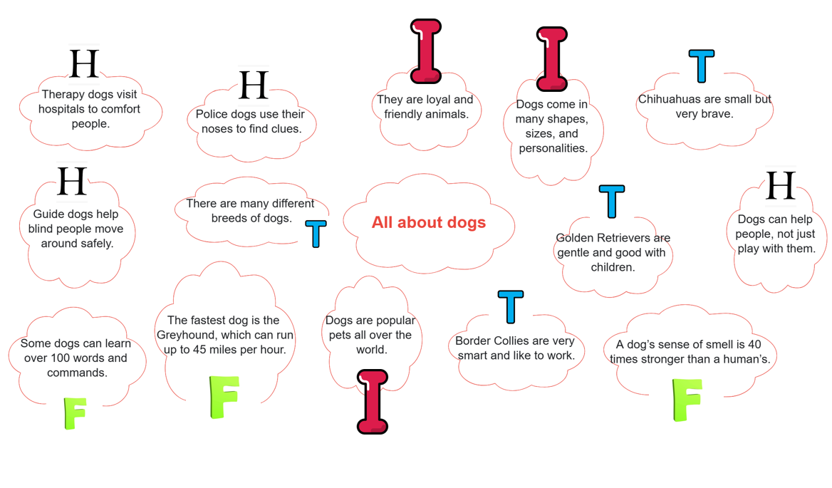

Slide 8
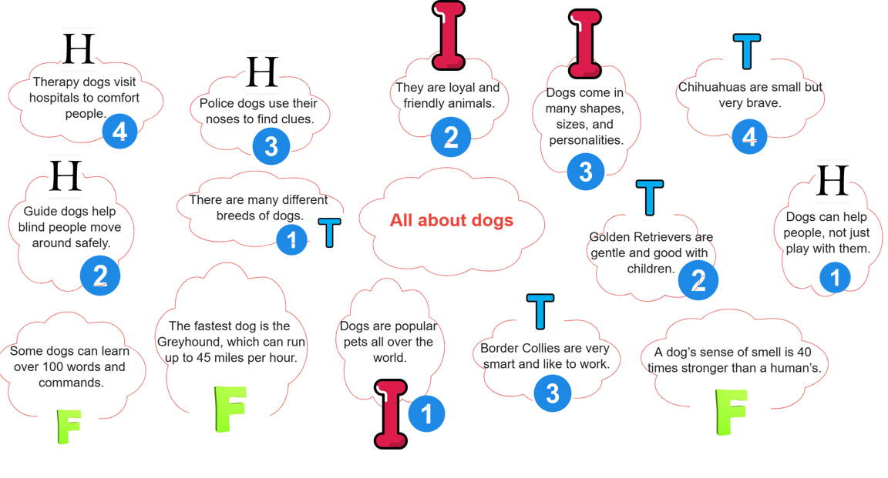

Slide 9


Slide 10


Slide 11
What Can We Add to This? 5 mins
Dogs are popular pets all over the world.
Try to add your own detail, example or reason.
Why are dogs popular?
What do dogs do that make people love them?
Try to add it with another fact using a connective.

Slide 12
For example
Dogs are popular pets all over the world because they are fun to play with and keep people company.
Dogs are one of the most popular pets in the world and they are known as loyal, friendly companions.

Slide 13
Do you love animals that are playful, loyal, and full of energy? Dogs are one of the most popular pets around the world. They come in all shapes and sizes and are always ready to be your best friend!
Dogs are one of the most popular pets in the world and they are known as loyal, friendly companions. They come in many shapes, sizes and personalities; in fact, this makes them exciting animals to learn about!
Dogs are awesome pets that bring joy, love and laughter to families everywhere! They are friendly, loyal, and come in many different breeds.Learning about dogs is fun because they are such incredible animals.

Slide 14

Types of Dogs
Use facts and add your own ideas.
Use connectives to link information.
There are many different breeds of dogs.
Golden Retrievers are gentle and good with children.
Border Collies are very smart and like to work.
Chihuahuas are small but very brave.
10 min.

Slide 15
There are many different breeds of dogs. For example, Golden Retrievers are gentle, friendly, and great with children. In addition, Border Collies are smart and love to stay active. On the other hand, tiny Chihuahuas are small but brave and make great watchdogs.
There are many different types of dogs and each breed has special features. For example, some dogs, like Golden Retrievers, are gentle and great with kids. Others, such as Border Collies, are very smart and love to work. On the other hand, tiny dogs like Chihuahuas are brave despite their small size.

Slide 16

How dogs help people
Use facts and add your own ideas.
Use connectives to link information.
Dogs can help people, not just play with them.
Guide dogs help blind people move around safely.
Police dogs use their noses to find clues.
Therapy dogs visit hospitals to comfort people.
10 min.

Slide 17
How dogs help people
Dogs are not just fun pets; they also have very important jobs. For example, guide dogs help people who are blind to walk safely in busy places. In addition, police dogs use their strong sense of smell to search for clues and track down criminals. Furthermore, some dogs are trained as therapy animals and visit people in hospitals to comfort them. As a result, dogs are considered heroes in many communities.

Slide 18
Interesting facts about dogs
A dog’s sense of smell is 40 times stronger than a human’s.
Some dogs can learn over 100 words and commands.
The fastest dog is the Greyhound, which can run up to 45 miles per hour.

Slide 19
Interesting facts about dogs
Dogs have some surprising and fun facts that make them even more awesome!
Did you know that a dog’s sense of smell is 40 times better than a human’s?
For instance, some dogs can even learn over 100 words and commands!
Amazingly, the fastest dog in the world is the Greyhound, which can run up to 45 miles per hour.

