Slide 1
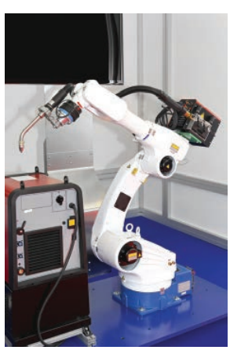
Computer Controlled System
Chapter 6

Slide 2
Robotics in manufacturing
Used in paint spraying of car bodies, welding bodywork on cars, manufacturing of microchips, manufacturing electrical goods and automatic warehouses.
They are controlled through embedded microprocessor or linked to a computer system.
Programming done in two ways:
The robot is programmed with a sequence of instructions and equipped with sensors so they can gather important information about their surroundings and prevent them from doing ‘stupid things’.
A human operator manually carries out the series of tasks and this can be done in two ways:
The robot arm is guided by a worker and each movement is stored as an instruction.
The worker straps sensors to his own arm and each movement is stored as a set of instructions in a computer

Slide 3
Robotics in manufacturing
Advantages | Disadvantages
They can work in harmful environments | Difficult to do unusual tasks
They can work 24/7 | They can cause higher unemployment
They are less expensive in the long term | There is a real risk of certain skills being lost
Higher productivity | The initial set-up and maintenance of robots can be expensive
Greater consistency | Factories can be moved anywhere because robots are independent of the skills base
They can do boring repetitive tasks
They can carry out different tasks

Slide 4
Robotics in manufacturing
Production line control
Production line control using robots is used extensively in industry. For example:
Filling bottles with a liquid, capping the bottle and applying a label
Filling metal cans with baked beans, sealing the cans and applying labels.
Using robots in this way leads to:
Faster operations
Much greater productivity
Greater consistency
Built-in quality control
Reduced cost to the consumer

Slide 5
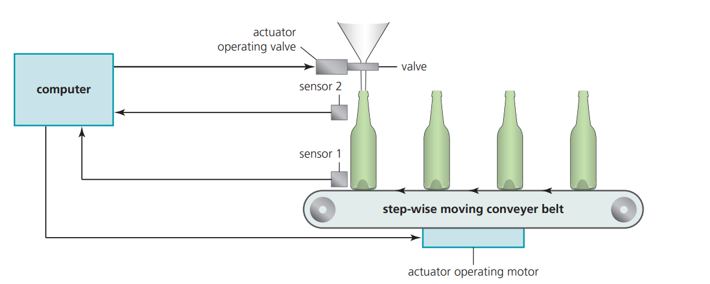
How robots could be used in a bottling plant.
Sensor 1 (a pressure sensor, light sensor or camera) detects the presence of a bottle and sends the signals to the computer.
When the signal from sensor 1 indicates a bottle is present, the computer sends a signal to an actuator which opens a valve allowing liquid to flow into the bottle.
Sensor 2 (a level sensor) is used to detect the correct liquid height in the bottle.
When the signal from sensor 2 indicates the bottle is full, the computer sends a signal to an actuator to close the valve.
The computer then sends another signal to a second actuator which operates a motor to move the conveyer belt to allow the next empty bottle to take its correct position.
The whole process is continuous until stopped for maintenance, errors occurring or a change in the process.

Slide 6
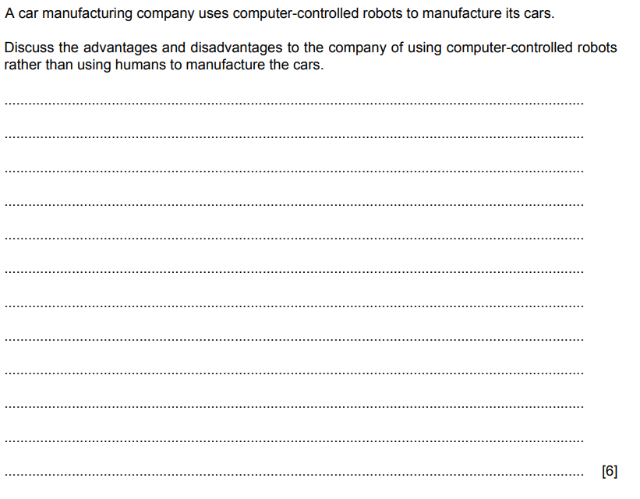

Slide 7
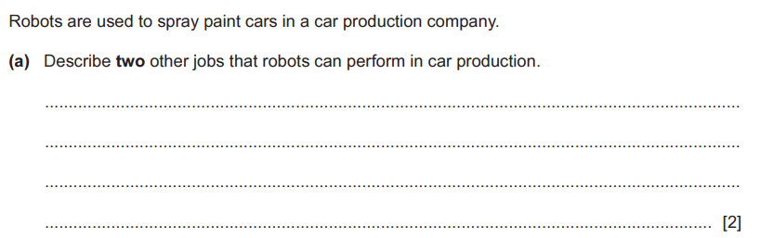
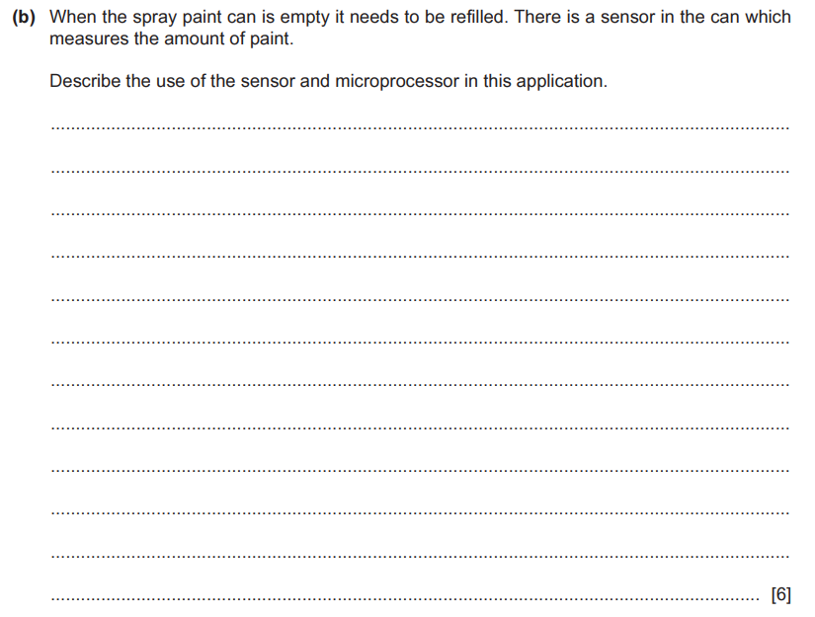

Slide 8
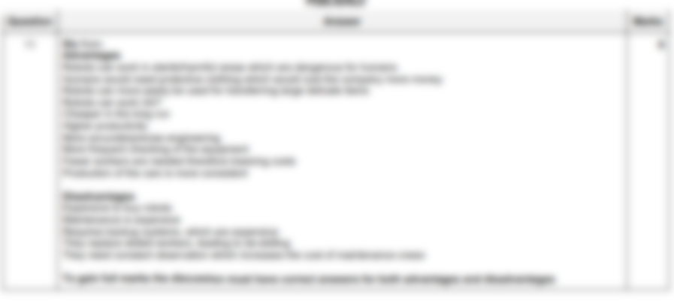

Slide 9

