Slide 1
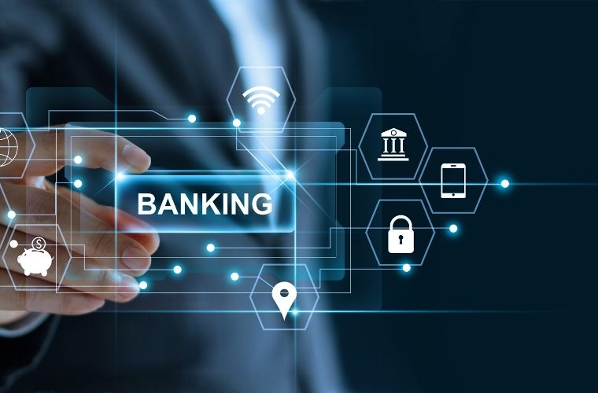

Banking Systems
Chapter 6

Slide 2
Banking applications
Examples for using computer technology in banking applications:
  The use of automatic teller machines (ATMs)
  Electronic funds transfer (EFT)
  Credit/debit card transactions
  Cheque clearing

Slide 3
Automatic teller machines –ATMs-
Automatic teller machines (ATMs) allow the customer to:
  withdraw cash
  deposit cash
  deposit cheques
  check the balance of their account
  see a mini bank statement
  Pay a bill
  Do a money transfer
Advantages →
  Possible to withdraw cash at any time of day.
  Offer many banking services without the need to go into the bank
  Possible to access an account from anywhere in the world.
  Usually provides quicker service than waiting in a queue in a bank.
Disadvantages →
  They are often in places where theft can take place at night.
  There is potential for shoulder-surfing and card-cloning scams.
  Some banks charge customers for using atms.
  Cash withdrawal limits are often imposed on customers.
  If the debit card is faulty then no transaction can take place
  There is a loss of the personal touch, which some customers will not like.

Slide 4
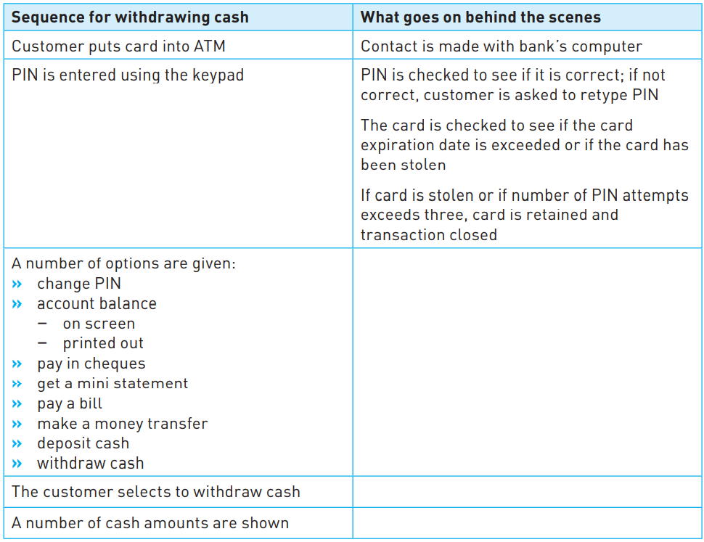
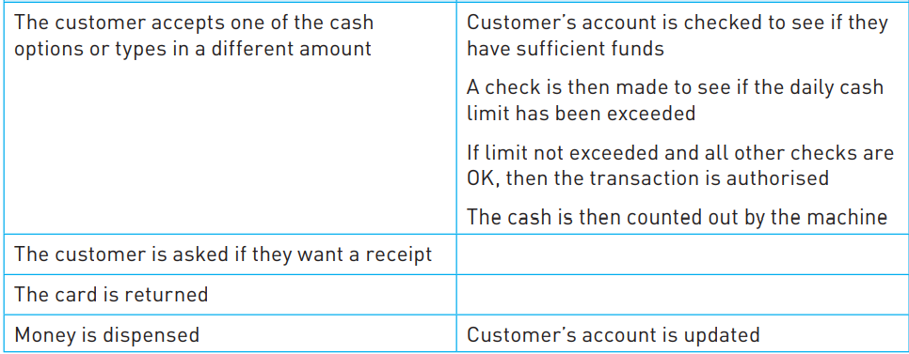
ATM process (Withdrawing cash)

Slide 5
ATM Process (Depositing cheques)
The user is asked to insert their debit card and type in the PIN.
A message will then appear asking the customer which service they require.
The customer chooses to deposit a cheque.
A drawer will then open and the customer inserts the cheque.
The drawer will then close and an OCR device will read the cheque details.
The amount appears on the screen and the customer confirms the amount.
The customer’s account is updated with the amount on the cheque.
A printed receipt of the cheque is then given to the customer.
If they do not require another service, the card is returned to the customer.

Slide 6
Electronic Funds Transfer (EFT)
System that allows money transfer instructions to be sent directly to a bank’s computer system.
No actual money is transferred. It relies on electronic transfer of money between accounts.
When an instruction is received, the computer system automatically transfers the money from one account to another.
Examples of EFT:
  Payment of Salaries to the staff
  Credit/debit card when purchasing in a store using a system called electronic fund transfer at point-of-sale (EFTPOS)

Slide 7
Electronic Funds Transfer (EFT)
Advantages →
  It is a very secure payment method.
  It is a very quick payment method.
  It is less expensive than, for example, using cheques.
  The customer has the right to dispute an EFT payment for up to 60 days.
Disadvantages →
  Once an amount has been transferred the bank cannot reverse a transaction.
  The customer needs to have funds available immediately.
  It cannot guarantee the recipient.

Slide 8
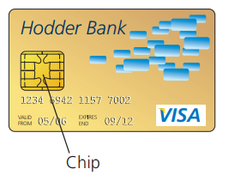
Credit/debit card transactions
Credit/debit cards are equipped with a chip as well as a magnetic stripe.
Paying for items using a chip and PIN card is a form of electronic funds transfer (EFT).
Example → suppose a customer goes into a restaurant to pay for a meal using a chip and PIN card:
  The PIN is entered using a keypad.
  The card is checked to see if it is valid.
  The PIN is read from the chip on the card and is compared to the one just keyed in.
  If they are the same, then the transaction can proceed.
  If different, the transaction is terminated.
  The restaurant’s bank contacts the customer’s bank.
  A check is made on whether they have enough funds.
  If the card is not valid or there are not enough funds available, then the transaction is terminated.
  An authorization code is sent to the restaurant.
  The price of the meal is then deducted from the customer’s account and debited to the restaurant’s bank account.
  A receipt is produced as proof of purchase.

Slide 9
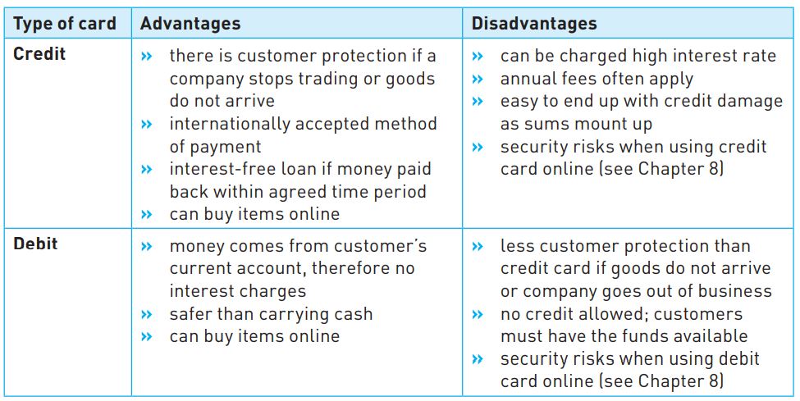
Credit/debit card transactions

Slide 10
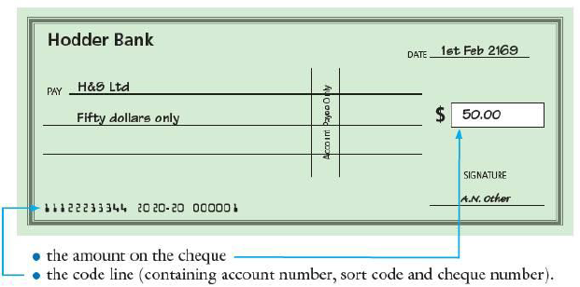
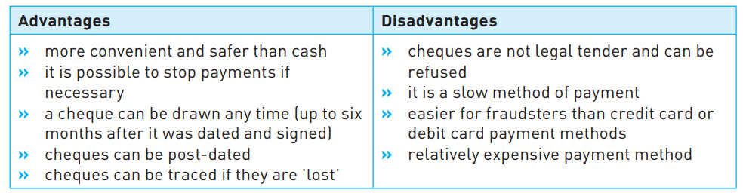
Cheques

Slide 11
Centralized clearing of Cheques
Suppose someone uses a bank called Hodder Bank and they pay a cheque for $50 to a company called H&S Ltd, who bank with the Smith Bank. How is the H&S bank account credited with $50?
  The first step is called out clearing, when Smith Bank are presented with the cheque, a camera takes an image of the cheque and OCR software turns this image into an electronic data format.
  Smith Bank uses this electronic data to create a digital record of the money to be paid, the sort code on the cheque and the account number on the cheque.
  The cheque image and digital record are added to a file of other cheque (related to Hodder bank) images paid in that day.

Slide 12
Centralized clearing of Cheques
Smith Bank now sends all the files to a central facility. The central facility processes this file in the following way:
  It breaks the file down into individual payment messages.
  It does a payment validation.
  It creates and sends a ‘request to pay’ message to Hodder Bank.
Hodder Bank receives a stream of ‘request to pay’ images and carries out the transactions.
All of this happens usually in less than 24 hours.

Slide 13
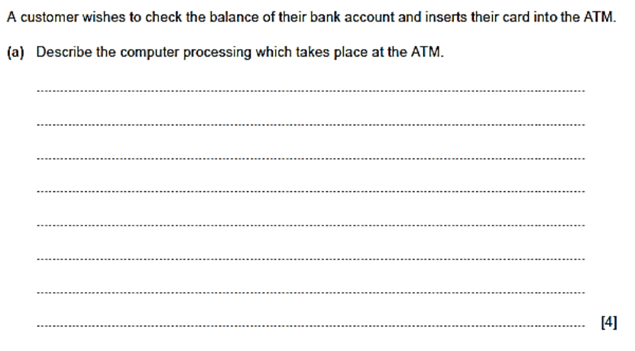
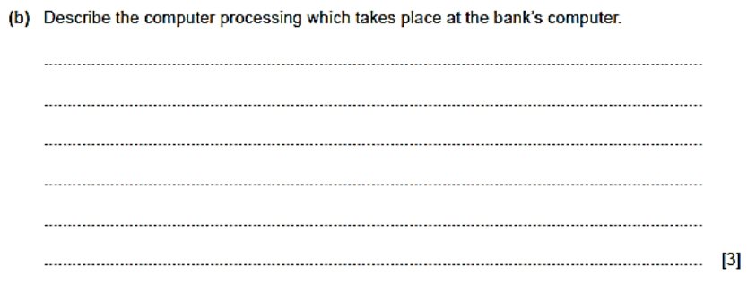

Slide 14
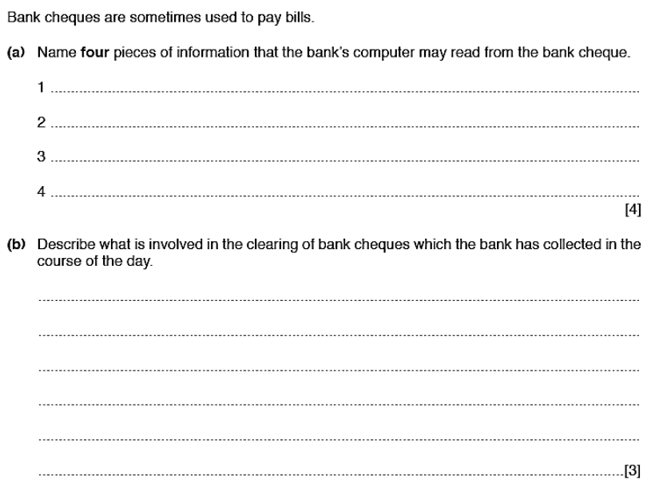

Slide 15
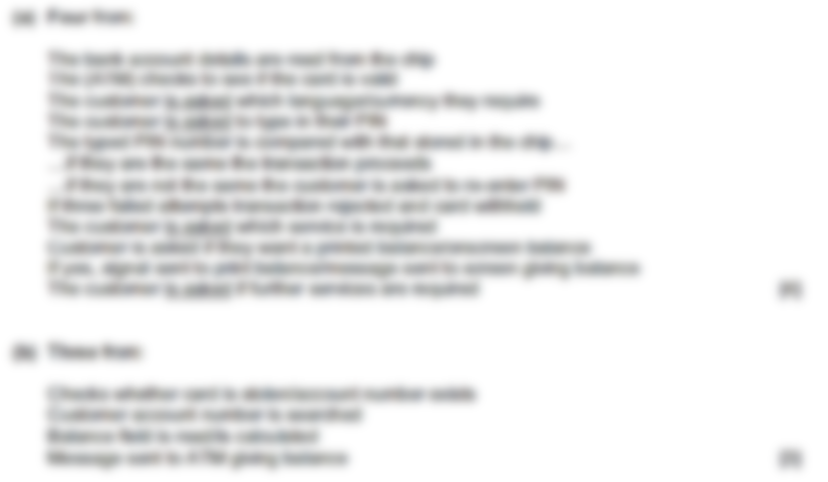

Slide 16
