Slide 1
Modelling Applications
Chapter 6

Slide 2
Computer modelling
Simulation is the creation of a model of a real system to find out how a system behaves, predict the behavior of the system in the future and see if it is possible to influence this future behavior.
The model is computer-generated and is based on mathematical representations.
Advantages:
They are less expensive than having to build the real thing.
It is safer to run a computer model.
It is much easier to try out various scenarios in advance.
It is nearly impossible to try out some tasks in real life because of the high risk.
Faster to use a computer model than do the real thing.

Slide 3
Computer modelling
Disadvantages:
A model is only as good as the programming or the data entered.
Sometimes computer modelling is also a very costly option.
People’s reactions to the results of a simulation may not be positive.
Examples:
Personal finance
Bridge and building design
Flood water management
Traffic management
Weather forecasting

Slide 4
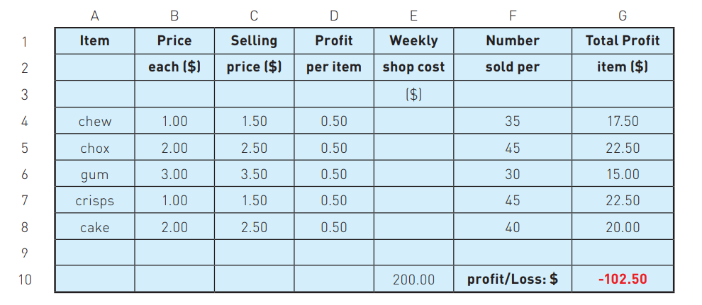
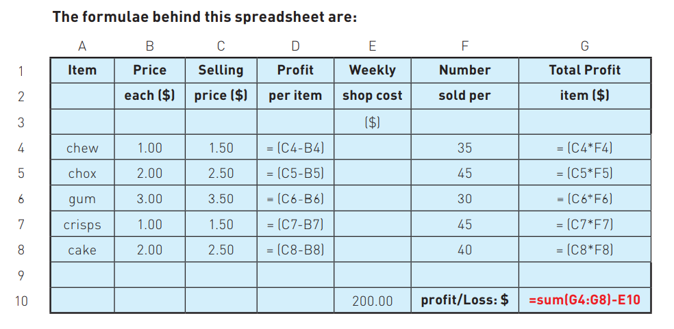
Case 1: Personal Finance
This example is a very simple model, but it shows the principal of using spreadsheets to carry out any type of modelling that can be represented in a mathematical form.
Spreadsheets are often used in some form to carry out financial modelling.

Slide 5
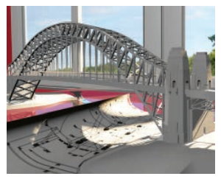
Case 2: Bridge and building design
3D computer modelling is used to try out a number of scenarios to ensure the final design meets critical criteria.
When building a bridge, the modeler has to consider a number of scenarios:
the amount of traffic that might be caught in a traffic jam on the bridge.
the effects of strong winds.
the effect of earthquakes.
the effect of tidal waves and ice floes during extreme weather conditions.
the effects of vibrations.
All of these scenarios can be tested using a computer model. The design can then be modified on the computer.
After a number of modifications, a final design will be decided on.

Slide 6
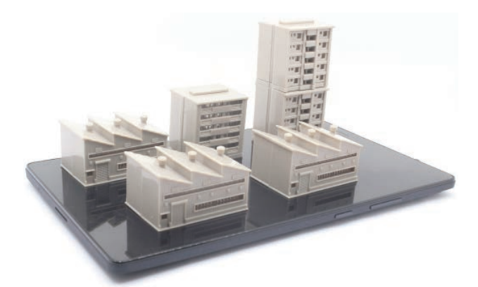
Case 2: Bridge and building design
Similar methods are used when designing new buildings.
When testing the building using a computer model, a number of scenarios need to be considered:
What is the effect of natural phenomena.
The effect of a disaster, such as a fire.
How is it possible to move people around the building efficiently.
Computer modelling provides the following features:
Possible to zoom into images.
The design can be rotated in a number of different ways.
Building a bridge or building is expensive and dangerous if the final design had a serious flaw.
Various scenarios can be tried out to see the effect on the design.

Slide 7
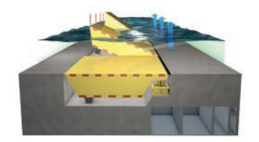
Case 3: Flood water management
Flood water management uses computer modelling:
To perform a risk assessment to identify sources of potential flooding.
The extent of flooding.
How any mitigation or protection measures could work.
Predict water levels, water flows and potential flood depths.
Input to the system could include:
Cross-section of rivers and sea inlets.
Dimensions of any bridges, weirs or sluices in the flood area.
Factors that can affect water flow rates.
Boundary conditions.
The start and finishing date for the simulation.
Calibration data (observation of actual flooding in the past).

Slide 8
Case 3: Flood water management
The main advantages of doing this are:
Sensors could be used out in the bay area to monitor sea height and wave height.
Using a computer system is safer.
Data collection is continuous and more accurate.
Because of the faster response to changing conditions, city dwellers can be warned well in advance.
Data from the sensors could also be fed into the simulation modelling the flood area; this could lead to further improvements.

Slide 9
Case 4: Traffic management
Traffic Light Simulation
How and what data needs to be collected?
How is the computer model carried out?
How would the system work in real life?

Slide 10
Case 4: Traffic management
How and what data needs to be collected?
Count the number of vehicles passing the junction in all directions at different times of day.
The day of the week –it may vary from day to day-
How long it takes a vehicle to clear the junction.
How long it takes the slowest vehicle to pass the junction.
Whether there are any pedestrian crossings.
Whether there are other factors which might affect the junction.

Slide 11
Case 4: Traffic management
How is the computer model carried out?
Vary the timing of the lights and see how the traffic flow was affected.
Increase the number of vehicles stopped at part of the junction and then change the timing of the lights to see how the traffic flow is affected.
Increase or decrease traffic flow in all directions.
Consider how emergency vehicles affect traffic flow at different times of the day.

Slide 12
Case 4: Traffic management
How would the system work in real life?
Sensors in the road gather data and count the number of vehicles at the junction.
This data is sent to a control box or to a computer (it may need to be converted).
The gathered data is compared to data stored in the system.
The control box or computer decides what action needs to be taken.
Signals are sent out to the traffic lights to change their timing if necessary.

Slide 13
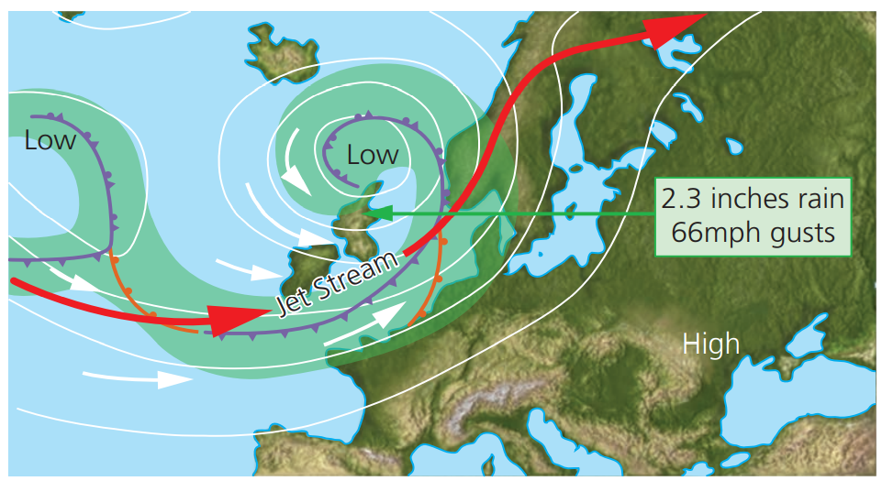
Case 5: Weather Forecasting
Weather stations use a variety of sensors to measure:
Rainfall
Temperature
Wind speed
Wind direction
Barometric pressure (air pressure)
Humidity
Weather modelling is often shown in animated format.

Slide 14
Case 5: Weather Forecasting
The data needs to be gathered every hour of every day of the week.
By running the computer model:
Data is input into the model and a prediction of the weather for the next few days is made.
At the end of the weather forecast period, the model compares its weather forecast with the actual weather.
The model ‘learns’ from previous weather situations.
The new data is then input into the model, and a weather forecast for the next few days is made.
A very powerful computer is needed to run this model.

Slide 15
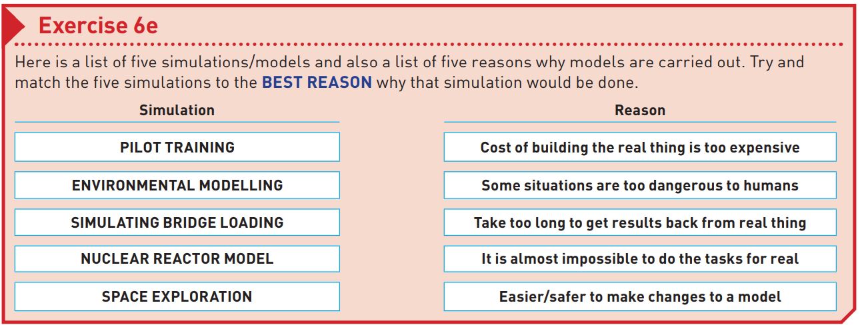

Slide 16
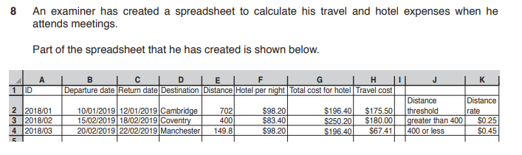


Slide 17
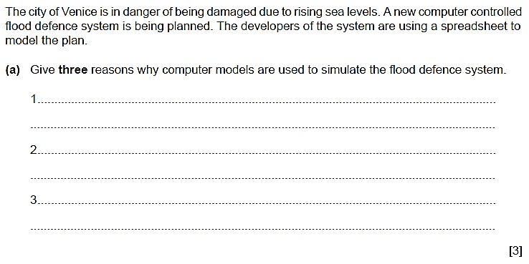
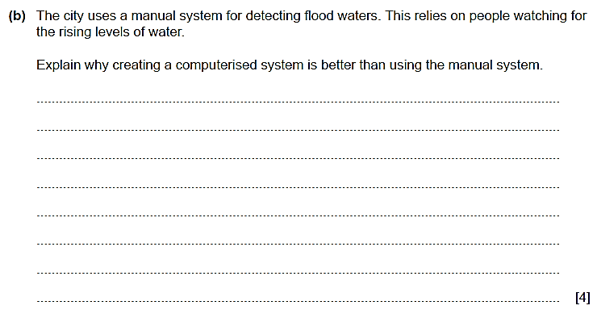

Slide 18
