Slide 1
Satellite Systems
Chapter 6

Slide 2
Satellites
In this final section, we will be considering:
Global positioning systems and satellite navigation (GPS or SATNAV SYSTEM)
Geographic information systems (GIS)
Media communication systems (satellite television and satellite phones).

Slide 3
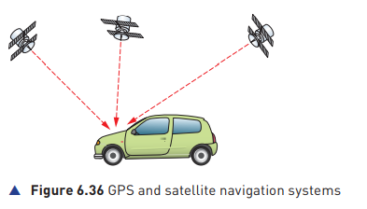
Global positioning systems and satellite navigation
Global positioning systems (GPS) are used to determine the exact location of a number of modes of transport (for example, planes, cars, ships, etc.).
Cars usually refer to GPS as satellite navigation systems (i.e. ‘satnav’)

Slide 4
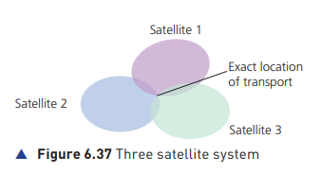
Global positioning systems and satellite navigation
Satellites surrounding the Earth transmit signals to the surface.
Computers installed in the mode of transport receive and interpret these signals.
Each satellite transmits data indicating its position and time.
Satellites need very accurate timing in order to know their position relative to the Earth. They use atomic clocks, which are very accurate.
The computer on board the mode of transport calculates its exact position based on the information from at least three/FOUR satellites.
A screen on the satnav device will also show the car’s position in relation to the road network.

Slide 5
Global positioning systems and satellite navigation
Advantages of GPS and satnav
Disadvantages of GPS and satnav
The driver does not have to consult paper maps, so it is far safer.
It removes errors (can warn drivers about one-way streets, street closures, etc.).
The system can estimate the time of arrival.
It is also possible to program in the fastest route, route to avoid towns, etc.
The system can also give useful information such as location of petrol stations.
If the maps are not kept up to date, they can give incorrect instructions.
Unless the system is sophisticated, road closures due to accidents or roadworks, can cause problems.
Loss of satellite signals can cause problems.
If an incorrect start-point or end-point is keyed in the system will give incorrect information.

Slide 6
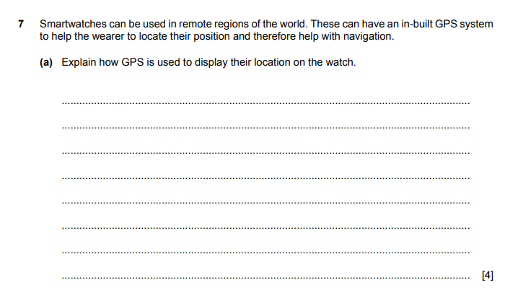
June 2019-11

Slide 7
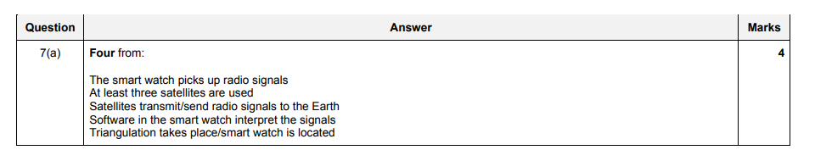
June 2019-11-ms

Slide 8
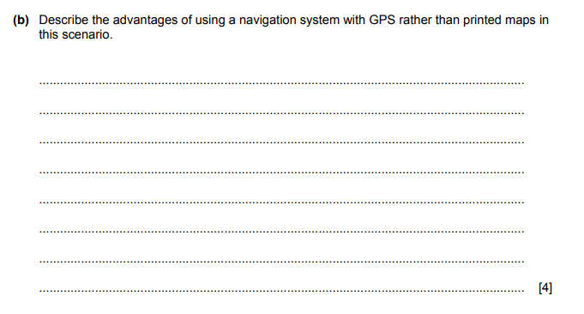
June 2019-11

Slide 9
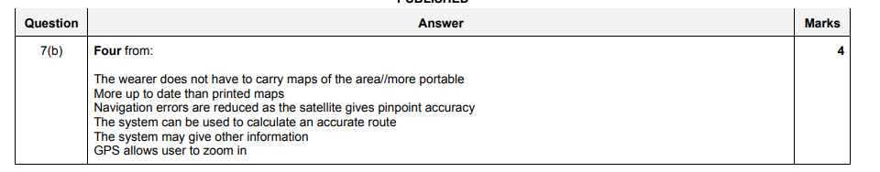
June 2019-11-ms

Slide 10
Geographic information systems (GIS)
Geographic information system (GIS) is a computer system that allows us to map, model, query and analyse large amounts of data according to their location.
GIS allows users to create interactive queries, edit map data or analyse spatial information. (Spatial information refers to how objects fit together in space.) The technology combines maps with computer graphics and databases.
Essentially GIS enables the following:
amalgamation of information into easily understood maps
performance of complex analytical calculations and then presentation of the results in the form of maps, tables or graphics (or a combination of all three)
geographers, scientists and engineers are able to see the data in several different ways in order to see patterns and relationships
anything that can be placed on a map is a candidate for GIS.

Slide 11
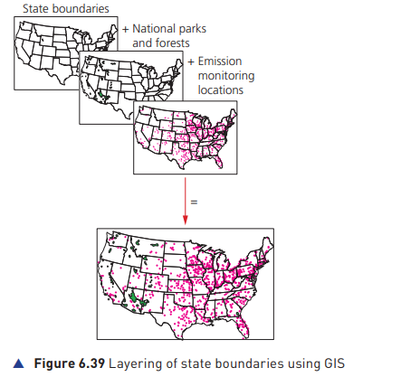
Geographic information systems (GIS)
Examples of the use of GIS
Emergency services use GIS to send the closest emergency personnel to a location.
Biologists and environmentalists use GIS to protect animal life and plants in certain vulnerable areas (which meet a certain criteria after carrying out a search on the database).
Teachers can use GIS in their geography, science or engineering lessons.
It can be used for route monitoring (used in conjunction with route scheduling software).
It can be used for management of agricultural crop data.
It can address public health issues – it was used in 2020 and 2021 during the Covid-19 pandemic to show how the virus spread in different parts of the world and allowed data to be combined (such as, age groups, ethnic group, population density, and so on) to create a unique insight into how it spread.
It can map of wildfire risks (it was used in Australia in 2019 during the wildfire outbreaks; it was possible to map out where and how the fire was spreading).

Slide 12
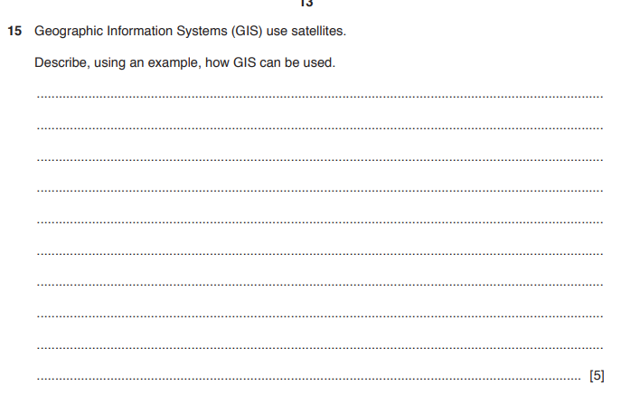
March 2019- 12

Slide 13
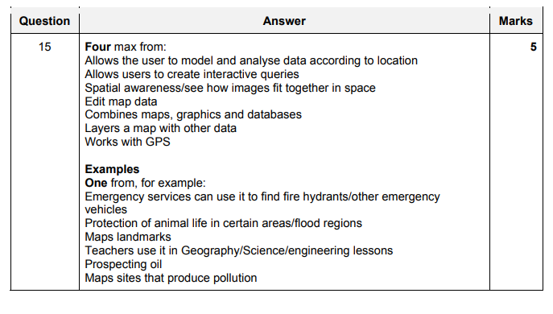
March 2019- 12 ms

Slide 14
Geographic information systems (GIS)
Advantages of GIS
Disadvantages of GIS
It allows geographical and thematic data of any kind to be combined in a way which shows how they are connected to each other.
It allows the handling and exploration of huge amounts of data (massive number crunching).
It allows data to be integrated from a wide range of very different sources (which appear at first to be totally unconnected).
The learning curve on GIS software can be very long.
GIS software is very expensive.
GIS requires enormous amounts of data to be input (thus increasing the chances of errors).
It is difficult to make GIS programs which are both fast and user-friendly; GIS requires very complex command language interfaces to work properly.

Slide 15
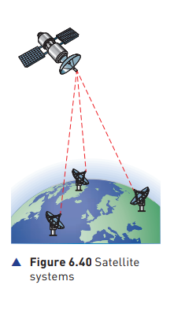
Media communication systems
There are many types of media used to send and receive information (for example, fibre optics, copper cable and Wi-Fi); we will concentrate on the global communication method which makes use of satellites.
Satellites contain antennas, transponders (to allow receiving and sending of data solar panels (for power from the Sun) and propulsion (to ensure the satellite is in the correct orbit at all times).
Signals are converted to analogue (if necessary) and then beamed to the satellite from a satellite dish on the Earth.
The signals are delivered by carrier waves which consist of radio waves.
Each signal has its own frequency and bandwidth (the larger the bandwidth the more data can be transmitted).
Once the data reaches the satellite, it is then re-sent to Earth.

Slide 16
Media communication systems
The satellite usually ‘boosts’ the signal before sending it back.
Often the frequency of the signal is changed to
Satellite systems are used to transmit data from one part of the planet to another. Due to the great distances involved, cables would be too costly and there is also the problem of signal deterioration in cables over long distances.
Satellites systems are used to transmit television, telephone and internet data around the world.

Slide 17
6.11.1 Media communication systems
Advantages of Media Communication systems
Disadvantages of Media Communication systems
They have good global coverage (covers the majority of the Earth’s surface).
They are cheaper, faster and safer than laying cables in difficult or treacherous terrain.
They have a very high bandwidth.
It is relatively easy to expand the network (there are numerous companies now manufacturing satellites for various uses
There is a time delay in receipt of the signals (this can be a problem in voice communications, where even 0.5 seconds delay can be noticeable as the sound and video appear out of synchronisation) or there may appear to be an ‘echo’ on the sound (note that there would also be a time delay for long-distance fibre-optic communications too).
The signals received can be affected by bad weather (for example, heavy rain or hailstones), obstructions (such as tree branches) and whether the satellite dish has been correctly orientated.

Slide 18
6.11.1 Media communication systems
Advantages of Media Communication systems
Disadvantages of Media Communication systems
Security in satellite transmission is very good due to the fact that data is coded and the receiver requires decoding equipment to read the data.
During emergency situations it is relatively easy to move stations on the ground from one place to another; satellites can also change their orbits if necessary, using built-in boosters.
They are well-suited for broadcasting, that is, one satellite signal being picked up by many different receivers on the ground.
Satellite receivers on the ground can be portable, enabling mobile communication in very remote locations.
Sunspot activity can affect the performance of a satellite.
If they are not in a fixed position relative to the Earth then they need to be monitored and controlled on a regular basis to ensure they remain in the correct orbit.

