Slide 1
Computers in medicine
Chapter 6

Slide 2
Patient and pharmacy records
Why it is important to create and maintain a Database for patients Information/Data?
  To ensure correct diagnosis and treatment depending on an up to date data.
  Databases are kept by doctors and hospitals so that data can be shared between medical practitioners and pharmacies (for example, to ensure no drugs are prescribed which interact with each other in an unsafe manner)
  Databases also allow a quick and easy search for patient records – this could be very important in an emergency (life and death).
  It also means that medication can be prescribed without issuing paper prescriptions – an email could be sent to the pharmacy instead.

Slide 3
Patient and pharmacy records
What data should be collected and saved in the patients database?
  a unique identification number
  name and address
  date of birth
  gender (male or female)
  medical history (for example, recent medicine/treatment)
  blood group
  any known allergies
  doctor
  any current treatment
  any current diagnosis
  important additional information such as X-rays, CT scans, and so on.

Slide 4
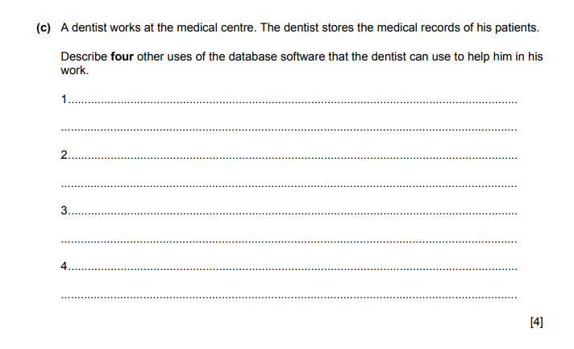
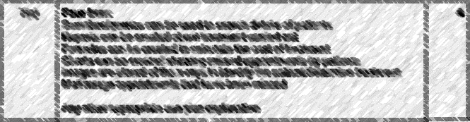
June 202-11

Slide 5
The use of 3D printers
Surgical and diagnostic aids
  How to create anatomical parts using 3D printers to be used in Surgical and diagnostic aids ?
    The patient is scanned using:
      CT (computed tomography) – which involves producing images of the internal parts of the body in a series of thin slices less than 0.1 mm thick, or
      MRI (magnetic resonance imaging) – this uses strong magnetic fields and radio waves to produce a series of images of the internal organs in the body.
    A 3D printer can then produce a three-dimensional representation of a patient’s internal organs, blood vessels, major arteries, tumors and so on.

Slide 6
The use of 3D printers
Why do you think it is important for a doctor or a surgeon to create a 3D model for the patient’s organ, or tumor before the surgery?
  To discuss the problem with the patient himself and explain to him what procedures are required.
  To help the surgeons when planning surgical procedures because they can see exactly what is required well in advance of the operation.
  To reduce the chance of any errors when the actual procedure is carried out.

Slide 7
The use of 3D printers
Prosthetics
  3D printers are now being used to print out prosthetics (false arms, hands and legs). While state-of-the-art myoelectric prosthetics cost tens of thousands of dollars, the price for 3D-printing a prosthetic arm or hand can be as little as $100.
Tissue engineering (replacement organs, using cells from the actual patient)
  3D printing of bio-compatible materials, cells and supporting structures has enabled the viability of producing artificial cells and tissues within a 3D printed object using bio-inks, is a very complex process, It has already been used successfully to produce multi-layered skin tissue, bone tissue, heart/artery grafts and tracheal splints

Slide 8
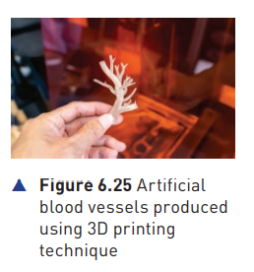
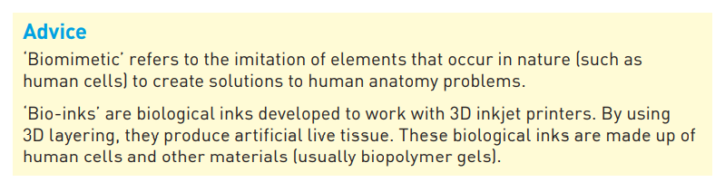
The use of 3D printers
Artificial blood vessels
  One particular type of tissue engineering is the 3D printing of artificial blood vessels using human cells. These bio-printed tissues work in much the same way as natural blood vessels. Biomimetic blood vessels can be fabricated using 3D printing and bio-inks.

Slide 9
The use of 3D printers
Customized medicines
  3D printing techniques now allow scientists to customize medicines to suit the individual. This is known as patient-centric medicine. 3D printed medicines are sometimes referred to as printlets (printed tablets).
  Why to produce Customized medicines?
  3D printing offers the possibility of creating personalized medicine which allows automatically controlled release of the medicine into the patient. It even allows multiple medicines, within a single printlet, to make fixed-dose combinations and allows for the optimum release of each medicine into the body.

Slide 10
The use of 3D printers
In the future it should be possible to send medicines to local pharmacies in the form of a blue print; each blueprint would be custom-made for a patient. By supplying the necessary materials, it would then be possible to print out the customised medicines for each patient using the blueprint.
Customized medicines
  Advantages
  Some of the advantages of this technology include:
  tailor-made medicines to suit the individual
  better control of medicine release into the body
  saves money (many modern medicines are very expensive)
  better targeting of the medicine so its effects can be optimized
  less chance of an overdose of the medicine, thus reducing harmful side-effects (for example, chemotherapy medicines can have very unwelcome side-effects; by reducing the release of the medicine to suit the individual, it will not only work better but also cause fewer harmful side-effects).

