Slide 1
Booking systems
Chapter 6

Slide 2
Online Booking systems
Give examples about online booking systems
Travel Industry
Concerts
Booking Sporting Events

Slide 3
What are the advantages of using he online booking systems?
Prevent double-booking.
Customer gets immediate feedback on the availability of seats.
Customer can make bookings at anytime.
Customer’s email address allows the booking company to attach special offers to them.
It is usually easier to browse the seating plans to choose the best seats.
Possible to reserve at seat for a period of time and make up their mind before finalizing the booking.
No printed tickets which saves postal and printing costs.
Online booking allows the use of modern smartphone apps technology such as QR code stores all the flight details.

Slide 4
What are the disadvantages of using the online booking systems?
The setup and maintenance of the online system is expensive.
All customers need access to a computer and internet connection.
Often difficult to cancel the booking and get your money back.
If the server is down for any reason, it becomes impossible to book seats.
If the websites are not well designed, it can be difficult to make exactly the booking you want.
Booking online does not allow to build a personal relationship with the travel agent.

Slide 5
The travel industry
User needs to fill the following fields:
Schedule
Flight type
Routes
Travelers
The system automatically search for available flights.
Make bookings and transfer the funds from the bank account.

Slide 6
Events such as concerts, theatres, cinemas and sporting events
1
Customer clicks on the performance they wish to see.
2
A date and time is typed in.
3
Required number of seats.
4
Seating display at the venue is shown on the screen.
5
User selects their seats and then click CONFIRM
6
The database check the availability of the selected seats.
7
If the seats are available the total price is shown and the customer clicks on confirm.
8
The customer then enters their personal details
9
Payment method is then selected and payment made.
10
An email is sent to the customer and may include a QR then the database is updated.

Slide 7
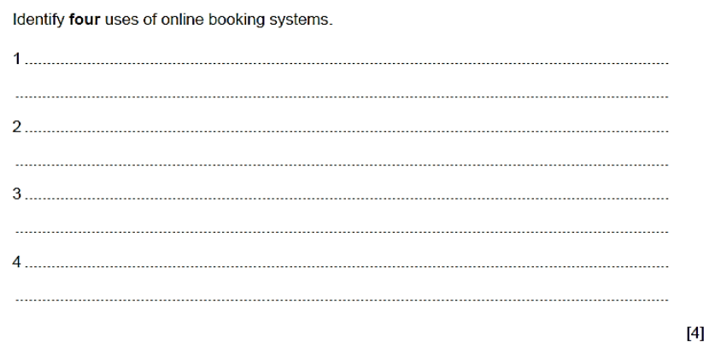
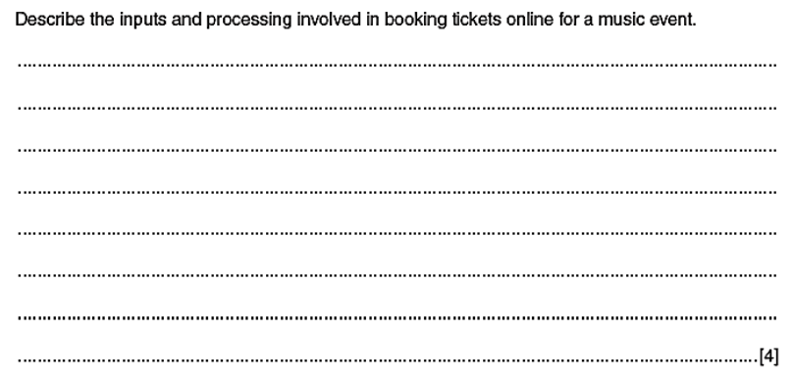

Slide 8
