Slide 1
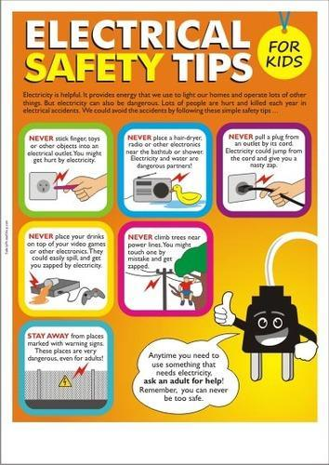

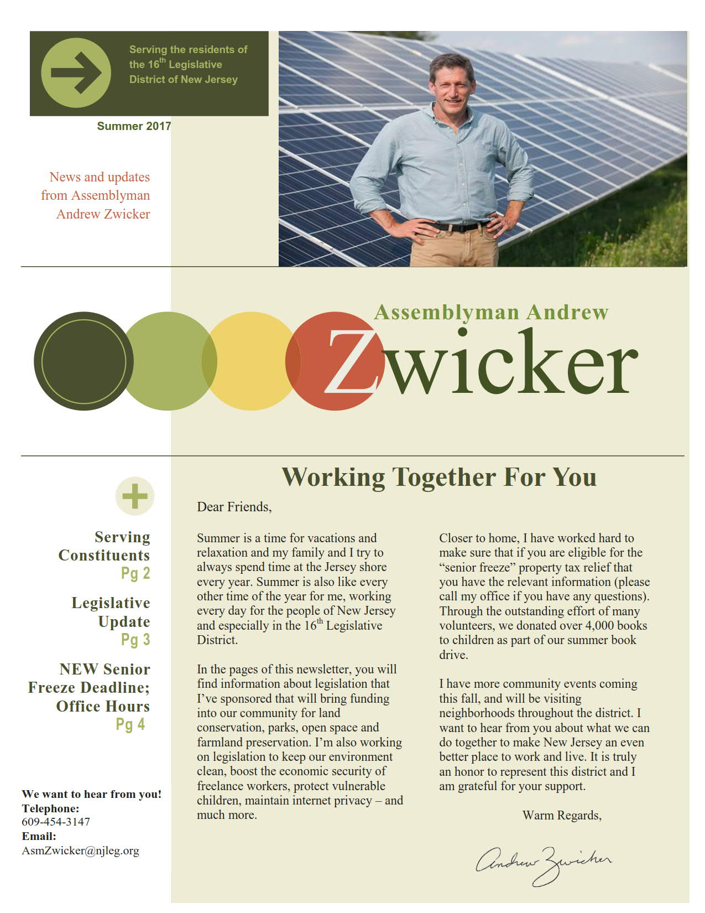
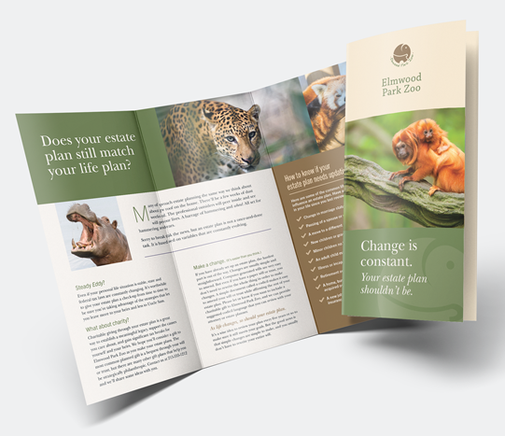
6.1 Communication
Chapter 6

Slide 2
newsletters and posters
newsletters and posters can be produced very easily using word processing and they will have photos.
  First a word-processor application would be opened.
  Photos can be added from different sources using a Digital camera or searching on the internet or using scanned images
  Text would be typed.
  Photos need to be placed in their correct position and the text wrapped.
  Finally, the whole document would need to undergo proofreading for errors and then saved, ready for printing.
other features, such as a spell checker, would be used for the following reasons:
  The language used in checking the spelling could be different.
  Names or proper nouns might be highlighted as an error but may be acceptable.
  Similar sounding words need to be checked; for example, where, were or wear.
  The (correct) highlighted word may not exist in the spell checker dictionary.

Slide 3
newsletters and posters
Newsletters is a very useful method for getting important information to a target group. Newsletters can be either printed out or available online as an e-publication.
guidelines to produce an attractive newsletter include:
  Do not try and squeeze too much information onto one page.
  Use very clear, easy-to-read fonts.
  Decide on whether to use columns.
  Avoid using capital letters.
  Use bold text in headings rather than underlining text.
  Use real photos rather than clip art.

Slide 4

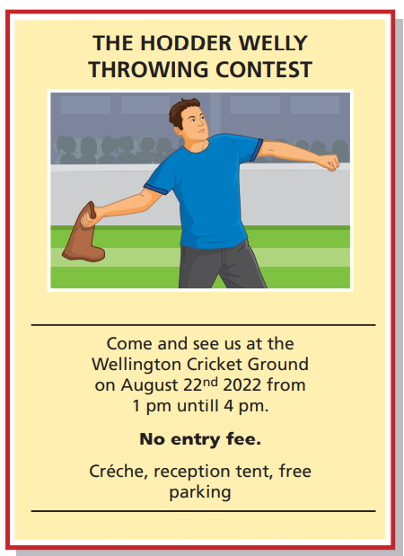
newsletters and posters
Posters are a good way of publicizing. posters can be printed out using high-quality printers or can be posted online. They may include the following:
  what the event is and where it will take place.
  date, time and place of event.
  admission fees (if any).
  contact details.
  other information (IF ANY).

Slide 5
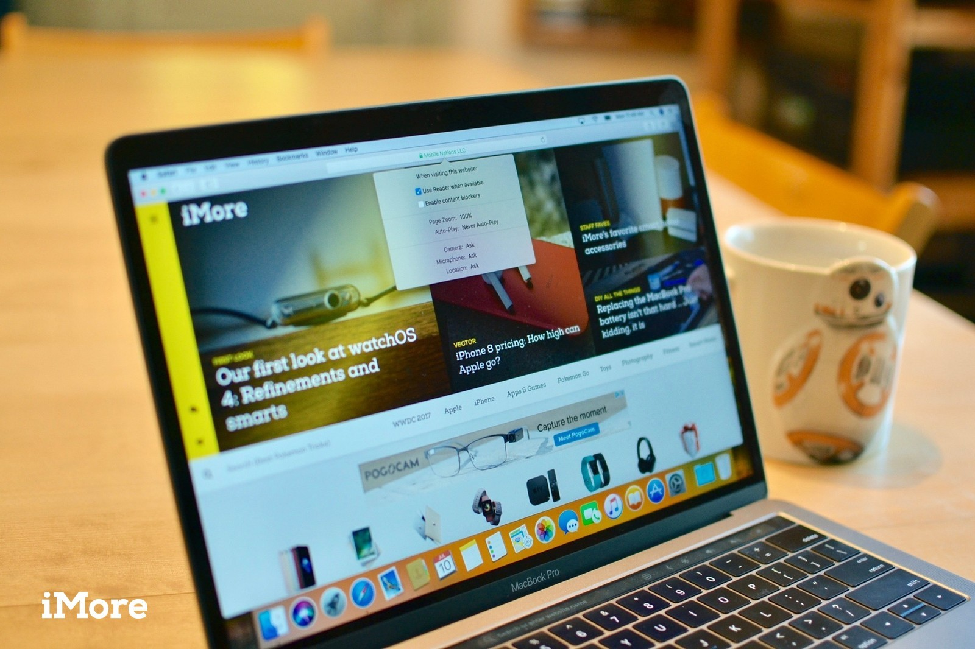
Websites
This method requires the company to either develop their own website or to pay another company to advertise on their website.
If they want to design their own website they need to:
  employ a team of web designers or o use specialist company.
  they need to buy hardware and software.
  Use programmers to make sure that the website is safe from hackers and from pharming attacks.

Slide 6
Websites
Advantages | Disadvantages
Sound/ Video/ animation can be added. | Websites can be hacked or contain viruses.
Links to other pages and websites can be added in hyperlinks and hot spots. | Risk of pharming.
Buttons to navigate and moving around the website for more information. | Not portable as a paper-based system.
Hit counters to see how many people visited the web. | Customers must have computers and internet connection.
Seen by a global audience. | Possible to go to undesirable websites.
 | More difficult to target the correct audience because it is global.
Can’t be thrown away. | Maintaining the website once it is set up and this can be expensive.
Easier to update a website. No need to reprint.
 | Still need to find a way for people to find out about the website.

Slide 7
Multimedia Presentations
Presentations that Use animation, video and sound or music are much more interesting than statistic presentations done on slides or papers.
Advantages | Disadvantage
Use sound, video effects and animation. | It may be expensive because we need special equipment.
Having interactive hyperlinks. | Equipment failure.
Use transition effects. | May need internet access.
Presentations can be interactive. | Focus could be on the medium rather than the message.
They are more flexible because of the links to websites and other external systems. | It may be a bad presentation with too many animation effects, text or images.

Slide 8
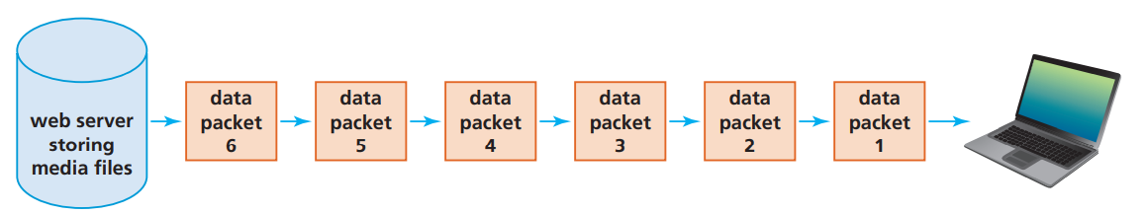
Media streaming
Media streaming is when users watch movies/videos or listen to music on devices connected to the internet.
  no need to download and save the video or audio files.
  data is transmitted and played in real time.
How it works?
  the file is sent as a series of packets of data.
  Each packet is interpreted by the web browser.
  Streaming only works well if the internet speed is stable. Sometimes the data packets are buffered. Buffering makes sure the video plays back smoothly without freezing.
    While the buffer is receiving data packets, it will be sending the data from the previous data packets to the playback device. In this way, there appears to be no gaps in the received data.

Slide 9
E-publications
material which is published on paper is also available in an electronic format. For example:
  e-books
  digital magazines
  digital newspapers
  digital libraries.
the publication can be downloaded to a device connected to the internet where it can be read.
Moving between pages is usually done by swiping a finger across the screen.
pages can be expanded in size.
it is possible to include media.
Because no printing costs, e-publications are usually cheaper than paper-based.

Slide 10
Mobile phones
Mobile phones communicate by using towers inside many cells networked together to cover a large areas.
The towers allow the transmission of data throughout the mobile phone network.
Each tower transmits within its own cell.
  If you are driving a car and get to the edge of a cell, the mobile phone then picks up the signal in one of the adjacent cells.
  If a person is making a call or sending a text to somebody in a different country then satellite technology is used to enable the communication.
Mobile devices either use a SIM (subscriber identity module) card or they use wireless internet connectivity. Together they allow all of the following features:
  SMS
  phone calls
  Voice over Internet Protocol (VoIP) communication
  video calling
  internet access.

Slide 11
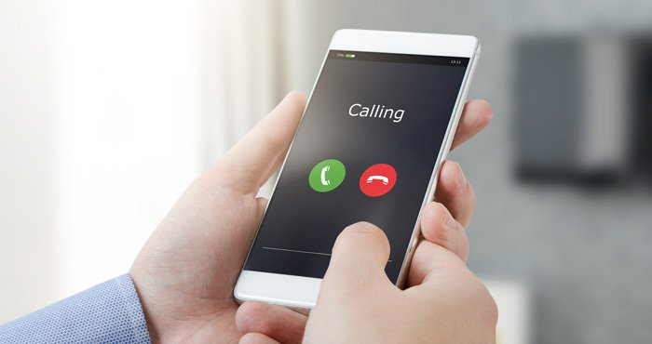
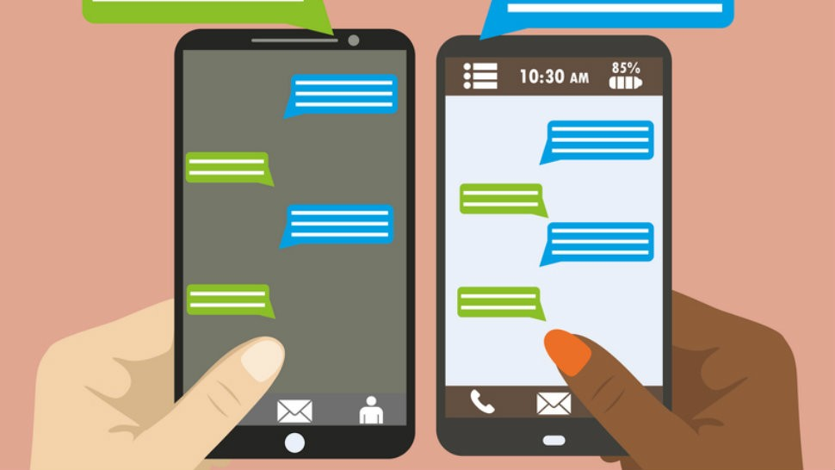
Mobile phones
mobile phone can be used to make phone calls from any location. phone calls has the following advantages:
  No need to look for an operational public telephone.
  Conduct business and personal phone calls on the move.
  Easier to keep in contact with co-workers at the office.
mobile phone can be used to allow text messaging –SMS- Some of the features of SMS/text messaging include:
  Quicker and less expensive than making phone calls.
  Can be sent at any time.
  Employ predictive texting where the system completes a word from the first few letters.

Slide 12
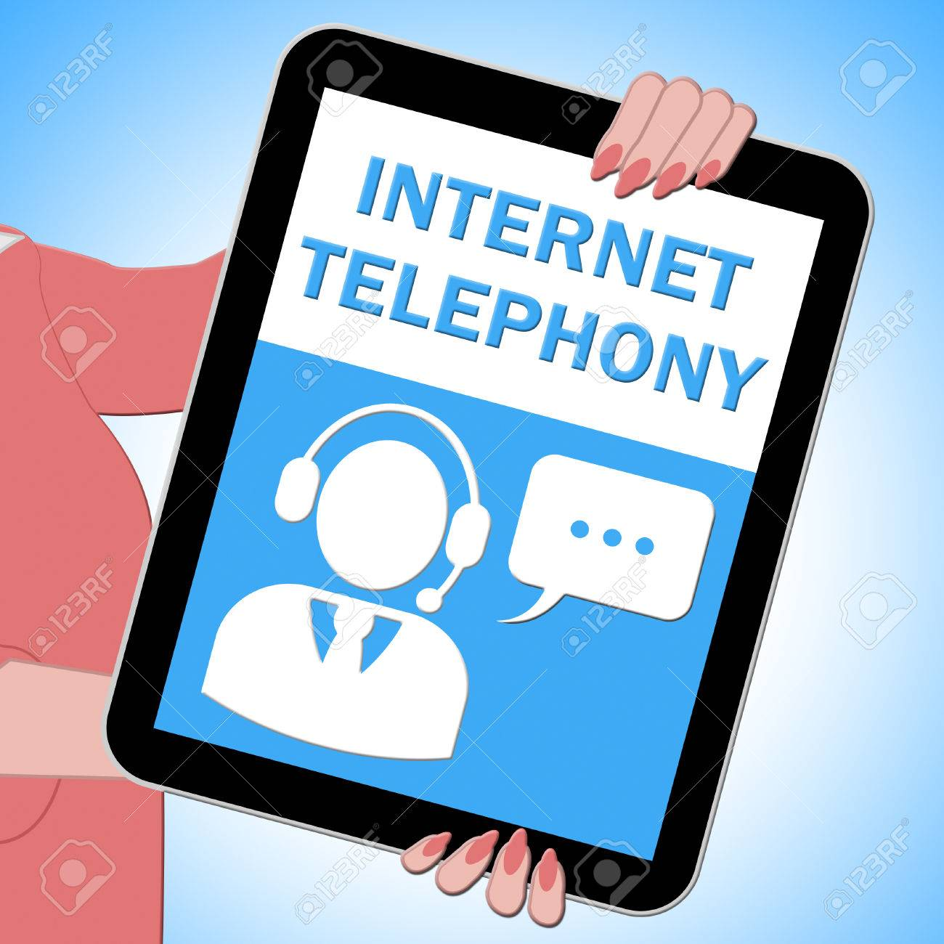
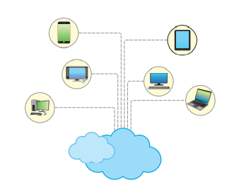
Voice over internet protocol (VoIP) and video calling
VoIP –Voice over internet protocol- a method used to talk to people using the internet.
VoIP converts sound into digital packets which can be sent to the destination via the internet.
To work in real time it requires mobile phone network or a broadband network.
VoIP uses built-in microphones, speakers and webcams.
Advantages →
  either it is for free or at a local rate.
  a built-in cameras can be used so it becomes a type of video chat but it is cheaper than the video conferencing (no need for special software and hardware items.
Problems →
  sound quality (echo and weird sounds).
  Security is also a main concerns with VoIP.
Video calls permit:
  live video and audio chat.
  screen-sharing during the call.
  recording during sessions.

Slide 13
Internet access
Access to the internet from a mobile device is another valuable feature.
Due to the use of smaller screens, internet pages displayed on mobile phones are often different.
Software detects which type of device is connecting to a website, which then sends out the web page optimized for that device.
Mobile devices also have a built-in feature which automatically selects wireless broadband connectivity (if possible), instead of the mobile phone network. The advantages of this feature:
  less expensive
  lower power consumption
  quality of service

Slide 14
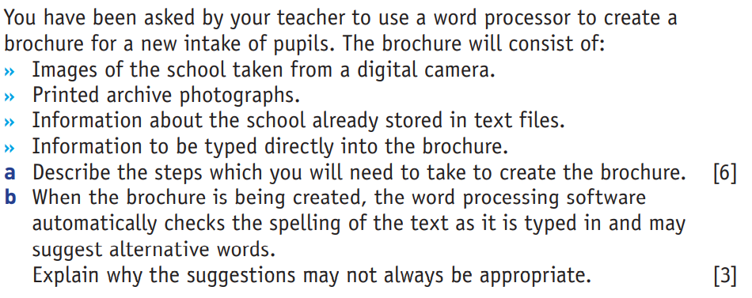
Past Paper questions

Slide 15
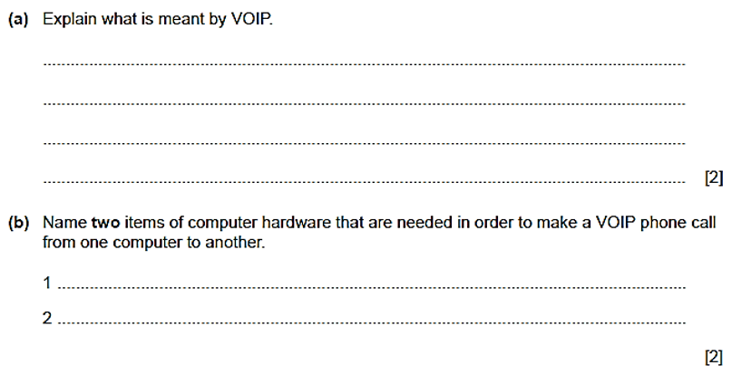
Past Paper questions

Slide 16
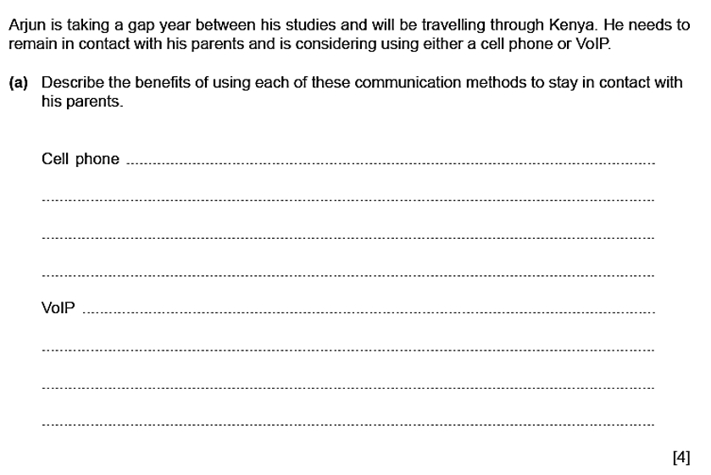
Past Paper questions

Slide 17
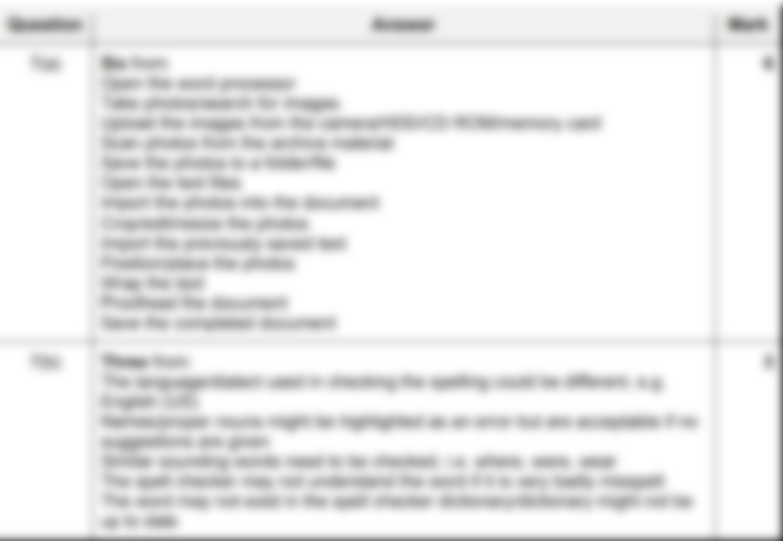

Slide 18
