Slide 1
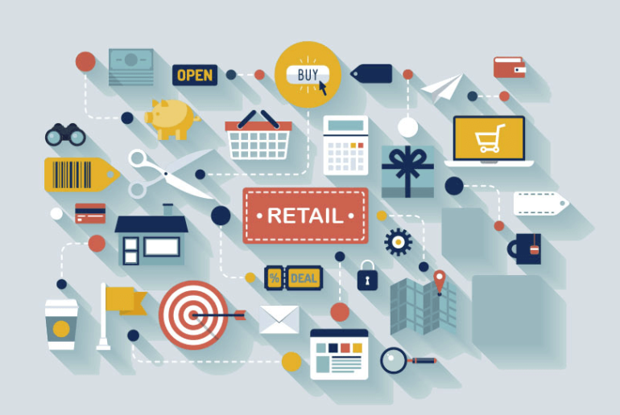

Computers in the retail industry
Chapter 6

Slide 2
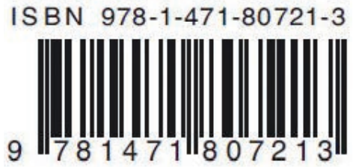
Computers in the retail industry
Computers are used in the retail industry at:
Point-of-sale (POS) terminals.
Automatic stock control systems.
Point-of-sale (POS) terminals:
Using barcodes → Barcodes are made up of dark and light lines, consists of four parts: country code, manufacturer’s code, product code and a check digit.
Allow quick identification of product details once the barcode has been scanned by a barcode reader.
Relays information back to the computer system allowing it to update its files.
The check digit is a form of validation which is used to make sure no errors occurred during the reading of the barcode.

Slide 3
Computers in the retail industry
Barcodes are used in the automatic control of stock levels in a supermarket:
Barcodes are attached to all items sold by the supermarket.
Each barcode is associated with a stock file which contains details about the item.
A customer takes their trolley/basket to the POS terminal
The barcode on each item is scanned at the POS.
The barcode is searched for on the stock file until a match is found.
Once the barcode has been found, the appropriate record is accessed.
The price of the item is then found and sent back to the POS together with a product description.

Slide 4
Computers in the retail industry
The stock level for the item is found in the record and is reduced by one.
If the number in stock of the item is less than or equal to the re-order/minimum number in stock, then the computer automatically orders a batch of items from the suppliers.
Once goods have been ordered, the item is flagged on the file to indicate an order has been placed to prevent re-order action.
When new goods arrive, the barcodes on the cartons will be used to update the stock files and the flags will be removed.
The above procedure is repeated until all the items in the customer’s basket/ trolley have been scanned.
The customer is given an itemized bill showing a list (with prices).
The computer also updates the files containing the daily takings.
If the customer has a loyalty card, the system will also automatically update their points total.

Slide 5
Computers in the retail industry
Electronic funds transfer at point-of-sale (EFTPOS) → When payment is made by card or electronic device it is known as electronic funds transfer at the point-of-sale (EFTPOS).
Payment will be done by the following methods:
Chip and PIN (discussed before)
Contactless cards
Near field communication (NFC) devices.

Slide 6
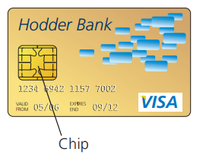
Computers in the retail industry
Advantages of chip and PIN cards:
They are more secure system than magnetic stripe cards.
It is a quicker system than magnetic stripe cards and allows for contactless payments to be made.
Disadvantages of chip and PIN cards:
The risk of fraud when typing in the PIN.
Some countries do not accept chip and PIN cards.

Slide 7
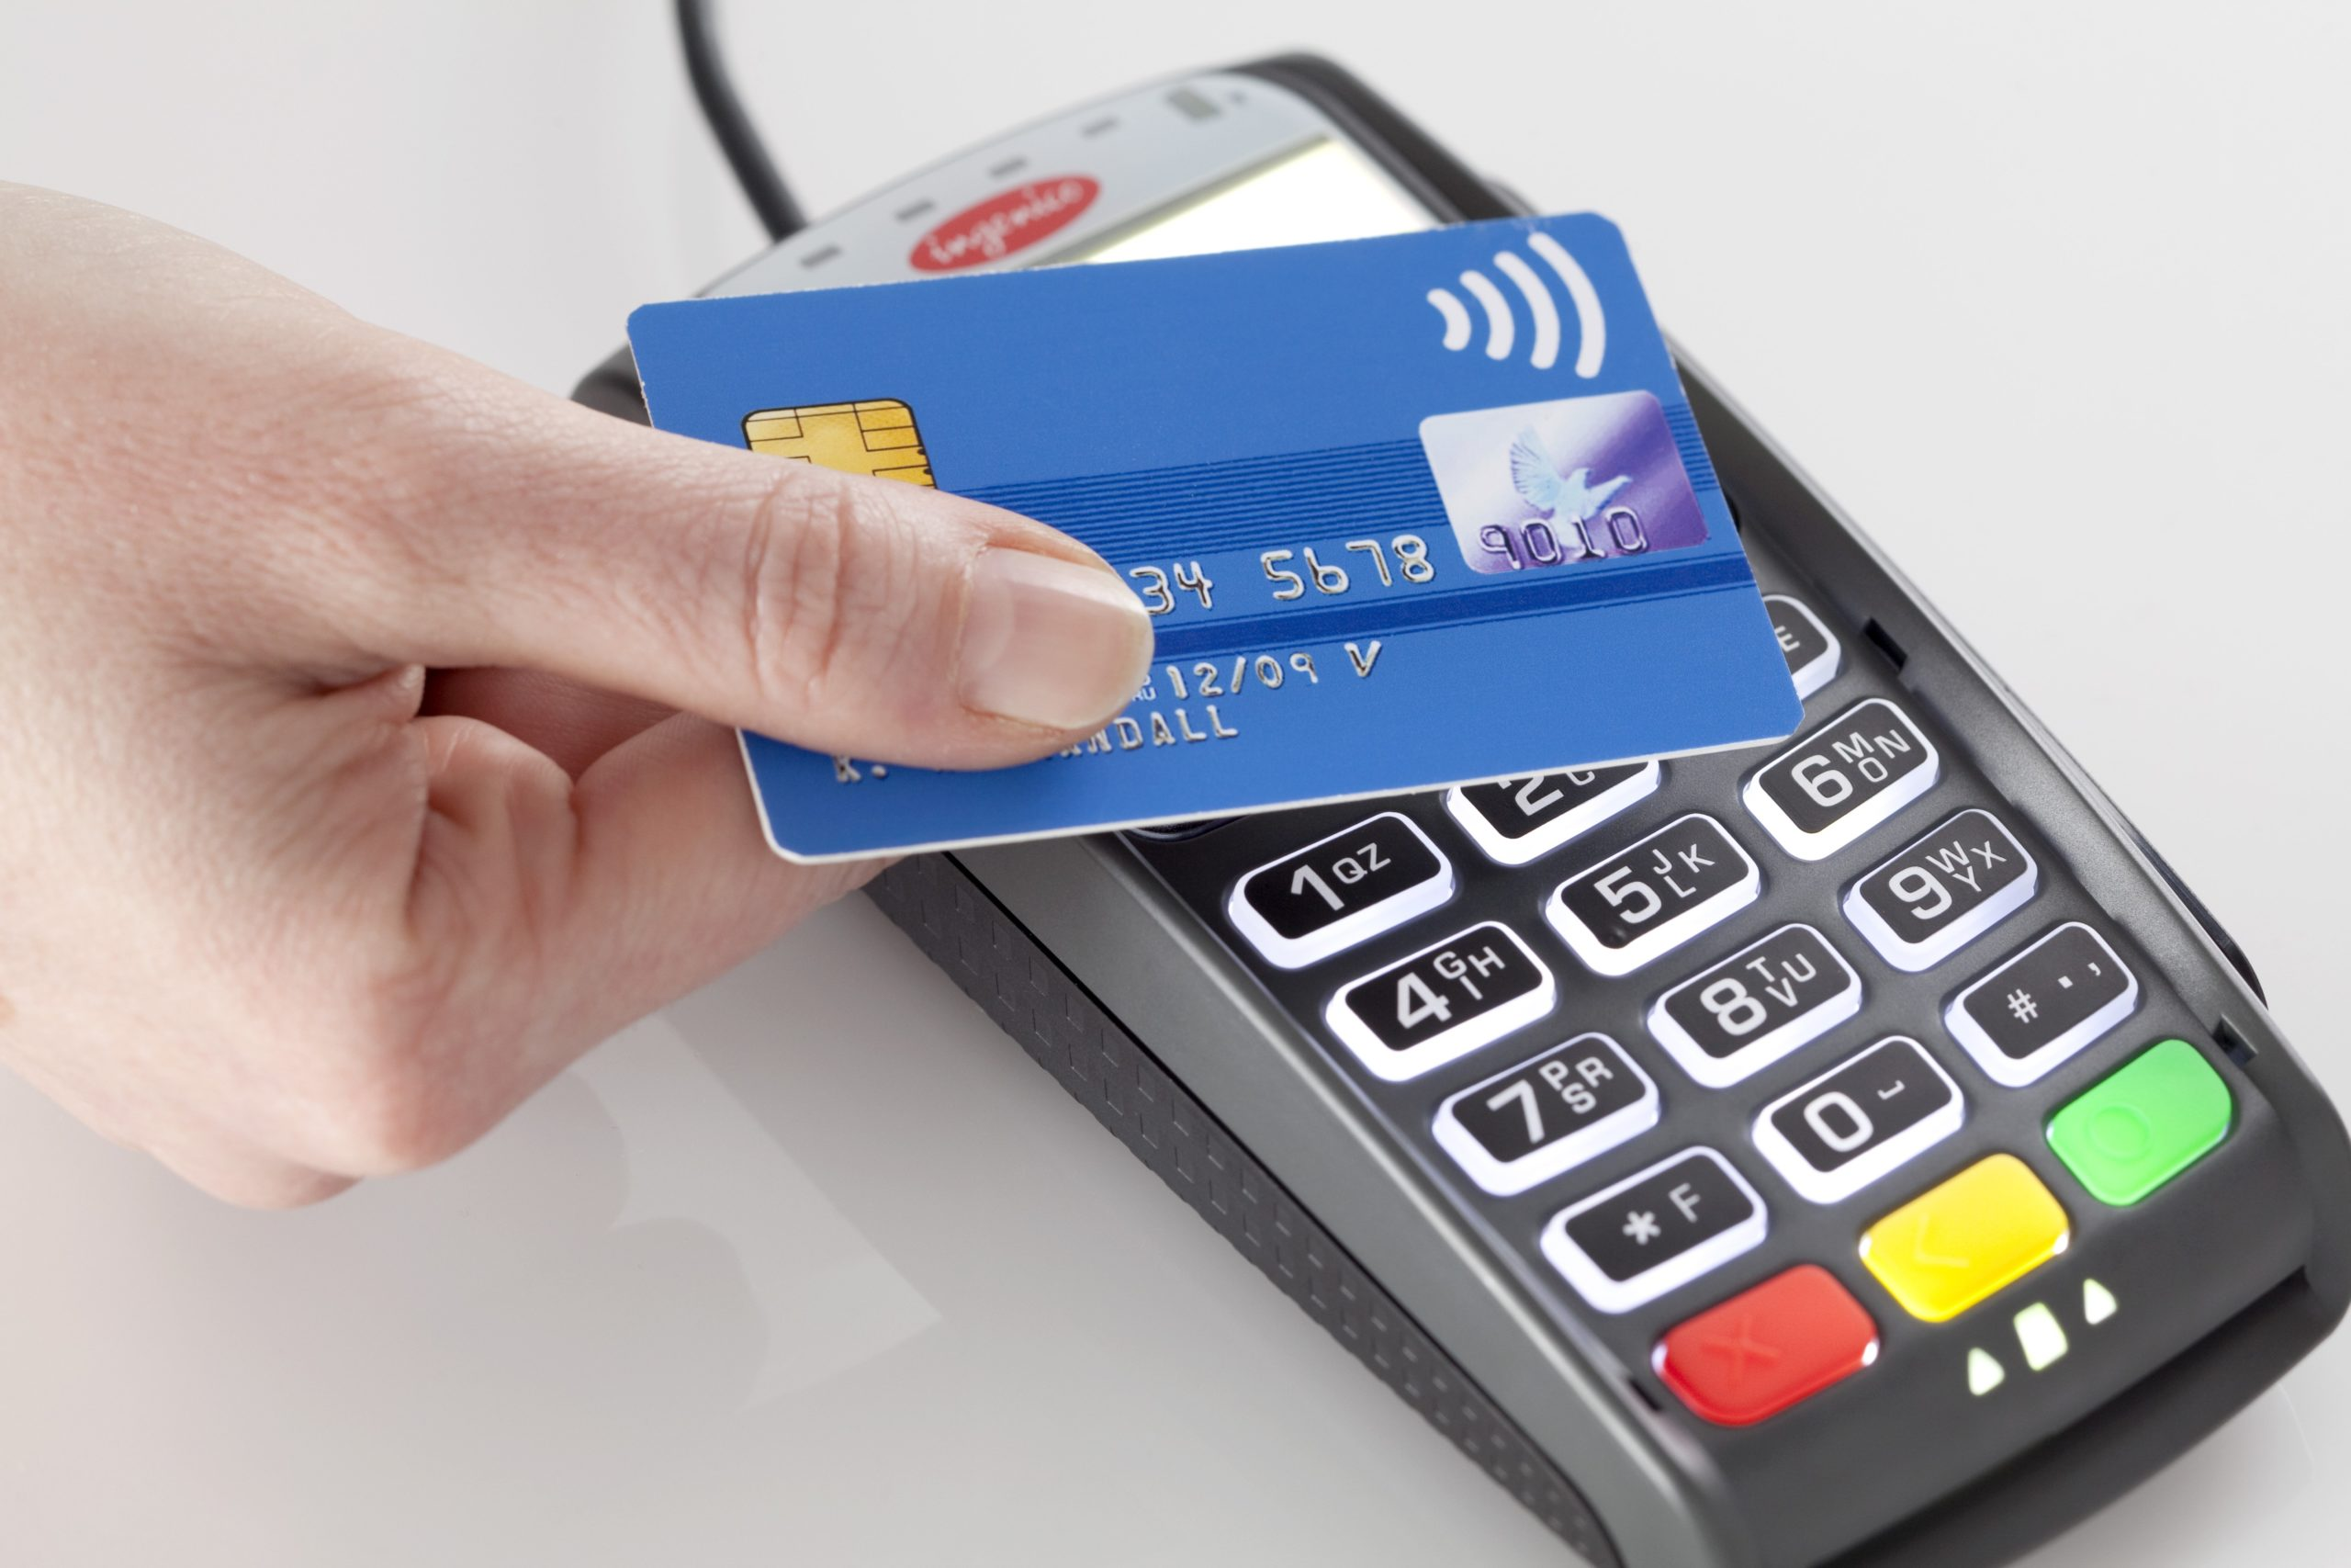
Computers in the retail industry
Contactless cards
Near field communication (NFC) devices (will be discussed later)
The electronic device is held close to the NFC reader.
When the NFC (contactless) payment is initiated, the NFC terminal and electronic device (smartphone) pass encrypted data back and forth to each other to enable the payment to be made.
This is very secure because NFC communications are encrypted.
Mobile phone manufacturers use tokenization (is used when setting up a mobile wallet) to improve security.

Slide 8
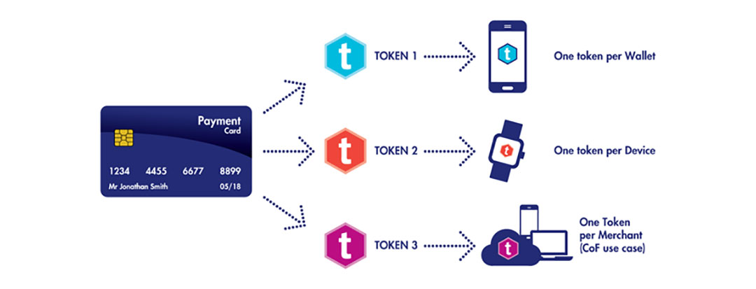
Computers in the retail industry
The process of tokenization →
The user takes a photograph of their credit card using the smartphone’s camera.
The details on the card are securely sent to the bank that issued the card.
The bank replaces the details on the card with a series of randomly generated numbers (called tokens) which they send back to the mobile phone manufacturer, who then programs this random number into the user’s smartphone.
This random number is then the one used for transactions.
Benefit → if their systems are hacked then the stored credit card details are not the real ones and therefore useless to the hackers.

Slide 9
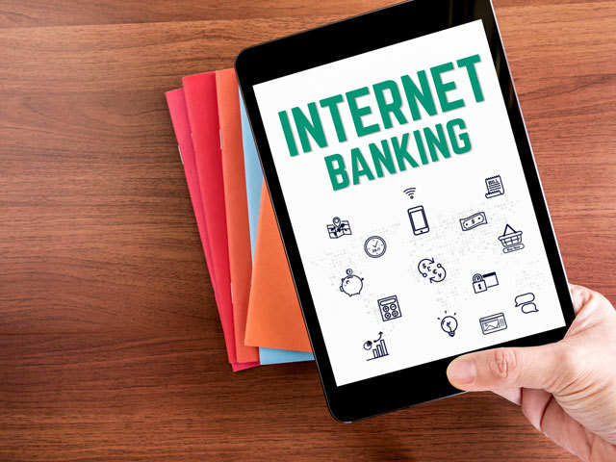
Internet Banking and internet Shopping
Using internet banking allows the transfer of sums of money between accounts, payment of bills, online shopping and so on.
Requires good security.
It would be done using a computer connected to the internet and some form of electronic payment (credit or debit card).

Slide 10
What are the advantages of Online shopping and banking?
No need to visit the bank during their normal opening hours.
Users can look for products in a worldwide market and can look for products that are cheaper.
Disabled people can now access any shop or bank without the need to leave home.
Shopping and banking online can be done at any time on any day of the week.
People can spend more time doing other things.
Paying bills was time-consuming, now this can be done easily and simply.
Many people find it less embarrassing to ask for a loan using the internet rather than face-to-face.
There are often long queues at the banks so internet banking saves time.
Shops and banks save money by not having as many staff working for them.

Slide 11
What are the disadvantages of Online shopping and banking?
Lack of social life when people stay at home to do their shopping and banking.
Health risks because of lack of exercise.
Security issues are a major concern (hacking, stealing credit details, viruses, pharming, phishing).
Using fraudulent bank or shopping websites is always a risk.
Necessary to have a computer and internet connection.
Only possible to see a picture of the goods which might not me as exact as the product is.
Physical shops and banks are closing because of the increase in online shopping and banking.
Local independent retailers may lose out to huge multinational retail companies.
It is easier to make errors with online banking and transfer money incorrectly to different accounts.

Slide 12
Effects on companies due to the spread of online shopping and banking
Companies can save costs.
Because the internet is global, the potential customer base is increased.
There will be some increased costs because the need of hiring a new staff to deal with the online shopping and banking.
Setting up and maintenance costs.
Since there is very little or no customer-employee interaction, this could lead to a drop in customer loyalty.
Robberies are less likely due to decrease in the number of high street banks.
Banks need to employ fewer security staff.

Slide 13
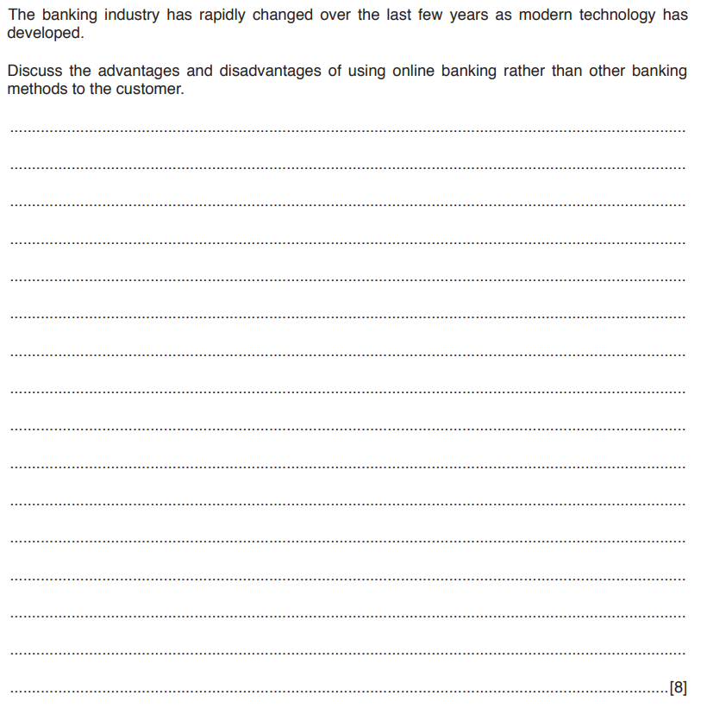

Slide 14
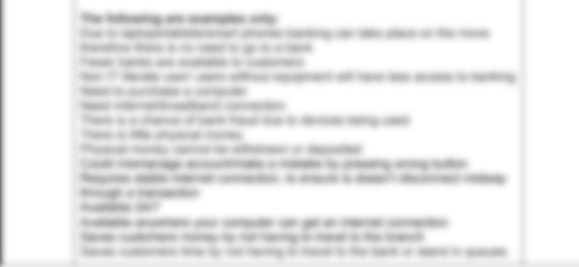

Slide 15
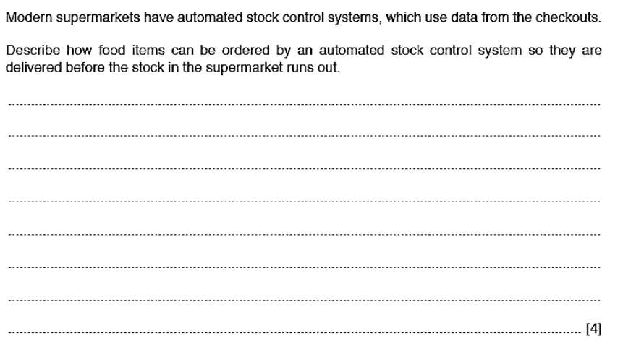

Slide 16
