Slide 1
Expert Systems
Chapter 6

Slide 2
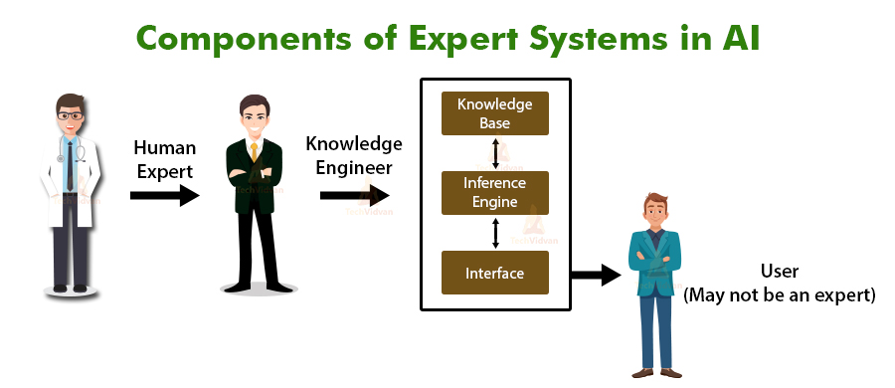
Expert Systems
Expert systems have been developed to mimic the expertise and knowledge of an expert in a particular field.

Slide 3
Expert Systems
Examples include:
prospecting for oil and minerals
diagnostics (finding faults in a car engine, finding faults on a circuit board, etc.)
medical diagnosis
strategy games (e.g. chess)
tax and financial planning
route scheduling for delivery vehicles
identification of plants, animals and chemical compounds.

Slide 4
Expert Systems
Advantages of expert systems
Disadvantages of expert systems
They offer a high level of expertise.
They offer high accuracy.
The results are consistent.
They have the ability to store vast amounts of ideas and facts.
They can make traceable logical solutions and diagnostics.
It is possible for an expert system to have multiple types of expertise.
They offer a very fast response time (much quicker than a human expert).
They provide unbiased reporting and analysis of the facts.
They indicate the probability of any suggested solution being correct.
Users of the expert system need considerable training in its use to ensure the system is being used correctly.
The set-up and maintenance costs are very high.
They tend to give very ‘cold’ responses which may not be appropriate in certain medical situations.
They are only as good as the information/facts entered into the system.
Users sometimes make the very dangerous assumption that they are infallible

Slide 5
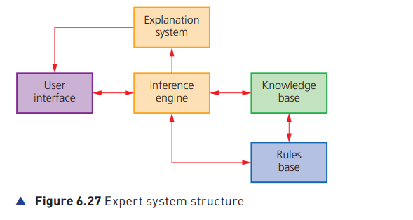
Expert Systems

Slide 6
Expert Systems
User interface
This is the method by which the expert system interacts with a user. » It allows interaction through dialogue boxes, command prompts or other input methods.
The questions being asked usually only have yes/no answers and are based on the responses to previous questions.

Slide 7
Expert Systems
Explanation system
This informs the user of the reasoning behind the expert system’s conclusions and recommended actions.
For example, suppose the user was investigating a series of symptoms in a patient and the expert system gave the diagnosis of mercury poisoning; the explanation system would explain its reasoning with a statement such as ‘impaired vision, lack of coordination, weak muscles, slurred speech and the patient used to work in a paint factory’. The user could then probe deeper if necessary.
The expert system will supply a conclusion and any suggested actions to take; the important thing is it will also give the percentage probability of the accuracy of its conclusions.

Slide 8
6.8 Expert Systems
Inference engine
This is the main processing element of the expert system.
The inference engine acts like a search engine examining the knowledge base for information/data that matches the queries.
It is responsible for gathering information from the user by asking a series of questions and applying responses where necessary; each question being asked is based on the previous responses.
The inference engine is the problem-solving part of the expert system, which makes use of inference rules in the rules base.
Because the knowledge base is a collection of objects and attributes, the inference engine attempts to use information gathered from the user to find an object that matches (making use of the rules base to find a match).

Slide 9
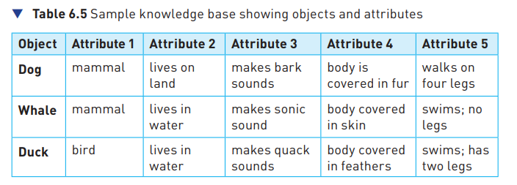
Expert Systems
Knowledge base
The knowledge base is a repository of facts.
It stores all the knowledge about an area of expertise obtained from a number of expert resources.
It is basically a collection of objects and their attributes (see the example in Table 6.5).
So, if we had the following series of questions and answers:
– Is it a mammal? YES
– Does it live in water? YES
– Does it make sonic sounds? YES
– Is its body covered in skin? YES
– Does it have any legs? NO
the conclusion would be: it is a WHALE.

Slide 10
Expert Systems
Rules base
The rules base is a set of inference rules.
Inference rules are used by the inference engine to draw conclusions (the methods used closely follow human reasoning).
They follow logical thinking like the example above; usually involving a series of ‘IF’ statements, for example: IF continent = ‘South America’ AND language = ‘Portuguese’ THEN country = ‘Brazil’.
Now that we know how an expert system works, it is important to find out how to set one up.

Slide 11
Expert Systems
Setting up an expert system
Information needs to be gathered from human experts or from written sources such as textbooks, research papers or the internet.
Information gathered is used to populate the knowledge base, which needs to be first created.
A rules base needs to be created; this is made up of a series of inference rules so that the inference engine can draw conclusions.
The inference engine itself needs to be set up; it is a complex system since it is the main processing element, making reasoned conclusions from data in the knowledge base.
The user interface needs to be developed to allow the user and the expert system to communicate.
Once the system is set up, it needs to be fully tested; this is done by running the system with known outcomes so that results can be compared and any changes to the expert system made

Slide 12
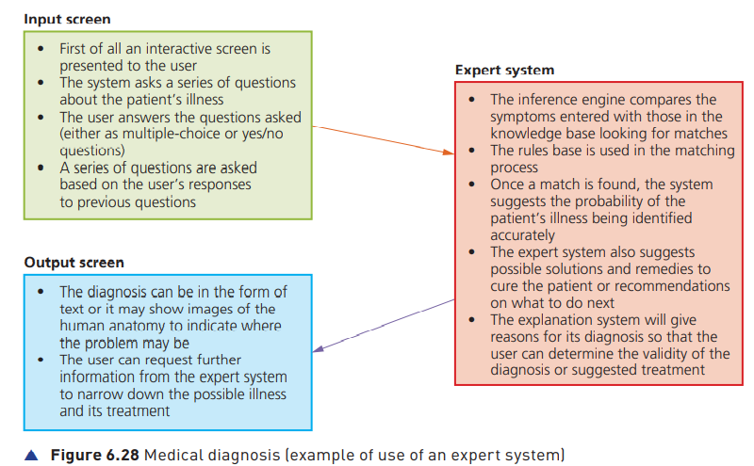
Example1: Medical diagnosis

Slide 13
Example2: Oil prospecting
An interactive user screen appears (this is often made up of multiple-choice questions or yes/no responses).
Questions are asked about geological profiles.
Answers to questions/geological profiles are typed in by the operator.
The next questions asked are based on the previous response(s) input by the operator.
The inference engine searches the knowledge base using the rules base.
The system suggests the probability of finding oil as an output.
It also indicates the probable depth of deposits (usually as a % probability).
The explanation system will also explain how the expert system arrived at its conclusions.
It makes predictions about geological deposits above the soil.
It produces contour maps showing concentration of minerals, rocks, oil, etc.

Slide 14
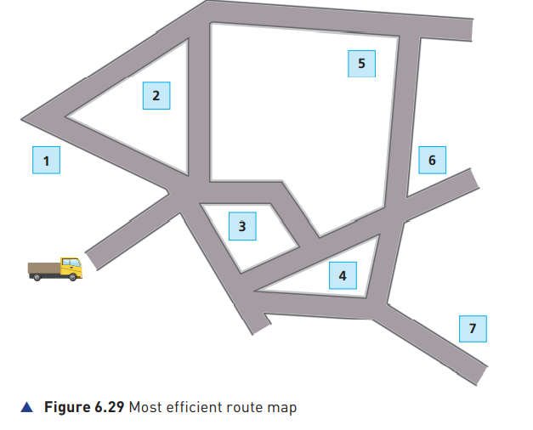
Example3: Route scheduling for delivery vehicles
An expert system could be employed to find the most efficient route for a parcel delivery van. The software will determine the fastest and least expensive route, as well as suggest the number of vehicles and drivers that should be used.
The inputs needed for the delivery system are:
the number of drop-off points and their location
the distance between the drop-off points
the type of vehicle used » delivery times expected at each drop-off point
layout of the road network.

Slide 15
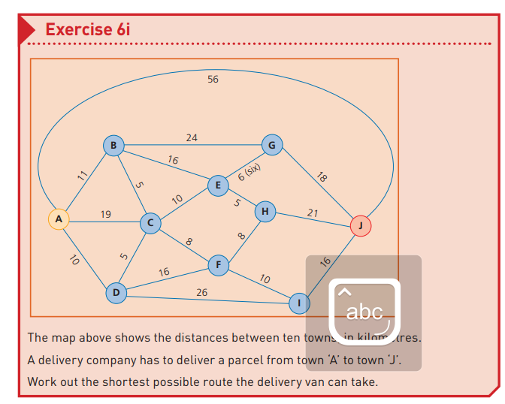

Slide 16
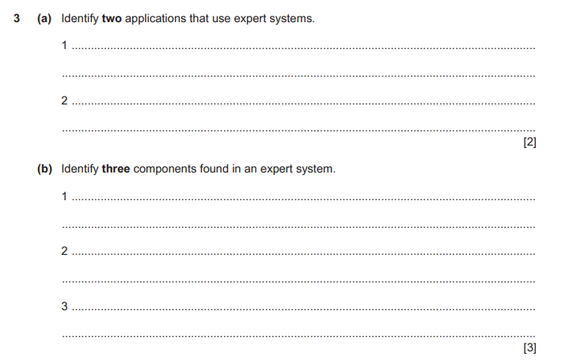
June 2021- 13

Slide 17
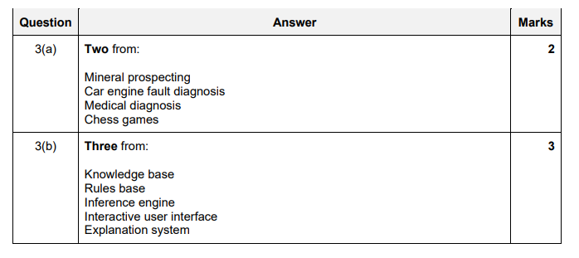
June 2021- 13

Slide 18
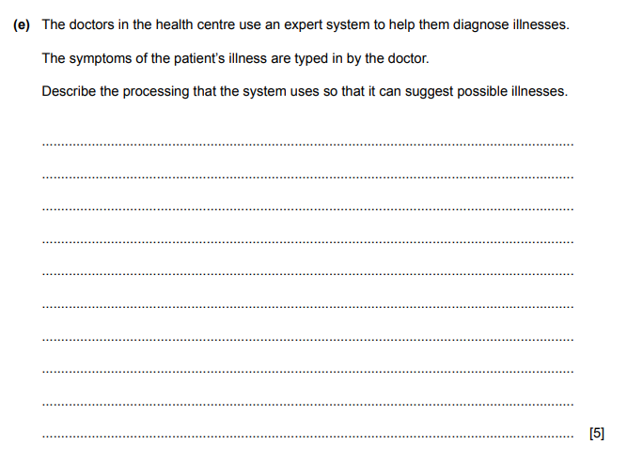
June 2019- 13

Slide 19
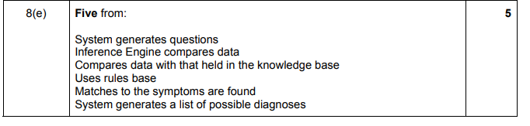
June 2019- 13

