Slide 1
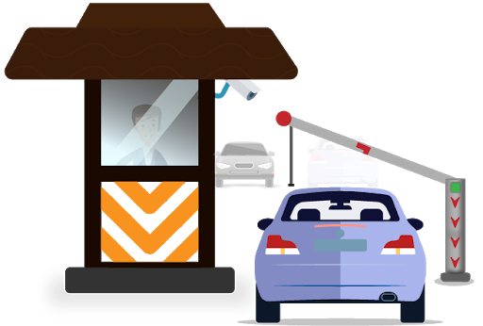

Recognition Systems
Chapter 6

Slide 2
Recognition systems
Recognition systems include:
OMR
Barcode readers (discussed before)
QR code readers (discussed before)
OCR recognition systems (discussed before)
RFID recognition systems
Biometric recognition systems.

Slide 3
Optical mark recognition (OMR)
Use of OMR to read multiple-choice question (MCQ) papers:
Completed multiple-choice forms can be scanned in using OMR.
The forms have timing marks down one side. These timing marks pass under the first column sensor of the scanner. These marks indicate the position of each question on the paper.
Using OMR software, a template is created to map out the X-Y coordinates of each lozenge, a value is then assigned to each lozenge.
The position of the filled in lozenges is compared to the corresponding coordinates on the ‘answer sheet template’.
If the position matches to the X-Y coordinates , then the answer is recorded as being correct.
The scanned results are exported to a database or spreadsheet.

Slide 4
Optical mark recognition (OMR)
Advantages of OMR devices:
It is a very fast way of inputting the results of a survey.
Because there is no typing, they are more accurate than keying in the data.
They are more accurate than OCR methods.
Disadvantages of OMR devices:
The forms need to be carefully designed to make sure the marks/shading are correctly positioned.
There can be problems if they have not been filled in correctly.
They often only work with black pen or pencil.
They are limited to the questions on the paper.

Slide 5
Automated number plate recognition systems (anpr)
Systems that are used to read number plates on cars in a number of applications.
How ANPR is used in a car park to enable automatic entry and exit controlled by a computer system?
Sensor detects a vehicle and sends the signals to the microprocessor to make the camera capture an image of the front of the vehicle.
An algorithm is used to locate and isolate the number plate from the image taken –it considers the size of the number plate and any damage or orientation-
The brightness and contrast of the number plate is first adjusted so that all the characters are clearly read and then they are segmented.

Slide 6
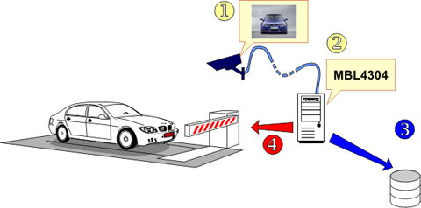
Automated number plate recognition systems (anpr)
Each character is then recognized using optical character recognition software and they are converted into a string of editable text by the software. And this text string is then stored on a database.
The car barrier is raised and the motorist is issued with a ticket. The ticket shows the date and time of entering the car park.
When the motorist returns back to the car park and the ticket is inserted into the machine it will calculate the charge and the payment will be registered in the database then the exit barrier is raised.

Slide 7
Automated number plate recognition systems (anpr)
Advantages of ANPR:
It can be used to automatically monitor average speed of vehicles over a road.
There is no need to employ car park security guards, which saves money.
It is a much faster system than having to check a ticket at the exit.
It can be used to automatically control the entry and exit to a car park or private roads.
It can be used as a security system; preventing illegal parking.
It can be used to analyze driver behavior.
It can be used in inner-city congestion charging systems.

Slide 8
Automated number plate recognition systems (anpr)
Disadvantages of ANPR:
There is a lack of manned security car park surveillance which could lead to vandalism because nobody is checking on a regular basis.
There could be invasion of privacy issues due to the recordings.
Damaged or very dirty number plates will not be recognized by the system.
Number plate cloning.

Slide 9
Radio frequency identification devices (RFID)
Advantages:
Tags can be read from a distance.
It is a very robust and reliable technology.
RFID tags are more robust than the barcodes and difficult to alter.
RFID tags can reduce the number of staff needed in
It provides a very fast read rate
It allows read and write operations to take place.
Bulk detection is possible (detect several RFID tags at the same time).
Disadvantages:
Tag collision – this is when the signals from two or more tags overlap.
Because RFID uses radio waves, they are relatively easy to jam or interrupt.
It is relatively easy to hack into the data.
the initial cost of an RFID system is more expensive than barcode system.

Slide 10
Radio frequency identification devices (RFID)
This section will look specifically at four uses of RFIDs:
Tracking of stock (discussed before)
Passports
Automobiles
Contactless payments

Slide 11
Use 2: Passports
Tiny RFID chips and antenna are now embedded into passports and these tags have no power supply.
When the passport is presented to an RFID scanner, the scanning device provides enough energy so that the chip can broadcast its stored information.
This information is then sent to a computer.
The tiny chips can contain security data.
The data sent to the computer is encrypted.
The RFID in a passport can be read from six meters.

Slide 12
Use 3: Use of RFID in vehicles
The main reasons for doing this include:
The tags allow or deny access to parking in a secure, private car park.
RFID tags in lorries and delivery vans can be used at weigh-stations.
Tags can be used on toll roads, a device near the barrier reads the tag and if it is valid the barrier will open without them having to stop.
RFID tags can be used on a car production line to track its progress through the assembly process.

Slide 13
Use 4: Near field communication
Near field communication (NFC) can be used by smartphones when making payments.
the frequency at which NFC operates requires the sender and receiver to be in very close proximity, which makes communication more secure.
NFC devices can act as a receiver (passive) or a reader (active).
There are three distinct modes of operation with NFC:
Peer-to-peer mode (used by smartphones):
This allows two NFC-enabled devices to exchange information with each other.
Both devices switch between being active (when sending data) and being passive (when receiving data).

Slide 14
Use 4: Near field communication
Read/write mode:
This is a one-way transmission of data.
The passive device (for example, a tablet) links up with another device and reads data from it.
This is used, for example, when an active tag is sending out advertising data to other devices.
Card emulation mode:
In this mode, an NFC device can function as a smart or contactless card.
This allows the card to make payments.
It is often used as way of entering public transport systems for example, a metro system.

Slide 15
Biometric recognition systems
Biometric recognitions systems include:
Face recognition (discussed before)
Finger and thumb recognition (discussed before)
Hand recognition (discussed before)
Voice recognition (discussed before)
Iris and retina recognition

Slide 16
Biometric recognition systems
Retina recognition:
The retina is the light-sensitive area at the back of the eye that has a unique pattern of blood vessels.
The retina cannot be seen without specialized equipment.
The special equipment is used to take an infrared photograph of the retina.
The subject has to sit very still and stare directly into the light source.
It is slower to scan and verify.
It is only used in very specialized high-security settings.

Slide 17
Biometric recognition systems
Iris recognition:
The iris is the colored part of the eye, surrounding the pupil.
A digital camera is used to take a sharp photograph of a person’s iris.
The method produces a unique pattern of a person’s iris by locating and taking an image of:
the center of the pupil
the edge of the pupil
the edge of the iris
the eyelids and eye lashes
This method is used in security systems such as immigration control and some banks.

