Slide 1

Diet and Health

Slide 2
Diet and health
Food is vital to life.
Food is any solid or liquid substance which, when taken by the body, provides it with the necessary materials to enable it to grow, to replace worn-out and damaged parts, and to function normally.
Human body is prone to faults and weakness if it is poorly maintained.

Slide 3
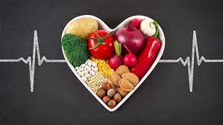
This can happen if too little or too much food is eaten, or if the daily food intake is in any way unbalanced.
One way of ensuring that health and fitness are maintained, when food is plentiful, is to have an understanding of food and its effects on the body and to use knowledge wisely.

Slide 4
What is Nutrition?
Food, like other substances, is composed of different chemical elements, arranged in a variety of ways to form molecules.
These molecules collectively give individual foods their flavour, colour, and texture, and affect their reaction to heat and their digestion.
The body uses some of the molecules in food to function correctly and to stay healthy. These are the nutrients.

Slide 5
There are many different nutrients, and each has its own function in the body.
Each nutrient is vital to life, and the health of an individual will suffer if any one nutrient is in short supply.
The study of nutrients and their relationship with food and living things is called nutrition.
Most foods contain more than one nutrient, so are of use to the body in several ways.

Slide 6
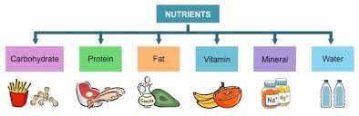
Some foods, such as sugar, contain only one nutrient, and are of limited use to the body.
No single food provides all the nutrients required by the body in sufficient quantities, so a variety of foods must be eaten.

Slide 7
Terms used in nutrition and nutritional related problems (Past Papers Definitions)
Diet: the food that a person normally eats everyday. There are also special diets, such as slimming diets, low fat diets or vegetarian or vegan diets.
Balanced diet: a diet that provides the correct amount of all nutrients for the needs of an individual in adequate amounts.
Metabolism: chemical reactions that happen in the body, which enable the body to carry out all the necessary functions and processes, as well as to grow and to replace the damaged and worn-out body cells.

Slide 8
Malnutrition: is the condition that develops when the body does not get the right amount of the vitamins, minerals, and other nutrients it needs to maintain healthy tissues and organ function.
It occurs in people who are either under-nourished or over-nourished. Under nutrition is a consequence of consuming too few essential nutrients or using or excreting them more rapidly than they can be replaced.
Undernutrition: is an insufficient total intake of nutrients to meet an individual’s needs to maintain good health.

Slide 9
Over nutrition: is a form of malnutrition, in which the nutrients are oversupplied relative to the amount required for normal growth, development and metabolism, it can develop into obesity.
Deficiency diseases: are the diseases such as rickets and scurvy caused by a dietary deficiency of specific nutrients especially a vitamin or mineral. The disease may stem from insufficient intake, digestion, absorption, or utilization of a nutrient.
Energy dense foods: foods that are notably low in nutrient density such as crisps, sweets, and similar snacks, these foods deliver only energy with little or no protein, vitamins, and minerals.

Slide 10
Metabolic rate: The rate of chemical processes in living organisms, resulting in energy expenditure and growth (the rate at which oxidation occurs).
Basal metabolism: the amount of energy that is required to keep the body alive when it is at complete rest and warm, it is used to keep the heart, lungs, and digestive system moving, to maintain the nerve impulses to and from the brain, and for all the necessary chemical reactions in the body.
Empty calorie-foods: a term used to donate foods that contribute energy, but lack protein, vitamins and minerals (low in nutrients and high in energy.

Slide 11
Metabolism
The human body is a complex living structure composed of millions of individual units called cells.
Cells are grouped into systems containing various tissues and organs, each performing special functions.
Chemical reactions and changes are continually taking place.
These enable the body to carry out all the necessary functions and processes, as well as to grow and to replace damaged and worn-out body cells.

Slide 12
This complex collection of chemical reactions is called metabolism.
Energy is required for all metabolic reactions, and the body must remain healthy if it is to be efficient.
This is mainly achieved by the intake of nutrients in food. Humans like all living things, must have a regular supply.

Slide 13
The Nutrients
Macronutrients : are needed by the body in relatively large amounts. They include protein, fat, carbohydrate, and the mineral elements sodium, calcium, potassium, phosphorus and magnesium.
Micronutrients : are needed by the body in smaller amounts. They include vitamins, essential fatty acids , and trace elements (the minerals iron, zinc, copper, iodine, selenium, chromium and cobalt).
Protein
Fat
Carbohydrate
Vitamins
Minerals
Water
Dietary fibre or nonstarch polysaccharide (NSP)

Slide 14
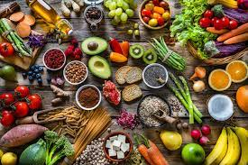
Water is also called a nutrient, as it is vital to life.
Some foods contain dietary fibre or non-starch polysaccharide (NSP), which is not strictly a nutrient, but is still of importance to the body.

Slide 15
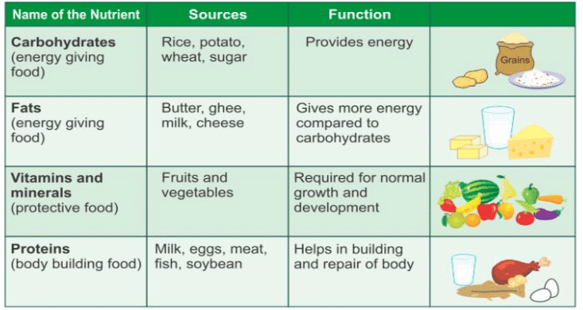

Slide 16
What is DRV? Past Paper Question
Dietary reference value.
Helps with planning nutritionally balanced meal.
Prevents malnutrition and deficiency.
Used to provide the right quantities of nutrients.
Covers 97% of different groups of people, not individual.
Groups are based on age and genders.
Only applies on healthy people “those with specific nutritional needs are not included”.

Slide 17
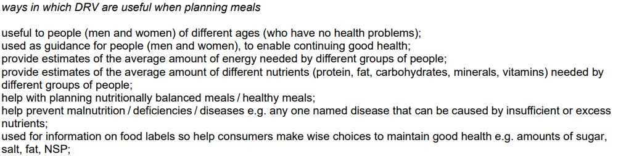

Slide 18
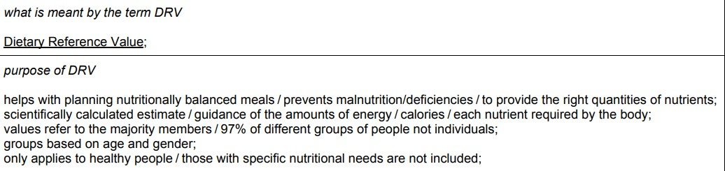

Slide 19
Dietary reference value :
EAR (estimated average requirements)
It’s the intake level for a nutrient at which the needs of 50% of the population will be met (particular for energy).
RNI (reference nutrient intake)
It’s the amount of a nutrient that is enough to ensure that the needs of nearly all the group(97.5%) are being met (used for protein, vitamins and minerals).

