Slide 1






Narrative Writing
Successful Writing P.4

Slide 2
Learning Objectives:
Identify and apply the key elements of a narrative (plot, setting, characters).
Use vivid descriptions and figurative language to bring the story to life.
Develop a story with a clear theme and revise it for improvement.

Slide 3



Warm up Activity
Instructions: 1. Look at the lists below of Characters, Settings, and Objects/Events.
2. Choose one item from each list.
3. Spend 2 minutes imagining a short story idea that uses all three elements.
4. Write your mini-plot idea in the space provided
Click Here

Slide 4


Definition
What is a narrative writing?
Narrative writing is a style that allows the writer to tell a story. It can include series of events or experiences told in chronological order or it may include imagined events told in a timeline that the author creates. Narrative writing can sustain the reader's attention and help them visualize a realistic experience from the words.

Slide 5
Purpose
What is the purpose of writing narrative story?
Narratives can entertain, inform, or convey a message.
They allow readers to experience a story firsthand (coming from the writer directly or his/her personal experience).

Slide 6
Let’s watch
Story starters: are strategies to consider when writing a story to make the beginning more engaging and purposeful.

Slide 7

key Narrative Components:
Rising Action
Expositions
Climax
Falling Action
Resolution:

Slide 8
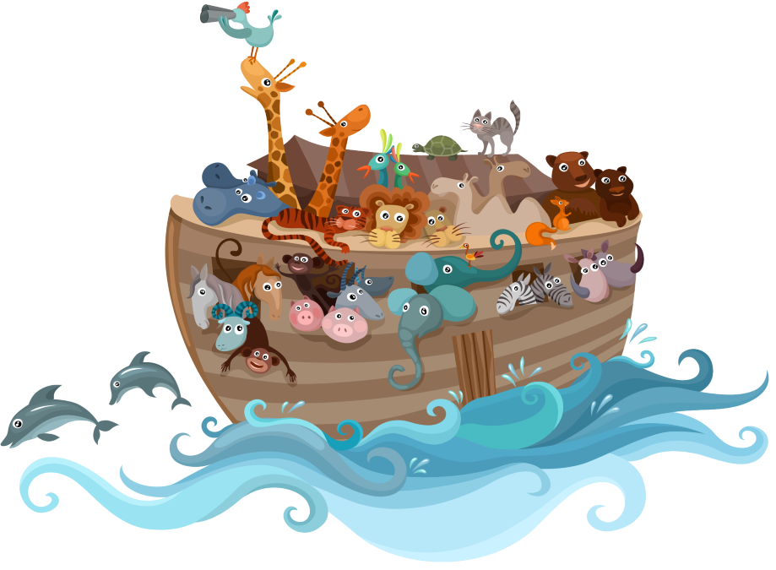
Exposition:
This introduces the setting (where and when the story takes place), characters (introduction to the main characters), and the background information (any important background we need to understand the story) and Initial Conflict or Situation (Often, the exposition hints at or introduces the central conflict that will drive the story forward).
back

Slide 9

Rising Action:
This part develops the conflict and builds tension through a series of events that complicate the story. It includes obstacles and challenges that the protagonist (the leading character or one of the major characters) faces.
back

Slide 10

Climax:
The climax is the turning point of the story, where the main conflict reaches its highest intensity. It is often the moment of greatest emotional or dramatic impact.
back

Slide 11
Falling Action:
What happens because of the climax?
How the story starts to calm down?
How problems begin to get solved?
After the climax, the falling action deals with the consequences of the climax and begins to resolve the story's conflicts.
back

Slide 12

Resolution:
This is where the story concludes, tying up loose ends and providing closure to the narrative.
Play me
back

Slide 13
Points to consider:
You should never start writing your story before you have decided on a plot.
Sequence of events is very important. Use time words such as at first, before, until, while, during, then, after, finally, etc.
Use of various adjectives (disgusted, exhilarating, haunting, serene, majestic etc.) and adverbs (fearlessly, surprisingly, reluctantly, effortlessly, eagerly etc.) to describe feelings and actions, as well as use of direct speech and a variety of verbs, will make your story more exciting to read.
Descriptions of people, places, objects or events and descriptive techniques can be used in a narrative when you want to emphasise specific parts of your narration.

Slide 14
Structure and layout:
Be careful with the tenses you choose.
You can use Past Continuous to set the scene (e.g. It was raining hard and the wind was blowing as Jonathan drove towards the small cottage.),
Past Simple to describe the main events of the story.
(e.g. Jonathan opened the garden gate and went through the garden towards the front door. He knocked on the door but there was no answer.) or
Past Perfect to give the background of the story (e.g. Jonathan had been planning to visit the old cottage for months before he was able to do so).
Present and past participles can also be used. e.g. Startled, he went round the house towards the back door.

Slide 15
What are story starters?
"Sleep tight, Scottie," his mother said as she kissed him goodnight and turned off the light.
As soon as she had closed the door behind her, Scott was fast asleep. He was completely exhausted after spending the whole afternoon assembling his new train set and then watching it go around the tracks and through the tunnels. Suddenly, a ball of brilliant yellow light shot past the window. Scott woke with a start when the ball entered his room. The light was so bright that he had to shut his eyes. When he opened them, he saw a strange, little man, about a foot tall with orange skin and huge blue eyes. Scott, not the least bit frightened, said in a friendly voice, "Hello, I'm Scott. Who are you?" The miniature man said nothing, but picked up a battery from the untidy heap of toys on the floor. He started running around the room, pointing urgently at the rest of Scott's toys. "What do you want?" asked Scott, who was puzzled. The man began shaking the battery frantically, and Scott realised that that was what he wanted. Scott opened all his toys, took out the batteries and piled them on the floor. Immediately gathering up all the batteries, the little man leapt onto the window sill, smiled warmly at Scott and disappeared. When Scott woke up the next morning, he thought about his unusual dream. He stared at his train set before jumping out of bed and trying to switch it on. Nothing happened. Then Scott realised that it had no batteries... and there were no batteries in any of his other toys, either.
Read the model below, which begins with the words "Sleep tight, Scottie,".. and write down the topic of each paragraph. In which person is the story written? Underline the parts of the story where descriptive techniques are employed. Underline the time words, adjectives, adverbs and direct speech. Has the writer used a variety of adjectives and adverbs, or are the same words used several times?

Slide 16
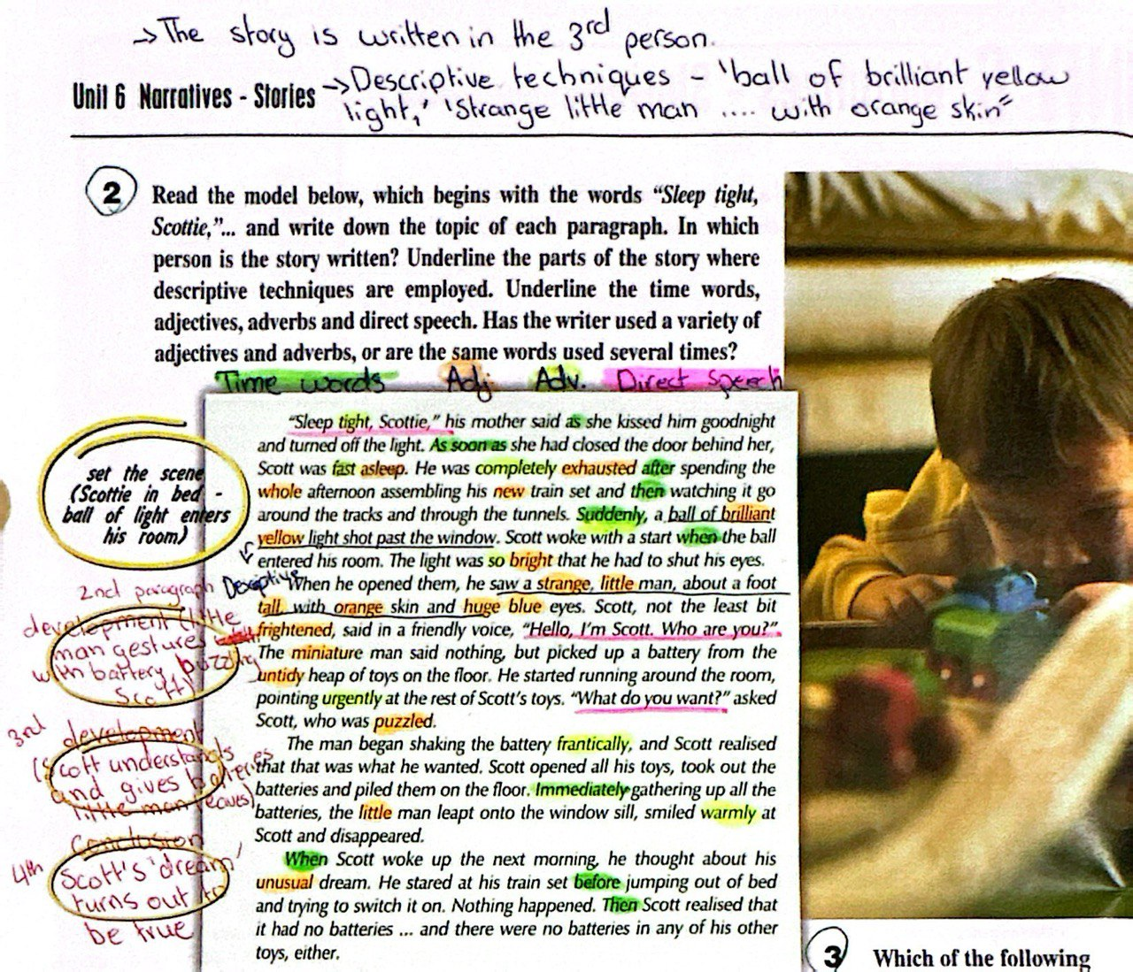

Slide 17
Question 3
Beginning B (sets the scene describing weather, use of descriptive adjectives and senses)
Ending A (ends the story referring to feelings, use of descriptive adjectives, use of direct speech)

Slide 18
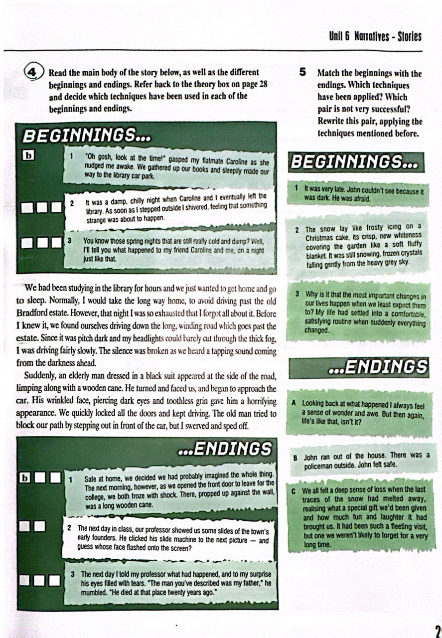
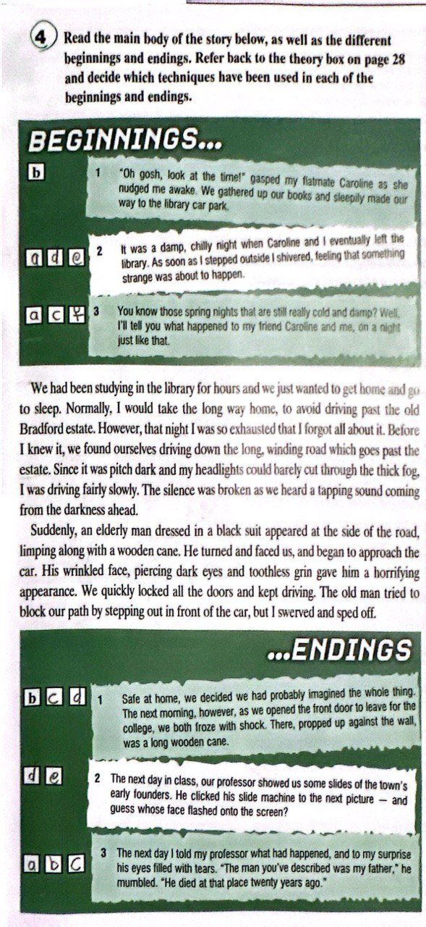
Question 4

Slide 19
Question 6
Read the following short Texts and Fill the gaps with Linking words or phrases from the list below
A: As soon as, at last, immediately, meanwhile, then, when, while
The areophane had only been in the air for about twenty minutes 1. when suddenly it began to dive towards the ground. 2. Immediately the passengers began to panic. 3. As soon as the flight attendance realized what was happening, they did their best to calm everyone down, 4. while the plane continued to lose altitude.
5. Meanwhile in the cockpit, the pilot was struggling to control the plane.
6. At last it righted itself and he sighed with relief. The fight
7. then continued without any further problems.
B after, before, finally, since, then, when
There had never been a storm like it 1. before - at least not 2.Since the great flood in 1962. Kevin was trying to steer his car through the pouring rain 3. when all of a sudden his car stopped. The engine very continued to run for a few seconds, 4. then coughed twice and fell silent. Reluctantly, Kevin got out of his car and watched it sink slowly into the mud at the side of the road. 5. After staring at his useless car for a few minutes, he 6) Final stuck his hands into his pockets, bent his head and began the long walk home. Now number the events below in the order in which they happened.

Slide 20
Question 6
Read the following short Texts and Fill the gaps with Linking words or phrases from the list below
Number the events
The passengers panicked.
he pilot managed to control the plane.
The aeroplane started falling.
The flight continued.
The flight attendants calmed the passengers.
The car stopped.
Kevin walked away
The car sank in the mud
Kevin got out of the car
Kevin was driving in the rain.
2
2
4
5
5
4
1
3
3
1

Slide 21
Question 9
Adjectives / Adverbs | Synonyms
Big | Enormous, massive, gigantic, huge, (large, vast, etc)
Small | Miniature, microscope, tiny, (minute, petite, etc)
Very | Absolutely, entirely, thoroughly, extremely( completely, totally, etc)
Bad | Horrible, horrifying, nasty, disgusting, terrible, unpleasant, (revolving, terrifying, awful, etc)
Good/ Nice | Delightful, superb, terrific, wonderful, fabulous, (excellent, fantastic, etc)
A
A
B
B
1. Massive
2. gigantic
3. Enormous
4. Thoroughly
5. Horrible
6. Huge
7. Tiny
8. Huge
9. Disgusting
10. Absolutely
Delightful
Superb
Tiny
Terrific
Absolutely
6. Wonderful
7. Horrible
8. Extremely
9. Huge
10. Terrible

Slide 22
Question 10
The adverbs below describe the way a person might speak or act. Explain what each adverb means, then choose suitable words from the list to complete the sentence
(sarcastically, angrily, threateningly, frantically, hurriedly, miserably, confidently, suddenly, urgently, nervously, patiently, calmly )
1. The woman on the third-floor balcony of the burning building waved her arms frantically/ urgently to attract the fireman's attention.
2. "Get out of here!" Bill shouted angrily/ threateningly / suddenly , his face turning red.
3. "My dog has run away" the little girl sobbed miserably.
4. Suddenly without any warning, her guide spun round and held a knife to her throat.
5.The detective looked at him in disbelief. "Oh, yes, of course a criminal like you wouldn't want £5 million," he said sarcastically
6.She gathered her papers together frantically/ hurriedly/ urgently/ nervously and rushed off to the meeting, which had already begun.
7. "If you tell anyone, you'll be sorry," said the kidnapper threateningly.
8. "Don't worry, I'll kill, the dragon, the knight said confidently/ patiently/ calmly to the king.

