Slide 1
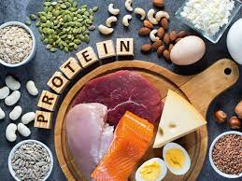
Protein

Slide 2
Our bodies are composed of millions of cells which are constantly being replaced and repaired. As the body grows, new cells are added.
Each cell contains a substance called protoplasm, which contains (amongst other things) protein.
Functions of protein: Past Paper Question
1. Essential for growth and repair.
2. Repair and maintenance of the body cells.
3. Secretion of enzymes, hormones and antibodies.
4. Energy, once it has been used for it’s main function of growth and repair.

Slide 3
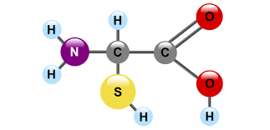
There are many different proteins and they are all complex molecules. Elements that make up protein are ( NCHOPS) Carbon, hydrogen, oxygen, nitrogen, and sometimes sulfur and phosphorus.

Slide 4
The protein molecules are made up of small units joined together like links in a chain. These units are called amino-acids.
At least 22 different amino-acids are known to occur naturally, and each has its own chemical name.
Different proteins are made when different numbers and types of amino-acids combine.
An enormous number of different proteins can be made from 22 amino-acids.

Slide 5
What is an amino acid?
1. Amino acids (A.A’s) are the building block of proteins.
2. There are at least 22 different types of amino acids.
3. Different proteins are made when different numbers and types of (A.A’s) combine.
Indispensable ( essential).
They must be obtained from foods containing protein in the diet, as they cannot be made in the body.

Slide 6
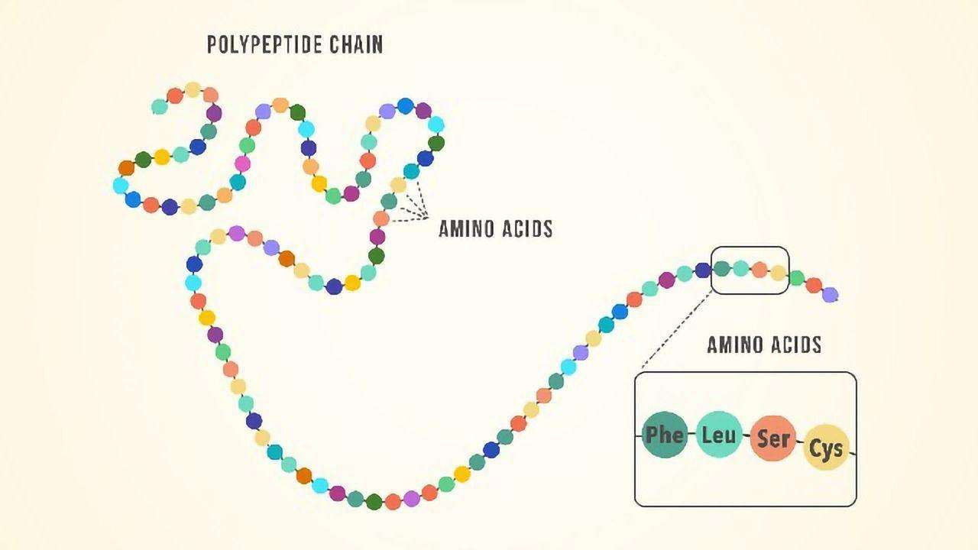

Slide 7
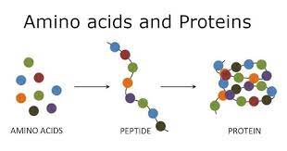
Amino acids peptones peptides protein

Slide 8
Ten are indispensable (essential) for growth and repair in children.
Eight are indispensable for repair and maintenance in adults.
This means that they must be obtained from foods containing protein in the diet, as they cannot be made in the body.

Slide 9
protein past paper question
HBV ( complete proteins)
LBV (incomplete proteins)
High biological value.
They are proteins that contain all indispensable (A.A’s) in sufficient quantities.
They are mainly from animal sources ex: meat, cheese, fish, milk and eggs.
Low biological value.
They are proteins that lack one or more of the indispensable (A.A’s) .
They are mainly from plant sources ex: cereals, pulses, some nuts and quorn mycoprotein.

Slide 10
There are two exceptions: 1. soya beans (plant source)but HBV protein 2. Gelatine ( animal source) but LBV protein
Complementary proteins Past Paper Question
When combining two proteins food to form a HBV protein and to improve the supply of essential (A.A’S) lacking in one and can be complemented by the other. This can be done by:
1.Mixture of HBV & LBV 2. Mixture of LBV & LBV
ex: rice pudding/ scrambled ex: beans on toast/ lentil
eggs on toast/ cheese sandwich. soup with bread.

Slide 11
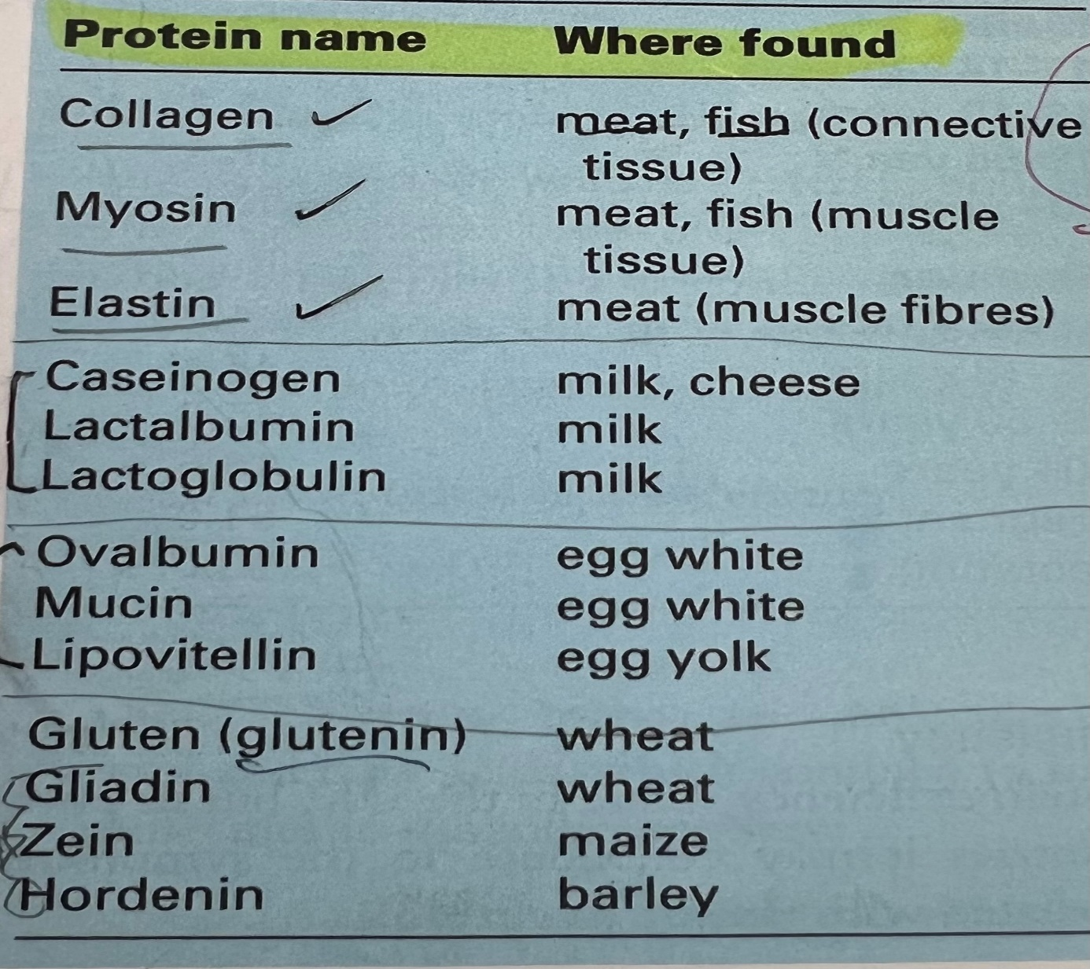
Animal protein foods are expensive to produce, and recently there have been attempts to manufacture alternative protein rich foods from soya beans.
Protein names

Slide 12
Protein requirements Past Paper Question
Everyone needs some protein in their daily diet, even when they have stopped growing, but at certain times of our lives these needs increase. For example:
Babies and children – require a lot of protein as they are growing rapidly.
Adolescents – require protein for their rapid spurt of growth.

Slide 13
Pregnant women – require more than normal to cater for the growing baby.
Nursing mothers – require more than normal for milk production during breast-feeding ( lactation).
Protein is required at all other times for body maintenance, repair, and the growth of hair, nails, and skin.

Slide 14
Deficiency
Protein deficiency is rare, but in poor countries it may contribute to the symptoms associated with famine. ( Kwashiorkor)

Slide 15
Effect of heat
Denaturation : it is the change of chemical structure of protein by applying some external stress like heat, mechanical agitation, acids and alcohol. This is permanent and can’t be reversed.
Coagulation : it is when the protein sets.
begins at 60 C.
cannot be reversed.
chemical structure changes.
over heating causes protein to shrink.

Slide 16
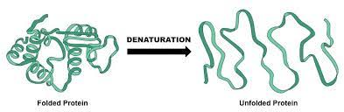
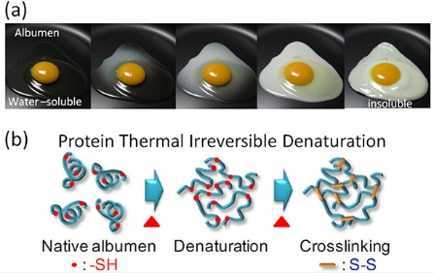

Slide 17
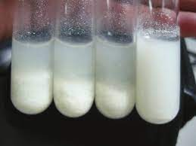
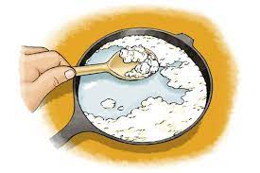

Slide 18
The effect of heat on specific proteins
Meat Past Paper Question
Dry or moist heat
Collagen and elastin molecules start to coagulate at 60 C, contracting as they do so, and causing the meat to shrink and become more digestible. Under 100 C, coagulation is slow, over 100 C, coagulation is rapid and the protein becomes hard and less digestible. In the presence of moisture, collagen is converted into the protein gelatin, which is soluble.

Slide 19
Milk
Boiling or baking
Lactalbumin and lactoglobulin coagulate gradually as milk is heated, and form a (skin) on the surface.
Cheese
Dry heat
Protein coagulates rapidly to a rubbery texture and finally to a crisp and less digestible state.

Slide 20
Egg white
Dry or moist heat
At 60 C coagulation starts when ovalbumin denatures into a solid, and continues until the whole white is solid and opaque.
Egg yolk
Dry or moist heat
proteins start to denature at 70 C, and continue to do so until the yolk becomes dry and hard.

Slide 21
Wheat
Dry heat
Gluten starts to coagulate at 80 C, and continues to do so until the heating ends. In this way it helps to form the structure of cakes, bread, and other baked wheat products, during baking.

Slide 22
Denaturation of protein is also brought about by:
Mechanical agitation:
as in the whipping of egg white, which cause ovalbumin to set partially.
Acids and alcohol:
as in the marinating of meat in vinegar, wine ,etc., and the clotting of casinogen in the stomach, which is aided by acid.

Slide 23
What happens to protein which is consumed in excess of body’s needs? Past Paper Question
Deamination occurs, which is a process where (A.A’S) are broken down , as the body is unable to store protein or (A.A’S).
The nitrogen is removed from amino acids and is then converted to Ammonia
Ammonia is toxic to the human body and enzymes convert it to uric acid, which is then excreted in urine via kidney as urea.
The rest of the (A.A’S) is oxidized for energy “ stored as glycogen in the liver” or stored as fat under the skin and adipose tissue or around internal organs which may lead to obesity and CHD ( coronary heart disease
Deamination takes place in liver.

Slide 24
C H O / N
Ammonia
energy
fats uric acid
urine via kidney

Slide 25
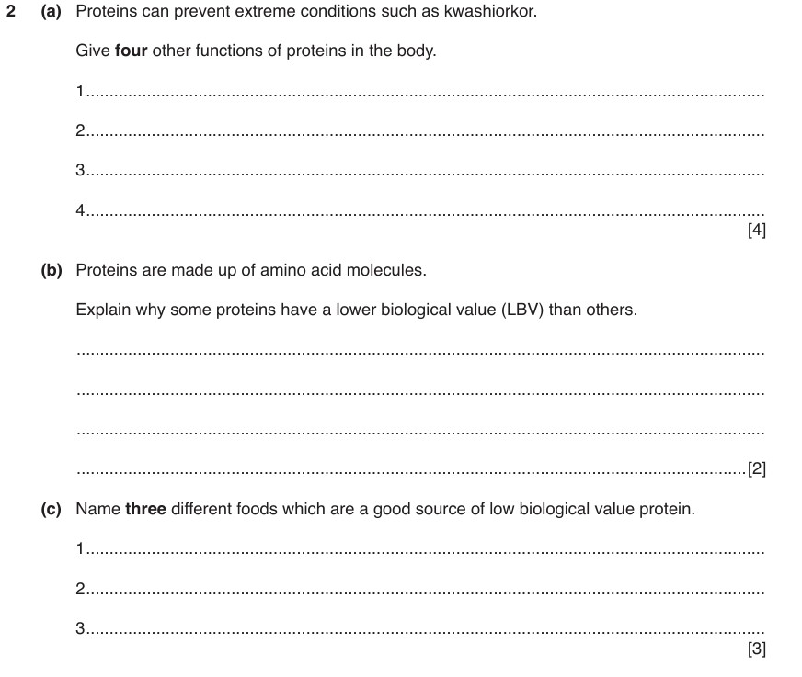

Slide 26
