Slide 1



WRITING
A
REVIEW

Slide 2

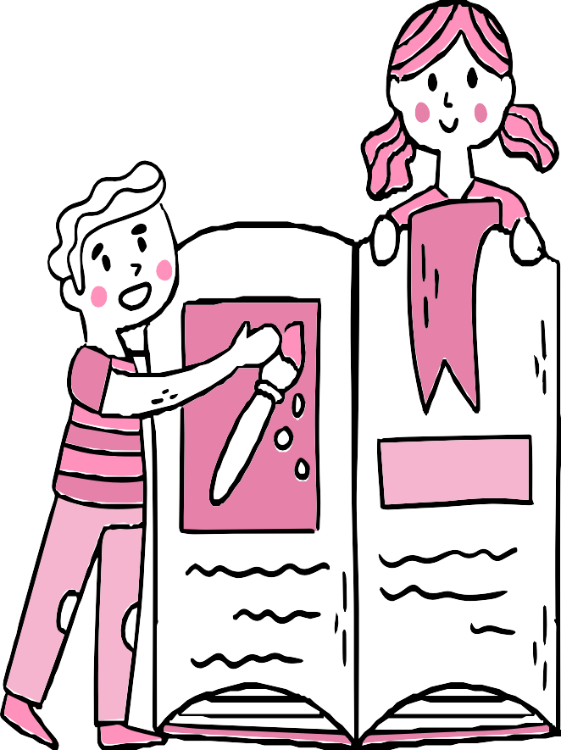
After this session , you should know:
The purpose of writing a review.
The required layout and format of a review.
Analyze several review samples.

Slide 3
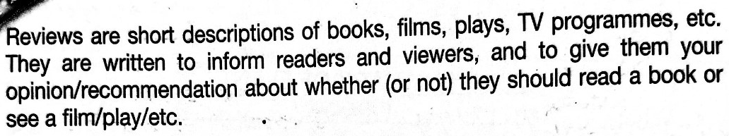


The purpose of a review is to introduce the reader to the piece, express the reviewer’s opinion/thoughts about it, and finally persuade the reader that the piece (is or is not) worth reading, seeing, or hearing.

Slide 4




A review is both a record of what you have read or seen and a recommendation to others.
Its main purpose is not only Informational!
It is analytical and persuasive.
—Someone Famous

Slide 5

The place review layout should consist of:
-Paragraph 1:
Introduction
Background information:
1- Name of the place.
2- Type of place.
3- Setting: (Where it is located + When did it open)
-Paragraph 2:
Main Body
Describe what other visitors are likely to experience (sensory details). Highlight what makes the place special, and try to share something unique and new.
-Paragraph 3:
General comment (In this context it is about the menu varieties and the service)
Conclusion
-Paragraph 4:
Recommendation and why

Slide 6

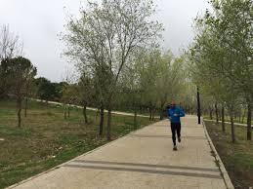
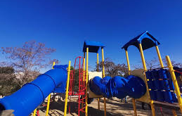
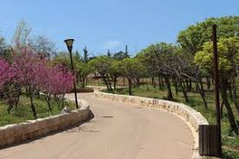
Sample Review (Park Review)
Al Hussein Public Park is one of the largest parks in Amman, Jordan. It was opened in 2002 and is a popular spot for families, students, and tourists.
The park has beautiful gardens, wide walking paths, sports courts, and a cultural village. Many people come to exercise, have picnics, or just relax outdoors. There are also playgrounds for children and open spaces for events and festivals.
The atmosphere is peaceful and refreshing, especially in the evenings when the weather is cooler. The park is clean and well-maintained, though it can get crowded on weekends and holidays.
I recommend Al Hussein Public Park to anyone who enjoys nature, sports, or spending time with family and friends outdoors. It’s the perfect place to escape the busy city and enjoy some fresh air.

Slide 7
Sample Review (Park Review)
Al Hussein Public Park is one of the largest parks in Amman, Jordan. It was opened in 2002 and is a popular spot for families, students, and tourists.
The park has beautiful gardens, wide walking paths, sports courts, and a cultural village. Many people come to exercise, have picnics, or just relax outdoors. There are also playgrounds for children and open spaces for events and festivals.
The atmosphere is peaceful and refreshing, especially in the evenings when the weather is cooler. The park is clean and well-maintained, though it can get crowded on weekends and holidays.
I recommend Al Hussein Public Park to anyone who enjoys nature, sports, or spending time with family and friends outdoors. It’s the perfect place to escape the busy city and enjoy some fresh air.
The layout in this review:
Background → Name of the park, location, year opened, and popularity.
Summary → What the park offers (gardens, walking paths, sports courts, playgrounds, festivals).
Opinion → Atmosphere, cleanliness, maintenance, and visitor experience (peaceful, refreshing, sometimes crowded).
Recommendation → Who would enjoy it and why (families, nature lovers, people who want fresh air and relaxation).

Slide 8

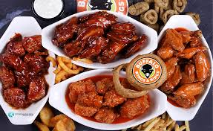
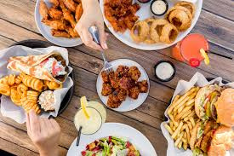
Sample Review (Place Review – Restaurant/Café)
Buffalo Wings & Rings is a popular American-style restaurant and sports café. It first opened in Cincinnati, USA, in 1984 and now has branches in many countries, including Jordan.
The restaurant is best known for its crispy chicken wings that come in different flavors and levels of spiciness. The menu also includes burgers, wraps, salads, and a variety of appetizers. Large TV screens show live sports games, which makes it a favorite place for football and basketball fans.
The atmosphere is fun, casual, and lively. It’s a great spot to hang out with friends, especially during big sports events. The staff are friendly, and the service is usually fast. However, it can get very noisy when the place is full.
I recommend Buffalo Wings & Rings to anyone who enjoys delicious comfort food, a fun vibe, and watching sports with friends. It’s not the quietest café, but it’s perfect for a night out with good food and energy.

Slide 9
Sample Review (Place Review – Restaurant/Café)
Buffalo Wings & Rings is a popular American-style restaurant and sports café. It first opened in Cincinnati, USA, in 1984 and now has branches in many countries, including Jordan.
The restaurant is best known for its crispy chicken wings that come in different flavors and levels of spiciness. The menu also includes burgers, wraps, salads, and a variety of appetizers. Large TV screens show live sports games, which makes it a favorite place for football and basketball fans. The atmosphere is lively, with loud music, colorful posters on the walls, and a vibrant vibe that makes every visit memorable.
The atmosphere is fun, casual, and energetic. It’s the kind of spot where friends gather to cheer for their teams, share big plates of food, and enjoy a fun night out. The staff are friendly, and the service is usually fast. However, it can get very noisy when the place is full.
I recommend Buffalo Wings & Rings to anyone who enjoys delicious comfort food, a fun vibe, and watching sports with friends. It’s not the quietest café, but it’s perfect for a night out with good food and energy.
The layout in this review:
Background → Name of the restaurant, type, origin, and where it has branches.
Summary →What the place offers (crispy chicken wings, burgers, wraps, salads, appetizers, TV screens for sports, and lively décor).
Opinion → Atmosphere, service, staff, and overall experience (fun, lively, but noisy).
Recommendation → Who would enjoy it and why (friends, sports fans, people who like comfort food).

Slide 10
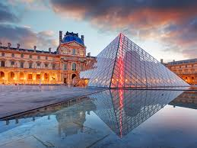
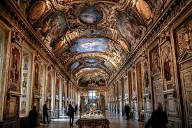
Sample Review (Museum Review)
The Louvre Museum is the most famous art museum in Paris, France. It opened in 1793 and is one of the largest museums in the world, attracting millions of visitors every year.
The museum has thousands of artworks, including paintings, sculptures, and historical objects. Its most famous piece is Leonardo da Vinci’s Mona Lisa, but there are also treasures from ancient Egypt, Greece, and Rome. The building itself is beautiful, with a glass pyramid at the entrance that has become a symbol of Paris.
The atmosphere is inspiring and educational, though it can be overwhelming because of the size and the large crowds. Visitors should plan carefully to make the most of their time. The museum is very well-organized, and the staff are helpful.
I recommend the Louvre to anyone interested in art, history, or culture. It’s a once-in-a-lifetime experience and a must-see for anyone visiting Paris.

Slide 11
Sample Review (Museum Review)
The Louvre Museum is the most famous art museum in Paris, France. It opened in 1793 and is one of the largest museums in the world, attracting millions of visitors every year.
The museum has thousands of artworks, including paintings, sculptures, and historical objects. Its most famous piece is Leonardo da Vinci’s Mona Lisa, but there are also treasures from ancient Egypt, Greece, and Rome. The building itself is beautiful, with a glass pyramid at the entrance that has become a symbol of Paris.
The atmosphere is inspiring and educational, though it can be overwhelming because of the size and the large crowds. Visitors should plan carefully to make the most of their time. The museum is very well-organized, and the staff are helpful.
I recommend the Louvre to anyone interested in art, history, or culture. It’s a once-in-a-lifetime experience and a must-see for anyone visiting Paris.
The layout in this review:
Background → Name of the museum, location, year opened, and importance.
Summary → What the museum offers (artworks, famous pieces, collections, building).
Opinion → Atmosphere, organization, staff, and visitor experience.
Recommendation → Who should visit and why (art and history lovers, tourists in Paris).

Slide 12


Every review begins with some background. For example, if I review Harry Potter, I would say: It’s a fantasy novel written by J.K. Rowling. It was first published in 1997.”
Next, a review usually includes a short summary — just enough for readers to understand what it’s about, but no spoilers. For example: The story follows a young wizard, Harry, as he discovers his powers and faces challenges at Hogwarts.”
After the summary, the writer gives their opinion. For example: The story is magical and full of suspense, and the characters are unforgettable.”
A good review ends with a recommendation. For example: I highly recommend this book to anyone who enjoys fantasy and adventure

Slide 13
Sample Review (Book Review)
Harry Potter and the Philosopher’s Stone is a fantasy novel written by J.K. Rowling. It was first published in 1997 and is the first book in the famous Harry Potter series.
The story follows Harry, a young boy who discovers on his 11th birthday that he is a wizard. He is invited to attend Hogwarts School of Witchcraft and Wizardry, where he makes lifelong friends, learns the art of magic, and uncovers secrets about his past. Along the way, he faces dangerous challenges and encounters dark forces, making the plot both mysterious and full of adventure.
The book is very engaging and creative. The characters feel real and memorable, especially Harry, Hermione, and Ron. The author’s style is easy to follow, and the magical world is described in a way that captures the reader’s imagination. Sometimes the story is dark and suspenseful, but it always keeps you interested.
I really enjoyed reading this book because it mixes friendship, adventure, and fantasy. I recommend it to anyone who enjoys exciting stories with a touch of magic. Even if you don’t usually read fantasy, this book is worth trying because it pulls you into its world from the very first page.

Slide 14
Sample Review (Book Review)
Harry Potter and the Philosopher’s Stone is a fantasy novel written by J.K. Rowling. It was first published in 1997 and is the first book in the famous Harry Potter series.
The story follows Harry, a young boy who discovers he is a wizard on his 11th birthday. He attends Hogwarts School of Witchcraft and Wizardry, where he makes friends, learns magic, and faces dangerous challenges. The plot is full of mystery and adventure, but I will not spoil the ending.
The book is very engaging and creative. The characters feel real and memorable, especially Harry, Hermione, and Ron. The author’s style is easy to follow, and the magical world is described in a way that captures the reader’s imagination. Sometimes the story is dark and suspenseful, but it always keeps you interested.
I really enjoyed reading this book because it mixes friendship, adventure, and fantasy. I recommend it to anyone who enjoys exciting stories with a touch of magic. Even if you don’t usually read fantasy, this book is worth trying because it pulls you into its world from the very first page.
The layout in this review:
Background → Title, author, type, year.
Summary → Main events without spoilers.
Opinion → the writer’s use of Language, development and choice of characters, style of writing, evaluation of events.
Recommendation → Who would enjoy it and why.

Slide 15
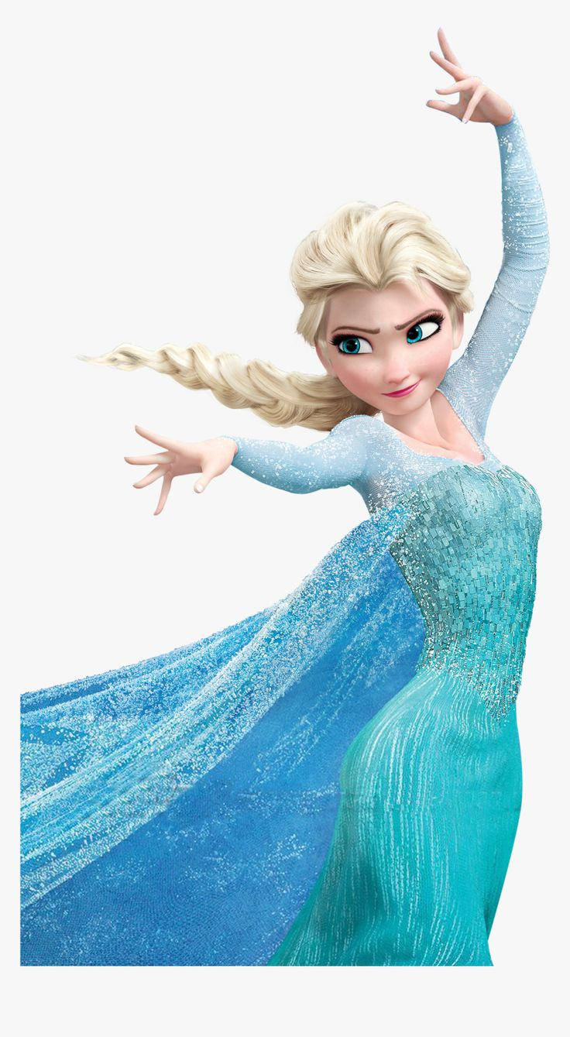
Sample Review (Film Review)
Frozen is an animated Disney film that was released in 2013. It is a fantasy adventure musical directed by Chris Buck and Jennifer Lee.
The story follows two sisters, Anna and Elsa, who live in the kingdom of Arendelle. Elsa has magical ice powers that she cannot control, which causes danger and leads her to hide away. Anna sets out on a journey with her friends Kristoff and Olaf to bring Elsa back and save the kingdom.
The movie is fun, emotional, and full of great songs, including the famous Let It Go. The animation is colorful and beautiful, and the characters are memorable. Some scenes are dramatic, but the humor and music balance it well.
I recommend Frozen to children, families, and anyone who enjoys magical adventures and musicals. It’s not just a children’s movie — it has a message about love, courage, and family that everyone can enjoy.

Slide 16
Sample Review (Film Review)
Frozen is an animated Disney film that was released in 2013. It is a fantasy adventure musical directed by Chris Buck and Jennifer Lee.
The story follows two sisters, Anna and Elsa, who live in the kingdom of Arendelle. Elsa has magical ice powers that she cannot control, which causes danger and leads her to hide away. Anna sets out on a journey with her friends Kristoff and Olaf to bring Elsa back and save the kingdom.
The movie is fun, emotional, and full of great songs, including the famous Let It Go. The animation is colorful and beautiful, and the characters are memorable. Some scenes are dramatic, but the humor and music balance it well.
I recommend Frozen to children, families, and anyone who enjoys magical adventures and musicals. It’s not just a children’s movie — it has a message about love, courage, and family that everyone can enjoy.
The layout in this review:
Background → Title, type, year, and directors.
Summary → Main events of the story without spoilers.
Opinion → Songs, animation, characters, humor, and overall style.
Recommendation → Who should watch it and why (families, children, anyone who enjoys magical adventures).

Slide 17

Some tips
Audience
No Spoilers !
Language
Keep your audience in
Don’t be a spoiler !
You normally use
If you are writing a
Present tense
mind.
review about a
and a variety of
narrative, take
adjectives to describe the plot
Use a friendly
care not to give
away the plot and
but fairly formal
and make your
tone.
ending.
comments clear.

Slide 18

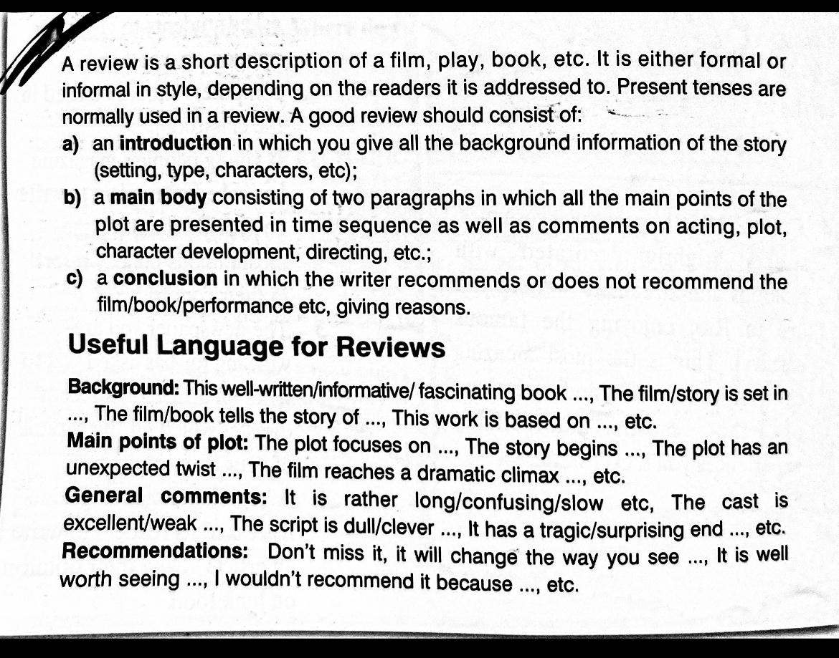
Page: 104.

Slide 19


Let’s answer question 2

Slide 20
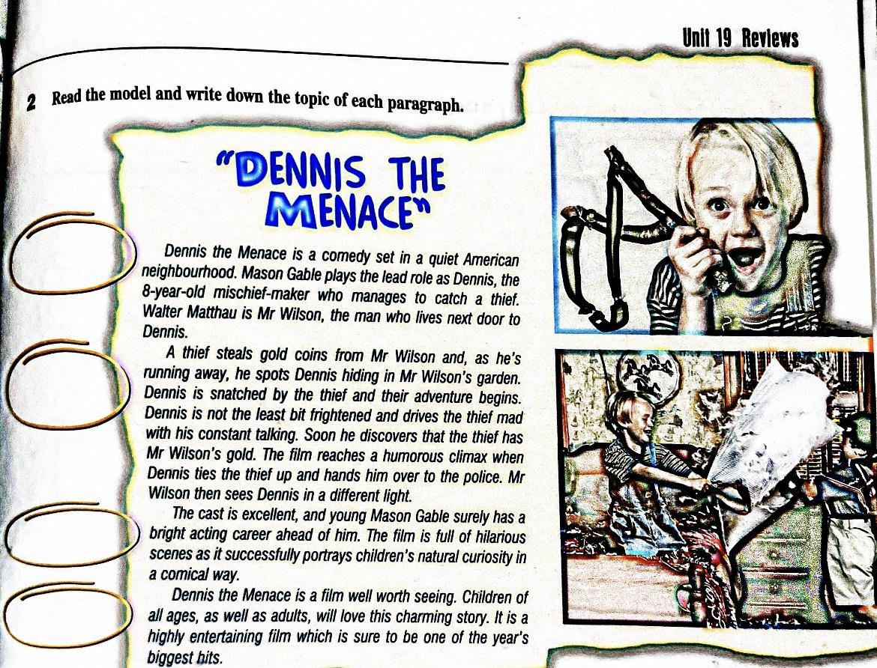
Q2. Page 105
P:105

Slide 21

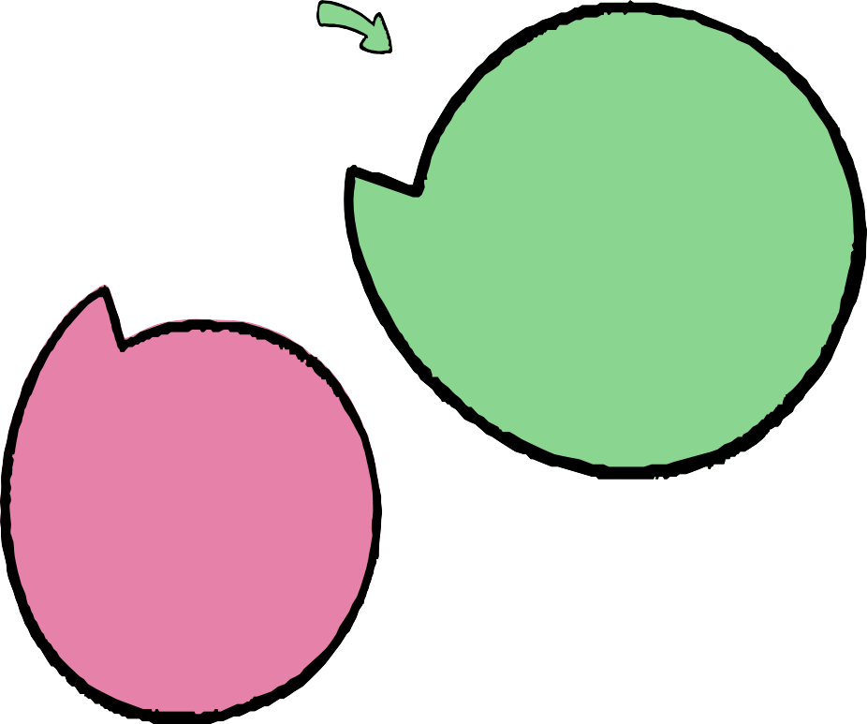
A successful review includes
A short
summary
Your recommendation
Background
Evaluation of
information
the content

Slide 22
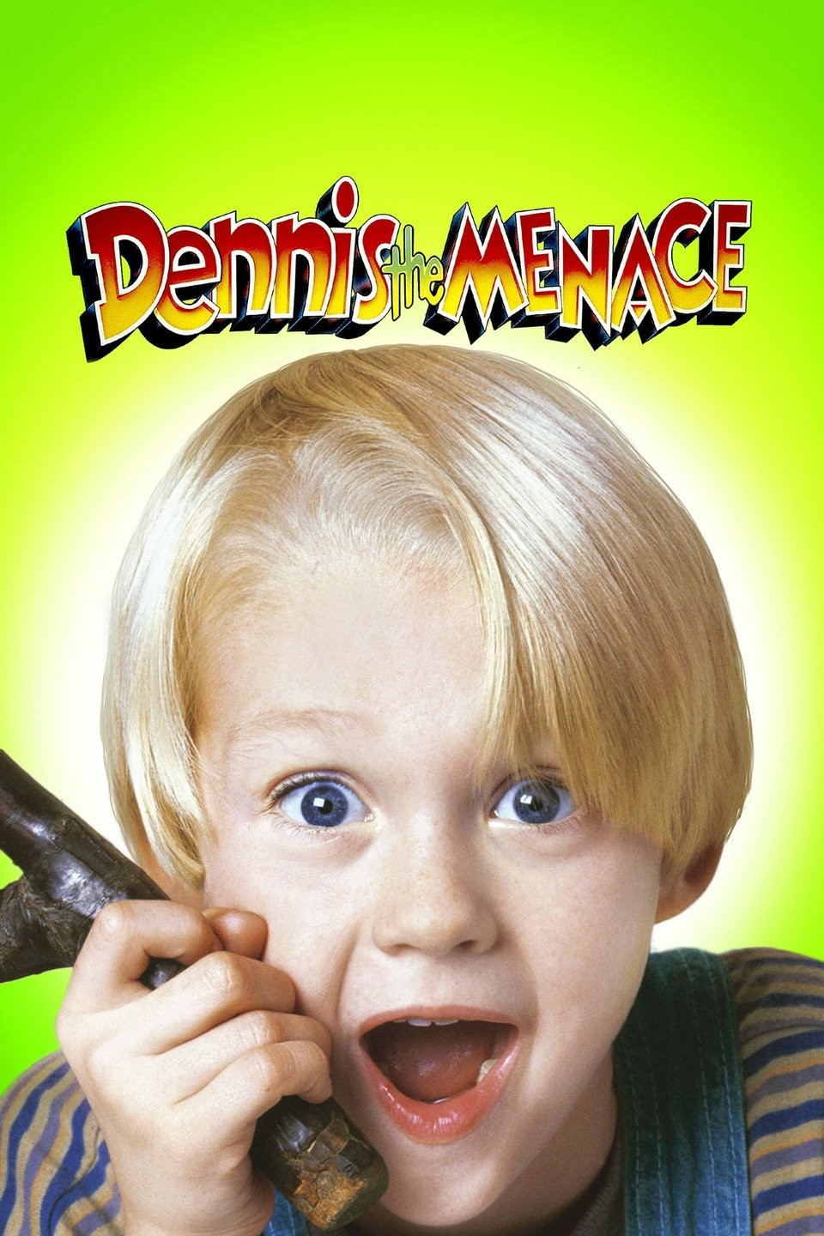
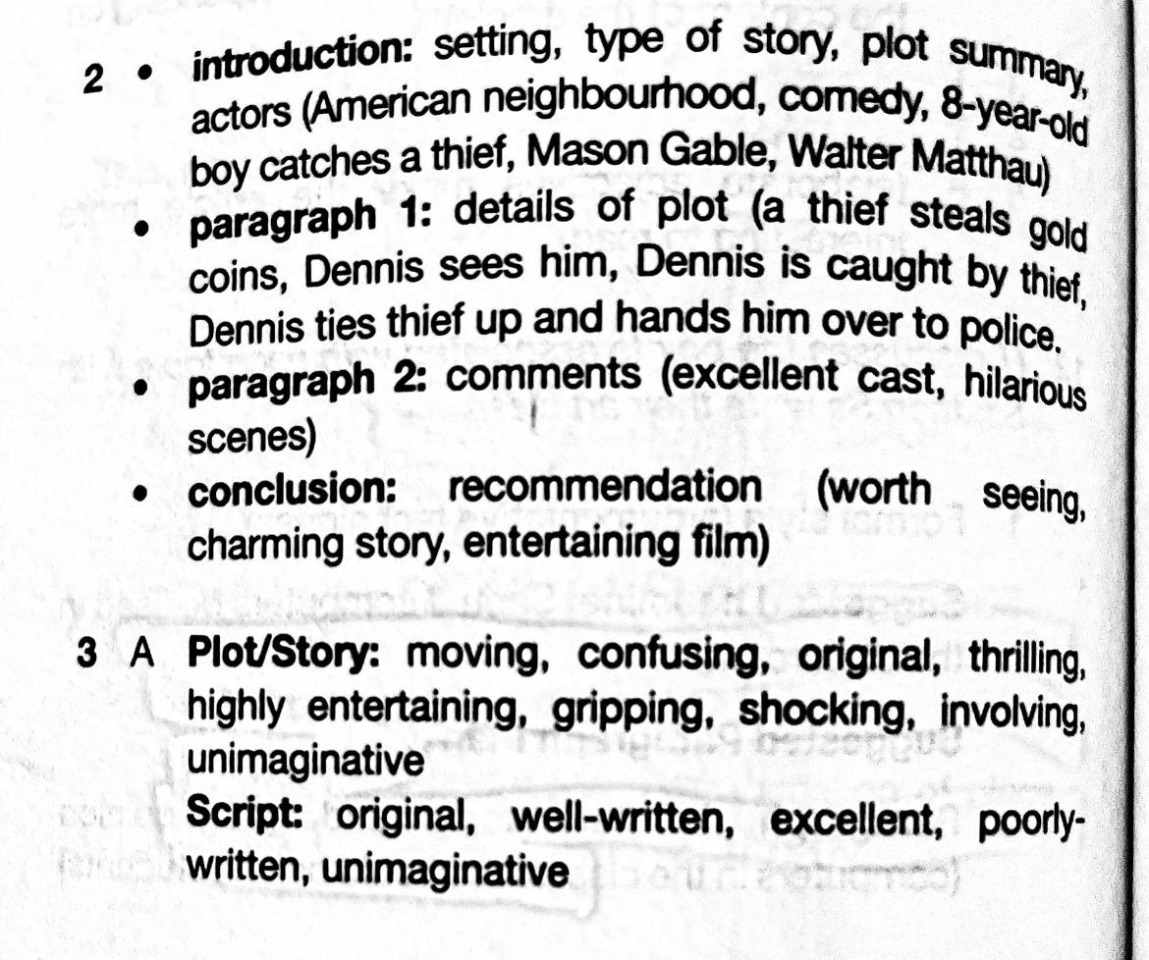
The answers:
Page: 105

Slide 23
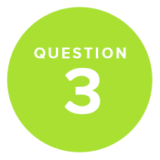
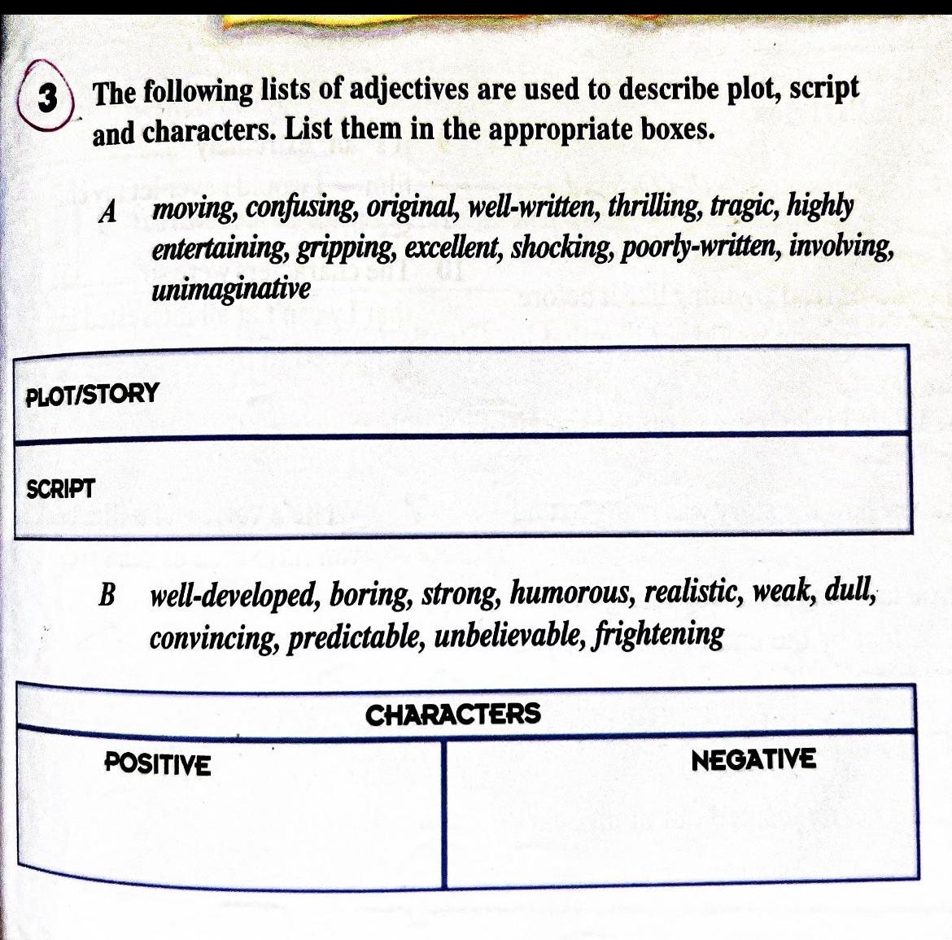
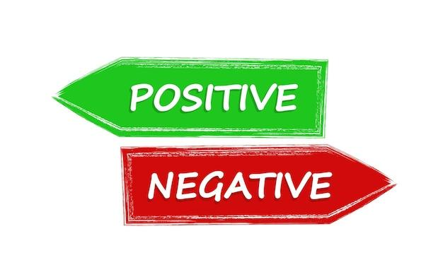
Q3. Page 105
Plot: (storyline, the main events of a play, novel, film, or similar work, devised and presented by the writer as an interrelated sequence.
Script: A script is a document that outlines every aural, visual, behavioral, and lingual element required to tell a story.
Page: 105

Slide 24
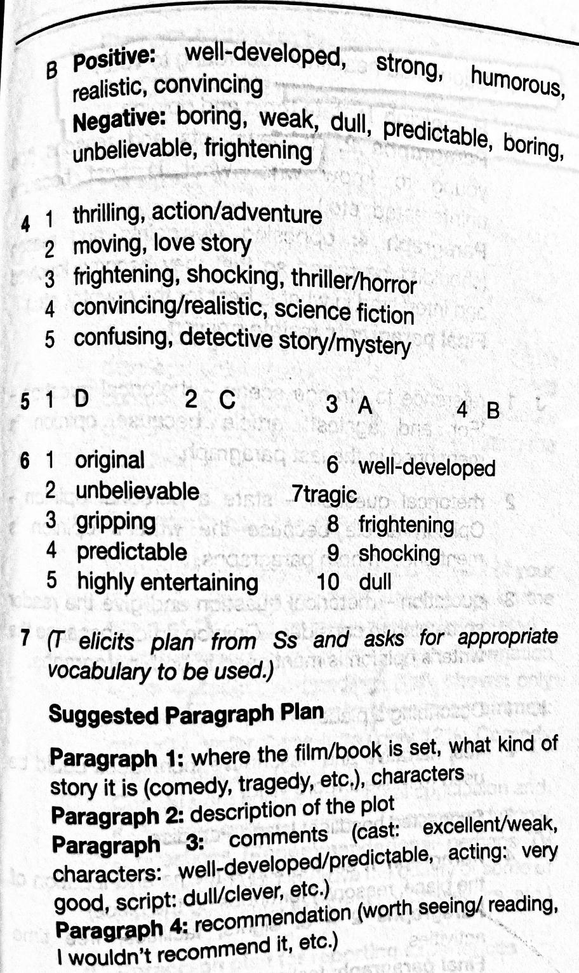
The answers:
Page: 105

Slide 25
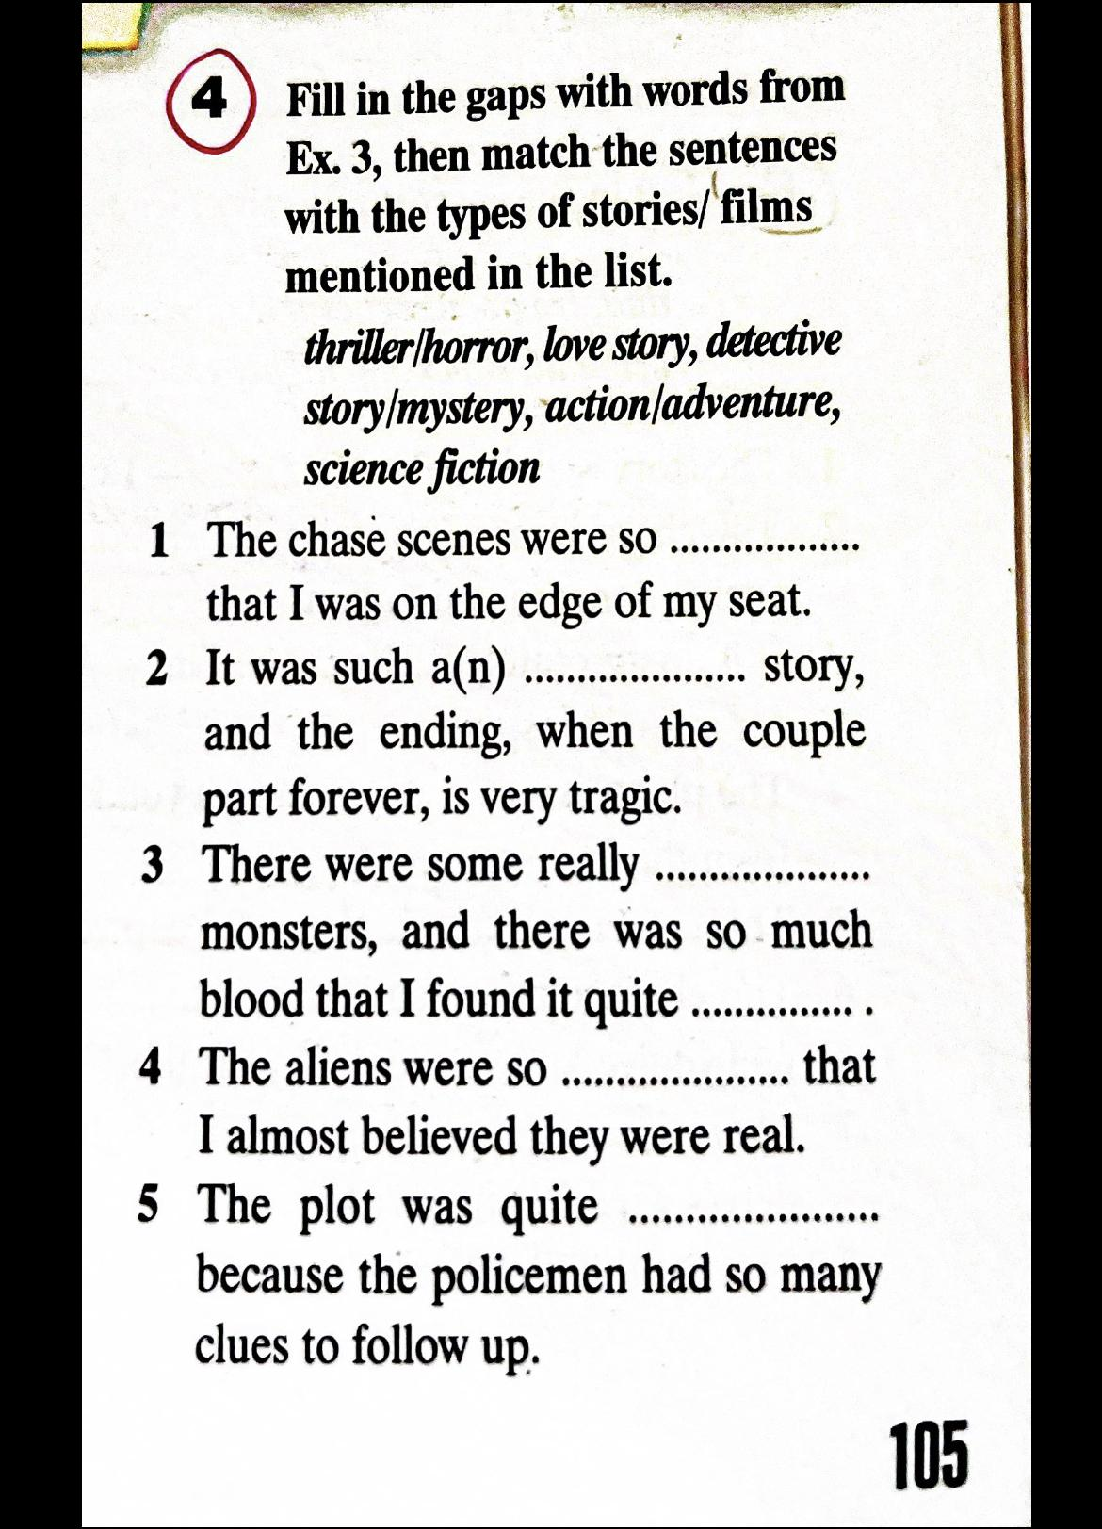
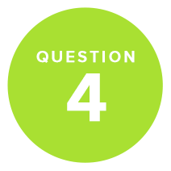
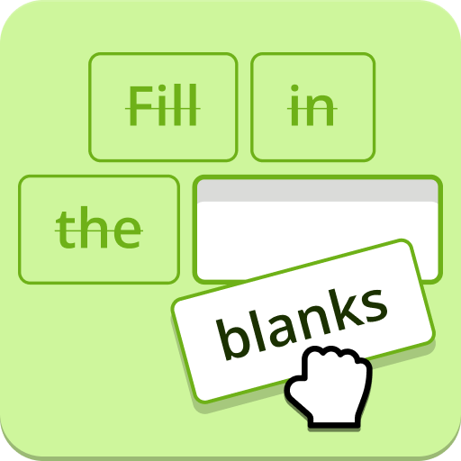
Q4. Page 105
Page: 105

Slide 26
The answers:
Page: 105

Slide 27
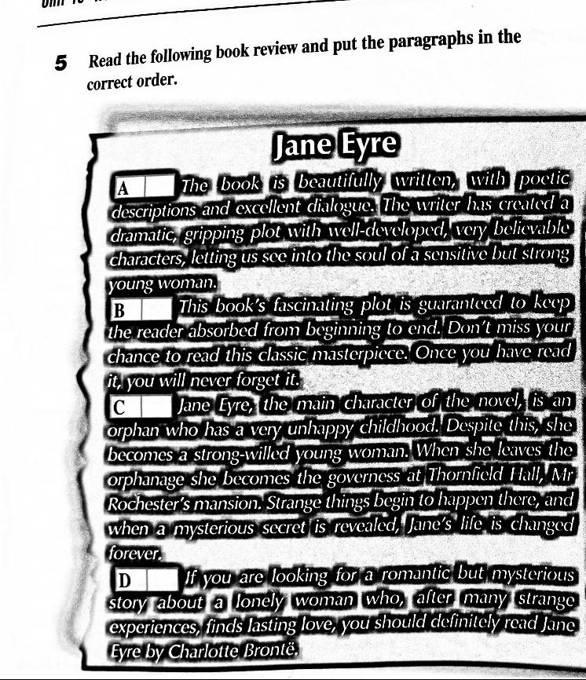
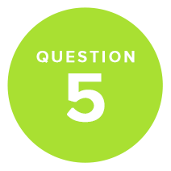
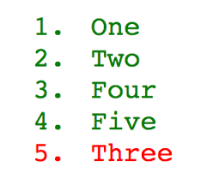
Q5. Page 106
Page: 106

Slide 28
The answers:
Page: 106

Slide 29
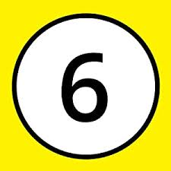
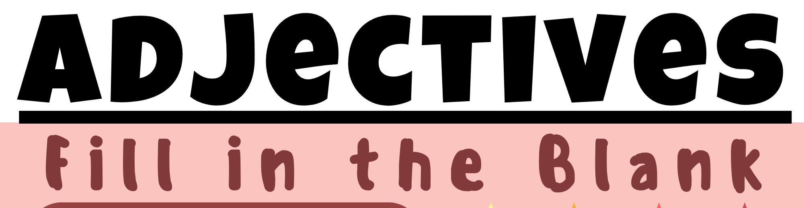
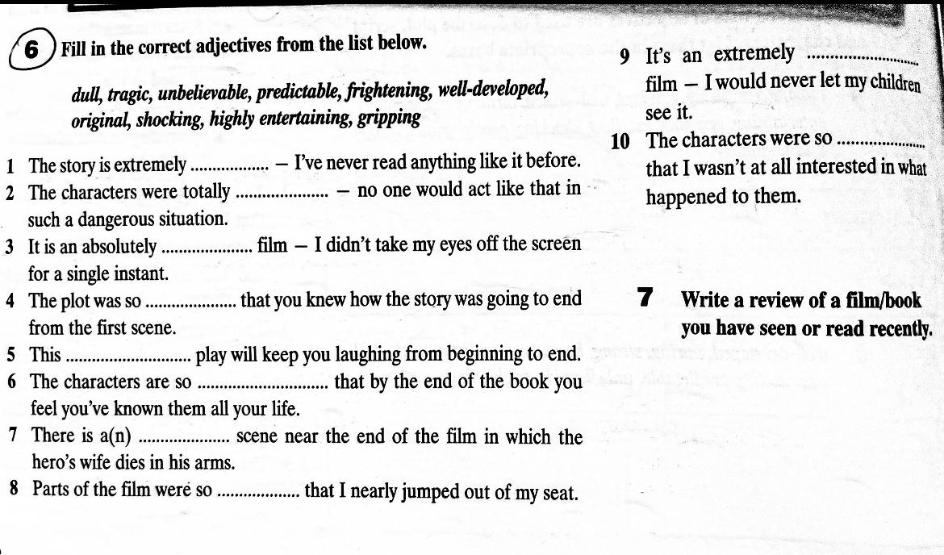
Q6. Page 106

Slide 30
The answers:
Page: 106

Slide 31
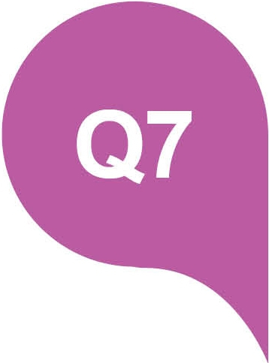
Q7. Page 106

Slide 32

Remember that a review could be
a book review, film review, a review of a place or a review of an event.

Slide 33
Our objectives:
1
Get familiar with the layout and content of different types of reviews (book, movie, restaurant, product).
2
Learn how each type is structured and what key features it includes (summary, opinion, evidence, recommendation).
3
Get familiar with the style of language used in writing reviews.
4
Plan what to write in each paragraph of your review so it is organized and easy to follow.

Slide 34
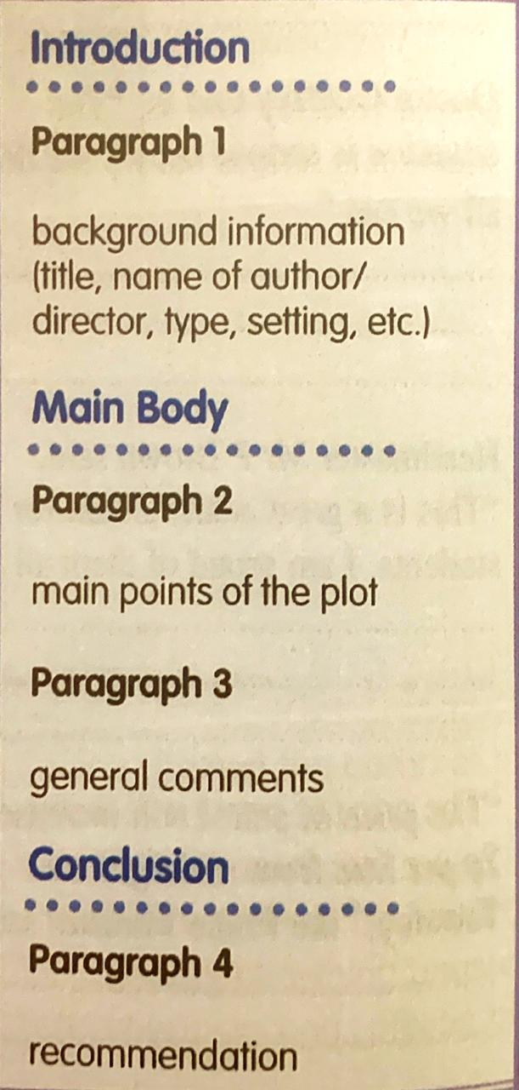
Layout and content of a book/film Review
Can be found in your Successful Writing book P. 78

Slide 35
Paragraph 1 :Introduction
1
02
2
04
3
A Hook
A “hook” is a line that catches your audience’s attention and piques their interest, so they continue reading your review .
Essential information
Identify the book’s author and title. Specify the type of book (for example, fiction, nonfiction, biography, autobiography). Mention the book's genre.
Extra information
(if needed)
Mention the year of publication if it is part of a series and what kind of readers would enjoy reading it.
D
D
D
Piques:
Arouse/ provoke/ stir awaken.
Background information

Slide 36
Paragraph 2
Main points of the plot
Paragraph 3
General comments
The Main Body
Share a short summary of the plot (without revealing too much about the plot), so your audience gets the gist of what the story is about (generally).
Introduce the characters and some situations/main events.
Best practice is to leave out the climax or ending of the book and avoid giving away spoilers, so you don’t ruin the story for your audience.
Simply saying a book was “good” or “bad”, or that you liked it or didn’t, isn’t helpful.
Comment on the style of language used
Use descriptive language:
Describe the book ; is it memorable ? Interesting? Dull?
Describe sequence of the events: are they logical? Confusing? Interesting? Too slow?
hard to keep up with?
Consists
of:
2 paragraphs

Slide 37
Paragraph 4:
Conclusion
Recommendation
Let your audience know your conclusions.
Did you personally enjoy reading the book ? Why ? Or why not?
Let your audience know why you think it’s a great read, or why you found it disappointing.
Remember to use the first person pronoun “I”

Slide 38
General tips:
Keep it Organized :
Follow the layout order
Pay attention to length
make every word count.
Remember to Proofread:
Make sure your spelling and grammar are on point.
Don’t Be Mean:
Remember that you’re reviewing a book that another human poured their heart and soul into. Express your honest opinion, but don’t be nasty about it.

