Slide 1
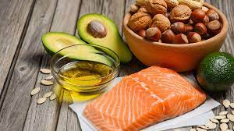
Fat

Slide 2
Fat
Functions of fat: Past Paper Question
1. Provides a convenient and concentrated source of energy, supplying more energy than the same weight of carbohydrate or protein.
2. Surrounds and protects certain vital organs, e.g. kidneys, glands.
3.Forms an insulating layer (adipose tissue) beneath the skin to help preserve body heat and protect the skeleton and organs.
4. Forms part of the structure of cell membrane throughout the body, especially in the brain.

Slide 3
5. Provides a source of the fat-soluble vitamins A, D, E, and K.
6. Provides a reserve of energy for long-term storage, which can be used if energy intake is restricted.
7.Provides texture and flavor in food and helps to make it palatable.
8. Foods containing fat provide a feeling of fullness (satiety) after a meal, as fat digestion is slow.

Slide 4
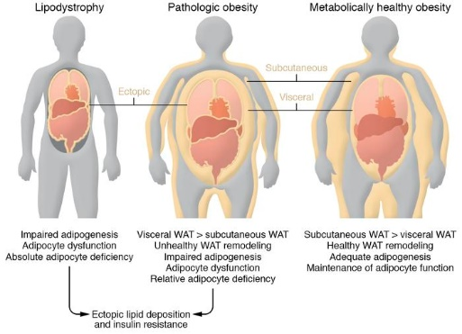

Slide 5
Past Paper Question
1g carbs = 4 kcals
1g protein = 4 kcals
1g fat = 9 kcals
Only nutrients that give energy
Kcal = calories

Slide 6
Vitamins ex: Vit A, Vit D, Vit E, Vit K ex: Vit C, Vit B complex
“ADEK” (B1,B2,B6,B12)
Fats and oils have the same basic chemical structure but their physical appearance differ at room temperature.
Fats are solid at room temperature.
Oils are liquid at room temperature.

Slide 7
There are 40 different fatty acids ( fatty acids are the building blocks of fats )
Fat refers to both fats and oils, lipid is another name of fat.
Elements that make up fat:
Carbon, Hydrogen, Oxygen
Fat molecules are made of Triglycerol or ( Triglyceride), which is a molecule of glycerol and fatty acids.
Glycerol
3
fatty fatty fatty Triglyceride
acid acid acid

Slide 8
Fatty Acids Past Paper Question
Saturated fatty acids
Unsaturated fatty acids
All the carbon atoms are saturated with hydrogen atoms and can’t accept more.
Fats that are solid at room temperature are mostly made up of saturated fatty acids.
No double bonds “single bond”.
Found in lard, suet, bacon, milk & butter.
Not all carbon atoms are attached to hydrogen atoms and can accept more.
Some of carbon atoms are joined by double bond.
Can be either cis or trans “depends on how the hydrogen atoms are arranged at the double bond”.
Mostly liquid at room temperature.
Found in vegetable oils, fish liver oils and oily fish.

Slide 9
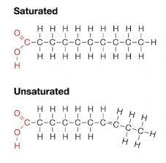
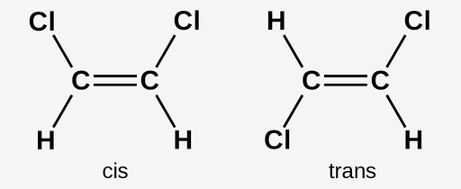
Unsaturated fatty acids are better than saturated fatty acids.

Slide 10
Unsaturated fatty acids
Mono-unsaturated fatty acids
Poly unsaturated fatty acids
More than one double bond ex: linoleic acid
linolenic acid vegetable oil
Omega3
Omega6 oily fish
C C C C C C
polyunsaturated “more than 1 double bond “
Only one double bond ex: oleic acid found in olive oil.
C C C C
Monounsaturated fatty acid

Slide 11
Cis fatty acids are thought to be better than trans fatty acids
Different combination of fatty acids combine with glycerol to form a wide variety of fat molecules.
All fats and oils contain a mixture of the three different of fatty acids :
Saturated fatty acids
Unsaturated fatty acids monounsaturated fatty acids
polyunsaturated fatty acids
This affects the hardness of the fat.

Slide 12
Fats and oils are obtained from both animals and plants foods.
Essential fatty acids : E F.A’S
are fatty acids that the body needs but can’t make
E F.A’S must be obtained from food containing fat

Slide 13
Fat is present in food either as
Visible fat :
is easy to detect in food
-fat on meat
- butter, margarine, lard, suet
- cooking fats and oils
Invisible fat:
is a constituent part of food, and is difficult to detect:
-lean meat – fat within muscle (marbling)
- egg yolk
- flesh of oily fish
-nuts, seeds, fruits
- prepared foods, e.g. pastry , cakes, biscuits
- fried foods, e.g. fritters, croquettes

Slide 14
Requirements:
The body can adapt most fatty acids in food to suit its requirements.
There are some fatty acids that the body needs but cannot make itself ( essential fatty acids (EFA’s) ).

Slide 15
Linoleic and Linolenic acids are:
Essential fatty acids.
Found mainly in plant oil.
Needed for brain development of babies;
make special essential fatty acids from linoleic and linolenic acid in breast milk. This is a reason why human breast milk is best for babies.

Slide 16
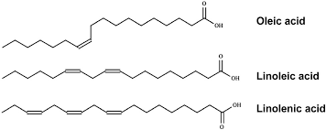
From vegetable oil

Slide 17
Omega 3
Found in oily fish (e.g. herrings, sardines, mackerel), contain EFA’s called omega 6 and omega 3.
Omega 3 helps lower the blood cholesterol and helps to prevent blood clots.
It is recommended to eat two portions of oily fish per week.
Some oily fish products mention omega 3 on their labels.

Slide 18
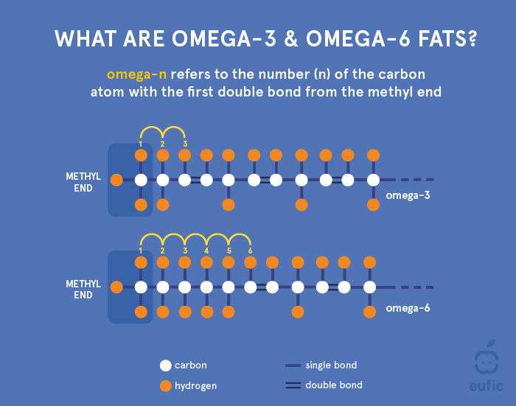
From oily fish

Slide 19
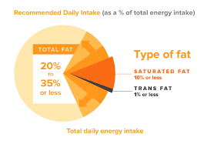
Fat provides an average of 35% of our total energy requirements.

Slide 20
Increasing the intake of fat may lead to a variety of diseases such as: Past Paper Question
Obesity leads to low self esteem, problems during surgeries, breathlessness.
CHD “ coronary heart disease”.
High cholesterol level.
High blood pressure.
Diabetes.
Low physical activity.
Depression.

Slide 21
Recommendations to decrease fat intake in the diet: Past Paper Question
1. Decrease the intake of invisible fat found in the form of (crisps, snacks, cakes and biscuits).
2. Decrease the intake of saturated F.A’S and increase the intake of unsaturated F.A’S.
3. Decrease the intake of trans F.A’S.
4. Increase the intake of omega 3 fatty acids found in oily fish.
5. Substitute products high in fat with others which are reduced in fat or low in fat.

Slide 22
What is the effect of heat on fat “continuous heating”? Fat soluble vitamins are not affected by heat Past Paper Question
Solid fats melt into liquid
Oil becomes thinner
It begins to bubble
Smoke
Fat molecules decompose into glycerol and F.A’S
A blue haze can be seen
Burns rapidly
Fat ignites

Slide 23
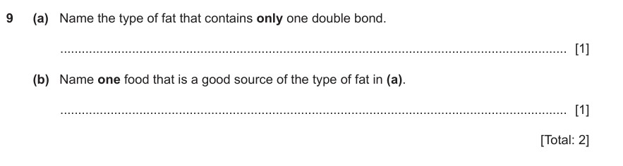

Slide 24
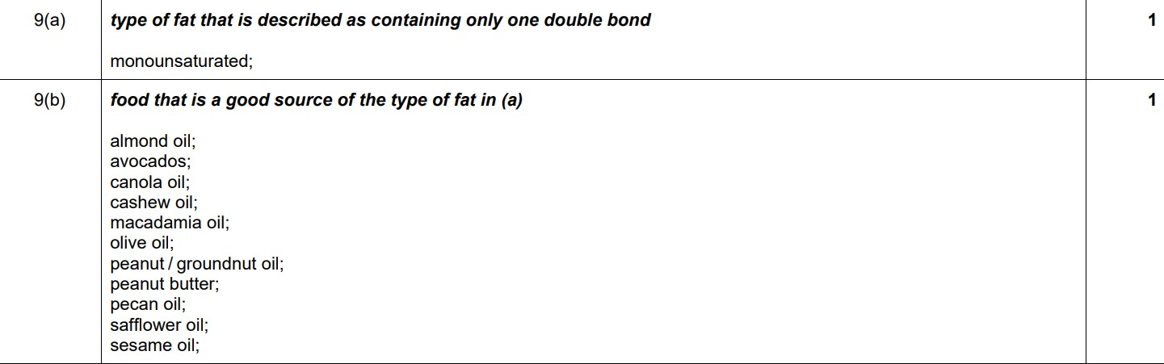

Slide 25
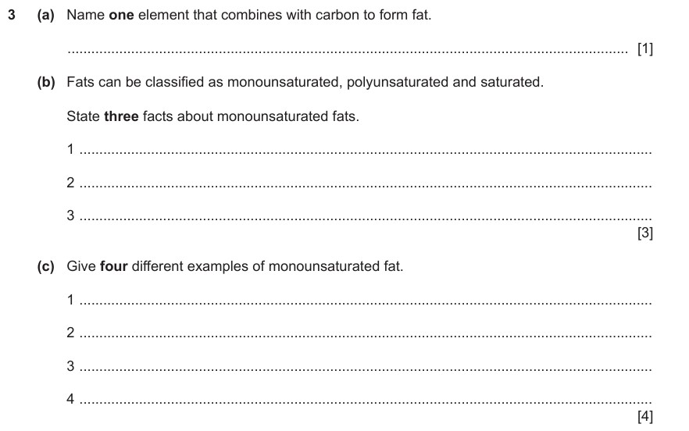

Slide 26
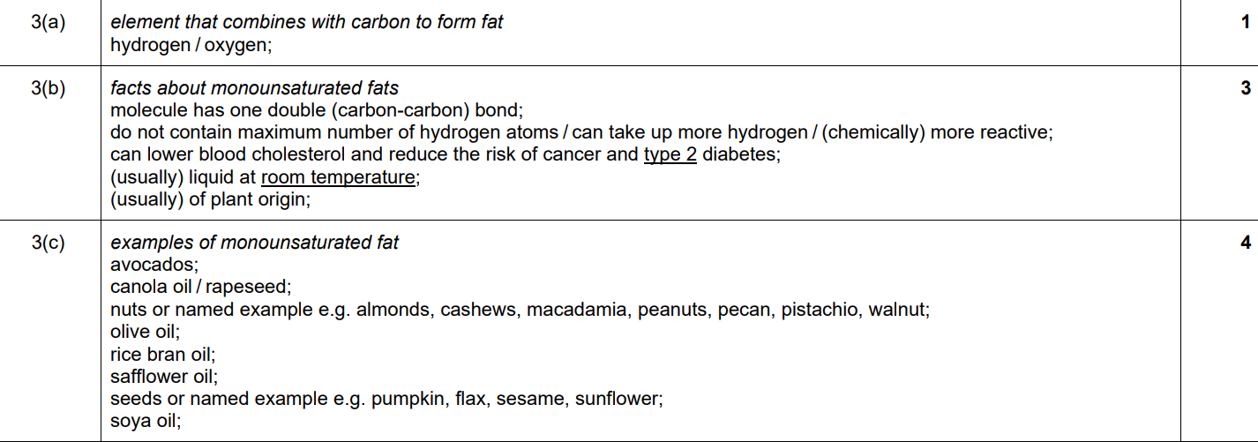

Slide 27
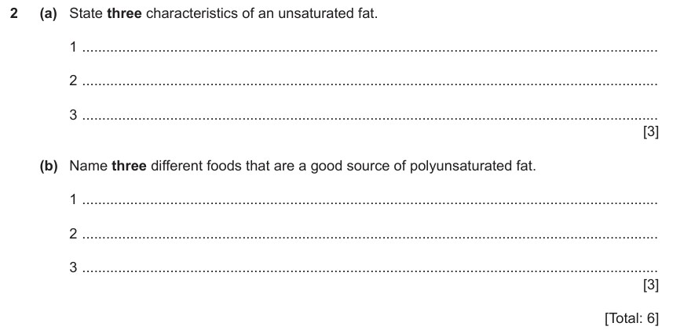

Slide 28
