Slide 1
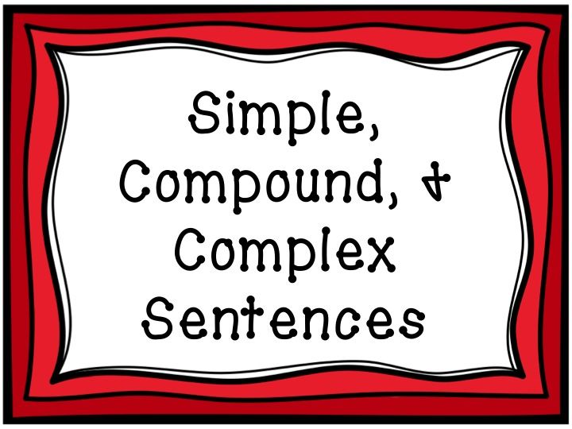

Slide 2
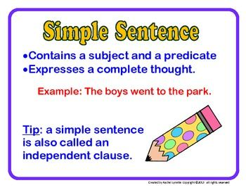

Slide 3
Examples
Joe waited for the train.
The train was late.
I looked for Mary and Samantha at the bus station
Subject
verb

Slide 4
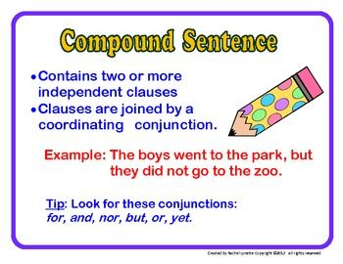
and, or, but

Slide 5
Examples
Joe waited for the train but it was late.
He can buy the book or he can borrow it from the library.
Mary and Samantha arrived at the bus station at noon and they left before I arrived.

Slide 6
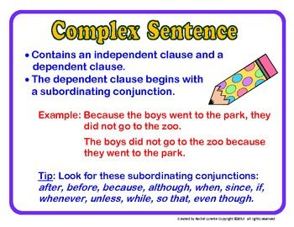

Slide 7
Examples
Lisa ate pancakes while she was reading the newspaper.
Whenever Lisa sees a pretty sunset, she wants to take a picture of it.
Because I was hungry, I ordered some food.

Slide 8
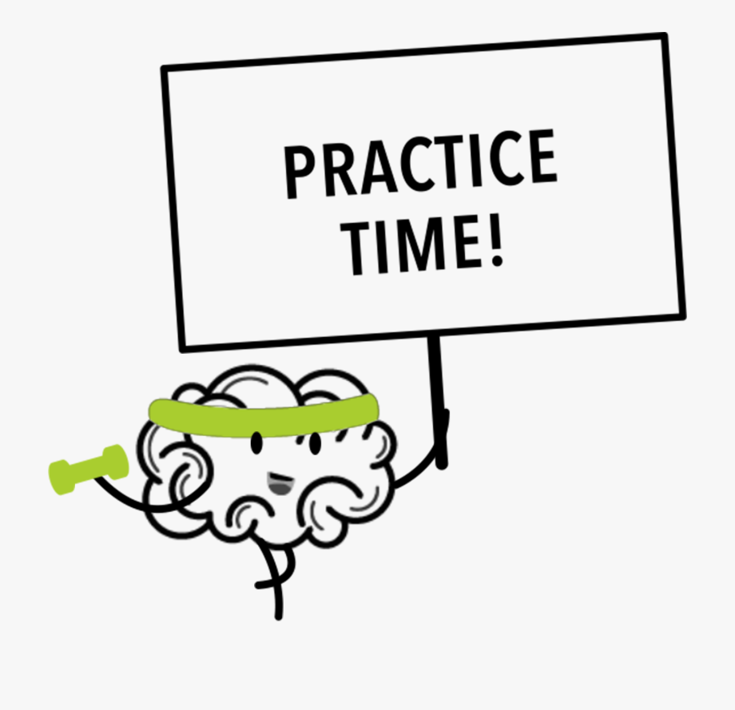

Slide 9
Exercises
Decide whether these sentences are simple, compound or complex.
1- Sally and Joe auditioned for the lead role in the play._________________
2- I’m going to the dance but I have to buy a new dress. _________________
3- Mark isn’t coming to the party since I didn’t invite him. _______________
4- Is the game this Friday or is it next week? _________________
5- Whenever I feel sick, I do not go to school._________________
6- Should I buy the red shirt or the blue one?__________________

Slide 10
Exercises
Decide whether these sentences are simple, compound or complex.
1- Cindy and Sue auditioned for the lead role in the play. Simple
2- I’m going to the dance but I have to buy a new dress. Compound
3- Mark isn’t coming to the party since I didn’t invite him. Complex
4- Is the game this Friday or is it next week? Compound
5- Whenever I feel sick, I do not go to school. Complex
6- Should I buy the red shirt or the blue one? Simple

Slide 11
Main and Subordinate clauses
A complex sentence consists of a main clause and one or more subordinate clauses.
A main clause is a simple sentence or an independent clause, which means that it can stand alone and deliver a meaningful thought.
A subordinate clause is a dependent clause so it can’t stand alone. It needs a main clause for it to make sense. A subordinate clause usually starts with a subordinate connective (or subordinate conjunction).

Slide 12
Examples
Subordinate clause
Subordinating connective
While I was running up the stairs, I saw my friend.
I saw my friend while I was running up the stairs.
The boy was waiting in the room because he was expecting a call.
Because he was expecting a call, the boy was waiting in the room.
Whenever I study all night, I wake up very late.
I wake up very late whenever I study all night.

Slide 13
Exercises
Underline the subordinate clause and circle the subordinating connective in each sentence below:
1- When the president arrives, he will give a speech to the public.
2- Because I can’t wait for the bus, I’ll walk to school.
3- Before the food gets cold, go sit at the table.
4- Tamara likes to dance whenever she has free time.
5- As the sun sets, I listened to my favorite songs.
6- If the dress is on sale, she will buy it.

Slide 14
Exercises
Underline the subordinate clause and circle the subordinating connective in each sentence below:
1- When the president arrives, he will give a speech to the public.
2- Because I can’t wait for the bus, I’ll walk to school.
3- Before the food gets cold, go sit at the table.
4- Tamara likes to dance whenever she has free time.
5- As the sun sets, I listened to my favorite songs.
6- If the dress is on sale, she will buy it.

