Slide 1
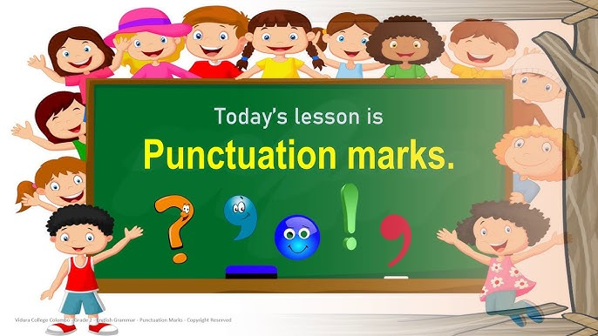

Slide 2
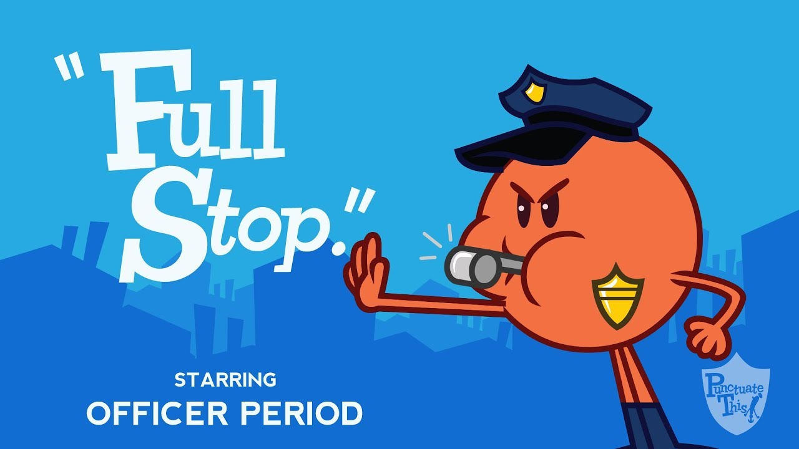
Full Stop (.)
General use: Ends a complete sentence.
In poetry:
Signals the end of a complete thought or image.
Creates a definite pause or sense of closure.
Example:
The stars shine bright.
The night is calm.
Effect:
Makes the rhythm slower and more final.
Gives the poem structure and clarity.

Slide 3

Comma (,)
General use: Indicates a short pause, separates items in a list.
In poetry:
Creates pauses that affect rhythm and flow.
Can emphasize descriptive words or build suspense.
Example:
Softly, the wind whispers,
through the quiet, dark trees.
Effect:
Adds gentle pacing.
Makes the line sound more musical.

Slide 4

Question Mark (?)
General use: Marks a direct question.
In poetry:
Introduces curiosity, reflection, or mystery.
Invites the reader to think beyond the poem.
Example:
Who calls my name?
Where does the river go?
Effect:
Makes the reader feel uncertainty or wonder.

Slide 5


Exclamation Mark ( ! )
General use: Expresses excitement, surprise, or strong feeling.
In poetry:
Adds intensity, urgency, or dramatic effect.
Example:
Run! The storm is near!
Dance! Sing! Laugh!
Effect:
Gives energy and emotion.
Makes the voice sound louder and stronger.

Slide 6
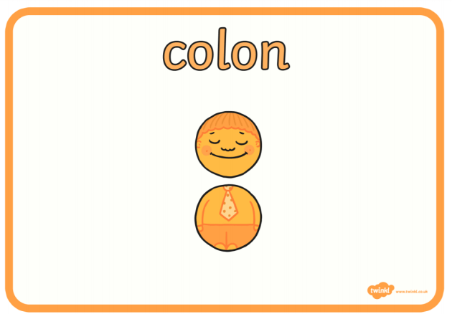
Colon (:)
General use: Introduces a list, explanation, or expansion.
In poetry:
Creates anticipation for what comes next.
Highlights important words or phrases.
Example:
I hold three gifts:
hope, love, courage.
Effect:
Builds expectation.
Makes the second part feel more powerful.

Slide 7
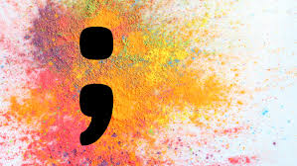
Semi-Colon (;)
General use: Links two related ideas.
In poetry:
Connects thoughts more smoothly than a full stop.
Shows relationship between two images or ideas.
Example:
The moon is rising;
the night begins to dream.
Effect:
Creates balance and flow.
Shows two ideas are linked but separate.

Slide 8
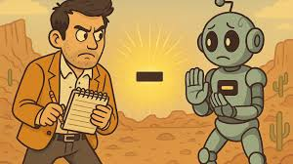
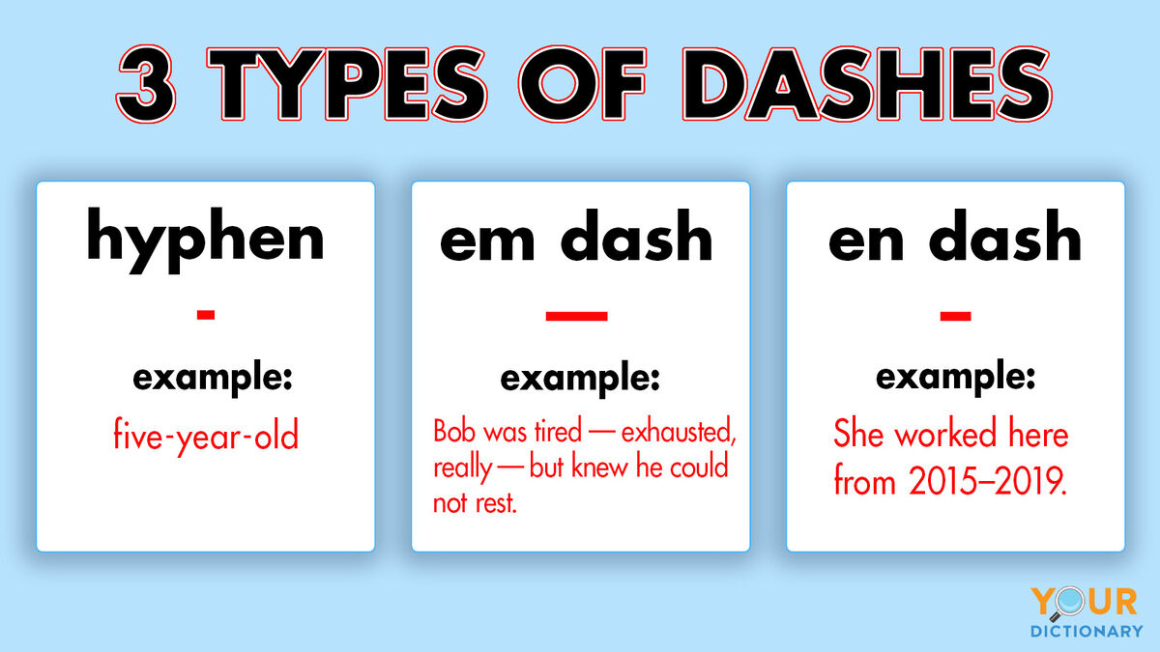
Dash (-)
General use: Interrupts a sentence or adds extra information.
In poetry:
Adds drama, surprise, or emphasis.
Can show a sudden break in thought.
Example:
I searched for light—
and found it in your eyes.
Effect:
Creates suspense or shock.
Makes the second part more powerful.

Slide 9

Ellipsis (...)
General use: Shows omission, hesitation, or something left unsaid.
In poetry:
Creates suspense, silence, or a trailing thought.
Suggests continuation beyond the line.
Example:
The sea waits …
endless, eternal … calling.
Effect:
Builds mystery.
Leaves space for the reader’s imagination.

Slide 10

Quotation marks (“ ”)
General use: Shows speech or highlights exact words.
In poetry:
Brings dialogue or “voice” into the poem.
Highlights words for emphasis.
Example:
“Sing,” said the bird,
“sing of the morning sun.”
Effect:
Adds personality and life.
Helps the reader hear a speaker inside the poem.

Slide 11
