Slide 1
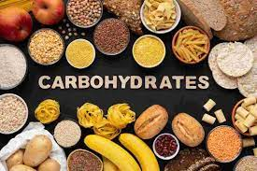
Carbohydrates

Slide 2
Carbohydrates
Functions of carbohydrates:
Main source of energy ( 55-60% of our total intake of calories should be from carbs)
Carbs act as a “protein sparer” so that protein can be used for its primary function “ main function” , rather than a source of energy.
Elements which make up carbohydrates Past Paper Question
Carbon Hydrogen Oxygen

Slide 3
Oxygen and hydrogen atoms have the same proportion of the same atoms of water (H2O) , HYDRATE
Sources of carbohydrates ( Carbs) mainly from plants
during photosynthesis
CO2 + H2O energy from Glucose + O2
sunlight carbohydrate
carbon dioxide water

Slide 4
Carbohydrates
Monosaccharides
Ex: Fructose
Glucose
Galactose
Disaccharides
Ex: Sucrose
fructose+glucose
Lactose
glucose+galactose
Maltose
glucose+glucose
Polysaccharides
Ex: Starch
Dextrin
Cellulose
Pectin
Glycogen
NSP ( Non starch polysaccharides)

Slide 5
Facts about monosaccharides:
Simplest form of carbs “ simple sugars”.
Base units of carbs.
C6H12O6.
Breakdown products after digestion of carbs.
Soluble in water.
Sweet.
Ex: Glucose, Fructose, and Galactose.

Slide 6
Fructose:
it is called “fruit sugars”.
it is found in fruits ,fruit juice, and honey.
it is a monosaccharide.
Glucose:
it is the form of carbs, the body uses for energy, and all other carbohydrates ae converted into glucose during digestion.
The glucose is then circulated around the bloodstream to the body cells.
found in ripe fruits and some vegetables like onions and beetroot.
fast source of energy.
can be found commercially in 3 forms Powder
Liquid
Tablet

Slide 7
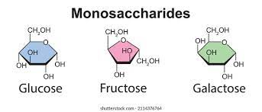
Galactose:
Found in milk of mammals.
it forms part of the milk sugar “ lactose”.
it is a monosaccharide.

Slide 8
Facts about disaccharide:
They are sometimes called double sugars.
They are composed of 2 monosaccharides (Glucose+ 1 other simple sugar).
C12H22O11.
Soluble in water.
Sweet.
Breakdown to monosaccharides during digestion.
Ex: Sucrose, Lactose, Maltose.

Slide 9
Sucrose: ( Glucose + fructose)
used in cookery.
obtained by refining sugar or beet.
present in some fruits and vegetables.
Lactose: ( Glucose + galactose)
Found in milk of mammals to supply infants with a source of energy.
Not sweet as sucrose.
Maltose: ( Glucose + glucose)
Sometimes called “malt sugars”.
found in cereals such as barely, where it is formed during germination.

Slide 10
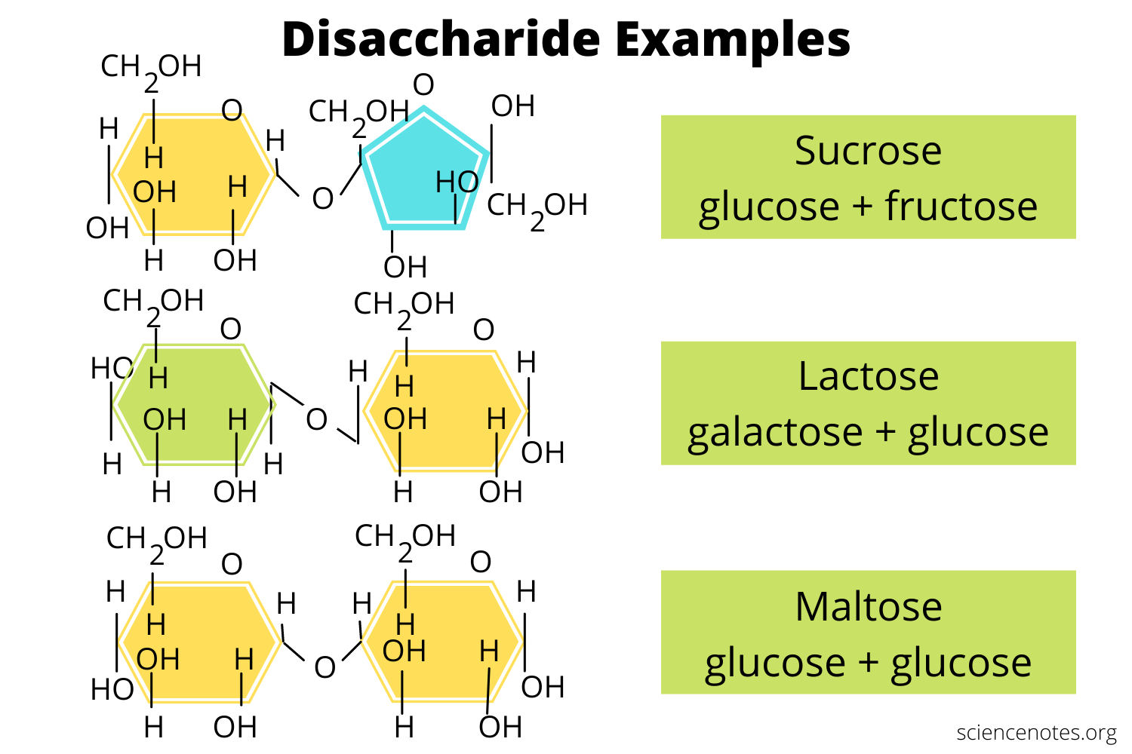

Slide 11
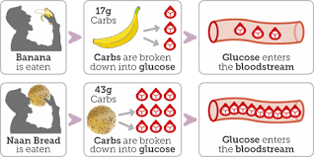
During digestion, disaccharides are broken down to glucose and other monosaccharides before being absorbed into the blood stream

Slide 12
Sugars
Intrinsic sugars
Those that form part of cell structure of plants
ex: fruit
Extrinsic sugars
Those that are not part of cell structure of plants.
They include non milk extrinsic sugars (NMES).
ex:(refined sugars, extracted sugars in honey and fruit juice, sugars added to foods)
milk sugars (mostly lactose, found naturally in milk and milk products).

Slide 13
Facts about polysaccharide:
They are made up of many monosaccharides.
They are insoluble in cold water, and are tasteless.
They are “not sweet”.
Not all polysaccharides can be digested, ex: NSP ( non starch polysaccharides) fibre.
NSP adds bulk to diet.
NSP prevents constipation, diverticular disease and various veins.
NSP chain is branched and can’t be broken.
Starch can be digested, because molecules are linked together in a simple chain.
Ex: Starch, dextrin, cellulose, pectin, glycogen, gum and NSP.

Slide 14
Starch:
starch is formed from many glucose units.
it is formed during photosynthesis in plants as a chief food reserve.
it is found in root vegetables, cereals, and pulses.
During digestion, the chains of glucose units are broken down into smaller chains, then into disaccharides, and finally into single glucose units, which are absorbed into blood.

Slide 15
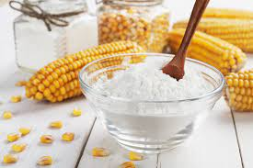
Dextrin: Past Paper Questions
it is formed when foods containing starch are baked or toasted.
forms part of the crust on foods ex, bread.
dextrin is more soluble than starch.
Colour of food surface changes to golden brown.

Slide 16
Cellulose:
it is formed by plants from glucose units joined together in a strong way.
cellulose gives plants support in stems, leaves, husks of seeds, and bark.
it is found in all foods of plant origin.
cannot be digested by humans, but is a great value to the body as dietary fibre (NSP).
Pectin:
complex polysaccharide formed by some plants.
ex: plums, apples in their fruits and roots.
it forms gels in water, and responsible for setting jam.

Slide 17
Glycogen:
formed after digestion in humans and other animals.
ensure that the body has a reserve of energy. ( can be quickly used)
glucose glycogen (stored in liver and muscles)
glycogen glucose (when energy is required)
Non-starch polysaccharides(NSP)
ex: cellulose, pectin, and gums.
they make up what we know as dietary fibre.
they are not digested by micro-organisms in the large intestine, and are very important in removing waste from the digestive system.

Slide 18
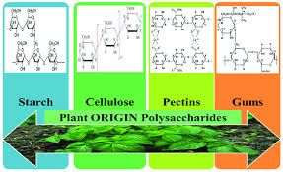

Slide 19
Carbohydrate requirements
Carbohydrate should be used in preference to protein as an energy supplier, so that protein can be used for it’s main function.
Protein and carbohydrate rich food are usually eaten together for this reason, e.g. meat and potatoes, bread and cheese.
If someone eats more carbohydrate than the body requires, the excess is converted into fat and stored under the skin. This is one of the major causes of obesity.
Eating too many carbohydrate-based snack e.g. sweets, chocolate, instant meals, and puddings may lead to an excess intake of energy from carbs. ( 55 – 60% )

Slide 20
Effect of heat on Carbs Past Paper Question
Sugar
Starch
Dry heat:
sugar first melts.
sugar then caramelizes.
finally burns, leaving black residue.
Wet heat:
sugar first dissolves, then becomes a syrup which caramelizes, finally burns when the water has evaporated.
Dry heat:
starch changes to Dextrin, surface of food becomes golden brown.
Wet heat:
starch grains soften, then absorbs water as swells (expand), causing some to rupture.
starch dissolves to form a paste ( gelatinisation). .

Slide 21
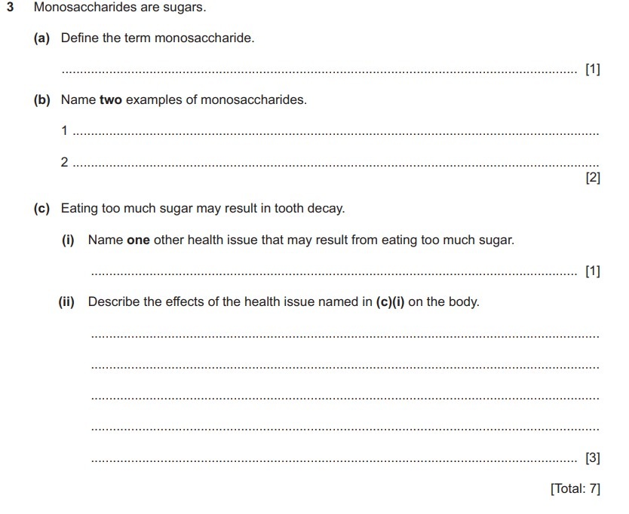

Slide 22
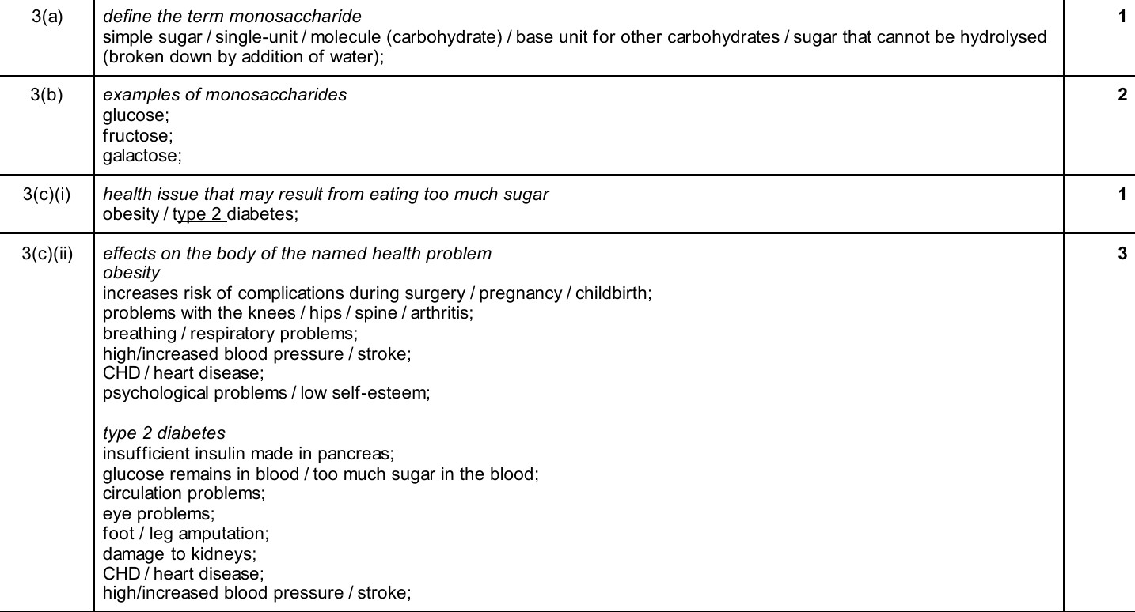

Slide 23
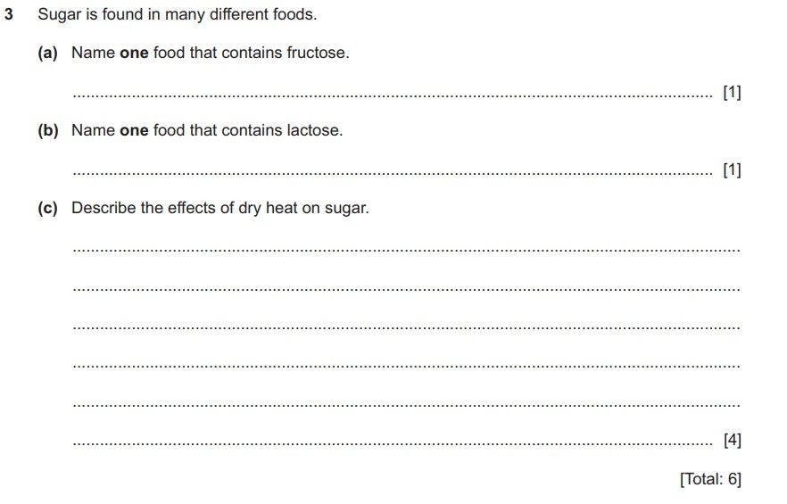

Slide 24
