Slide 1



HelloCode

Slide 2
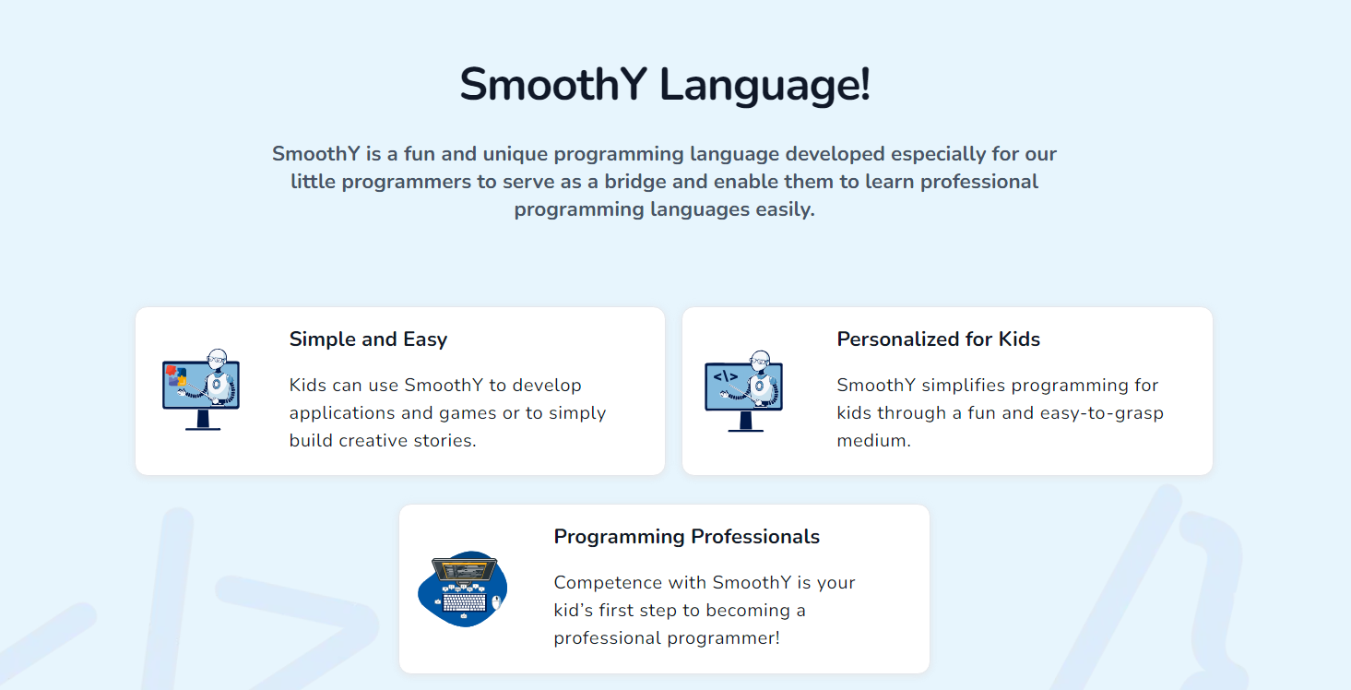

Slide 3
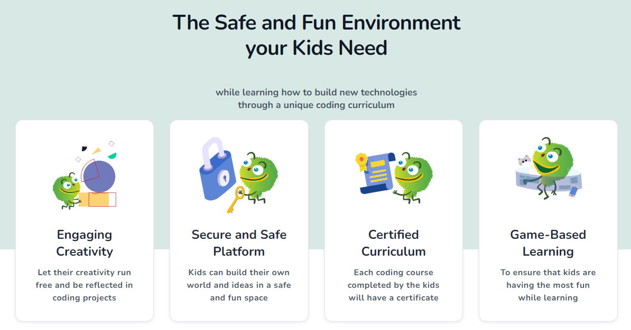

Slide 4


Slide 5
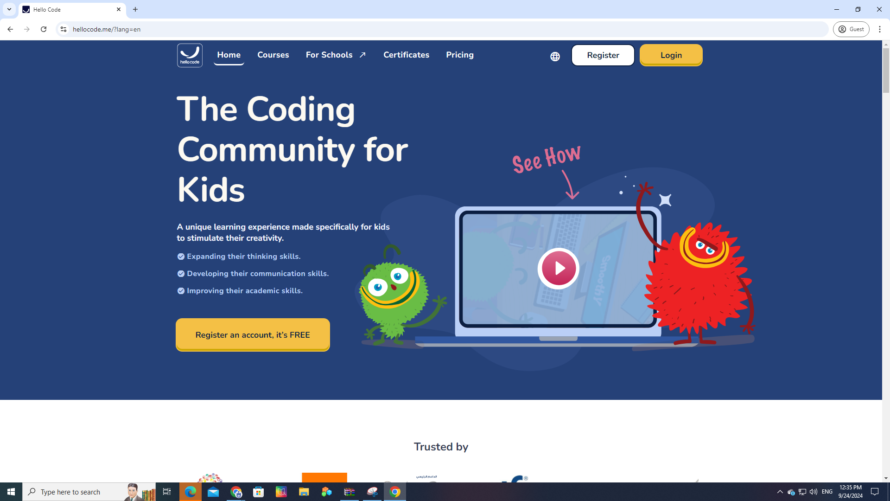
Go to https://www.hellocode.me/?lang=en

Slide 6
2. Click on Login

Slide 7
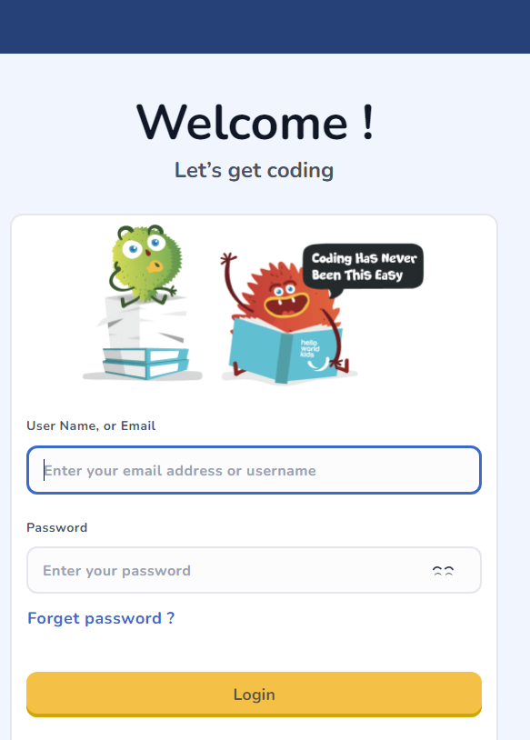
3. Enter your username and password and Login
PS: the login details are printed on the labels.
Please refer to your teacher if you need help with this.

Slide 8
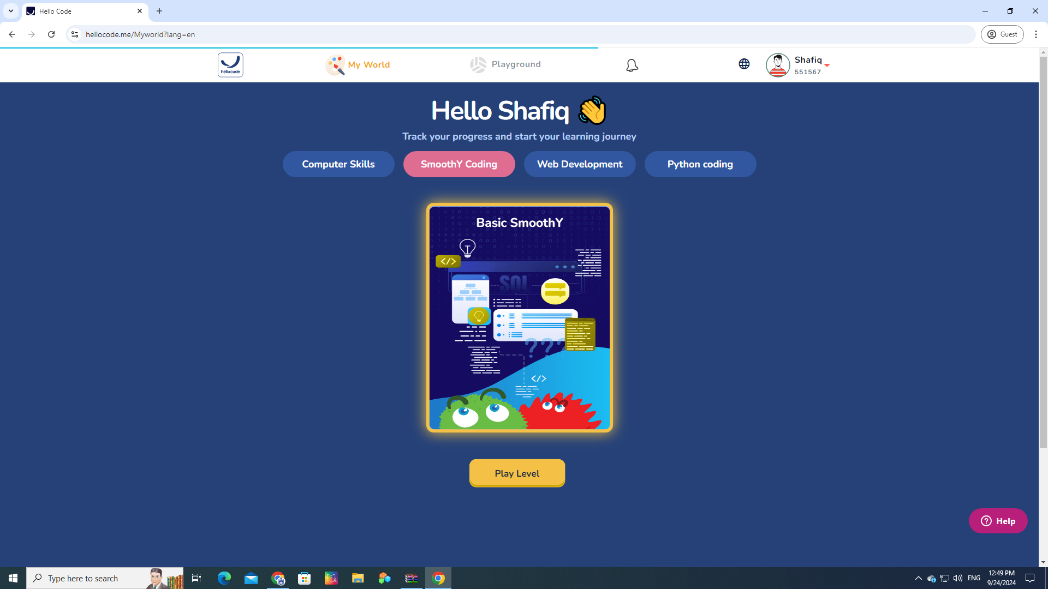
4. You will get this screen, Select My World Click on Play Level
Student
Student

Slide 9
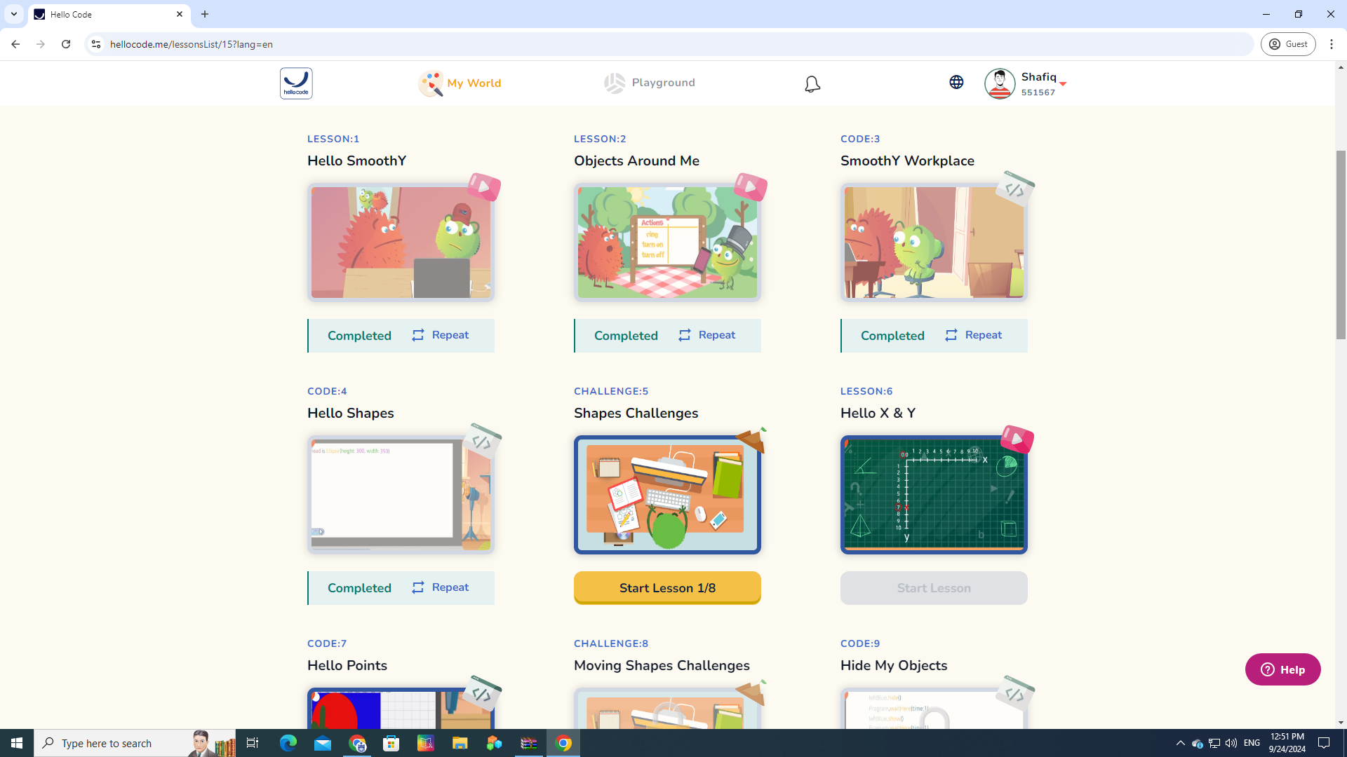
5. You will find a list of all the lessons for this course.The student’s progress will be monitored by the teacher.
Student

Slide 10
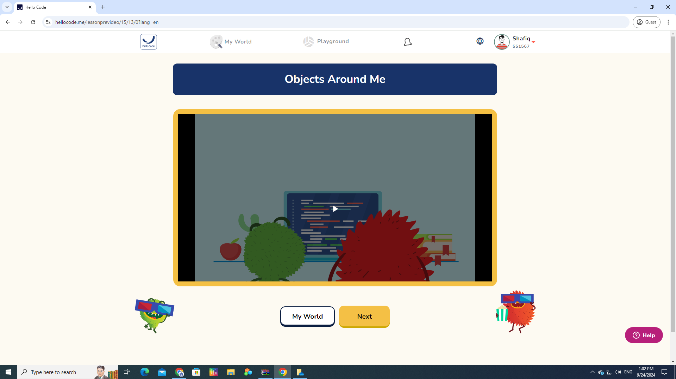
6. When you start a lesson, you can play a video to understand the concept.
Student
Student

Slide 11
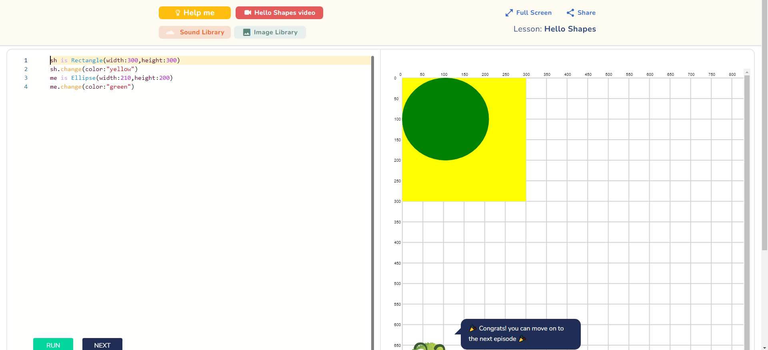
7. Then, navigate to the Integrated Development Environment (IDE)
You write your code here
The result is displayed here

Slide 12

What is an IDE
An IDE, or Integrated Development Environment, is a special kind of software that helps people write and test computer programs. Here’s how it works:
"Integrated" means everything you need is in one place. The IDE has all the tools you need to write and fix your code.
"Development" means creating or building something, in this case, a program.
"Environment" is the workspace where you do everything.
So, an IDE makes coding easier by giving you:
A place to write your code.
A way to check for mistakes.
A button to run your program and see what happens.

Slide 13
What are we going to cover in this semester
We are going to finish 20 lessons as below:

Slide 14
# | Lesson Title | Learning Outcomes
1 | 1 Hello SmoothY (Introduction to SmoothY) | Recognize the terms: Programmer, programming languages, end-user and they will be introduced to SmoothY language
2 | Objects Around Me Recognize object term | List objects’ properties and actions and distinguish between them
3 | Hello SmoothY’s Workplace | Add ellipses to SmoothY’s canvas Distinguish between ellipse’s width and height
4 | Hello Shapes | Add rectangles to SmoothY’s canvas Color SmoothY’s shapes Distinguish between width and height Get introduced to code order importance
5 | Shapes Projects | The student will be able to apply previously gained skills through challenges with specific requirements.

Slide 15
# | Lesson Title | Learning Outcomes
6 | Hello X and Y (Coordinates) | Get familiar with the grid concept Name a point on a grid with its coordinates Locate a point on a grid when given its coordinates
7 | Hello Points (Point and move to) | Create points objects on SmoothY Move SmoothY shapes to a certain point
8 | Moving Shapes Projects | The student will be able to apply previously gained skills through challenges with specific requirements.
9 | Hide my objects (Objects visibility) | Control SmoothY’s objects visibility Pause program execution
10 | Scene Projects | The student will be able to apply previously gained skills through challenges with specific requirements.

Slide 16
# | Lesson Title | Learning Outcomes
11 | Hello Triangle | Add triangle to SmoothY’s canvas
12 | Hello Angles | Recognize the terms: rotation, angles Distinguish between directions and relate them to angles/ rotation Get introduced to the special angles
13 | Hello Images | Add images to SmoothY programs Rotate SmoothY images and shapes Access images library and copy images paths
14 | Images and Angles Projects | The student will be able to apply previously gained skills through challenges with specific requirements.
15 | Speed it up | Recognize the term: speed Relate time taken to move to a specific destination to speed

Slide 17
# | Lesson Title | Learning Outcomes
16 | Hello Animation (Move and rotate during time) | Animate shapes and images by moving them and rotating them within specific time Apply speed concepts using SmoothY’s code Use suitable time values to get specific results
17 | Animation Projects | The student will be able to apply previously gained skills through challenges with specific requirements.
18 | More Animation Projects | The student will be able to apply previously gained skills through challenges with specific requirements.
19 | Hello Sounds | Add sounds to SmoothY programs Play e sounds in SmoothY programs Access sounds library and copy sounds paths
20 | Graduation project | The student will be able to apply previously gained skills through challenges with specific requirements.

Slide 18
Thank you
The computer Department

