Slide 1
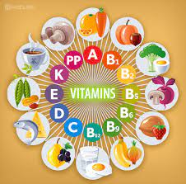
Vitamins

Slide 2
Vitamins are a group of chemical substances, most of which have been identified during this century as vital to the body.
The body requires only small amounts of each vitamin, but as it cannot make most of them itself, they must be supplied by foods.
Functions of vitamins
Regulate the maintenance and growth of the body.
Control metabolic reactions in cells.
* A diet lacking in one or more vitamins will result in specific deficiency diseases.

Slide 3
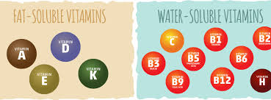
Vitamins are classified according to the substance in which they dissolve
Fat -Soluble Vitamins
Vitamins A, D, E and K
Water-Soluble Vitamins
Vitamin C and vitamin-B complex

Slide 4
Fat-soluble Vitamins Past Paper Questions
Retinol ( Vitamin A)
*Functions of Retinol ( Vitamin A)
Make a substance called visual purple, which is formed in the retina of the eye to enable it to see in the dim light.
Required to keep mucous membranes in the throat and the digestive bronchial, and the excretory systems moist and free of infection.
Required for maintenance and health of the skin.
Required for the normal growth of children, particularly the bones & teeth.

Slide 5
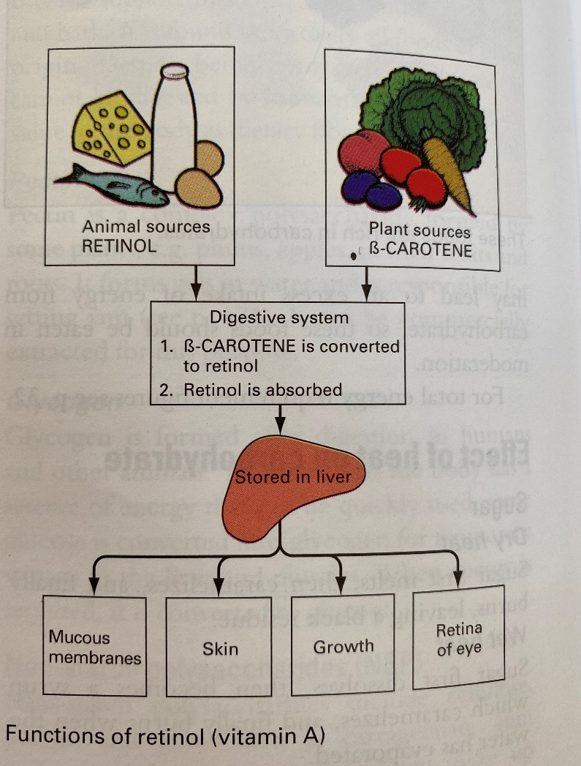

Slide 6
Sources: Past Paper Question
Vitamin A is found as retinol in animal foods, ex: milk, cheese, egg yolk, oily fish, liver and kidney ……….
Vitamin A is found as B-carotene in plant foods, ex: carrots, spinach, parsley and apricots……..
B-carotene gives plants their orange/yellow color, but in green vegetables, the color is by green chlorophyll.

Slide 7
B-carotene converted retinol in the body
Two parts of B-carotene are required to form one part of retinol
B-carotene is used as a food coloring in many foods
gives protection against heart diseases, and some cancers.

Slide 8
Requirements:
As Vitamin A is fat-soluble, it can be stored in the body, mainly in the liver, so a daily supply is not always necessary.
Too much Vitamin A in the diet is poisonous it is stored in the liver can affect skin and joints, in children.
Can pregnant woman eat liver? Past Paper Question
pregnant women are advised not to eat liver, because it contains very high amounts of retinol which could lead to damage and defects in the unborn baby.

Slide 9
B-carotene does not cause harm, so pregnant women are advised to eat plenty of fresh fruits and vegetables, to receive the extra vitamin A, that they need.
Special requirements:
Children need plenty for growth and development.
People who cannot digest and absorb fat, may need a vitamin A injection.

Slide 10
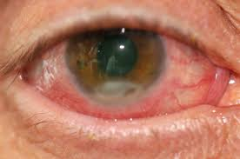
Deficiency: (the opposite of it’s functions)
1. The retina ceases to make visual purple, then vision in dim light is impaired, leading to night blindness then total blindness.
2. The skin and mucous membranes become dry and infected, and the resistance to disease is reduced.
3. Growth of children is retarded.

Slide 11
-Stability in food preparation: Retinol & B-carotene are insoluble in water, and are unaffected by normal temperature and methods of food preparation.

Slide 12
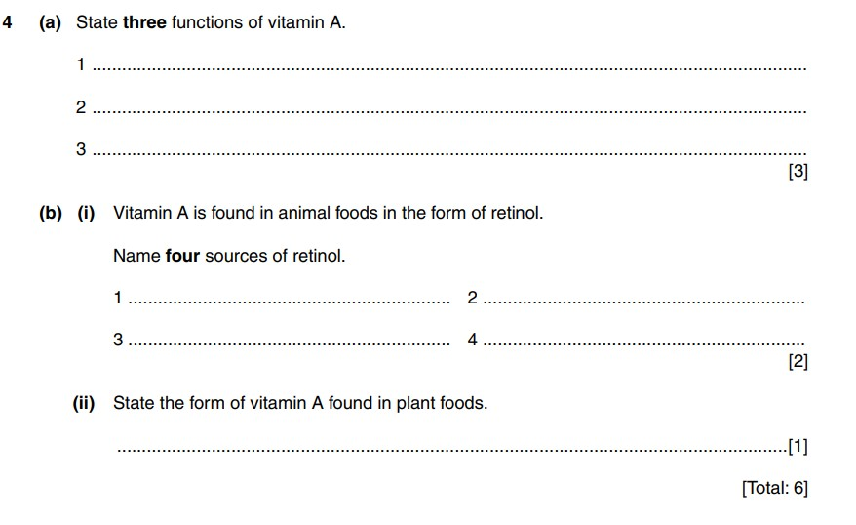

Slide 13
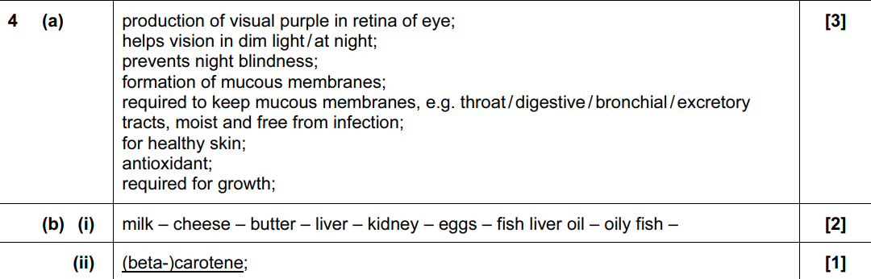

Slide 14
Cholecalciferol (Vitamin D)
Functions of Vitamin D ( cholecalciferol)
Required for the proper formation of bones and teeth, which contain large amounts of the minerals calcium & phosphorus.
Maintenance of bones and teeth.
Vitamin D helps to promote the absorption of the minerals.
After digestion, they are absorbed from the small intestine into the blood, which takes them to the bones and teeth.
* Vitamin D aid the absorption of calcium & phosphorus.

Slide 15
Sources
Vitamin D is found in good supply in : liver, fish-liver oils, oily fish.
is found in smaller amounts in : egg yolk, margarine
( added by law), milk
and dairy products.
Sunlight is an important source . A substance under the skin (dehydrocholesterol) converted to cholecalciferol, which is stored in the liver.

Slide 16
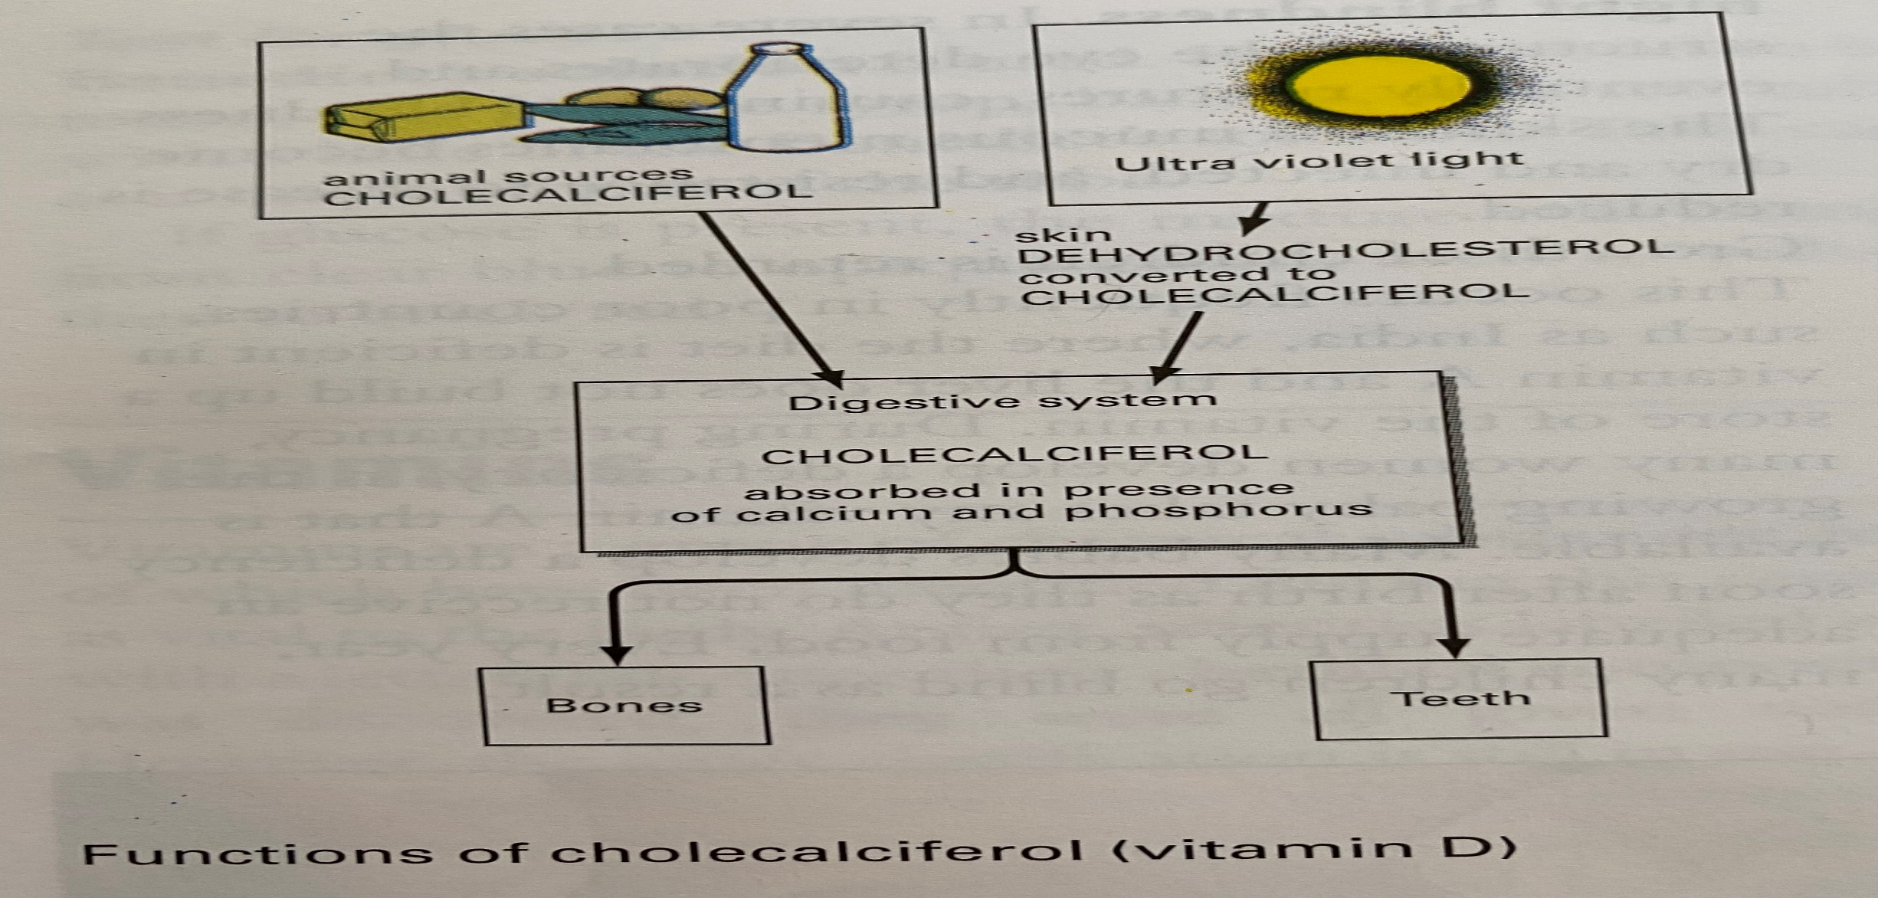
* This accounts for the variable supply of Vitamin D in dairy foods. It depends on the dairy animal’s exposure to the sun.

Slide 17
Requirements: Past Paper Question
Vitamin D is fat-soluble and can be stored in the body.
Most people make enough Vitamin D from the action of sunlight on their skin.
Only people who do not get enough sunlight – because they are housebound or totally cover their body as part of religious custom – are likely to be deficient.
Too much Vitamin D can be dangerous, as it results to excess absorption of calcium into the blood.
The extra calcium is deposited in the lungs and kidneys and can cause death.

Slide 18
people who are house-bound / do not go outdoors;
those who cover their body for religious / health reasons;
people who live in industrial / polluted areas where sunlight cannot penetrate;
people who live in cities surrounded by high buildings;
people who live in countries with limited sunlight hours;
wearing a sunscreen with a sun protection factor of 30 reduces vitamin D synthesis in the skin by more than 95%;
people with occupations that limit sun exposure;
people with dark skin have larger amounts of melanin in the epidermal layer and this reduces the skin’s ability to produce vitamin D from sunlight

Slide 19
*Deficiency:
Absorption of calcium & phosphorus from the small intestine is reduced, the bones and teeth become weak, the bones of the legs may bend, the ends of the limb bones become enlarged and the skull becomes fragile. This disease is called rickets , and mainly affect children.
An adult form of rickets known as osteomalacia, may occur particularly in the elderly, can result in serious fractures after minor falls.
Growth of children is retarded.

Slide 20
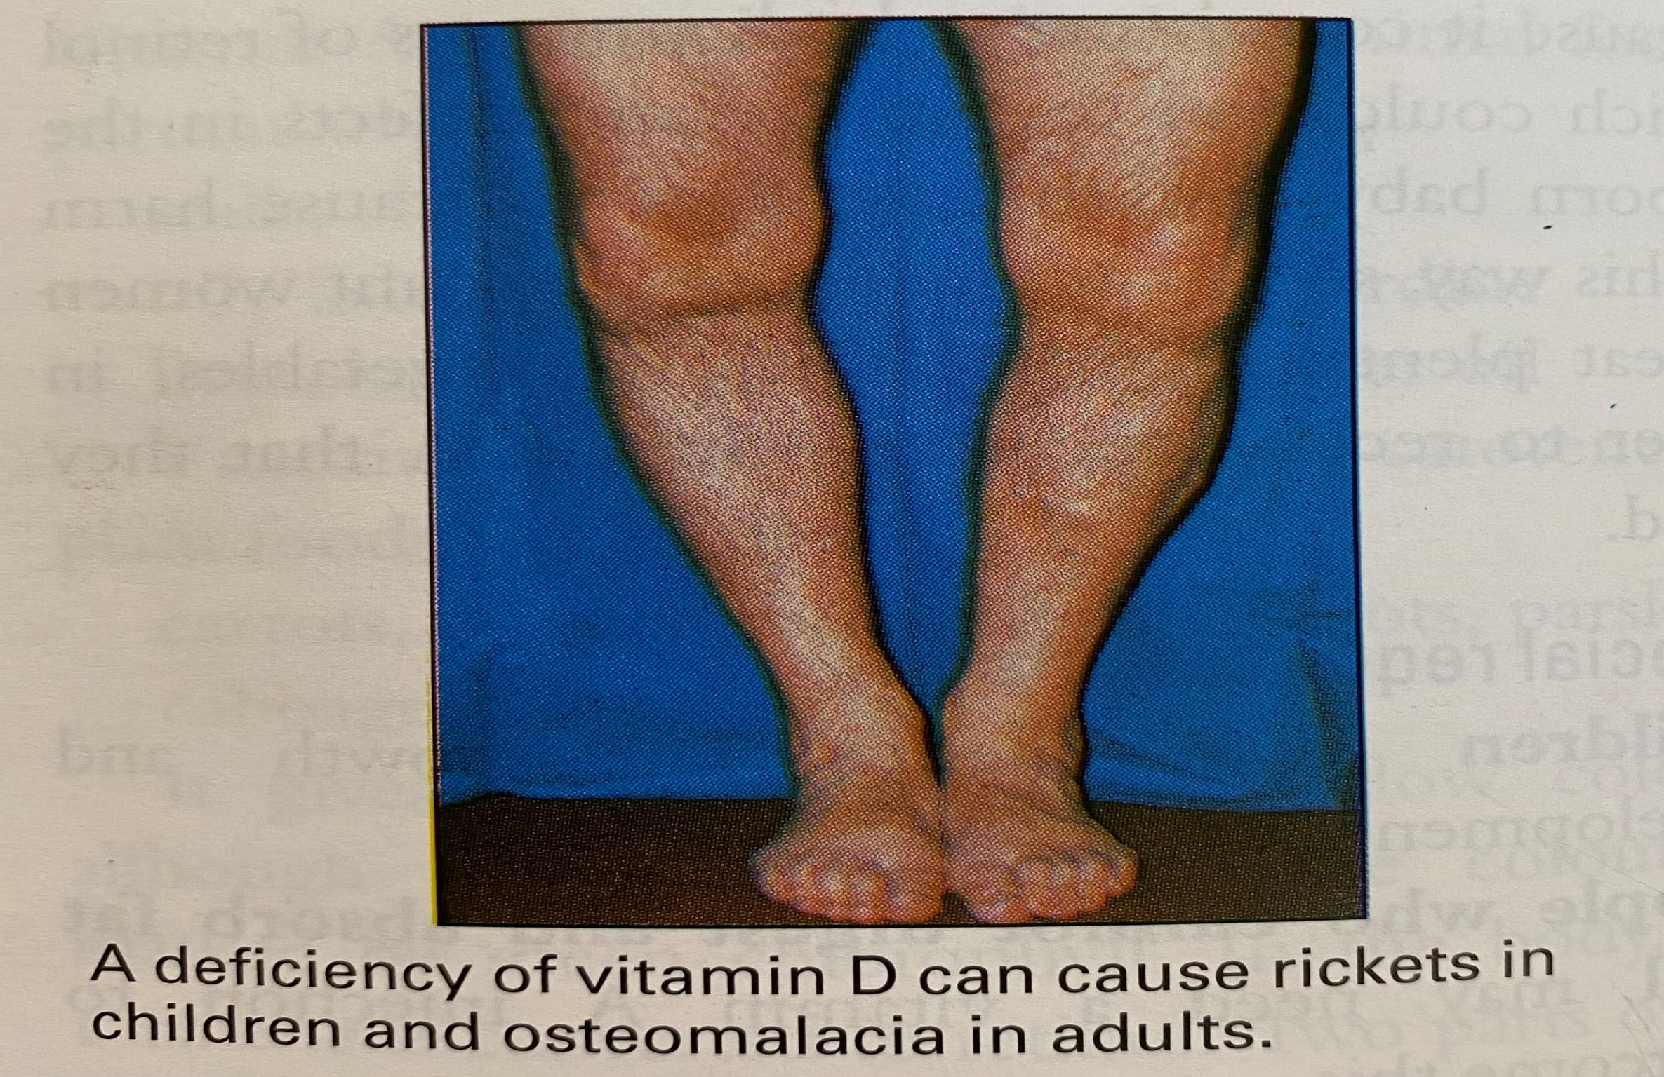

Slide 21
Stability in food preparation:
Vitamin D is unaffected by normal cooking temperatures and processes, and does not dissolve in water.

Slide 22
Tocopherol ( Vitamin E)
Functions of Vitamin E (Tocopherol)
Vitamin E is a very effective antioxidant, and protects polyunsaturated fatty acids from damage by free radicals.
Protects against heart disease.
Vitamin E is widely used in the food industry as an antioxidant to stop fats becoming rancid.

Slide 23
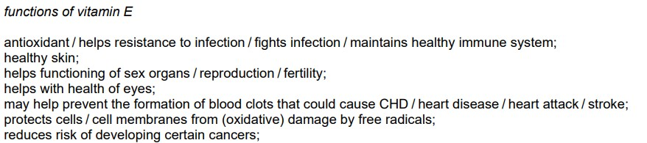
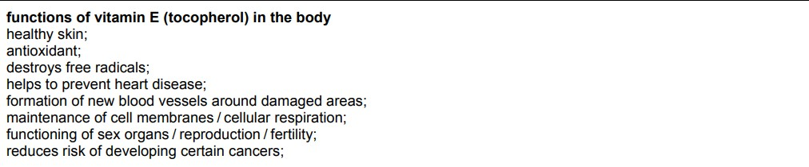

Slide 24
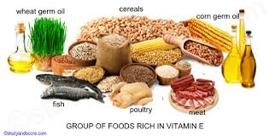
Sources:
Vitamin E is found in small quantities in many plants: lettuce ,grasses, peanuts, seeds, wheatgerm oil, vegetable oils (sunflower seed oil).
Vitamin E is found in milk and milk products and egg yolk.

Slide 25
*Deficiency:
Deficiency of Vitamin E is rare, but premature babies and people who cannot absorb fat may show:
Increase breakdown of red blood cells.
Muscle tissue damage.
Swelling of adipose (fatty tissue).

Slide 26
Vitamin K
Several substances with similar functions are known, so there is more than one Vitamin K.
*Functions of Vitamin K: Past Paper Question
Vitamin K assists in the production of coagulation factors in the blood to enable it to clot properly after an injury.
Clotting of blood

Slide 27
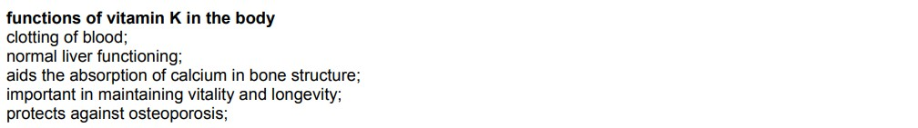

Slide 28
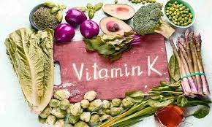
Sources:
Vitamin K is widely distributed in foods, especially in leafy vegetables such as spinach.
Bacteria that are normally present in the intestinal tract also produce a useful supply of the vitamin, which the body is able to use.

Slide 29
*Deficiency
A deficiency is rare, but as a precaution, babies are given Vitamin K immediately after they are born, so that their blood will clot if they are injured.

