Slide 1
MS Excel
Unit(3)

Slide 2
Learning Objectives
The students will learn about:
Introduction (Uses of MS Excel)
Parts of Excel Window
Starting MS Excel.
Opening and closing a Spreadsheet.
Creating a blank workbook in MS Excel.
Save workbook

Slide 3
Introduction
What is a Spreadsheet?
A spreadsheet is a grid consisting of rows and columns. Each spreadsheet(Workbook) file can contain many worksheets.
Why do we need to use MS Excel?
Data Entry & Organization
Easily input and store data in a structured format (rows and columns).
Data Analysis
Use formulas and functions (like SUM, AVERAGE, VLOOKUP, IF, etc.) to analyze data.

Slide 4
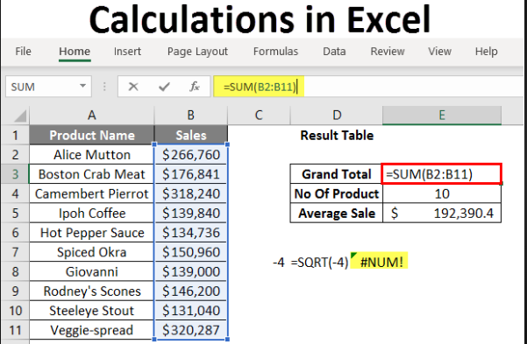
Introduction
Calculations
Perform complex calculations automatically.

Slide 5
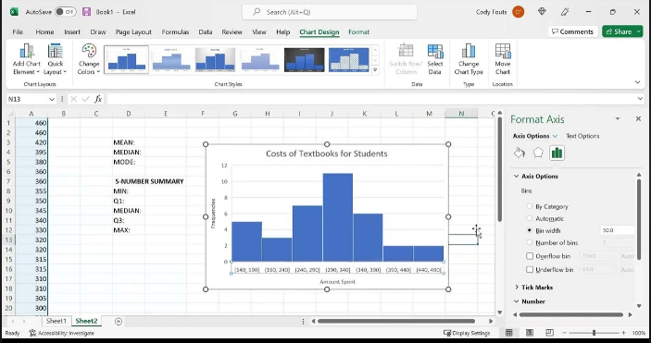
Introduction
Charts
Create charts (bar, pie, line, etc.) and graphs to make data easier to understand.

Slide 6
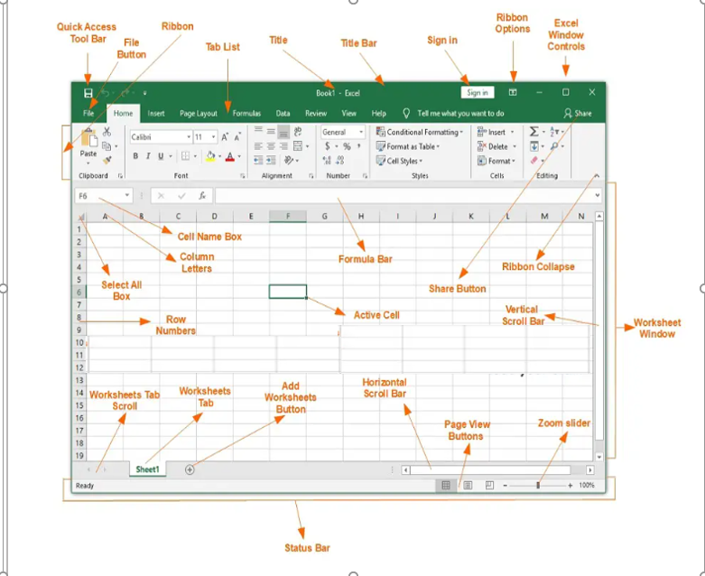
Window Parts

Slide 7
KEY TERMS:
Worksheet/Sheets
A worksheet is a collection of cells in the form of rows and columns.
Workbook
A collection of worksheets is known as a workbook. The name of the default workbook is Book1.
Columns
The columns are arranged vertically. These are headed with letters.
Rows
Rows are arranged horizontally. These are headed with numbers.

Slide 8
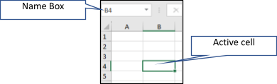
KEY TERMS:
Cell
A cell is the intersection of a row and a column. Each cell can store a single item of data, it can be text, number, or a date value.
Active Cell
The selected cell is called the active cell. It is displayed with bold, dark border.
Name Box
The name box displays the cell reference of the active cell.
Formula Bar
The formula bar is a long bar found above the columns of a worksheet.
.

Slide 9
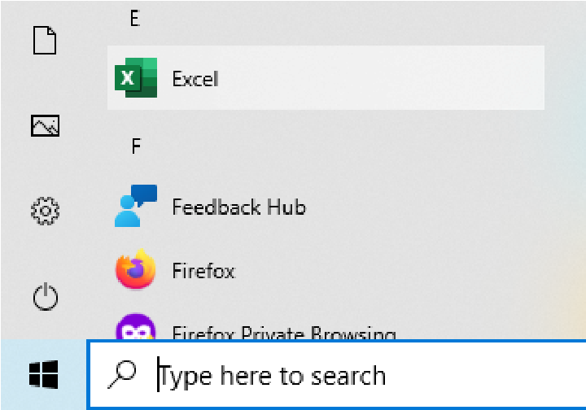
Starting MS Excel:
Starting MS Excel:
Click on start ➡ locate the letter e ➡ click on Excel to open.
OR
Type Excel in the search box➡ click on Excel to open.
MS Excel window opens.

Slide 10
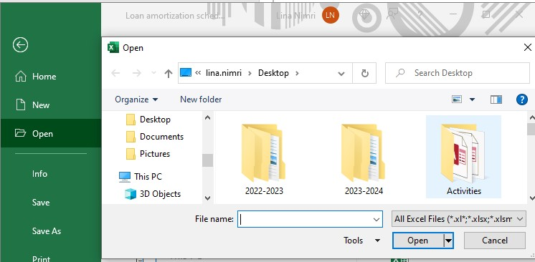
Opening a Spreadsheet
Click on the File tab.
Select Open from the list.
The Open dialog box appears. Click the Browse button and select the source folder and select the chosen file in that folder.
Click on the Open button.

Slide 11
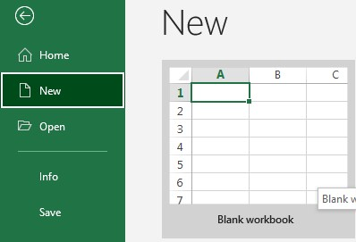
Creating a blank workbook in MS Excel
Click on the File tab.
Select New option from the drop-down list.
The New Workbook dialog box appears. Select the Blank Workbook option from the Available Templates.
Click on the Create button.

Slide 12
Saving a Spreadsheet with Another Name, File Type and Another Location
After completing the work, you can save the change in two ways.
1. Click on the Save button on the Quick Access Toolbar.
2. Choose a directory folder to save the file in.
3. Specify File type(Excel Workbook[.xlsx], Excel Template[.xltx], Excel 97-2003 Workbook [.xls], and PDF[.pdf]), Name and Location press Save.
OR
1. Click on File tab list ➡Save/Save As option.
2. The Save As dialog box appears. Select the destination folder and specify the file name.
3. Click on the Save button.

Slide 13
Apply Skills
Open the file called scoreboard.xlsx from your own folder .
Save the scoreboard.xlsx spreadsheet to your own folder in template format (Excel Template) as scoreboard.xltx. Save and close
Open the file called golfbudget.xlsx from your own folder .
Save the golfbudget.xlsx spreadsheet as extensionbudget.xlsx to your own folder .
Open the file called CustomerList.xlsx from your own .
Save the CustomerList.xlsx spreadsheet as a text file (tab delimited) called customer.txt to your own folder (Click Yes to dialog box prompt).

Slide 14
Learning Objectives
The students will learn about:
Selecting Cells
Insert or Delete Rows and Columns.
Hide or show rows or columns.
Change the column width or row height in Excel.

Slide 15
Let’s Play
https://wordwall.net/resource/83142809/parts-of-ms-excel-window

Slide 16


Selecting Cells
A cell must be selected before data can be entered, edited or formatted.
To select a cell or cells, do the following:
Single Cell
Click a cell to select it. A dark border displays around a selected cell.
Adjacent Cell Range
Select the first cell and then, holding down the left mouse button, drag over the cells to be selected and release.
The first cell in the selected range appears to be unselected.

Slide 17


Selecting Cells
Non-Adjacent Cell Range
Select the first cell or range of cells and, holding down the CTRL key, click the cell or drag over the cells to be selected and release.
Entire Worksheet
Select the button on the top left of the spreadsheet (above row number 1 and to the left of column A).
All cells in the worksheet will be selected. Alternatively, press CTRL + A. Click away from a cell range to remove the selection

Slide 18
How to select multiple columns in Excel?
Case 1: Selecting multiple adjacent columns in Excel
To select columns that are placed next to each other in order, follow the below steps:
Step 1: Select a column by left-clicking on the relevant column header
Step 2: Keeping the left button on the mouse pressed down, drag the mouse cursor on the column header towards the left or right depending on which columns you wish to select

Slide 19
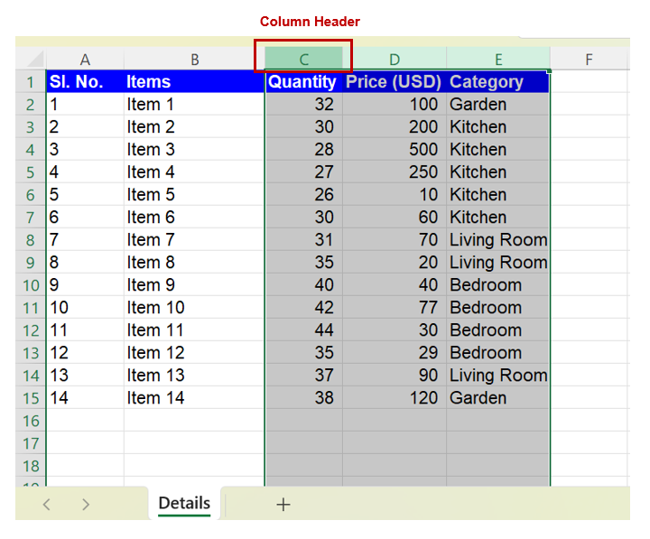
How to select multiple columns in Excel?
For example:
To select columns C, D and E - >
select column C by left-clicking on the column header .
keeping the left button on the mouse pressed, drag the cursor towards the right` until columns D and E are selected as shown in the image below.

Slide 20
How to select multiple columns in Excel?
Case 2: Selecting non-adjacent columns in Excel
To select more than one column that are non-adjacent (meaning not placed in sequence next to each other) in Excel, follow the below steps:
Step 1: Click on the first column you want to select
Step 2: Press and hold down the “CTRL” (“Command” in case of Mac) key on your keyboard and then click on the additional columns you want to select

Slide 21
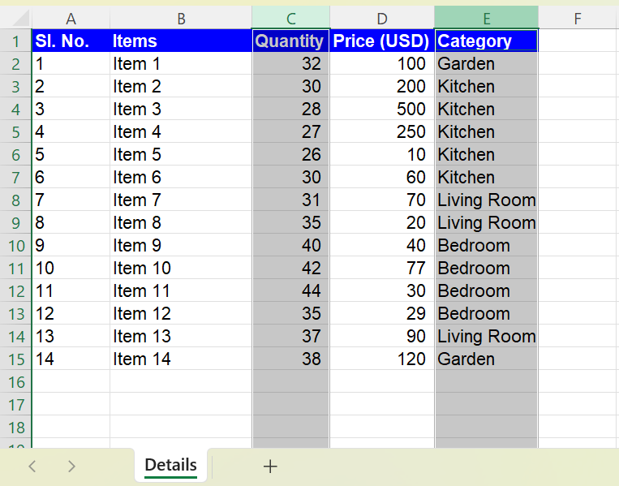
How to select multiple columns in Excel?
For example:
To select columns C and E ->
select column C by clicking on the column header
press and hold down the “CTRL” (“Command” in case of Mac) key.
select column E by clicking on the column header
column C and E will be selected as shown in the image below.

Slide 22
How to select multiple rows in Excel?
Case 1: Selecting multiple adjacent rows in Excel
To select consecutive rows in a spreadsheet, follow either of the three simple methods described below:
Method 1:
Step 1: Select a row by left-clicking on the relevant row header
Step 2: Keeping the left button on the mouse pressed down, drag the mouse cursor on the row header upwards or downwards depending on which rows you wish to select

Slide 23
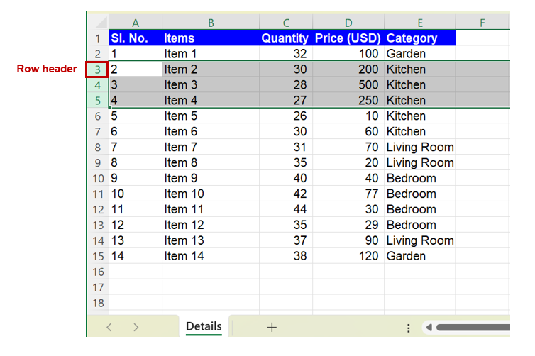
How to select multiple rows in Excel?
For example:
To select rows 3, 4 and
select row 3 by left-clicking on the row header
keeping the left button on the mouse pressed, drag the cursor downwards until rows 4 and 5 are selected as shown in the image below.

Slide 24
How to select multiple rows in Excel?
Case 2: Selecting non-adjacent rows in Excel
To select more than one row that are non-adjacent (meaning not placed in sequence one below the other) in Excel, follow the below steps:
Step 1: Click on the first row you want to select by clicking on the row header
Step 2: Press and hold down the “CTRL” (“Command” in case of Mac) key on your keyboard and then click on the additional row headers you want to select

Slide 25
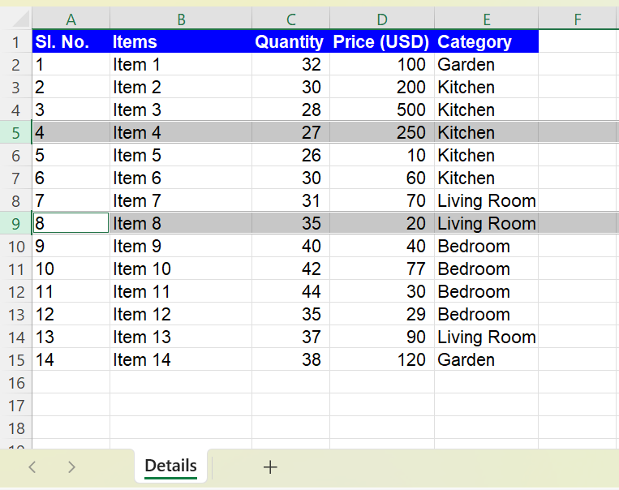
How to select multiple rows in Excel?
For example:
To select rows 5 and 9
select row 5 by clicking on the row header
press and hold down the “CTRL” (“Command” in case of Mac) key
select row 9 by clicking on the row header -> row 5 and 9 will be selected as shown in the image below.

Slide 26


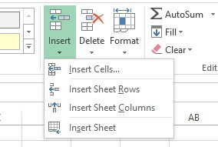
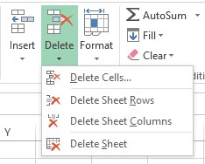
Insert or Delete Rows and Columns
Insert or delete a column.
Select the desired column, then go to Home > Insert > Insert Sheet Columns or Delete Sheet Columns.
Alternatively, right-click the top of the column, and then select Insert or Delete.
Insert or delete a row.
Select any cell within the row, then go to Home > Insert > Insert Sheet Rows or Delete Sheet Rows.
Alternatively, right-click the row number, and then select Insert or Delete.
Note: The new column will appear before the selected column

Slide 27
Hide or show rows or columns
Hide columns
Select one or more columns, and then press Ctrl to select additional columns that aren't adjacent.
Right-click the selected columns, and then select Hide.
Note: The double line between two columns is an indicator that you've hidden a column.
Unhide columns
Select the adjacent columns for the hidden columns.
Right-click the selected columns, and then select Unhide.

Slide 28
Change the column width or row height in Excel
Resize rows
Select a row or a range of rows.
On the Home tab, select Format > Row Width (or Row Height).
Type the row width and select OK.
Alternatively, right-click the row number, and then select Row Height then type the row width.
Resize columns
Select a column or a range of columns.
On the Home tab, select Format > Column Width (or Column Height).
Type the column width and select OK.

Slide 29
Change the column width or row height in Excel
Automatically resize all columns and rows to fit the data
Select the Select All button at the top of the worksheet, to select all columns and rows.
Double-click a boundary. All columns or rows resize to fit the data.
Note: The boundary is the line between cells, columns, and rows. If a column is too narrow to display the data, you will see ### in the cell.

Slide 30
Apply Skills
Open Company.xlsx Spreadsheet from your own folder do the following:
On Customers worksheet widen column B (Firstname) as appropriate so that entered data is fully visible.
On Customers worksheet Change the width of column C (Surname) to 40.
On Customers worksheet Change the Height of row 2 to 50.
On Register worksheet delete column D (Department).
On Register worksheet Delete row 5.
On Salaries worksheet Hide column E (Salary Increase 2016).
On Salaries worksheet Unhide column C.
On Costing worksheet Insert a new column after column C (June).

Slide 31
Font and Text Formatting
Select: the cells you want to format.
On the Home tab, use the Font group to:
Change the font type and size.
Apply Bold, Italics, or Underline.
Change the font color using the A with a colored bar icon.
Apply a fill color (background color).
Use the Format Painter to copy formatting to other cells.
Alignment and Cell Layout
Select: the cells.
On the Home tab, use the Alignment group to:
Change the text alignment (left, right, center).
Use Wrap Text to fit content within a column.
Merge & Center: cells to combine them into a single cell.
Change text orientation.
Select: the cells.
On the Home tab, use the Styles group:
Apply cell styles from a dropdown menu.
Apply borders to the selected cells.
Change the border style and color.

Slide 32
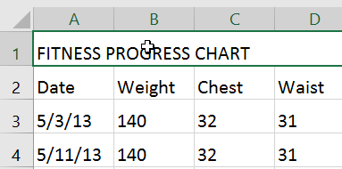
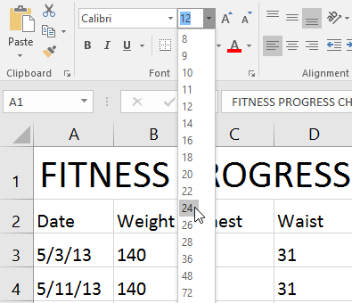
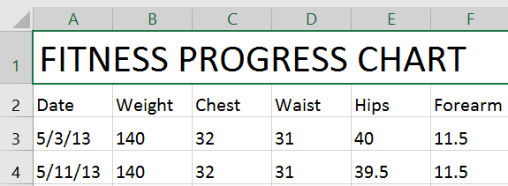
To change the font size:
Select the cell(s) you want to modify.
On the Home tab, click the drop-down arrow next to the Font Size command, then select the desired font size. In our
Example: we will choose 24 to make the text larger.
The text will change to the selected font size.
Note: You can also use the Increase Font Size and Decrease Font Size commands or enter a custom font size using your keyboard.

Slide 33
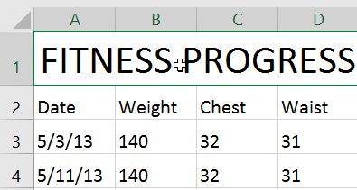
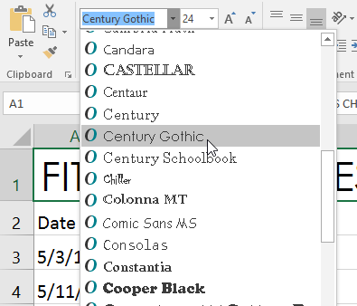
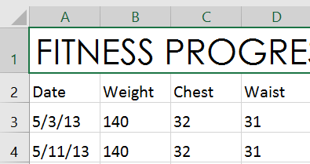
To change the font Type:
Select the cell(s) you want to modify.
On the Home tab, click the drop-down arrow next to the Font command, then select the desired font. In our example, we'll choose Century Gothic.
The text will change to the selected font.

Slide 34
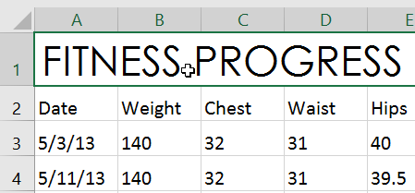
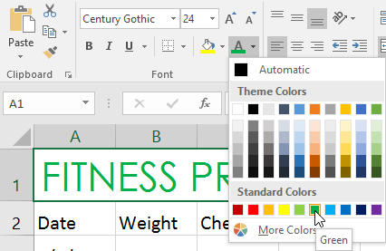
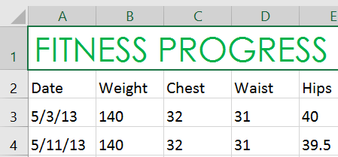
Select the cell(s) you want to modify.
To change the font color:
On the Home tab, click the drop-down arrow next to the Font Color command, then select the desired font color. In our example, we'll choose Green.
The text will change to the selected font color.

